Slide 1
802.11ba Awards
Date: 2021-9-15
Authors:

Slide 2
Abstract
This presentation contains the list of awards for the P802.11ba project

Slide 3
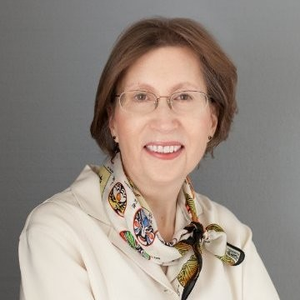
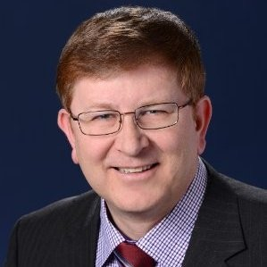
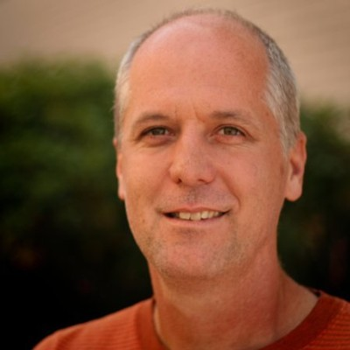
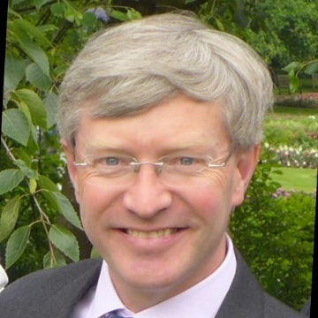
WG Officer Awards
Name | Officer Position and contributions to TGba
Dorothy Stanley | 802.11 WG Chair
Jon Rosdahl | 802.11 WG Vice Chair
Robert Stacey | 802.11 WG Vice Chair
Stephen McCann | 802.11 WG Secretary
Dorothy Stanley
Jon Rosdahl
Robert Stacey
Stephen McCann

Slide 4
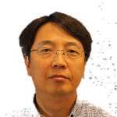
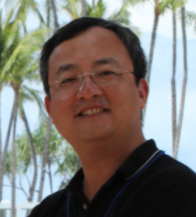
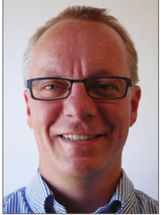
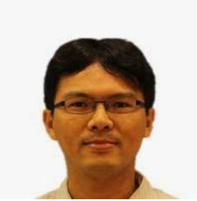
WG and TGba Officer Awards
Name | Officer Position and contributions to TGba
Minyoung Park | TGba Chair, PHY, MAC and comment resolution contributions
Yunsong Yang | TGba Vice Chair, MAC and comment resolution contributions
Eunsung Park | Former TGba Vice Chair, PHY and comment resolution contributions
Leif Wilhelmsson | TGba Secretary, PHY and comment resolution contributions
Po-Kai Huang | TGba Editor, MAC and comment resolution contributions
Minyoung Park
Yunsong Yang
Eunsung Park
Leif Wilhelmsson
Po-Kai Huang

Slide 5
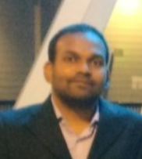
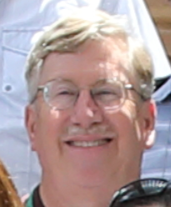
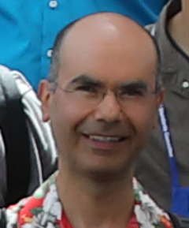
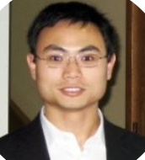
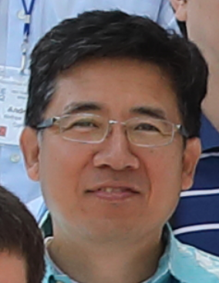
TGba PHY Contributor Awards 1
Name | Contributions to TGba
Vinod Kristem | PHY/comment resolution contributions
Steve Shellhammer | PHY/comment resolution contributions
Miguel Lopez | PHY/comment resolution contributions
Rui Cao | PHY/comment resolution contributions
Junghoon Suh | PHY/comment resolution contributions

Slide 6
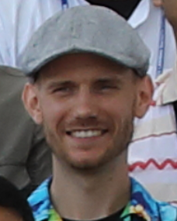
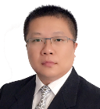
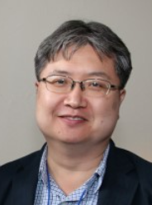
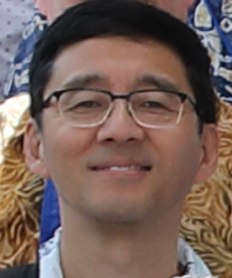
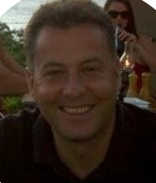
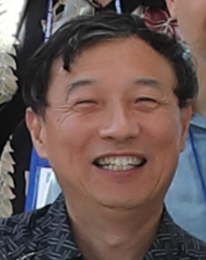
TGba PHY Contributor Awards 2
Name | Contributions to TGba
Dennis Sundman | PHY/comment resolution contributions
Bo Sun | PHY/comment resolution contributions
Jae Seung Lee | PHY comment resolution
Rui Yang | PHY/comment resolution contributions
Geert Awater | PHY/comment resolution contributions
Yonggang Fang | PHY/comment resolution contributions

Slide 7
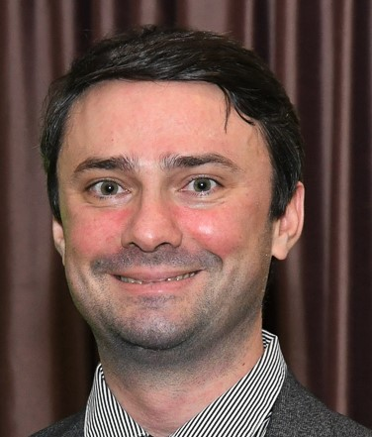
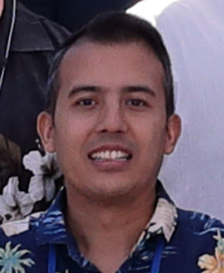

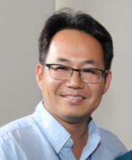
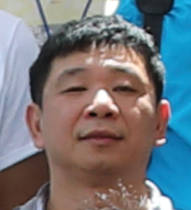
TGba MAC Contributor Awards 1
Name | Contributions to TGba
Alfred Asterjadhi | MAC/comment resolution contributions
Rojan Chitrakar | MAC/comment resolution contributions
Suhwook Kim | MAC/comment resolution contributions
Yongho Seok | MAC/comment resolution contributions
Lei Huang | MAC/comment resolution contributions

Slide 8
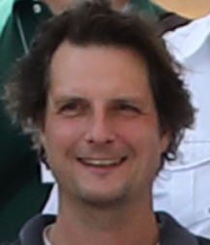
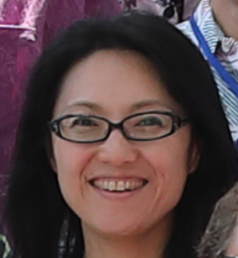
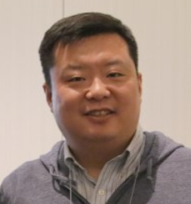
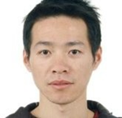
TGba MAC Contributor Awards 2
Name | Contributions to TGba
Woojin Ahn | MAC/comment resolution contributions
Menzo Wentink | MAC/comment resolution contributions
Kaiying Lu | MAC/comment resolution contributions
Xiaofei Wang | MAC/comment resolution contributions
Ming Gan | MAC/comment resolution contributions

Slide 9
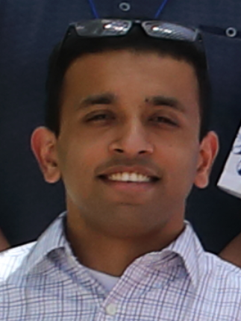
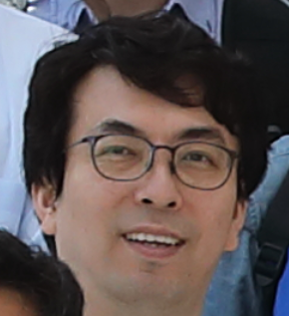
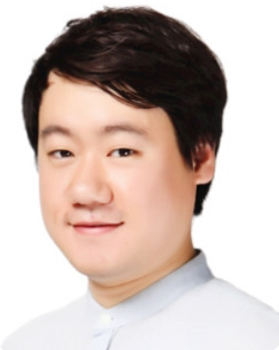
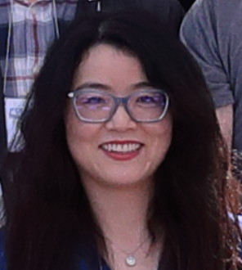
TGba MAC Contributor Awards 3
Name | Contributions to TGba
Gaurav Patwardhan | MAC/comment resolution contributions
Jeongki Kim | MAC/comment resolution contributions
Taewon Song | MAC/comment resolution contributions
Guoqing Li | MAC/comment resolution contributions

Slide 10
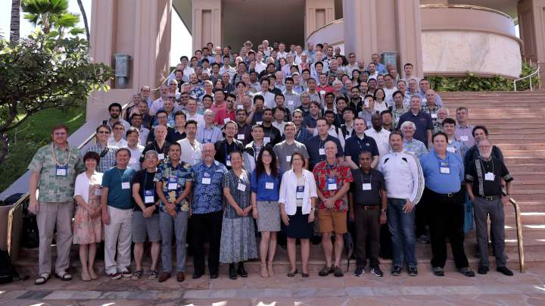
… and thanks to the rest of 802.11 WG members

