Slide 1
Discussion on reporting procedure
Date: 2021-09-01
Authors:
Name | Affiliation | Address | Phone | Email
Chaoming Luo | OPPO |  |  | luochaoming@oppo.com
Pei Zhou
Lei Huang
Chaoming Luo (OPPO)

Slide 2
Introduction
Results of measurement performed in a sensing session should be obtained by or reported to its initiator. (Motion 11, 21/0147r3)
In the reporting phase, sensing measurement results are reported. (Motion 15, 20/1851r4)
Both immediate and delayed reporting are acceptable (Motion 21, 21/0908r2)
An optional threshold based measurement and reporting procedure is defined. (Motion 18, 21/0351r5)
This contribution discusses more about the reporting procedure.

Slide 3
Recap-immediate reporting
non-TB measurement with feedback. [21/1015r2]
TB measurement with triggered feedback. [21/1015r2]

Slide 4
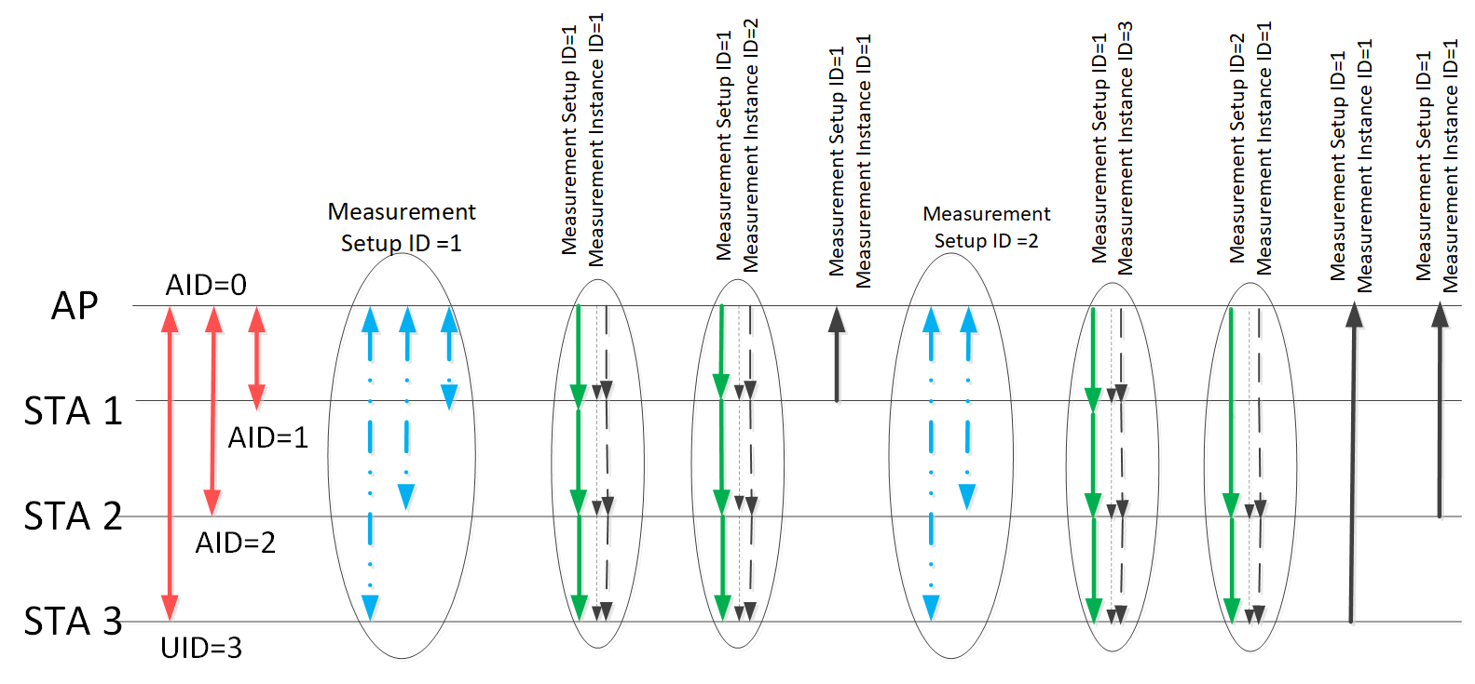
Recap-delayed reporting
Example of the sensing measurement timeline. [21/0644r4]

Slide 5
Discussion
The discussed contributions generally show examples for reporting result of one measurement instance.
Hower, it’s not clear: in a reporting procedure, whether results of multiple measurement instances are allowed to be reported together in one measurement report frame?
  We may make the measurement result as an information element (IE) where the measurement report frame can include one or more of such IEs. Or, it may be a list of report fields in an IE.
  For some use cases, the measurement result of the instances may be small (e.g. only partial bandwidth or single ss feedback), so put them in one report frame would not result in a "piggy" frame.

Slide 6
Example
One user application may have multiple measurement setups, so it's possible to report for instances of different measurement setups together (e.g., the non-AP STA 3). E.g., each TB instance contains one TF Polling phase, one TF sounding phase, one NDPA sounding phase, and one Reporting phase.
E.g., An application inside of a TV asks for instuder detection, fall detection, gesture detection and follow me sound sensing. Measurement setup 1 & 2 may require higher accuracy, measurement result size may be large, so STA 3 may need delayed reporting. Measurement setup 3 & 4 may require lower accuracy, measurement result size could be small, hence immediate reporting is possible for STA 3.
Report 1 (invalid result 1): a report with indication of invalid measurement result for delayed reporting, similar as 11az.

Slide 7
SP 1
Do you agree to add the following into 11bf SFD ?
  In reporting phase, the measurement results from multiple measurement setups of a sensing responder may be included in a single measurement report frame for delayed reporting.
    Support for obtaining more than one measurement results in a single measurement report frame sent by the responder is optional for the initiator.
    Support for buffering more than one measurement result and sending it in a single measurement report frame to the initiator is optional for the responder.
  Y/N/A
Chaoming Luo (OPPO)

Slide 8
Reference
[1] 11-21-1015-02-00bf-non-tb-and-tb-measurement-procedure-for-wlan-sensing
[2] 11-21-0644-04-00bf-sensing-session-and-measurement-exchange-identification
Chaoming Luo (OPPO)

