Slide 1
Discussion on reporting procedure
Date: 2021-09-01
Authors:
Name | Affiliation | Address | Phone | Email
Chaoming Luo | OPPO |  |  | luochaoming@oppo.com
Pei Zhou
Lei Huang
Chaoming Luo (OPPO)

Slide 2
Introduction
Results of measurement performed in a sensing session should be obtained by or reported to its initiator. (Motion 11, 21/0147r3)
In the reporting phase, sensing measurement results are reported. (Motion 15, 20/1851r4)
Both immediate and delayed reporting are acceptable (Motion 21, 21/0908r2)
An optional threshold based measurement and reporting procedure is defined. (Motion 18, 21/0351r5)
This contribution discusses more about the reporting procedure.

Slide 3
Recap-immediate reporting
non-TB measurement with feedback. [21/1015r2]
TB measurement with triggered feedback. [21/1015r2]

Slide 4
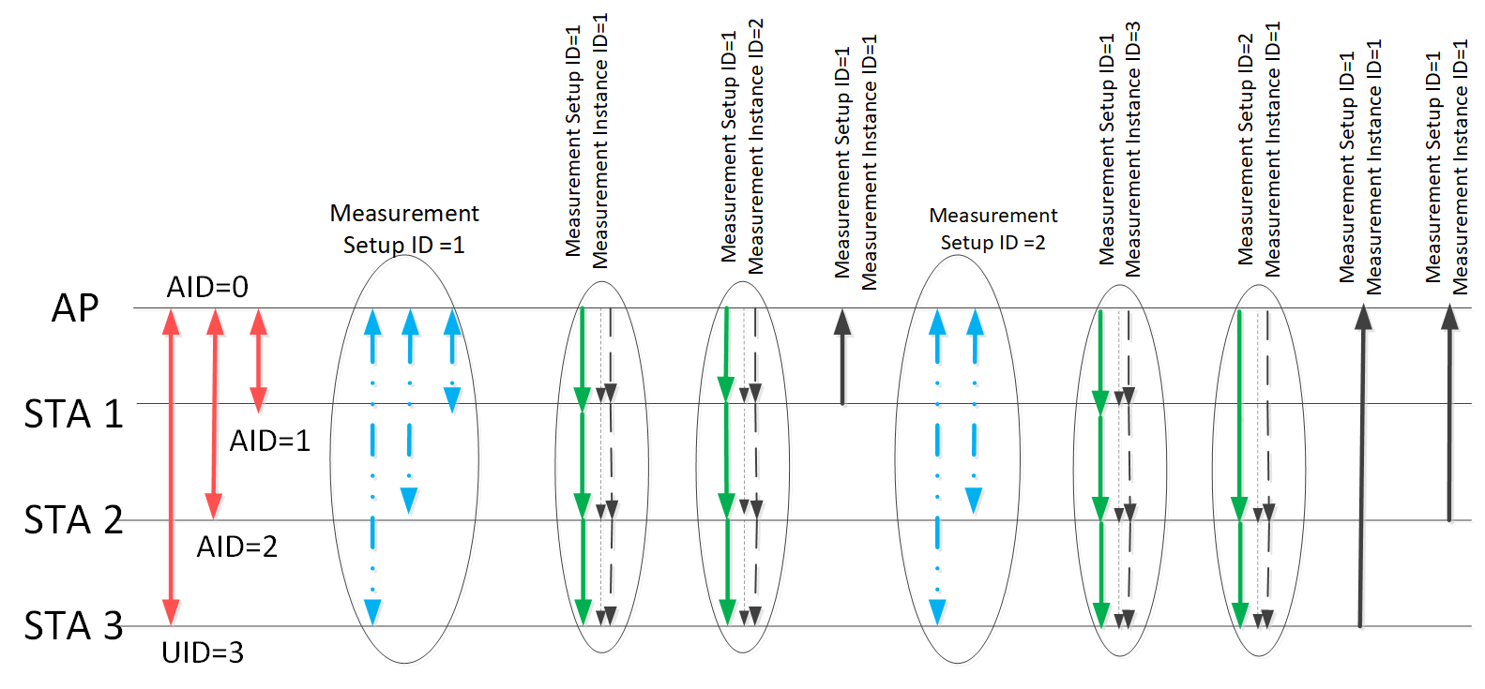
Recap-delayed reporting
Example of the sensing measurement timeline. [21/0644r4]

Slide 5
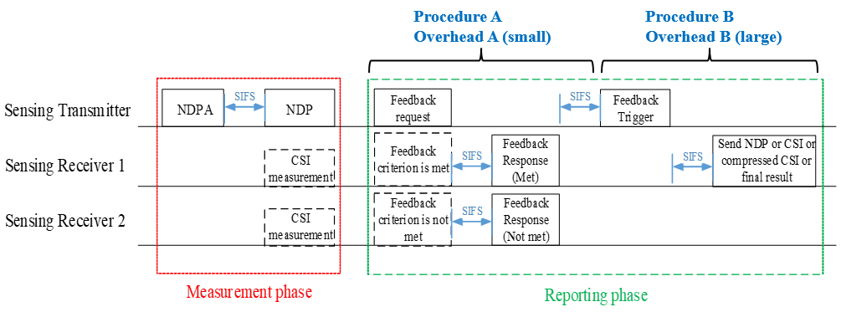
Recap-threshold based reporting
An optional threshold based measurement and reporting procedure is defined. [21/0351r5, 21/1069r1]
The sensing transmitter regularly sends feedback requests to the sensing receivers. The sensing receivers that meet the feedback criterion will send the feedback response to indicate they will perform a further feedback. Then the sensing transmitter will further trigger these sensing receivers. [21/0351r5]

Slide 6
Discussion
The discussed contributions generally show examples for reporting result of one measurement instance.
Hower, it’s not clear: in a reporting procedure, whether results of multiple measurement instances are allowed to be reported together (denoted as aggregated report below)?
  e.g. after measurement instance 1, 2, 3, then transmit results of instance 1, 2, 3 togother in a single report.
Proposal: for effiency consideration, it’s better to allow aggregated report.
  In trigger based reporting case, this may require indication for multiple measurement instance IDs in the Trigger frame.
  In threshold based reporting case: this may require indication for multiple measurement instance IDs in the Feedback Request frame and/or Feedback Trigger frame.

Slide 7
SP 1
Do you agree to add the following into 11bf SFD ?
  In reporting phase, it is allowed to include the measurement results from multiple measurement instances in a single report.
  Y/N/A
Chaoming Luo (OPPO)

Slide 8
Reference
[1] 11-21-1015-02-00bf-non-tb-and-tb-measurement-procedure-for-wlan-sensing
[2] 11-21-0644-04-00bf-sensing-session-and-measurement-exchange-identification
[3] 11-21-0351-05-00bf-threshold-based-sensing-measurement
[4] 11-21-1069-01-00bf-threshold-based-sensing-measurement-follow-up
Chaoming Luo (OPPO)

