Slide 1
Non-TB sensing measurement
Date: 2021-09-27
Authors:
Name | Affiliations | Address | Phone | Email
Cheng Chen | Intel |  |  | cheng.chen@intel.com
Dibakar Das |  |  |  | dibakar.das@intel.com
Carlos Cordeiro |  |  |  | carlos.cordeiro@intel.com
Notes:
September 2012

Slide 2
Motivation and background
11bf has defined the Trigger-based sensing measurement instance.
  It starts with the polling phase, where the AP polls STAs that are supposed to participate in the following TF sounding and/or NDPA sounding.
  So basically, this is mostly an AP-initiated measurement flow.
  TB sensing measurement instance works well in scenarios where:
    An AP is the initiator.
    A non-AP STA is the initiator, and the AP already knows all the sensing schedules and parameters, for example, through sensing negotiation with the STA initiator [1].
In [1], we also presented the Non-TB sensing measurement instance where the measurement instance is initiated by a non-AP STA.
  We propose the Non-TB sensing measurement to enable scenarios where a non-AP STA is the initiator, and sensing occurs in an on-demand manner between the non-AP STA initiator and the AP responder.
  Similar ideas were presented in [2][3].
In this contribution, we continue discussions on the Non-TB sensing measurement instance.

Slide 3
TB vs. Non-TB sensing measurement instance
The key difference between TB and Non-TB sensing measurement is who initiates the sensing measurement.
  In TB sensing measurement, the AP initiates the flow by polling the STAs to check the availability, which is necessary because:
    Some of the STAs may be unassociated, in which case the AP has no knowledge of the STAs and has to check the availability of them before the TF and/or NDPA sounding.
    Even if the STAs are associated to the AP, they may go to power save and therefore the AP still needs to check the availability of them before the TF and/or NDPA sounding.
  In Non-TB sensing measurement, the non-AP STA initiates the flow and directly goes into the sounding with the AP.
    The non-AP STA can safely assume the AP is there as long as it obtains a TXOP.

Slide 4
Assumptions
In this contribution, we make the following assumptions
  We assume the non-AP STA initiator is either associated to the AP or has already established security context with the AP in an unassociated state.
  We only consider the scenario where there is a single AP responder in one measurement instance
    Of course, the non-AP STA can always establish multiple sensing sessions with multiple AP responders, but generally it can only talk to one AP responder in one measurement instance.
    If there are additional non-AP STA responders in addition to the AP responder, we think the TB sensing measurement instance is a better fit because:
      A non-AP STA typically cannot support MU functionalities.
      The non-AP STA initiator will have to rely on the AP for the scheduling, synchronization etc. to coordinate multiple responders.
  We assume the non-AP STA and the AP has already finished the Session Setup and Sensing Measurement Setup.

Slide 5
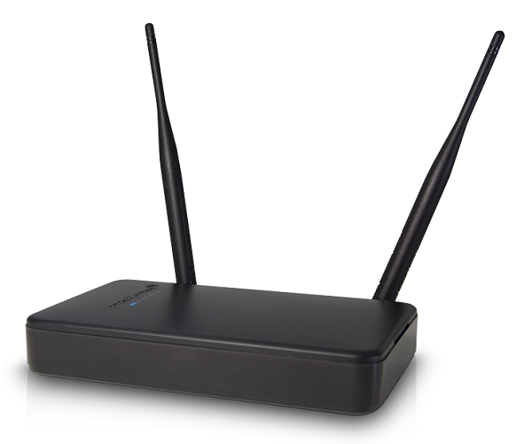

Possible scenarios
1)
AP
STA1
Bidirectional sensing
Sensing Responder
Sensing Transmitter & Receiver
Sensing Initiator
Sensing Receiver & Transmitter
Sensing PPDU transmission
2)
AP
STA1
Unidirectional UL sensing
Sensing Responder
Sensing Receiver
Sensing Initiator
Sensing Transmitter
3)
AP
STA1
Unidirectional DL sensing
Sensing Responder
Sensing Transmitter
Sensing Initiator
Sensing Receiver

Slide 6
Unified flow to cover all 3 scenarios
1)
AP
STA1
I2R sensing sounding
R2I sensing sounding
AP
R2I NDP
Sensing Feedback
Sensing Responder
Sensing Transmitter & Receiver
Sensing Initiator
Sensing Receiver & Transmitter
Sensing Responder
SIFS
2)
AP
STA1
STA1
Sensing NDPA
I2R NDP
Sensing Initiator
SIFS
SIFS
Sensing Responder
Sensing Receiver
Sensing Initiator
Sensing Transmitter
Different from the scenarios where the initiator is an AP, whenever the non-AP
STA obtains a TXOP, it can safely assume the AP responder is always there.
So, it can directly go ahead and transmit the NDPA.
Depending on the roles of the STA and AP, I2R NDP or R2I NDP may be
“dummy” and is transmitted with the minimum possible length.
The sensing NDPA frame will include the Measurement Setup ID [4], which
corresponds to the sensing setup where STA1 and AP understand their roles,
so, they know if I2R NDP or R2I NDP is “dummy” NDP with the minimal length
or not.
We could also include a signaling in the NDPA to indicate that if I2R NDP or
R2I NDP is “dummy” NDP with minimal length or not.
Sensing feedback for the I2R sounding could be sent to STA1 from the AP.
3)
AP
STA1
Sensing Responder
Sensing Transmitter
Sensing Initiator
Sensing Receiver
Sensing PPDU transmission

Slide 7
Non-TB sensing measurement instance for scenario 1)
Sensing PPDU transmission
I2R sensing sounding
R2I sensing sounding
1)
AP
R2I NDP
Sensing Feedback
AP
STA1
Sensing Responder
Sensing NDPA
I2R NDP
SIFS
STA1
Sensing Responder
Sensing Transmitter & Receiver
Sensing Initiator
Sensing Receiver & Transmitter
Sensing Initiator
SIFS
SIFS
Both I2R NDP and R2I NDP are regular sounding NDPs (i.e., not “dummy” NDP).
The sensing NDPA frame will include the Measurement Setup ID [4], which corresponds to the sensing
setup where STA1 and AP understand their roles, so they know both I2R NDP and R2I NDP are needed
following the Sensing NDPA frame.
We could also include a signaling in the NDPA to indicate that both I2R NDP and R2I NDP are needed
following the Sensing NDPA frame.
Sensing feedback for the I2R sounding could be sent to STA1 from the AP.

Slide 8
Non-TB sensing measurement instance for scenario 2)
I2R sensing sounding
Sensing PPDU transmission
“Dummy” R2I NDP
Sensing Feedback
AP
2)
AP
STA1
Sensing Responder
SIFS
STA1
Sensing NDPA
I2R NDP
Sensing Responder
Sensing Receiver
Sensing Initiator
Sensing Initiator
Sensing Transmitter
SIFS
SIFS
The R2I NDP is “dummy” NDP and transmitted with minimum possible length.
The sensing NDPA frame will include the Measurement Setup ID [4], which corresponds to the sensing
setup where STA1 and AP understand their roles, so they know R2I NDP will be the “dummy” NDP.
We could also include a signaling in the NDPA to indicate that R2I NDP will be “dummy” and transmitted
with the minimal possible length.
Sensing feedback for the I2R sounding could be sent to STA1 from the AP.

Slide 9
Non-TB sensing measurement instance for scenario 3)
R2I sensing sounding
Sensing PPDU transmission
R2I NDP
3)
AP
AP
STA1
Sensing Responder
STA1
Sensing NDPA
“Dummy” I2R NDP
Sensing Initiator
Sensing Responder
Sensing Transmitter
Sensing Initiator
Sensing Receiver
SIFS
SIFS
The I2R NDP is “dummy” NDP and transmitted with minimum possible length.
The sensing NDPA frame will include the Measurement Setup ID [4], which corresponds to the sensing
setup where STA1 and AP understand their roles, so they know I2R NDP will be the “dummy” NDP.
We could also include a signaling in the NDPA to indicate that I2R NDP will be “dummy” and transmitted
with the minimal possible length.

Slide 10
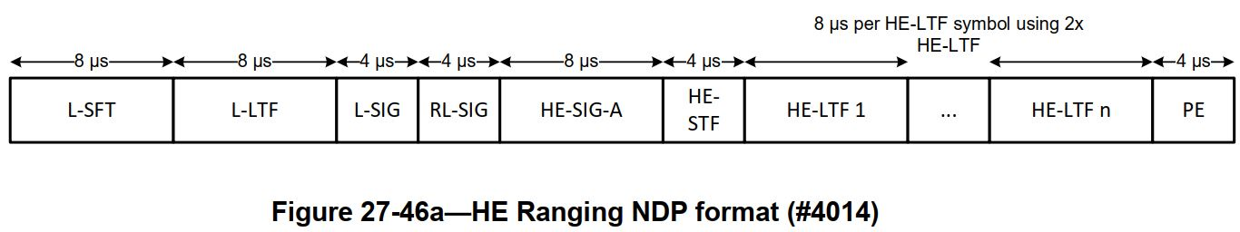
Overhead of the “dummy” NDP
Assume we reuse the format of HE Ranging NDP for the Sensing NDP.
The number of HE-LTF symbols in an HE Ranging NDP depends on the number of space-time streams N_STS, the number of LTF repetitions LTF_REP, and, when Secure HE-LTFs with randomized LTF sequence are used, the number of users NUM_USERS.
  At least 48us minimum.

Slide 11
Conclusions
We propose a unified non-TB sensing measurement instance flow which works in scenarios where a non-AP STA is the initiator, and an AP is the responder.
  The proposed flow of non-TB sensing measurement instance reuses much of existing non-TB Ranging measurement flow and is able to address different scenarios.

Slide 12
SP
Do you agree with the following?
  11bf shall define a non-Trigger based (non-TB) sensing measurement instance as follows:
    One non-AP STA is the sensing initiator and one AP is the sensing responder.
    Once the non-AP STA obtains a TXOP, it shall initiate a non-TB sensing measurement instance by transmitting an NDPA frame to the AP followed by an Initiator-to-Responder (I2R) NDP SIFS after. SIFS after the I2R NDP, the AP shall transmit a Responder-to-Initiator (R2I) NDP to the non-AP STA.
    If the non-AP STA is only the sensing transmitter, then the R2I NDP should be transmitted with minimum possible length with one LTF symbol.
    If the non-AP STA is only the sensing receiver, then the I2R NDP should be transmitted with minimum possible length with one LTF symbol.
    The details of the NDPA frame are TBD.

Slide 13
References
[1] DCN0990r2, Discussions on sensing measurement flows
[2] DCN0842r0, A channel measurement procedure for WLAN sensing
[3] DCN1015r2, Non-TB and TB measurement procedure for WLAN sensing
[4] DCN0644r3, Sensing session and measurement exchange identification

