Slide 1
AANI SC Agenda September 2021 Interim
Date: 2021-09-17
Authors:

Slide 2
Abstract
Agenda for:
802.11 AANI SC
(Advanced Access Network Interface Standing Committee)
September Interim 2021
Chair: Joseph Levy (InterDigital)
Vice Chair: Open
Secretary: Open
r0: First draft of the Agenda
r1: As modified during the Monday 13 September 2021 19:00 – 21:00 h ET teleconference
r2: Status updated based on the Monday 13 September teleconference and during the Tuesday 14 September teleconference
r3: As modified during the Friday 17 September 2021 9:00-11:00 h ET teleconference

Slide 3
Registration for the September 802.11 electronic interim session
This meeting is part of the September 802.11 interim session
You must pay the registration fee in order to attend
If you have not already done so, you can register here or follow the registration link for this session here https://www.ieee802.org/11/Meetings/Meeting_Plan.html
If you do not intend to register for this session you must leave this meeting and, if you have logged attendance on IMAT, email the 802.11 chair or vice chairs to have your attendance cancelled

Slide 4
Reminders and Rules
Call for Secretary
Reminders to attendees:
  Please record your attendance: https://imat.ieee.org/sp7200043/attendance-log?p=3632200005&t=47200043
  Please mute yourself, unless you wish to speak
  No recordings
AANI SC Operating Rules:
  Anyone present can:
  Participate in discussions
  Provide and present contributions (please notify the Chair)
  Vote on straw polls and motions
  Motions are in order for this teleconference, as it is during an 802.11 Interim meeting.

Slide 5
Agenda
  Monday 13 September 2021 19:00-21:00 h ET
  Call for Secretary
  Administrative: Reminders, Rules, Guidelines, Resources, Participation [5 min]
  Approval of Minutes
  Status [5 min.]
  Contributions/Discussion:
    Discussion on 11-20-0013r15
      Straw Poll on audience
      Document review
      Straw Polls/Motions
    Discussion on the 802.11 reply LS to WBA
Tuesday 15 September 2021 11:15-13:15 h ET
Friday 17 September 2021 9:00-11:00 h ET
  Future Sessions Planning [5 min.]

Slide 6
Guidelines for IEEE-SA Meetings
All IEEE SA standards meetings shall be conducted in compliance with all applicable laws, including antitrust and competition laws.
  Don’t discuss the interpretation, validity, or essentiality of patents/patent claims.
  Don’t discuss specific license rates, terms, or conditions.
    Relative costs of different technical approaches that include relative costs of patent licensing terms may be discussed in standards development meetings.
      Technical considerations remain the primary focus
  Don’t discuss or engage in the fixing of product prices, allocation of customers, or division of sales markets.
  Don’t discuss the status or substance of ongoing or threatened litigation.
  Don’t be silent if inappropriate topics are discussed. Formally object to the discussion immediately.
---------------------------------------------------------------
For more details, see IEEE-SA Standards Board Operations Manual, clause 5.3.10 and
Antitrust and Competition Policy: What You Need to Know at http://standards.ieee.org/develop/policies/antitrust.pdf

Slide 7
Resources – URLs
Link to IEEE Disclosure of Affiliation
  https://standards.ieee.org/faqs/affiliation.html
Links to IEEE Antitrust Guidelines
  https://standards.ieee.org/content/dam/ieee-standards/standards/web/documents/other/antitrust.pdf
Link to IEEE Code of Ethics
  https://www.ieee.org/about/corporate/governance/p7-8.html
Link to IEEE Code of Conduct
  https://www.ieee.org/content/dam/ieee-org/ieee/web/org/about/ieee_code_of_conduct.pdf
Link to IEEE Patent Policy
  http://standards.ieee.org/develop/policies/bylaws/sect6-7.html#6
Notes:
September 2012

Slide 8
IEEE SA Copyright Policy
By participating in this activity, you agree to comply with the IEEE Code of Ethics, all applicable laws, and all IEEE policies and procedures including, but not limited to, the IEEE SA Copyright Policy.
  Previously Published material (copyright assertion indicated) shall not be presented/submitted to the Working Group nor incorporated into a Working Group draft unless permission is granted.
  Prior to presentation or submission, you shall notify the Working Group Chair of previously Published material and should assist the Chair in obtaining copyright permission acceptable to IEEE SA.
  For material that is not previously Published, IEEE is automatically granted a license to use any material that is presented or submitted.

Slide 9
IEEE SA Copyright Policy
    The IEEE SA Copyright Policy is described in the IEEE SA Standards Board Bylaws and IEEE SA Standards Board Operations Manual
      IEEE SA Copyright Policy, see
      Clause 7 of the IEEE SA Standards Board Bylaws
      https://standards.ieee.org/about/policies/bylaws/sect6-7.html#7
      Clause 6.1 of the IEEE SA Standards Board Operations Manual
      https://standards.ieee.org/about/policies/opman/sect6.html
    IEEE SA Copyright Permission
      https://standards.ieee.org/content/dam/ieee-standards/standards/web/documents/other/permissionltrs.zip
    IEEE SA Copyright FAQs
      http://standards.ieee.org/faqs/copyrights.html/
    IEEE SA Best Practices for IEEE Standards Development
      http://standards.ieee.org/develop/policies/best_practices_for_ieee_standards_development_051215.pdf
    Distribution of Draft Standards (see 6.1.3 of the SASB Operations Manual)
      https://standards.ieee.org/about/policies/opman/sect6.html

Slide 10
Participants in the IEEE-SA “individual process” shall act independently of others, including employers
The IEEE-SA Standards Board Bylaws require that “participants in the IEEE standards development individual process shall act based on their qualifications and experience”
This means participants:
  Shall act & vote based on their personal & independent opinions derived from their expertise, knowledge, and qualifications
  Shall not act or vote based on any obligation to or any direction from any other person or organization, including an employer or client, regardless of any external commitments, agreements, contracts, or orders
  Shall not direct the actions or votes of other participants or retaliate against other participants for fulfilling their responsibility to act & vote based on their personal & independently developed opinions
By participating in standards activities using the “individual process”, you are deemed to accept these requirements; if you are unable to satisfy these requirements then you shall immediately cease any participation

Slide 11
Approval of Minutes
Minutes from the May 2021 Interim Telecons:
11-21/1135r0 “AANI SC Teleconference 07 July 2021 Minutes”
Comments?
Moved: Stuart Kerry
Second: Ben Rolfe
Objections to approving the minutes by unanimous consent? Approved by unanimous consent
Minutes from AANI SC Teleconferences:
11-21/1429r0 “AANI SC Teleconference Minutes 10 August 2021”
11-21/1430r0 “AANI SC Teleconference Minutes 24 August 2021”
Moved: Ben Rolfe
Second: Stuart Kerry
Objections to approving the minutes by unanimous consent? Approved by unanimous consent

Slide 12
AANI SC Status/Activity
Topics:
The WBA LS (11-21-0170r0) - specifically, addressing 802.11ax or other 802.11-2020 capabilities that can be used to meet the use cases identified in the LS.
  Contributions:
  11-21/0616 “802.11ax Features and Applicability to 5G and Wi-Fi Convergence” Osama Aboul-Magd (Huawei Technologies) - presented 13 April 2021. (additional input requested)
  11-21/0865 “Draft Reply LS from 802.11 to WBA regarding the WBA 5G & Wi-Fi RAN Convergence Paper” Joseph Levy (InterDigital)
  11-21/0953 - “Proposed QoS response to WBA”, Thomas Derham (Broadcom)
  11-21/1198r1 – “Draft LS Response to WBA QoS material”, Thomas Derham (Broadcom)
Contributions related to the "Draft technical report on interworking between 3GPP 5G network and WLAN" (11-20/0013).
  Discussion continued during the July Plenary meeting and the AANI teleconferences.
  The technical report was updated to 11-20/0013r14, All technical issues seem to be resolved
  Tailoring the Introduction and Conclusion for the target audience is still open.
  Discussed: 11-21/1410r0 “Possible Edits to11-20-0013r14” – 11-20/0013 updated.

Slide 13
Way Forward the Technical report (11-20/0013r15):
Review possible updates/modification to the Introduction and Conclusion to address the audience
  Review reflector discussion
  Proposed target audience is: 3GPP with CC to WFA and WBA
  Further discussion on target audience
  Discuss/modify the technical report: 11-20/0013r15 based on 11-21/1410r0 “Possible Edits to11-20-0013r14”
  Straw Polls
  Motion – dependent on Straw Polls

Slide 14
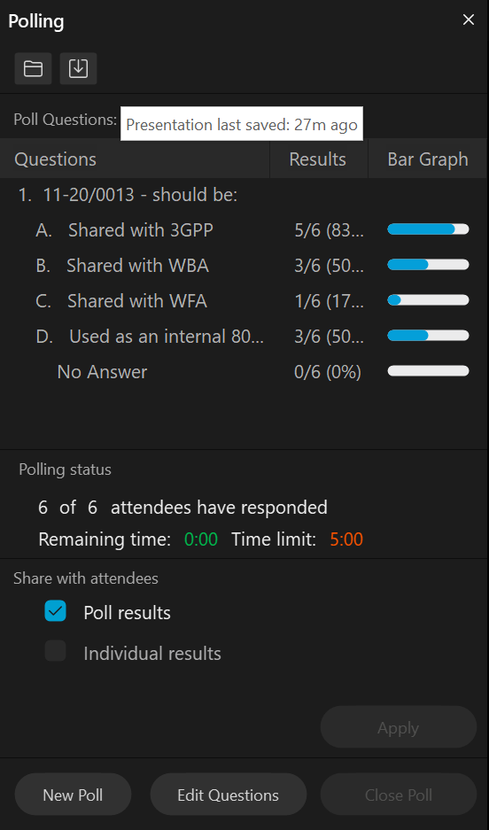
Straw Poll from 10 Aug: Target Audience for 11-20/0013
Question: 11-20/0013 – should be:
Shared with 3GPP
Shared with WBA
Shared with WFA
Used as an internal 802.11 report – only
Results:

Slide 15
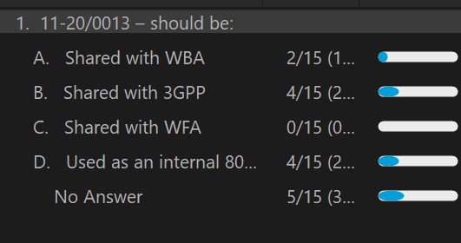
Straw Poll
Rerunning the target audience SP with the current participates:
Question: 11-20/0013 – should be:
  Shared with WBA
  Shared with 3GPP
  Shared with WFA
  Used as an internal 802.11 report – only
Results:

Slide 16
Technical Report Discussion/Contributions
11-20/0013r15
??

Slide 17
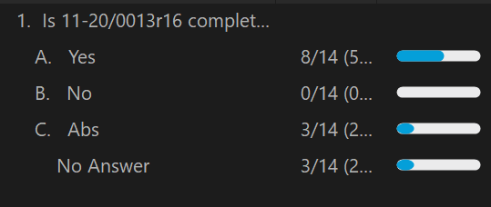
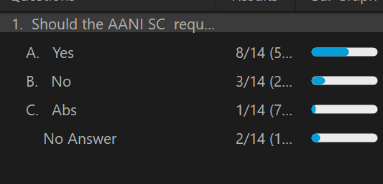
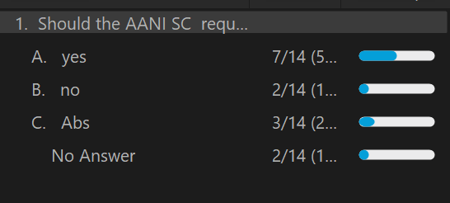
Straw Polls
Is 11-20/0013r16 complete and ready to be submitted to the 802.11 WG?
  Yes
  No
  Abs
Should the AANI SC request that the 802.11 WG approve and send to 3GPP with CC to WBA and WFA: 11-20/0013r16?
  Yes
  No
  Abs
Should the AANI SC request that the 802.11 WG note 11-20/0013r16 and use it for internal 802.11 purposes?
  Yes
  No
  Abs

Slide 18
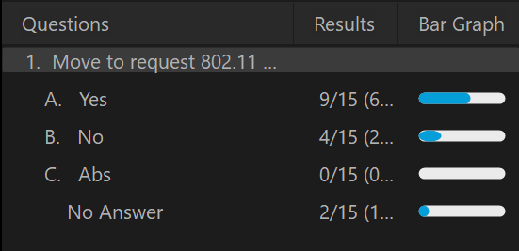
Motion
Move to request 802.11 WG approve 11-20/0013r16 the “Draft technical report on interworking between 3GPP 5G network & WLAN” and send to 3GPP with CC to WBA and WFA, with editorial privileges given to the WG Chair.
Moved: Ben Rolfe
Second: Marco Hernandez
Result: Y: N: A: DNV:
69.2% yes

Slide 19
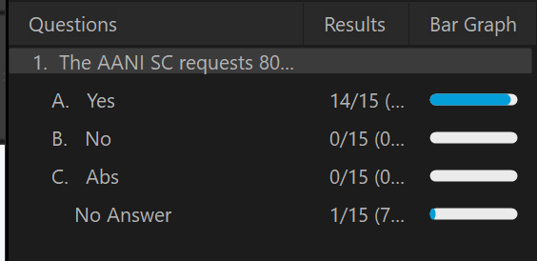
Motion
The AANI SC requests 802.11 WG to review and consider the completed report in 11-20/0013r16 the “Draft technical report on interworking between 3GPP 5G network & WLAN”.
Moved: Stuart Kerry
Second: Marco Hernandez
Result: Y: N: A: DNV:

Slide 20
Way Forward – To Complete the WBA reply LS
For the WBA reply LS
(11-21/1198r1, 11-21/0865r6, 11-21/0953r0 11-21/0616r0)
There was no AANI reflector discussion on the reply LS, the following are open for discussion:
  Adding text to reference the Technical report (11-20/0013)
  Providing edits to existing text
  Adding additional content / Removing existing content

Slide 21
Agenda
  Monday 13 September 2021 19:00-21:00 h ET
Tuesday 15 September 2021 11:15-13:15 h ET
  Call for Secretary
  Administrative: Reminders, Rules, Guidelines, Resources, Participation [5 min]
  Status [10 min.]
  Contributions/Discussion:
    Discuss possible press release on the technical report
    Discussion on the 802.11 reply LS to WBA
Friday 17 September 2021 9:00-11:00 h ET
  Future Sessions Planning [5 min.]

Slide 22
AANI SC Status/Activity
Status of the "Draft technical report on interworking between 3GPP 5G network and WLAN" (11-20/0013).
  During the last AANI SC teleconference the following SP were taken:
    11-20/0013 – should be:
    Shared with WBA, Shared with 3GPP, Shared with WFA, Used as an internal 802.11 report, only (2,4,0,4)
    Is 11-20/0013r16 complete and ready to be submitted to the 802.11 WG? (8, 0, 3, 3)
    Should the AANI SC request that the 802.11 WG approve and send to 3GPP with CC to WBA and WFA: 11-20/0013r16? (8, 3, 1, 2)
    Should the AANI SC request that the 802.11 WG note 11-20/0013r16 and use it for internal 802.11 purposes? (7, 2, 3, 2)
  During the last AANI SC teleconference the following Motions were taken:
    Move to request 802.11 WG approve 11-20/0013r16 the “Draft technical report on interworking between 3GPP 5G network & WLAN” and send to 3GPP with CC to WBA and WFA, with editorial privileges given to the WG Chair.
    Motion Failed (9, 4, 0, 2) 69.2%, 75% required
    The AANI SC requests 802.11 WG to review and consider the completed report in 11-20/0013r16 the “Draft technical report on interworking between 3GPP 5G network & WLAN”.
    Motion Passed (14, 0, 0, 1) Unanimous
  The AANI SC Chair will report to the 802.11 WG that the AANI SC considers the report complete and recommends that the 802.11 review and consider the report.

Slide 23
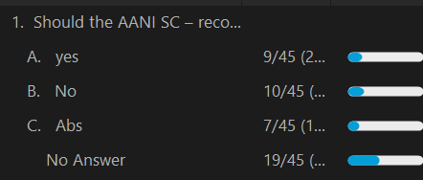
Straw Poll
Should the AANI SC – recommend to the 802.11 WG that a request for the development of a press release (or similar) announcing the availability of the Technical Report in 11-20/0013r16 and its conclusions?
Yes
No
Abs

Slide 24
AANI SC Status/Activity
The WBA LS (11-21-0170r0) - specifically, addressing 802.11ax or other 802.11-2020 capabilities that can be used to meet the use cases identified in the LS.
  Contributions:
  11-21/0616 “802.11ax Features and Applicability to 5G and Wi-Fi Convergence” Osama Aboul-Magd (Huawei Technologies) - presented 13 April 2021. (additional input requested)
  11-21/0865 “Draft Reply LS from 802.11 to WBA regarding the WBA 5G & Wi-Fi RAN Convergence Paper” Joseph Levy (InterDigital)
  11-21/0953 - “Proposed QoS response to WBA”, Thomas Derham (Broadcom)
  11-21/1198r1 – “Draft LS Response to WBA QoS material”, Thomas Derham (Broadcom)

Slide 25
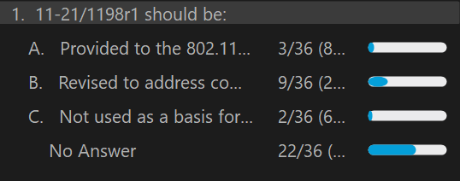
Reply LS to WBA Discussion
Thomas Derham reviewed: 11-21/1198r1 – “Draft LS Response to WBA QoS material”, Thomas Derham (Broadcom)
Straw Poll:
11-21/1198r1 should be:
Provided to the 802.11 WG as is
Revised to address comments, and further clean up the document
Not used as a basis for the reply LS
Way forward - 11-21/1198r1 to be
updated for discussion Friday

Slide 26
Agenda
  Monday 13 September 2021 19:00-21:00 h ET
Tuesday 15 September 2021 11:15-13:15 h ET
Friday 17 September 2021 9:00-11:00 h ET
  Call for Secretary
  Administrative: Reminders, Rules, Guidelines, Resources, Participation [5 min]
  Status [5 min.]
  Contributions/Discussion:
    Discussion on the 802.11 reply LS to WBA
      11-21/1198r2 – “Draft LS Response to WBA QoS material”, Thomas Derham (Broadcom)
      Straw Polls/Motions
  Future Sessions Planning [5 min.]

Slide 27
802.11 reply LS to WBA Discussion/Contributions
11-21/1198r2
??

Slide 28
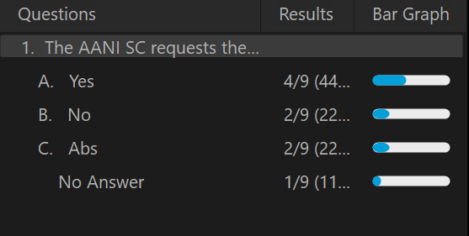
Motion
The AANI SC requests the 802.11 WG to send the reply LS in 11-21/1198r2 “Draft LS Response to WBA QoS material” to WBA, with editorial privileges given to the WG Chair.
Moved: Thomas Derham
Second: Jon Rosdahl
Result: Y: N: A: DNV:

Slide 29
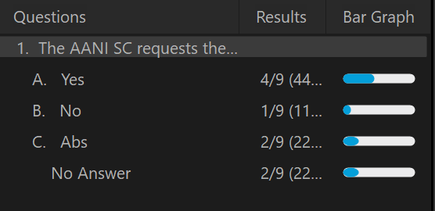
Motion
The AANI SC requests the 802.11 WG to send the reply LS in 11-21/1198r3 “Draft LS Response to WBA QoS material” to WBA, with editorial privileges given to the WG Chair.
Moved: Thomas Derham
Second: Marco Hernandez
Result: Y: N: A: DNV:

Slide 30
Future Sessions Planning
802.11 WG November Plenary Meeting:
AANI SC - to be confirmed
  Propose 2 teleconferences:
    Tuesday 9 Nov 11:15-13:15 ET
    Wednesday 10 Nov 19:00-21:00 ET
Teleconferences TBD:
  No additional teleconferences prior to the November Plenary?
WBA Report/LS 11-21-0170r0 request – 802.11ax or 802.11-2020 related contributions
  Contributions on 802.11ax capabilities addressing specific challenges identified in the WBA Report/LS
  Contribution on 802.11-2020 capabilities addressing specific challengers identified in the WBA Report/LS
  Discussion/contributions reply LS text proposals
Technical Report related contributions

