Slide 1
Truncated Power Delay Profile - follow up
Date: 2021-08-24
Authors:
Name | Affiliation | Address | Phone | Name
Rui Du | Huawei Technologies Co. Ltd | F3, Huawei Base, Shenzhen, China |  | ray.du@huawei.com
Chenchen Liu
Meihong Zhang
Mengshi Hu
Danny Kai Pin Tan

Slide 2
Outline
Abstract
Calculation of TPDP/TCIR
Performance evaluation: TPDP/TCIR vs. CSI grouping
Report length of the TPDP/TCIR
Experimental Validation of multiple targets
The effect of FFT/IFFT points
Further considerations of offsets
Comparison of the potential measurement results
Signal processing at MAC
Summary
References
SP

Slide 3
1. Abstract
In previous meeting, Truncated Power Delay Profile(TPDP)/Truncated Channel Impulse Response(TCIR) has been proposed as a potential WLAN sensing measurement result in explicit CSI feedback.
Some simple mathematical representations and experiment validation with single target has been shown in our last contribution[1].
In this presentation, further results are presented to show the performance of TPDP/TCIR method.

Slide 4
2. Calculation of TPDP/TCIR
The TPDP/TCIR is processed with two steps:
Calculating the PDP/CIR (time domain) from CSI/CFR (frequency domain) through IFT(usually, IFFT) .
Reporting the first few complex samples (corresponding to the range of interest) of the entire PDP/CIR .

Slide 5
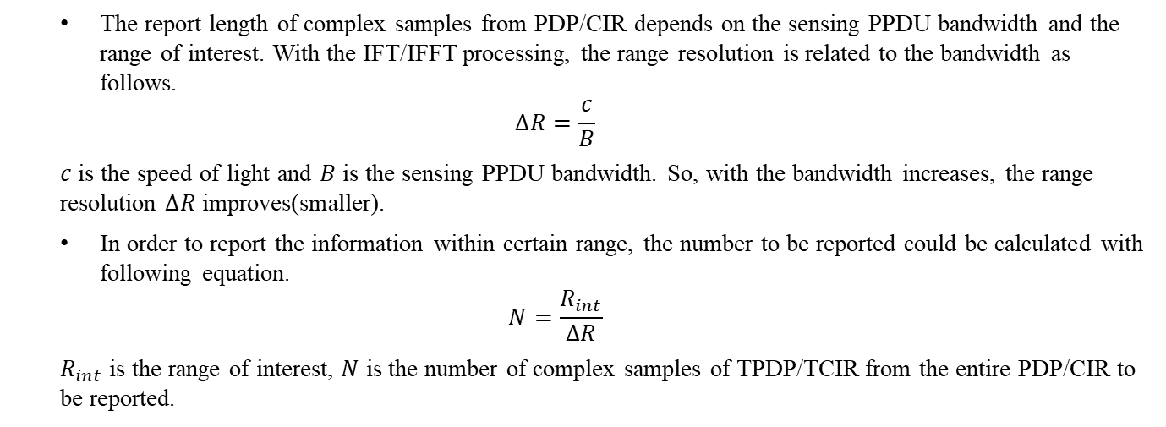
3. Report length of TPDP/TCIR
The report length of complex samples from PDP/CIR depends on the sensing PPDU bandwidth and the range of interest. With the IFT/IFFT processing, the range resolution is related to the bandwidth as follows.
$$∆R=\frac{c}{B}$$
$c$ is the speed of light and $B$ is the sensing PPDU bandwidth. So, with the bandwidth increases, the range resolution $∆R$ improves(smaller).
In order to report the information within certain range, the number to be reported could be calculated with following equation.
$$N=\frac{R_{int}}{∆R}$$
$R_{int}$ is the range of interest, $N$ is the number of complex samples of TPDP/TCIR from the entire PDP/CIR to be reported.
Number of TPDP/TCIR samples to be reported
Range of interest(m) | 15(7.5 for monostatic sensing) |  |  |  | 30(15 for monostatic sensing) |  |  |  | 45(22.5 for monostatic sensing) |  |  |  | …
Bandwidth (MHz) | 20 | 40 | 80 | 160 | 20 | 40 | 80 | 160 | 20 | 40 | 80 | 160 | …
Report length (samples without offsets) | 1 | 2 | 4 | 8 | 2 | 4 | 8 | 16 | 3 | 6 | 12 | 24 | …

Slide 6
4. Performance evaluation: TPDP/TCIR vs. CSI grouping(1)
The main difference between (T)PDP/(T)CIR and grouped CSI is the number of subcarriers could be used for sensing.
For (T)PDP/ (T)CIR technique, IFFT is conducted with full subcarriers.
For the grouped CSI, IFFT only could be conducted with limited subcarriers(decided by the group factor).
Based on the basic signal processing principles, the greater of the CSI grouping factor (sparser of the subcarriers), the higher of the sidelobe level in PDP/CIR after IFT/IFFT!
The sidelobe level of the PDP/CIR is very important for target detection !
Target 2(120m)’s amplitude is 10 dB less than target 1(30m)’s amplitude.
The SNR is 10dB.
Target 2 is not masked by the sidelobe target 1.
Target 2 is masked by the sidelobe target 1.

Slide 7
4. Performance evaluation: TPDP/TCIR vs. CSI grouping(2)
To further investigate the performance difference between full CSI and grouped CSI. Monte Carlo simulation method is adopted in the simulation: 20000 times simulation is conducted independently at each SNR level.
The accuracy vs. SNR curve is adopted to evaluate the performance of TPDP/TCIR(full CSI) or grouped CSI(grouping factor is 8).
Simulation parameters
Accuracy vs. SNR
Simulation parameters | Values
Bandwidth | 20MHz
Subcarrier index | [-122:-2, 2:122]
Subcarrier spacing | 78.125 kHz
Target 1 | 30m
Target 2 | 120m (10dB smaller than target 1)
SNR Region | [-20dB 30dB]
Simulation number per SNR | 20000
Accuracy improves with the SNR increases.
Estimation accuracy of strong target (target 1) is better than weak target (target 2).
Estimation accuracy with full CSI is better than grouped CSI(both for target 1 and target 2).

Slide 8
4. Performance evaluation: TPDP/TCIR vs. CSI grouping(3)
Accuracy vs. SNR of target 1 with different grouping factor
Accuracy vs. SNR of target 2 with different grouping factor
For both targets, accuracy improves with SNR increases.
For both targets, estimation accuracy degrades with grouping factor increases.
The estimation accuracy is analyzed based on single PDP/CIR, and the performance will further improve if coherent integration could be adopted. Similarly, better performance with smaller grouping factor !
So, based on the analysis of estimation accuracy, the TPDP/TCIR (full CSI) has better performance than grouped CSI !

Slide 9
5. Experimental Validation of multiple targets(1)
Signal parameters
Parameters | Values
Signal Form | 802.11ax
Bandwidth | 20MHz
Carrier Frequency | 5GHz
Antennas Number | 1Tx 2Rx
Subcarriers | 242
The system architecture is shown in the left figure. One transmitter and two receivers are adopted in the experimental validation. During the experiment, Tx is transmitting HE NDP periodically and Rx1/Rx2 are receiving the NDP and estimating the channel.
During the experiment, two fingers from different target humans are drawing independently in the air.

Slide 10
5. Experimental Validation of multiple targets(2)
As discussed in last meeting, the phase tracking technique works well in single target scenario.
In multiple target scenarios, the phase represents the summation of the signals from different target. It is impossible to track the motion of multiple targets directly through the phase under this condition.
However, different targets could be separated through other information, e.g. Doppler as follows.
Doppler of target 1
Left figure shows the Doppler-time result of multiple targets with the first complex sample of PDP/CIR(TPDP/TCIR).
TPDP/TCIR contains the information of multiple targets and further signal processing could be adopted to track the movements.
Doppler of target 2

Slide 11
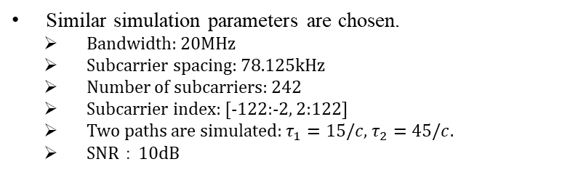
6. The effect of IFFT processing(simulation)
Similar simulation parameters are chosen.
Bandwidth: 20MHz
Subcarrier spacing: 78.125kHz
Number of subcarriers: 242
Subcarrier index: [-122:-2, 2:122]
Two paths are simulated: $τ_{1}=15/c$, $τ_{2}=45/c$.
SNR：10dB
Legend | CSI/CFR subcarrier index | IFFT points
 |  | Same length with CSI | 256(sideband to 0)
No DC tone | [-122:-2, 2:122] | IFFT (csi) | IFFT (csi, 256)
With DC tone | [-122:-2 0 0 0 2:122] | IFFT (csi) | IFFT (csi, 256)
Interp DC tone | [-122:-2, interpolation of(-1 0 1) , 2:122] | IFFT (csi) | IFFT (csi, 256)
PDP/CIR based on different simulation parameters
For IFFT processing using different parameters, the values of the peak and sidelobes profiles experience only minor variations.
More importantly, the location of the peaks (which represents the delay of the paths), are still accurately remained.
To reduce the sidelobe level, interpolation could of the subcarriers near DC could be conducted before the IFFT.

Slide 12
6. The effect of IFFT processing(experiment)
Amplitude and phase of the first complex sample from TPDP/TCIR during finger moving
Finger tracking result with TPDP/TCIR based on different FFT/IFFT points
The left figure shows the amplitude and phase of the first complex sample from PDP/CIR(TPDP/TCIR).
The amplitudes based on different IFFT processing parameters change a little bit(same conclusion with simulation), but the trends are similar.
The phases based on different IFFT processing parameters are nearly same.
The right figure shows the tracking results of a moving finger with trajectory ‘B’ based on different IFFT processing parameters.
The results indicate that the effect of different IFFT processing parameters has very limited effect on TPDP/TCIR, especially for WLAN sensing whose range of interest is less than 20m.

Slide 13
7. Further considerations of offsets
The result shown above (simulation and experiment measurement) is under perfect synchronization condition. The sensing CSI report only depends on the range of interest and signal bandwidth.
But in actual systems, there will be some non-ideal offsets (e.g. synchronization offset, pre-advancement). All of these offsets would affect the PDP/CIR after IFFT and make the PDP/CIR shift to right[3].
So, with all of these offsets taken into consideration, the sensing CSI report should contain more PDP/CIR complex samples to avoid the potential loss of desired sensing range and information.

Slide 14
8. Comparison of the potential measurement results
Types | Description | Pros | Cons
CSI matrix | Raw CSI data, and it is the CSI in frequency domain . | Full CFR information. | Large overhead.
Grouped CSI | Reducing the CSI matrix feedback by subcarrier grouping. | Small overhead. Full information within the unambiguity range(decided by the subcarrier spacing after grouping). | The sidelobe level of the PDP/CIR generated with grouped CSI is higher than the PDP/CIR generated with full CSI(PDP/TPDP/TCIR).
PDP/CIR | Generated through IFT/IFFT of the raw CSI matrix in frequency domain. | Full CIR information. | 1. Large overhead. 2. IFFT processing.
Truncated PDP/ Truncated CIR | Truncating the PDP/CIR according to the range of interest. | Small overhead. Full information within the range of interest. Lower sidelobe level. | IFFT processing.

Slide 15
9. Signal processing at MAC
The CSI matrix could be sent to MAC layer from PHY layer through relevant PHY interface[4].
CSI matrix could be processed(e.g. IFFT) and TPDP/TCIR could be generated at MAC layer.
Then the TPDP/TCIR could be sent to SME and report to the device who needs sensing measurement result.
Notes:
SIFS时间，软件无法完成。

Slide 16
10. Summary
In this contribution, TPDP/TCIR is further analysed theoretically and experimentally.
Based on the results have been shown above,
TPDP/TCIR has lower sidelobe level than CSI grouping.
TPDP/TCIR works well for single target and multiple targets scenarios.
In actual systems an offset could be further considered to avoid the potential loss of desired sensing range and information.
The TPDP/TCIR is processed with two steps:
Calculating the PDP/CIR(time domain) from CSI/CFR (frequency domain) through IFT(usually, IFFT) .
Reporting the first few complex samples (corresponding to the range of interest) of the entire PDP/CIR according to the range of interest.

Slide 17
References
[1] 11-21-0660-00-00bf-truncated-power-delay-profile.pptx
[2] 11-20-1712-01-00bf-wifi-sensing-use-cases.xlsx
[3] Tadayon N, Rahman M T, Han S, et al. Decimeter ranging with channel state information[J]. IEEE Transactions on Wireless Communications, 2019, 18(7): 3453-3468.
[4] 11-21-0908-00-00bf-sensing-measurements-interfaces-and-reporting.pptx

Slide 18
SP 1
Do you support to add the following to the TGbf SFD:
Truncated Channel Impulse Response(TCIR) described as follows should be considered as one optional type of the sensing measurement results for sub-7GHz sensing.
  Calculating the CIR (time domain) from frequency domain CSI through IDFT(usually, IFFT) .
  Reporting the subset of complex samples corresponding to the range of interest of the entire CIR .
  Note: the size of the subset is TBD.
Yes:
No:
Abstain:

