Slide 1
Agenda for IEEE 802.11 Coexistence SC virtual meeting in September 2021
20 Sept 2021
Authors:
Name | Company | Phone | email
Andrew Myles | Cisco | +61 418 656587 | amyles@cisco.com

Slide 2
Welcome to the 8th virtual meeting of the Coex SC in September 2021
IEEE 802.11 Coexistence SC
9 | Bangkok | Nov 2018
10 | St Louis | Jan 2019
11 | Vancouver | Mar 2019
12 | Atlanta | May 2019
13 | Vienna | Jul 2019
14 | Hanoi | Sep 2019
15 | Hawaii | Nov 2019
16 | Irvine | Jan 2020
17 | Virtual 1 | Jul 2020
18 | Virtual 2 | Sep 2020
19 | Virtual 3 | Nov 2020
20 | Virtual 4 | Jan 2021
21 | Virtual 5 | Mar 2021
22 | Virtual 6 | May 2021
23 | Virtual 7 | Jul 2021
24 | Virtual 8 | Sep 2021
IEEE 802.11 PDED ad hoc
1 | Warsaw | Sep 2016
2 | San Antonio | Nov 2016
3 | Atlanta | Jan 2017
4 | Vancouver | Mar 2017
5 | Daejeon | May 2017
IEEE 802.11 Coexistence SC
1 | Berlin | July 2017
2 | Hawaii | Sep 2017
3 | Orlando | Nov 2017
4 | Irvine | Jan 2018
5 | Chicago | Mar 2018
6 | Warsaw | May 2018
7 | San Diego | July 2018
8 | Hawaii | Sep 2018

Slide 3
Registration is required for the IEEE 802.11 WG electronic interim session in September 2021
  This IEEE 802.11 Coex SC meeting is part of the IEEE 802.11 WG interim session in September 2021
  You must pay the registration fee in order to attend!
  If you have not already done so, you can register here or follow the registration link for this session here
  If you do not intend to register for this session you must leave this meeting …
  … and, if you have logged attendance on IMAT, email the IEEE 802.11 WG Chair or Vice Chairs to have your attendance cancelled

Slide 4
Coex SC minutes today will be kept by our permanent SC secretary
  It is important to keep proper minutes of all Coexistence SC meetings …
  … and fortunately, Guido Hiertz (Ericsson) agreed in Berlin (way back in July 2017 at a time when we actually saw each other F2F) to be appointed the IEEE 802.11 Coexistence SC’s permanent Secretary

Slide 5

The Coex SC will review the official IEEE-SA patent material for pre-PAR groups
Approved slide

Slide 6
Participant behavior in IEEE-SA activities is guided by the IEEE Codes of Ethics & Conduct
Approved slide
  All participants in IEEE-SA activities are expected to adhere to the core principles underlying the:
    IEEE Code of Ethics
    IEEE Code of Conduct
  The core principles of the IEEE Codes of Ethics & Conduct are to:
    Uphold the highest standards of integrity, responsible behavior, and ethical and professional conduct
    Treat people fairly and with respect, to not engage in harassment, discrimination, or retaliation, and to protect people's privacy.
    Avoid injuring others, their property, reputation, or employment by false or malicious action
  The most recent versions of these Codes are available at
    http://www.ieee.org/about/corporate/governance

Slide 7
Participants in the IEEE-SA “individual process” shall act independently of others, including employers
Approved slide
  The IEEE-SA Standards Board Bylaws require that “participants in the IEEE standards development individual process shall act based on their qualifications and experience”
  This means participants:
    Shall act & vote based on their personal & independent opinions derived from their expertise, knowledge, and qualifications
    Shall not act or vote based on any obligation to or any direction from any other person or organization, including an employer or client, regardless of any external commitments, agreements, contracts, or orders
    Shall not direct the actions or votes of other participants or retaliate against other participants for fulfilling their responsibility to act & vote based on their personal & independently developed opinions
  By participating in standards activities using the “individual process”, you are deemed to accept these requirements; if you are unable to satisfy these requirements then you shall immediately cease any participation

Slide 8
IEEE-SA standards activities shall allow the fair & equitable consideration of all viewpoints
Approved slide
  The IEEE-SA Standards Board Bylaws (clause 5.2.1.3) specifies that “the standards development process shall not be dominated by any single interest category, individual, or organization”
    This means no participant may exercise “authority, leadership, or influence by reason of superior leverage, strength, or representation to the exclusion of fair and equitable consideration of other viewpoints” or “to hinder the progress of the standards development activity”
  This rule applies equally to those participating in a standards development project and to that project’s leadership group
  Any person who reasonably suspects that dominance is occurring in a standards development project is encouraged to bring the issue to the attention of the Standards Committee or the project’s IEEE-SA Program Manager

Slide 9
IEEE SA Copyright Policy
Approved slide
  By participating in this activity, you agree to comply with the IEEE Code of Ethics, all applicable laws, and all IEEE policies and procedures including, but not limited to, the IEEE SA Copyright Policy.
    Previously Published material (copyright assertion indicated) shall not be presented/submitted to the Working Group nor incorporated into a Working Group draft unless permission is granted.
    Prior to presentation or submission, you shall notify the Working Group Chair of previously Published material and should assist the Chair in obtaining copyright permission acceptable to IEEE SA.
    For material that is not previously Published, IEEE is automatically granted a license to use any material that is presented or submitted.

Slide 10
IEEE SA Copyright Policy
Approved slide
  The IEEE SA Copyright Policy is described in the IEEE SA Standards Board Bylaws and IEEE SA Standards Board Operations Manual
    IEEE SA Copyright Policy, see:
      Clause 7 of the IEEE SA Standards Board Bylaws
      Clause 6.1 of the IEEE SA Standards Board Operations Manual
  IEEE SA Copyright Permission
  IEEE SA Copyright FAQs
  IEEE SA Best Practices for IEEE Standards Development
  Distribution of Draft Standards (see Clause 6.1.3 of the SASB Operations Manual)

Slide 11
The Coex SC will only meet once during the virtual IEEE 802 interim meeting in September 2021
Schedule
  Monday, 20 September 2021 @ 4-6pm ET
Webex details
  https://ieeesa.webex.com/ieeesa/j.php?MTID=m2323e8819b97d7f900ac18dfcc674a6b
  Meeting number: 179 321 1784
  Meeting password: wireless

Slide 12
The Coex SC will consider a proposed agenda for its virtual meeting in September 2021
Proposed agenda
  Bureaucratic stuff
    Scope of IEEE 802.11 Coexistence SC (a reminder)
    Approve minutes
  What is happening this week? (in no particular order)
    Drivers of Coex SC work
    Coex measurement efforts
    ETSI BRAN activities
      EN 301 893 issues (5 GHz), incl.
        Coexistence challenges for 802.11be
      EN 303 687 issues (6 GHz), incl.
        NB FH in 6 GHz
        Specification challenges for 802.11ax/be
      Future BRAN meetings
    MulteFire in 5 GHz
    6 GHz spectrum availability
    3GPP RAN coex
    60 GHz coex
    Plans for next meeting

Slide 13
  Scope of IEEE 802.11 Coexistence SC

Slide 14
The Coex SC scope was revised in Sept 2020
IEEE 802.11 Coex SC Scope
  The Coex SC shall promote, within the 802.11 WG and externally, an environment that enables IEEE 802.11 technologies to have equitable access to unlicensed spectrum globally
  The Coex SC should focus particularly on coexistence of 802.11ax & 802.11be with LAA & NR-U in the 5 GHz & 6 GHz bands globally
  The Coex SC may consider coexistence with other technologies and in other bands as directed by the Chair of the 802.11 WG
IEEE 802.11 Coex SC close down criteria
  802.11 WG Chair has authority to close down SC

Slide 15
The scope of the Coex SC was expanded in March 2021 to include 60 GHz coexistence issues
  It was noted during the March 2021 plenary that ETSI BRAN is working on 60 GHz Harmonised Standards that may impact IEEE 802.11ay coexistence
  Subsequently, the 802.11 Chair directed the Coex SC to consider 60GHz coexistence within scope
    At today's WG11 Opening Plenary, the comment was made that ETSI BRAN is also considering operational and coexistence requirements related to 57-71 GHz (60GHz) spectrum, relevant of course to 802.11ad and 11ay
    The scope of the Coex SC focuses on, "coexistence of 802.11ax & 802.11be with LAA & NR-U in the 5 GHz & 6 GHz bands globally". However, it "may consider coexistence with other technologies and in other bands as directed by the Chair of the 802.11 WG". So the Coex SC can consider 60 GHz issues if directed by the WG Chair
    I have directed the Coex SC to additionally consider coexistence topics for 60GHz operation

Slide 16
  Minutes

Slide 17
The Coex SC will consider the approval of its virtual meeting minutes from July 2021
  The draft minutes for the Coex SC at the virtual meeting in July 2021 are available on Mentor:
    See 11-21-1366-00
  Proposed motion:
    The IEEE 802 Coex SC approves 11-21-1366-00 as the minutes of its virtual meeting in July 2021
    Moved:
    Seconded:
    Result:

Slide 18
Coex SC
Key messages for Sept 2021

Slide 19
There are few key message for the Coex SC that arise out of today’s session
Key messages from today’s session …
  The need for LAA/Wi-Fi coex grows as LAA is deployed
  Measurements suggest concerns with LAA/Wi-Fi coex (hidden station)
  5 GHz rules in Europe stabilising
    but with issues for 11ax/be coex
  6 GHz rules in Europe stabilising
    but with ongoing questions about Wi-Fi/NB FH coex
    and questions about 11ax/11be operation when sharing with NR-U
  … with possible updates on MulteFire coex, 3GPP discussion in 6 GHz, 6 GHz availability globally and 60 GHz coex
… you can leave if you are not interested in the details ☺

Slide 20
  Agenda items
  Unlicensed LAA deployment

Slide 21
There was a significant LAA deployment in Chicago as early as Jan 2020
Refined from Sept 2020
Chicago LAA deployment (Jan 2020)
  A study in Chicago in Jan 2020 shows a significant LAA deployment … that was expanding rapidly
    In Jan 2020, AT&T mostly used channel 149 & Verizon mostly used channel 36, avoiding intra-LAA coex issues
  See Measurement-based coexistence studies of LAA & Wi-Fi deployments in Chicago
    Vanlin Sathya, Muhammad Iqbal Rochman, & Monisha Ghosh (Uni of Chicago)
AT&T
Verizon
T-Mobile

Slide 22
We have tracked the use of 5G by SPs in unlicensed bands to highlight importance of coexistence work
Updated
Tech | Stage | GSMA¹ (July ‘18) | GSA² (Oct ‘18) | GSA³ (Jan ‘19) | GSA⁴ (Jul ‘19) | GSA⁵ (Nov ‘19) | GSA⁶ (Dec ‘19) | GSA⁷ (Mar ‘20) | GSA⁸ (Aug ‘20)
LAA | Trials/plans | 23 | 22 | 26 | 29 | 30 | 29 | 29 | 28
 | Deployed | 4 | 6 | 6 | 8 | 8 | 8 | 9 | 9
eLAA | Trials/plans | ? | 1 | 1 | 1 | 1 | ? | 0 | 1
 | Deployed | ? | 0 | 0 | 0 | 0 | ? | 1 | 0
LWA | Trials/plans | ? | 2 | 2 | 2 | 2 | 2 | 2 | 2
 | Deployed | ? | 1 | 1 | 1 | 1 | 1 | 1 | 1
LTE-U | Trials/plans | ? | 8 | 8 | 8 | 8 | 9 | 9 | 9
 | Deployed | ? | 3 | 3 | 3 | 3 | 3 | 3 | 3
GSMA (July 2018)
GSA: Evolution from LTE to 5G: Global Market Status (Nov 2018)
GSA: LTE in unlicensed and shared spectrum (Jan 2019)
GSA: Evolution from LTE to 5G: Global Market Status (Aug 2019)
GSA: LTE Unlicensed - LTE in Unlicensed and Shared Spectrum (Nov 2019
GSA: LTE and 5G Market Statistics (Dec 2019)
GSA: LTE in Unlicensed Spectrum and Shared Spectrum (Mar 2020)
GSA: LTE and 5G in Unlicensed Spectrum: Trials, Deployments & Devices (Aug 2020)

Slide 23
We are now also tracking support by 5G clients for unlicensed bands to highlight importance of coex work
Updated
Tech | Stage | GSA⁹ (Oct ’20) | GSA¹⁰ (Jan ’21) | GSA¹¹ (Feb ’21) | GSA^{12, 13} (Mar ’21) | GSA¹⁴ (Jun ’21) | GSA¹⁵ (Aug ’21)
LAA | Trials/plans | 27 | 27 | 27 | 27 | - | 27
 | Deployed | 9 | 9 | 9 | 9 | - | 9
 | Devices | - | - | - | 247 | 329 | -
LWA | Trials/plans | 2 | 2 | 2 | 2 | - | 2
 | Deployed | 1 | 1 | 1 | 1 | - | 1
 | Devices | - | - | - | 16 | 16 | -
LTE-U | Trials/plans | 9 | 9 | 9 | 9 | - | 9
 | Deployed | 3 | 3 | 3 | 3 | - | 3
 | Devices | - | - | - | 46 | 46 | -
A new data series, focused on client devices rather than operators
GSA: LTE and 5G Market Statistics (Oct 2020)
GSA: LTE and 5G Market Statistics (Jan 2021)
GSA: Networks, Technologies & Spectrum Snapshot: LTE and 5G Market Statistics (Feb 2021)
GSA: LTE Ecosystem Status (Mar 2021)
GSA: LTE 5G Market Statistics (Mar 2021)
GSA: LTE Ecosystem Report (Status Update Jun 2021)
GSA: NTS Stats Update (Aug 2021)

Slide 24
The number planned/testing & deployed LAA networks globally is currently steady
Updated

Slide 25
The number of devices supporting LAA globally was up by almost 200 between March & June 2021
No update

Slide 26
  Agenda items
  Coex measurements

Slide 27
The Coex SC heard about an LAA/Wi-Fi coexistence study in Chicago in Jan 2021
Refined from
Mar 2021
  One of concerns with many of the conclusions drawn in relation to coexistence is that they are based on simulation studies …
  … which have been used over the years to provide evidence for just about any conclusion one might want to draw
  A good complement to simulation studies is measurements of actual deployments …
  … recognising they also have limitations
  In early 2021, the Coex SC heard from one of the authors of the Chicago Wi-Fi deployment study noted in previous meetings
    See 11-20-1973

Slide 28
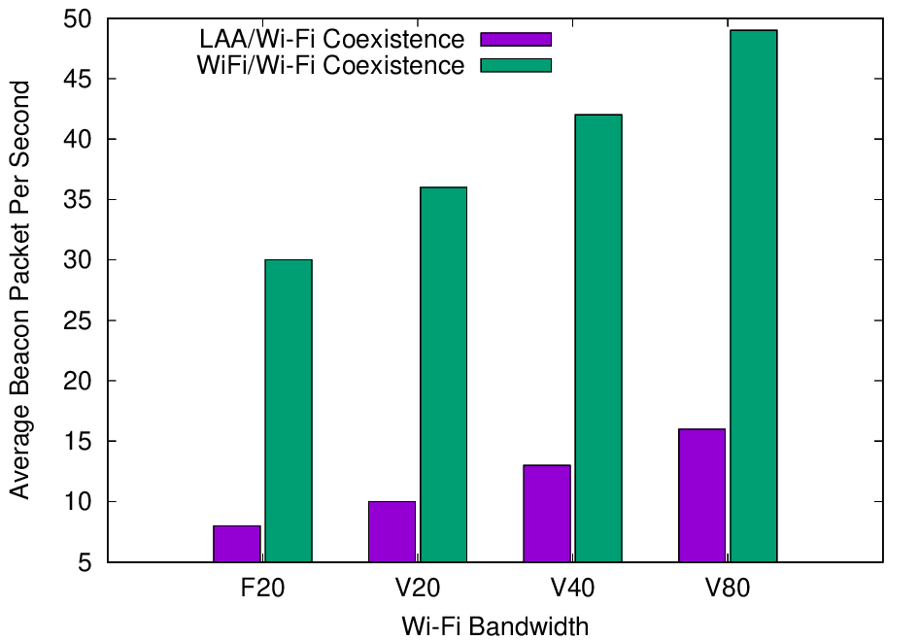
Experiments with deployed systems show LAA has a significant impact on Wi-Fi Beacon success
Refined from
Mar 2021
  The Uni of Chicago study investigated the effect of LAA on Wi-Fi operation in various typical configurations, including hidden nodes
  The work showed that LAA
  caused significant interference
  to Wi-Fi Beacons in the tested
  configuration
    Probably because LAA is:
      Using ED @ -72 dBm
      Rather than PD @ - 82 dBm
    Also because LAA typically uses
    long TxOPs (~8 ms)
Addition of a single LAA system to five Wi-Fi systems causes successful Beacon rate to reduce by > 75%
Pushing Wi-Fi APs into the same channel also causes successful Beacon rate to reduce, but by less than LAA

Slide 29
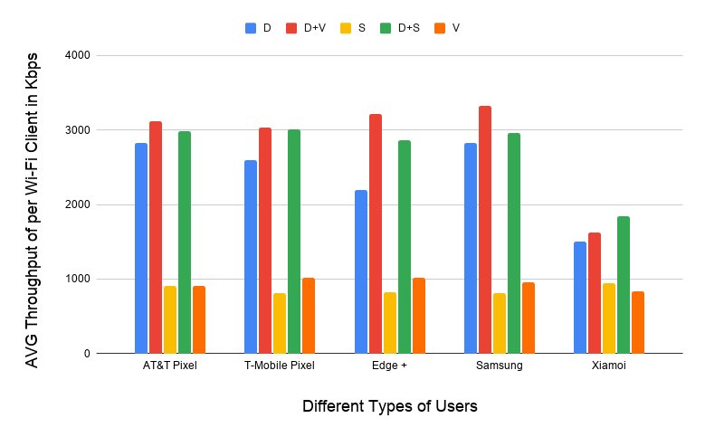
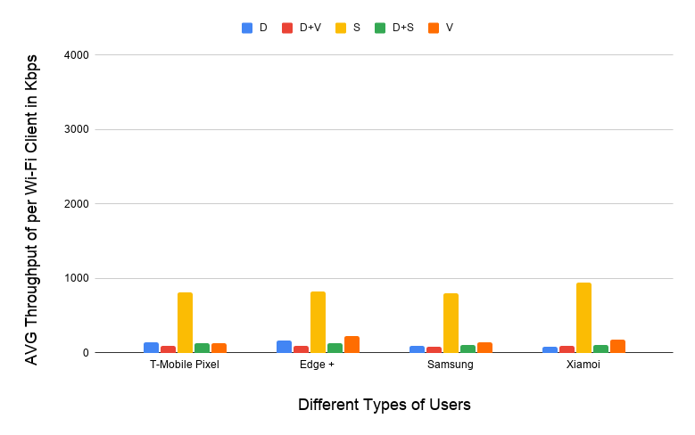
Experiments with deployed systems show LAA has a significant impact on Wi-Fi data success
Refined from
Mar 2021
  The work showed that LAA caused significant interference to data traffic in the tested configuration
    Probably because LAA is using ED @ -72 dBm rather than PD @ - 82 dBm
    Also because Wi-Fi’s hidden station mitigation mechanisms based on RTS/CTS have no effect on LAA
5 Wi-Fi APs on one channel, no LAA
5 Wi-Fi APs on one channel, one LAA
11-20-1973 slide 16
All client close
to Wi-Fi APs
Addition of LAA caused all Wi-Fi traffic to collapse …
… except streaming because LAA uses licensed for streaming

Slide 30
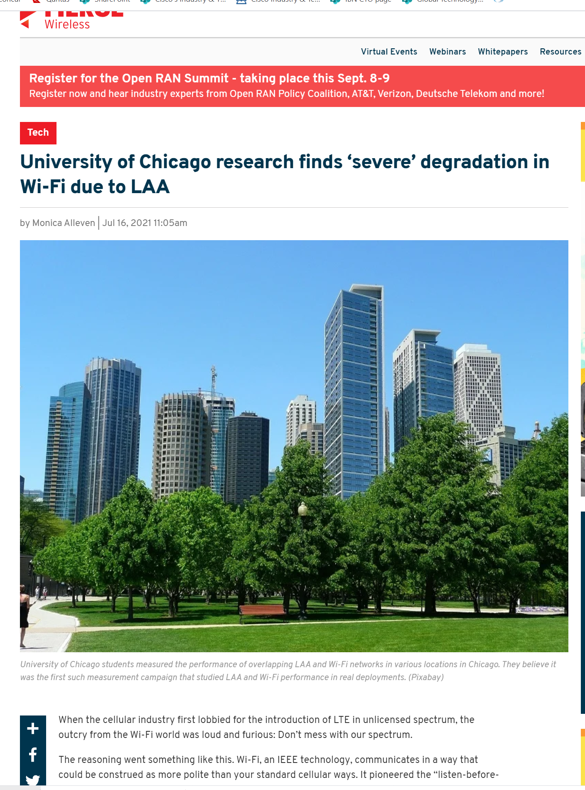
There has been some public reporting & discussion of the University of Chicago results
Refined from
Jul 2021
  The previous University of Chicago results were reported publicly here (7 Jul 2021)
  There was some subsequent commentary
  in “University of Chicago research finds ‘severe’
  degradation in Wi-Fi due to LAA” in FierceWireless
  (16 July 2021)
    The reported response from Qualcomm used the 3GPP
    simulations from some years ago to claim that after years
    of testing and evaluation, the wireless industry and FCC
    determined the use of LAA has “no adverse impact” on
    Wi-Fi performance (see article for full response)
    The reported response from the Wi-Fi Alliance stated
    they are ready to engage constructively with industry
    stakeholders to ensure that new technologies in
    unlicensed spectrum do not disadvantage Wi-Fi
    operation

Slide 31
There seems to be a growing acceptance that LAA/NR-U will not share well with Wi-Fi ☹
  During the recent discussions in ETSI BRAN related to NB FH coexistence with wideband systems, the following argument was put forward (by a company mainly focused on 3GPP technologies)
    Wi-Fi & LAA/NR-U do not coexist very well in some scenarios, particularly pointing out hidden station scenarios
    If it is acceptable for LAA/NR-U to reduce Wi-Fi performance in these sharing scenarios then it is also acceptable for NB FH to also reduce Wi-Fi performance in some scenarios
  The issue of Wi-Fi/NB FH coexistence will be discussed later in the agenda …
  … but the scary point here is an apparent acceptance that LAA/NR-U do not share well with Wi-Fi, and that is OK!
    This is caused by the use of ED as the only inter-technology coexistence mechanism, without the benefit of a hidden station coexistence mitigation mechanism like RTS/CTS used by Wi-Fi

Slide 32
The Uni of Chicago is planning to undertake further measurements (& simulations)
Updated from
Jul 2021
  Monisha Ghosh (University of Chicago) has notified the Chair that they are continuing their Wi-Fi/LAA coexistence work and are expecting to be ready to report further results to the Coex SC in November 2021
  The abstract of the planned report is Coexistence of multiple LAA and Wi-Fi networks in 5 GHz
    Our measurement campaign in the Chicago area revealed multiple areas where two operators have deployed LAA on the same channels in close proximity to each other. In order to study the coexistence behavior in such scenarios, we present new measurement results on Wi-Fi/LAA coexistence, using newer, more capable, enterprise access points, deployed LAA and a National Instrument SDR based LAA to study coexistence performance between Wi-Fi and two LAA deployments.

Slide 33
  Agenda items
  ETSI BRAN issues

Slide 34
Note that ESTI BRAN documents are available to IEEE 802.11 WG members
  Today’s material references many ETSI BRAN documents
  They are (or should be) available in the IEEE 802.11 WG members area
    See http://www.ieee802.org/11/private/ETSI_documents/BRAN

Slide 35
  Agenda items
  ETSI BRAN 5 GHz

Slide 36
The stable draft of EN 301 893 (5 GHz) includes the adaptivity compromise & associated testing
Document status before BRAN#111 (Sept/Oct 2021)
  Draft EN 301 893 v.2.1.44 (stable draft) – as 20 Sep 2021
Discussion before BRAN#111
  EN 301 893 v2.1.44 was published after BRAN#110, including
    Variety of editorial issues & other issues with less relevance to coexistence
    Compromise for adaptivity (and associated testing), as agreed at BRAN#109
      The adaptivity requirements most relevant to Wi-Fi equipment are the requirements in clause 4.2.7.3.2 (Load Based Equipment (LBE))
        … and sub-clauses
        … particularly 4.2.7.3.2.5 (Energy Detection Threshold (EDT) level)
      The associated testing procedures most relevant to Wi-Fi equipment are the procedures in clause 5.4.9.3.2 (Conducted measurements)
        … and sub-clauses
  Further work has occurred to refine EN 301 893 v2.1.44
    See BRAN(21)111013 - Rapporteur's copy of EN 301 893

Slide 37
The EN 301 893 journey has been long & interesting, achieving good sharing but with future risks for 802.11be
From
Jul 2021
V1.8.1
Standard
Mar 2015
802.11a/n/ac conformant devices use access mechanisms in 802.11 standard
Other devices followed weird rules with little connection to anything
Very 802.11 focused …
… as only game in town
… but not clear there is good sharing between Wi-Fi/LAA/…
V2.1.1
Standard
May 2017
EDCA based adaptivity
  802.11a/n/ac conformant devices use EDT at -62 dBm
  Other devices use EDT @ -72 dB (scaled)
Enabled good sharing, using LBT with exponential backoff …
… but a compromise, with different thresholds for Wi-Fi & LAA/NR-U
V2.1.8
Stable draft
Sep 2018
EDCA based adaptivity
  Any devices using 802.11 defined PD may use EDT at -62 dBm
  Otherwise use EDT @ -72 dB (scaled)
Enabled any technology to use either of the two options
Assisted placement of 802.11ax on market today
V2.1.44
Stable draft
Jun 2021
EDCA based adaptivity
  802.11a/n/ac/ax conformant devices use EDT at -62 dBm
  Other devices use EDT @ -72 dB (scaled)
Required compromise to make progress
Allows traditional Wi-Fi operation …
… but forces 802.11be to use ED-only
@ -72 dBm, with potential issues

Slide 38
The EN 301 893 journey will continue, with multiple options for consideration by the Coex SC
Refined from
Jul 2021
The future?
Option 1: status quo based on v.2.1.44
Option 2: ED-only
@ -62 dBm
Option 3: ED-only
@ -72 dB (scaled)
Option 4: Something else
Likely to be acceptable for next 2-3 years for reasonable coex between 802.11a/n/ac/ax & LAA/NR-U
Coex SC will need to evaluate coex between 802.11ax & 802.11be
Very simple and flexible
Aligned with US
Coex SC will need to evaluate:
  Effect on reuse vs interference
  Whether 802.11 should use PD/ED @ -82/-62 dBm or ED-only @ -62 dBm when coexisting with LAA/NR-U
Attractive in that it would establish similar rules in both 5 GHz & 6 GHz
Coex SC will need to evaluate:
  Impact on legacy
  Whether 802.11 should use PD/ED @ -82/-72 dBm or ED-only @ -72 dBm when coexisting with LAA/NR-U
What?
  Focus 802.11be on 6 GHz operation
  Operate 802.11be in 802.11ax mode if coexisting with 802.11ax
  Change rules in ETSI BRAN to allow 802.11be to use the same rules as 802.11a/n/ac/ax
How significant is this problem? Do we need to solve it? How?

Slide 39
The Coex SC has started a process of evaluating the optimum path for 5 GHz (& 6 GHz) coexistence
Refined from
Jul 2021
  In May 2021, two submissions started the discussions about the optimum future path for coexistence in 5 GHz …
    11-21-0705-00
      Simulation and Evaluation of the Impact of Varying ED Thresholds
      Gaurav Patwardhan (HPE), Eldad Perahia (HPE), Stuart Strickland (HPE)
      Uniform use of EDT @ -72 dBm likely to have a positive impact on sharing
      EDT @ -72 dBm in 5 GHz will sometimes disadvantage 802.11be compared to legacy using EDT @ -62 dBm, with some mitigation from RTS/CTS
      Specification work is required in both TGme (for 802.11ax) and TGbe
    11-21-0851-00 (Word document)
      5 GHz ED Analysis
      Menzo Wentink (Qualcomm)
      EDT @ -72 dBm in 5 GHz will sometimes disadvantage 802.11be compared to legacy
      Use of EDT @ -72 dBm limits spectral reuse
      EDT of -62 dBm may be a better long-term approach
  … with no clear or agreed next steps (yet!)

Slide 40
The Coex SC has started a process of evaluating the optimum path for 5 GHz (& 6 GHz) coexistence
  In July 2021, Stuart Strickland (HPE) presented a discussion on possible next steps in relation to 5 GHz coexistence, especially in relation to the use of 802.11be
    11-21-1179-00
      Similar submission to 11-21-0705-00 in May 2021
      Focused on coexistence between legacy 802.11 using EDT of -62 dB & 802.11be using EDT of -72 dBm
      Concluded that ~10% of 802.11be traffic may suffer a disadvantage, compared to legacy traffic
      Noted that in managed networks a common EDT of -72 dBm may benefit both 802.11be & legacy equipment
      However, highlighted that the simulations used to draw these conclusion are relatively simple … and more work is required

Slide 41
The Coex SC has started a process of evaluating the optimum path for 5 GHz (& 6 GHz) coexistence
  As of Sept 2021, it appears others are undertaking additional work to understand the impact of restricting 802.11be (under ETSI BRAN rules in Europe) to EDT of -72 dBm
    The Chair is aware of at least one study underway that suggests 802.11be is severely disadvantaged in some 802.11ax/be 5 GHz sharing scenarios
    The people undertaking the work were planning present to the Coex SC in Sep 2021 but have now decided to delay until Nov 2021 …
    … to give them more time to understand their results and possible next steps
  More submissions are welcome!

Slide 42
There is clearly work to be done before we come to a conclusion on how to handle 802.11be in 5 GHz
Possible questions for Coex SC/TGbe
  Is there a problem?
    Probably … at least sometimes!
  What should we do about it?
    Which of the three options (and any sub-options) should be chosen as an alternative to status quo where 802.11be access is different from 802.11ax access?
  How should be handle the uncertainty while we decide what to do?
    Keep the standard flexible, especially in terms of EDT’s & PDT’s
    Keep implementations flexible, so that can handle changing rules and different rules in different countries

Slide 43
  Agenda items
  ETSI BRAN 6 GHz issues

Slide 44
A stable draft of EN 303 687 includes the 6 GHz compromise for ED-only @ -72 dBm, but not NB FH
Document status before BRAN#111
  Draft EN 303 687 v0.0.13 (stable draft) – as of 7 Sep 2021
Discussion before BRAN#111
  All agreements are included in EN 303 687 v0.0.13, including:
    ED-only at -72 dBm (reflecting previously discussed compromise)
    Variety of editorial issues & issues with less relevance to coexistence
  The primary topic not included in EN 303 687 v0.0.13 is NB FH access
    Previous topics of contention (synchronous access, wideband access & LBT mechanisms) were not discussed at BRAN#110 … and have not been mentioned since

Slide 45
  Coex SC
  ETSI BRAN 6 GHz issues
  NB FH update

Slide 46
Many believe NB FH systems represent a potential threat to coexistence in the 6 GHz band in Europe
Refined from
Jul 2021
  In Nov 2020, the Coex SC were made aware of two PSD limits being discussed for VLP devices in Europe:
    Default: 1 dBm/MHz
    Narrowband (NB) devices: 10 dBm/MHz with FH across at least 15 hops, with NB defined as a BW of less than 20 MHz
  Many in the Wi-Fi/NR-U/LAA industries were concerned that these NB FH systems could have an adverse affect on Wi-Fi/NR-U/LAA systems
    ie, they will randomly “stomp” on Wi-Fi (and LAA/NR-U) systems without LBT leading to poor coexistence ☹
    The concern was exacerbated by the proponents of NB FH pushing the proposal through the regulator process in Europe without the knowledge or involvement of Wideband/Broadband stakeholders

Slide 47
The ECC decision that allows NB FH requires ETSI BRAN to agree on a spectrum sharing mechanism
From
Jul 2021
Table 2: Very Low Power (VLP) WAS/RLAN devices
(extract from ECC Decision (20)01)
Permissible operation | Indoors and outdoors
Category of device | The VLP device is a portable device
Frequency band | 5945-6425 MHz
Channel access and occupation rules | An adequate spectrum sharing mechanism shall be implemented.
Maximum mean e.i.r.p. for in-band emissions (note 1) | 14 dBm
Maximum mean e.i.r.p. density for in-band emissions (note 1) | 1 dBm/MHz
Narrowband usage maximum mean e.i.r.p. density for in-band emissions (note 1) (note 2) | 10 dBm/MHz
Note 2: Narrowband (NB) devices are devices that operate in channels bandwidths below 20 MHz. Narrowband devices also require a frequency hopping mechanism based on at least 15 hop channels to operate at a PSD value above 1 dBm/MHz.
Requires an ETSI BRAN defined spectrum sharing mechanism …
… without defining adequate spectrum sharing
Allows NB FH at 10 dBm/MHz

Slide 48
In May 2021, the Coex SC heard about the NB FH in 6 GHz issue … with no conclusions
Refined from
Jul 2021
  The IEEE 802.11 WG has an interest in how NB FH is specified by
  EN 303 687 for 6 GHz because it may have a significant impact on Wi-Fi operation in at least some circumstances
  Several WG members interested in the coexistence issues between
  Wi-Fi & NB FH in 6 GHz provided contributions in May 2021:
    11-21-0814-00 – ETSI 6GHz Narrow Band Status - Stuart Thomas (Apple)
    11-21-0832-00 – Narrowband in 6 GHz - Menzo Wentink (Qualcomm)
  There were no conclusions or decisions from the Coex SC at the time …

Slide 49
In June 2021, at BRAN#1110 there was lots of discussion about NB FH … with no consensus
From
Jul 2021
Submissions to BRAN#110 (Jun 2021)
  BRAN(21)110019 (Apple) - EN 303 687 NB Inputs
  BRAN(21)110045 (Qualcomm) - NB coexistence in 6 GHz – eDAA
  BRAN(21)110046 & BRAN(21)110047 (Facebook & HPE) - Proposal to approve EN 303 687 stable draft
Summary of presentations at BRAN#110
  Apple proposed the use of Adaptive Frequency Hopping using non-LBT based Enhanced-DAA (eDAA)
  Qualcomm asserted that eDAA causes latency issues with Wi-Fi and is inadequate for NB vs NB sharing too
    With very high latency spikes & unstable throughput
  Facebook suggested that the NB FH issue be delayed until a future WI

Slide 50
In July 2021, the Coex SC heard about issues with eDAA … but came to no conclusions
Refined from
Jul 2021
  In July 2021, Menzo Wentink (Qualcomm) provided a summary of his latest eDAA simulations & findings
    See 11-21-1191-00 - NB Coexistence in 6 GHz – eDAA
    eDAA has been proposed by Apple in ETSI BRAN as a mechanism to enable adequate spectrum sharing
    Menzo’s conclusions in relation to eDAA were:
      NB with eDAA may cause latency issues at Wi-Fi
      eDAA also appears inadequate for NB/NB sharing
      LBT shows no issues for either Wi-Fi/NB or NB/NB coexistence
      The eDAA coexistence issues pointed out in this analysis should make it unlikely that a notified body can certify 'no-LBT' NB equipment
  There were no conclusions or decisions from the Coex SC at the time …

Slide 51
In Sept 2021, BRAN#110d underlined fundamental disagreements about eDAA spectrum sharing
Submissions
  BRAN(21)110a003 (Apple) - Spectrum sharing comparisons
  BRAN(21)110d003r1 (Qualcomm) - Response to BRAN(21)110a003
  BRAN(21)110d009 (Apple) - Inaccuracies in BRAN(21)110d003r1
  BRAN(21)110d006 (Ericsson) - Co-existence considerations for 6GHz channel access
Summary
  Lots of claims & counter claims, but still little agreement
    One side claims eDAA provides adequate spectrum sharing, is the only way to enable <10 ms latency, & causes no more problem to Wi-Fi than Wi-Fi or NR-U
    Other side claims eDAA cannot share with Wi-Fi, particularly in terms of latency, and eDAA can’t even share with eDAA
    Both sides questioned the other side’s sims & analysis

Slide 52
The issues in BRAN#110d were derived from a lack of an agreed definition of adequate spectrum sharing
Commentary (by Andrew Myles)
  It took years to find a sharing compromise between Wi-Fi & LAA/NR-U, technologies that were similar in terms of access
  Unsurprisingly, it is proving difficult to find a solution quickly for sharing between two technologies (NB FH vs Wi-Fi/NR-U) that are very different
  It is interesting that the NB FH promoters are using poor sharing between Wi-Fi & LAA/NR-U in hidden node scenarios as justification for poor sharing between NB FH & Wi-Fi – are we sliding down a slippery slope?
  The fundamental issue is that there is no common understanding of what adequate spectrum sharing means
    It is claimed it means equal access …
    … but equality is often in the eyes of the beholder
      … eg is latency or throughput more important?
      …eg is NB latency more important than Wi-Fi latency?

Slide 53
In Sept 2021, BRAN#110e focused on both process & technical NB FH aspects … again without consensus
Submissions
  BRAN(21)110d004 (Rapporteur/Broadcom) - Proposal for way forward for NB in EN 303 687
  BRAN(21)110d007 (Ericsson) - Next Step for Narrowband in 6 GHz
  BRAN(21)110d005 (Apple) - Equal Treatment of Narrow Band
  BRAN(21)110e004 (Ericsson) - LBT and MU for Narrowband Frequency Hopping
  BRAN(21)110d008 (Apple) - Way forward for Narrow-band in 6GHz
  BRAN(21)110e003 (Ericsson) - Relevance of EN 300 328

Slide 54
BRAN#110e did not come to any agreement about NB FH on various process related issues
Summary of process issues
  BRAN#110e discussed various procedural options, including:
    Include NB FH in EN 303 687 now, even if that means delay for 6 GHz
    Include NB FH in EN 303 687 as proposed, and refine in next version
    Include NB FH in next version of EN 303 687, which will mean delay for NB FH
    Develop NB FH in a parallel WI
  There was no agreement after intense discussion about:
    What is (not) allowed by rules?
      eg parallel WI’s, noting 60 GHz precedent
      eg could EN 303 687 even be a stable draft before regulations were published?
    What was (not) intended by regulators?
      eg Should Wi-Fi/NR-U have priority over NB FH, or equal treatment?
    Can Notified Bodies be informed about disagreements related to adequate sharing for NB FH?
      This is important if NB FH is not included in a Harmonised Standard soon
    …

Slide 55
There is an ongoing debate within ETSI BRAN about the urgency of including NB FH in EN 303 687
From
Jul 2021
A case has been made in ETSI BRAN that EN 303 687 should include NB FH requirements ASAP…
… with a counter case that the inclusion of NB FH requirements can wait for proper evaluations to complete
The concern is that ECC Decision (20)01 means Notified Bodies might approve product placements without the constraints of a Harmonised Standards
See BRAN (21)109e004r1 (Ericsson)
It is asserted the risk of Notified Bodies approving NB FH products is low given the issues highlighted already in ETSI BRAN
See BRAN(21)110045 (Qualcomm)
The answer?
Given the public debate on the question of whether (or not) NB FH uses an adequate spectrum sharing mechanism …
… it seems less likely that a Notified Body would authorise NB FH products at this time without strong evidence of adequate spectrum sharing
… but who knows?

Slide 56
BRAN#110e did not come to any agreement on issues related to adoption of EN 300 328 techniques
Summary of EN 300 328 related issues
  In BRAN#110e, some (re)asserted that sharing techniques from
  EN 300 328 (2.4 GHz) provide:
    Adequate sharing for 6 GHz as is …
    … but refinements are possible to make sharing even better in 6 GHz
  Others disagreed (again), noting 2.4 GHz is a different band to 6 GHz, and that EN 300 328 does not even provide good sharing in 2.4 GHz
    Different goals
    Different size of band
    Different channel plan
  The bottom line in relation to NB FH sharing is:
    Some want it to be based on (a refinement of) EN 300 328 … ASAP
    Others want it to be based on LBT … after a full technical discussion

Slide 57
The next steps to a resolution of the NB FH 6 GHz questions are unclear
  It is well understood in ETSI BRAN that EN 303 687 needs to enable NB FH in 6 GHz in some form … eventually
    Because ECC Decision (20)01 allows it
  However, the lack of consensus at BRAN#110 and in subsequent ETSI BRAN teleconferences (BRAN#110d & BRAN#110e) means, for NB FH in EN 303 687, the:
    Form of sharing is unknown
    Timing of sharing determination is uncertain

Slide 58
Coexistence between Wi-Fi and NB FH is important
Why is any of this important?
  If NB FH unreasonably interferes with 802.11 then Wi-Fi will not perform in Europe at a level that we expect
  The European rules are often adopted by other countries and so the coexistence issues will propagate

Slide 59
The Coex SC may hear technical summaries of issues related to NB FH sharing with Wi-Fi
  The Chair has invited proponents from both sides of the NB FH discussion to summarise the technical issues from their perspective
    11-21-1550-00 - Narrowband coexistence issues with enhanced DAA in 6 GHz
      Menzo Wentink (Qualcomm), Stuart Strickland (HPE), Michael Tseytlin (Facebook), Xinrong Wang (Intel), Scott Blue (Microsoft)
    11-21-xxxx-00 - Title
      Stuart Thomas (Apple)

Slide 60
  Coex SC
  ETSI BRAN 6 GHz issues
  Specification challenges

Slide 61
Coex SC/Tgbe needs to decide how to specify 802.11ax/be in context of 6 GHz rules in Europe
  In EN 303 687, the EDT is -72 dBm (scaled) for 802.11ax and 802.11be
  This is different to traditional 802.11 that uses an ED of -62 dBm
  The Coex SC/TGbe need to decide how to handle this difference
    Use PD/ED @ -82/-72 dBm
    Use ED-only @ -72 dBm (like NR-U)
    Something else
  The decision could be:
    Reflected in the standard
    Handled outside the standard
  This issue is recorded as a tbd – submissions requested

Slide 62
  Coex SC
  Future ETSI BRAN meetings

Slide 63
ETSI BRAN will now meet virtually for the rest of 2021
Schedule for 2021
  BRAN #111
    27 Sep 2021 – 1 Oct 2021
    (next week!)
    Virtual
  BRAN #112
    13 Dec 2021 – 17 Dec 2021
    Virtual
A variety of additional ad hoc’s are also likely to be scheduled

Slide 64
ETSI BRAN has tentatively agreed its 2022 schedule based on F2F meetings
Meeting schedule for 2022
  BRAN #113
    4 Feb 2022 – 14 Feb 2022
    Sophia-Antipolis, France
  BRAN #114
    3 Jun 2022 - 10 Jun 2022
    Sophia-Antipolis, France
  BRAN #115
    29 Aug 2022 until 2 Sep 2022; OR
    5 Sep 2022 until 9 Sep 2022
  BRAN #116
    17 Oct 2022 until 21 Oct 2022
  BRAN #117
    5 Dec 2022 until 9 Dec 2022
A variety of additional ad hoc’s are also likely to be scheduled

Slide 65
  Agenda items
  MulteFire in 5 GHz

Slide 66
Nokia has announced that MulteFire will soon operate in the 5 GHz band …
From
Jul 2021
  At the end of June 2021, Nokia announced the availability of a MulteFire solution operating in 4.9 GHz band
  An associated blog from Nokia suggested that MulteFire will also operate in the 5 GHz band …
    MulteFire now makes it possible to quickly set up and tear down a private LTE/4G network anywhere that Wi-Fi is allowed in 5.x GHz spectrum
  … with Nokia also claiming that MulteFire is better than Wi-Fi:
    MulteFire latency & throughput are stable with an increasing numbers of users, whereas with Wi-Fi throughput quickly decreases to a few Mbps
    MulteFire has range of 700m whereas Wi-Fi range is less than 200m
    MulteFire supports mobility, including high-speed mobility, whereas Wi-Fi cannot maintain connectivity during handovers between access points
    MulteFire offers inherent 3GPP-defined security features that are suitable for mission-critical networks, implying Wi-Fi does not

Slide 67
… suggesting the Coex SC probably needs to understand/evaluate MulteFire/Wi-Fi coexistence
From
Jul 2021
  The Nokia blog mentions that MulteFire uses a 3GPP standards-based specification that would make LTE/4G compliant for use in 5 GHz unlicensed spectrum around the world, ensure coexistence with Wi-Fi, …
  The Nokia blog goes on to state that MulteFire uses an adaptive LBT mechanism for coexistence with Wi-Fi
    … an adaptive Listen Before Talk (LBT) procedure, which allows for transmission in the unlicensed spectrum for a known duration and opens channel access to ensure that MulteFire can coexist with neighboring Wi-Fi using the same channel
  This suggests some future questions of Coex SC consideration:
    Are MulteFire coexistence mechanisms the same as NR-U?
    If not, does MulteFire raise any additional coexistence issues?
  (Sep 2021): would anyone with knowledge of MulteFire coexistence mechanisms volunteer to lead a future discussion in the Coex SC?

Slide 68
  Agenda items
  6 GHz spectrum availability

Slide 69
Coexistence will become increasingly important as
6 GHz spectrum opens globally for unlicenced operation
Unchanged from July 2021
6425-7125 MHz in Region 1 is undecided
Costa Rica
Guatemala
Honduras
Taiwan
1200 MHz
1200 MHz Consultation
500 MHz
500 MHz Consultation
TBD (early in process)
Jordan Qatar Oman

Slide 70
The battle for 6 GHz continues globally …
Refined from July 2021
Good news in Europe
  The EC has formally released the lower 6 GHz band for unlicensed used by a formal announcement in the Official Journal of the European Union
    It is now binding for every EU member state to update their national frequency allocation plans before 1 Dec 2021
    Applies to VLP & LPI operation, without the standard power operation available in the US
Better news in Europe
  Is rumoured that the upper 6 GHz will soon be opened in Europe!
Bad news globally
  GSMA are aggressively advocating for at least the upper 6 GHz band to be made available for licenced operation only
    GSMA with Ericsson, Huawei, Nokia & ZTE have published a joint statement advocating for licensed operation in some/all of 6 GHz
  GSMA are also urging governments to do nothing with
  6 GHz until at WRC-23
    See Vision 2030, Insights for Mid-band Spectrum Needs – GSMA - July 2021

Slide 71
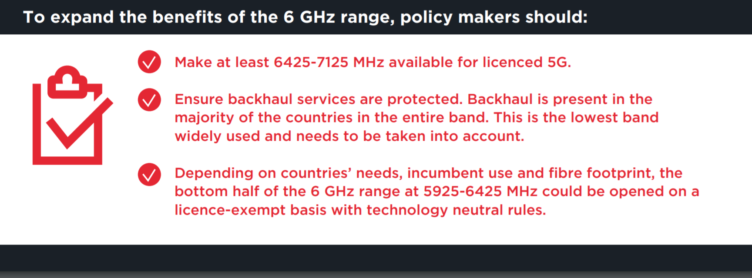
… with GSMA leading a campaign to reserve as much as 6 GHz as possible for licensed use
  From https://www.gsma.com/spectrum/wp-content/uploads/2021/05/6-GHz-Capacity-to-Power-Innovation.pdf
GSMA are after as much (“at least”) of the 6GHz band as possible for licensed use

Slide 72
  Coex SC
  3GPP RAN coex issues

Slide 73
The Coex SC may hear an update on coex issues out of 3GPP RAN in Nov 2021
  At the 3GPP RAN meeting last week, the following papers were submitted
    RP‑211823 - On Introduction of lower 6GHz NR unlicensed operation for Europe (Nokia, Nokia Shanghai Bell)
    RP‑211906 - Requirements for 6GHz NR-U band plan in Europe (BT, Telecom Italia, Telefonica, Vodafone, Deutsche Telekom, Orange, Telia, Telenor, Bouygues Telecom)
    RP‑212050 - On progress for WI on introduction of lower 6GHz NR unlicensed operation for Europe (Qualcomm)
    RP‑212125 - On the introduction of lower 6GHz NR unlicensed operation for Europe (Ericsson)
    RP‑212300 - Overview of the regulatory requirements for in- and out-of-band blocking in the 6GHz EU/CEPT band (Apple)
    RP‑212409 - Discussion on band plan for Europe unlicensed 6GHz (ZTE, Sanechips)

Slide 74
The Coex SC may hear an update on coex issues out of 3GPP RAN in Nov 2021
  The overall situation was (before the recent RAN meeting):
    One camp of companies support re-using existing 6 GHz band n96, because there are no obstacles for doing that (Option 1);
    Another camp of companies support adding a new 6 GHz band, because they believe/assume that upper frequency range will get IMT designation (Option 2)
  Progress was apparently made and an update on this topic is expected in Nov 2021
    Alexander Sayenko (Apple) has volunteered
  Does anyone have information today?

Slide 75
  Agenda items
  60 GHz coexistence

Slide 76
The Coex SC has previously discussed coexistence in 60 GHz
  At the Coex SC meeting in Mar 2021 a submission was presented that provided the status of 60 GHz work in ETSI BRAN
    See 11-21-0430-00 (Assaf Kasher (Qualcomm))
  In May 2021, the Coex SC heard about Coexistence between radars and communication systems in the 60 GHz band
    See 11-21-0796-00 (Alecsander Eitan (Qualcomm) et al)
  In July 2021,the Coex SC will heard about Coexistence between radars and communication systems in the 60GHz band – U.S. Update
    See 11-21-1089-00 (Alecsander Eitan (Qualcomm) et al)

Slide 77
The Coex SC will address 60 GHz coexistence issues in Nov 2021
  The e-mail asking Assaf Kasher (Qualcomm) and Alecsander Eitan (Qualcomm) for an update on 60 GHz was stuck in the Chair’s outbox ☹
  An update will be scheduled for Nov 2021 ☺
  Are there any quick updates today?

Slide 78
  Coex SC
  Plans for next meeting

Slide 79
The Coex SC will continue its normal business in November 2021
Possible agenda items
  Discuss coexistence measurement studies
    Uni of Chicago
  Review ETSI BRAN coex activities
    EN 301 893 (5 GHz)
      802.11be coex with 802.11ax in 5 GHz
    EN 303 687 (6 GHz)
      NB
  Review 60 GHz coex
    ETSI BRAN
    Regulatory aspects
  Review 3GPP related coexistence activities
Submissions are requested!

Slide 80
The IEEE 802.11 Coexistence SC virtual meeting in September 2021 is adjourned!

