Slide 1
MAC features impacted by RCM
Date: 2021-08-23
Authors:
Name | Affiliation | Address | Phone | Email
Chaoming Luo | OPPO |  |  | luochaoming@oppo.com
Lei Huang
Liuming Lu
Pei Zhou
Chaoming Luo (OPPO)

Slide 2
Introduction
As stated in the PAR, many references in IEEE Std 802.11 to MAC address were made at times where the assumption of a unique assocation between a STA and a MAC address was strong. There is a need to ensure that IEEE Std 802.11 provisions that refer to a STA MAC address remain valid when that MAC address is random or changes. [1]
This contribution recaps some features in IEEE Std 802.11 that identify a STA by its MAC address, and draws the group’s attention to solve the related issue when using random MAC address.

Slide 3
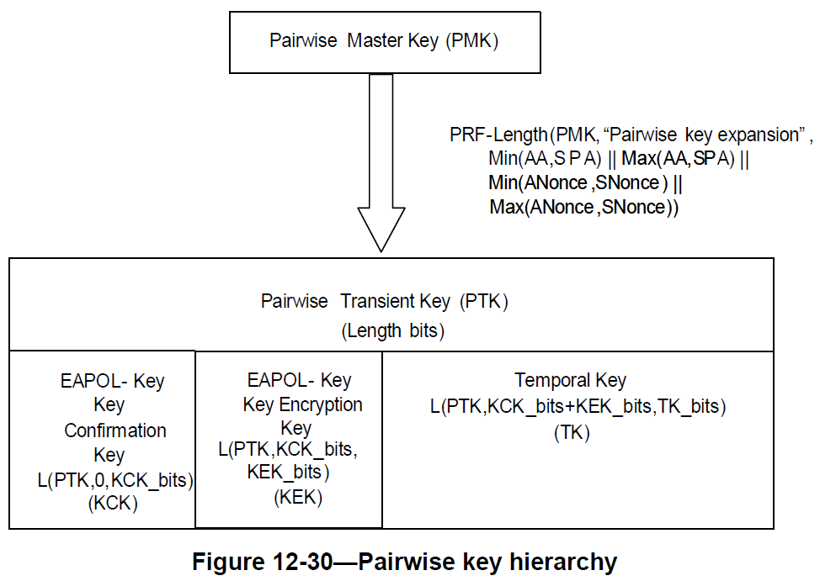
Recap - Pairwise key hierarchy
The Pairwise key hierarchy is using the non-AP STA’s MAC address. [2]
In infrastructure bss, typically:
Authenticator MAC address (AA) is AP’s MAC address
Supplicant’s MAC address (SPA) is non-AP STA’s MAC address

Slide 4
Recap – Clause 4.5.4.10 MAC privacy enhancements [2]
When a non-AP STA searches for, and connects to, an infrastructure BSS, IBSS, or PBSS or attempts to discover services on a network preassociation, it defines the addressing of its MAC layer for the particular connection. If the STA uses a fixed MAC address it is trivial to track the STA.
To mitigate this sort of traffic analysis a STA can support the ability to periodically and randomly change its MAC addresses and reset counters and seeds prior to association.

Slide 5
Recap – Clause 12.2.10 Requirements for support of MAC privacy enhancements [2]
The STA shall periodically change its MAC address to a random value while not associated to a BSS.
However, the non-AP STA shall not change its MAC address during a transactional exchange, for example, transmitting Public Action frames for preassociation discovery, or during the creation of state on an AP using preassociation capabilities, for example, RSN preauthentication or FT over-the-DS.
State created with an AP using a prior MAC address, for instance, RSN preauthentication state or FT state established over-the-DS, is bound to the MAC address used when that state was created. Prior to establishing an association to the AP, the non-AP STA shall change its MAC address to the MAC address used when the state was created.
The non-AP STA connecting to an infrastructure BSS shall retain a single MAC address for the duration of its connection across an ESS.
A PMKSA created as part of an RSNA will contain the MAC address used to create the PMKSA. The non-AP STA that supports PMKSA caching shall, if necessary, change its MAC address back to that value when attempting a subsequent association to the ESS using PMKSA caching.
Preassociation discovery (PAD): Discovery of services offered by a BSS or an external network reachable via that BSS. [Ref: Clause 4.5.9 Interworking with external networks]
Preauthentication allows a STA to perform RSNA authentication with an AP prior to attempting (re)association. This might reduce the time that the IEEE 802.1X port is not valid. [Ref: Clause 12.6.10.2 Preauthentication and RSNA key management]

Slide 6
Recap – Possible relevant use case
4.6 Grocery store frequent shopper notifications [3]
A very different use case from the grocery store foot traffic analysis, is a grocery store that wants to recognize and reward frequent shoppers. This is likely to be an “opt-in” service, where the shoppers that are interested in participating with the store indicate that they are willing to have the store know some identity that the store can use (possibly not their true or complete identity, however). For maximum effectiveness, such programs need to recognize when the customer enters (or approaches) the store, and provide information (such as daily specials for frequent shoppers) without any action on the user’s part. Additionally, the store could be able to build a profile of the user, and push content (with a cellular text, perhaps, since the customer may not be associated to the store’s network) such as items that of likely interest to the customer and are on sale/special, when the customer is near those items in the store.
If this scenario is limited to opt-in uses, and it can be assumed that the device will have been configured to associate to the grocery store infrastructure when in range, then the scenario can be handled with an “opt-in” method for providing a device or user identification that is hidden from third party snooping, and provided only to trusted infrastructure (for example, where RSN has been established).
Any broader solution (not explicitly “opt-in”, not secured from snooping, or not restricted to trusted infrastructure) is considered out of scope for 802.11bh.
This may be a scenario of idendify a non-AP STA when it using different MAC addresses for different associations.

Slide 7
SP 1
Do you agree that TGbh should consider a mechanism to assist the AP to identify an associated non-AP STA when the non-AP STA uses different MAC addresses for different associations. This identity is in MAC layer, and should be secure, and does not expose a privacy concern for the non-AP STA.
Chaoming Luo (OPPO)

Slide 8
Reference
[1] P802.11bh-par
[2] IEEE Std 802.11-2020
[3] 11-21-0332-13-00bh-issues-tracking
Chaoming Luo (OPPO)

