Slide 1
MAC features impacted by RCM
Date: 2021-08-17
Authors:
Name | Affiliation | Address | Phone | Email
Chaoming Luo | OPPO |  |  | luochaoming@oppo.com
Lei Huang
Liuming Lu
Pei Zhou
Chaoming Luo (OPPO)

Slide 2
Introduction
As stated in the PAR, many references in IEEE Std 802.11 to MAC address were made at times where the assumption of a unique assocation between a STA and a MAC address was strong. There is a need to ensure that IEEE Std 802.11 provisions that refer to a STA MAC address remain valid when that MAC address is random or changes. [1]
This contribution recaps some features in IEEE Std 802.11 that identify a STA by its MAC address, and draws the group’s attention to solve the related issue when using random MAC address.

Slide 3
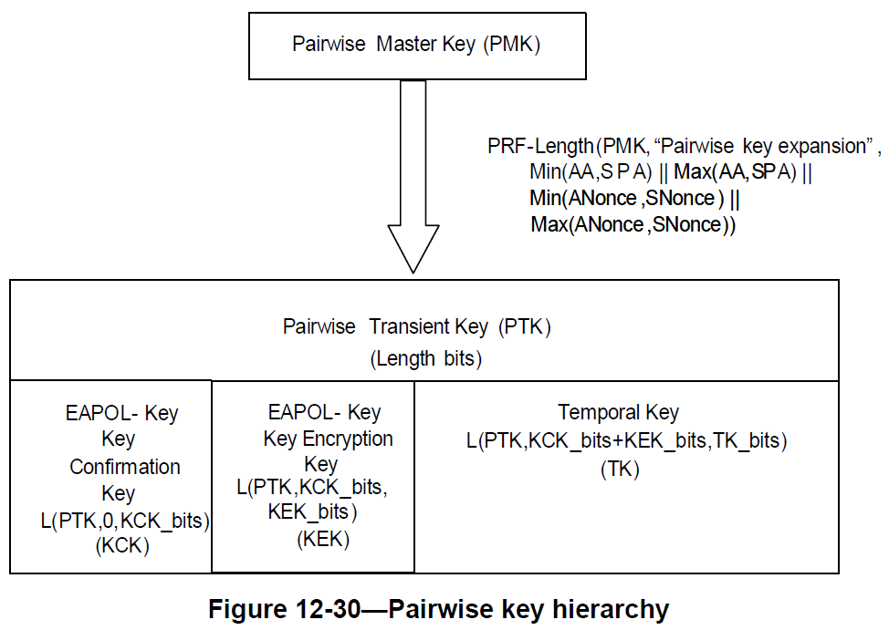
Recap - Pairwise key hierarchy
The Pairwise key hierarchy is using the non-AP STA’s MAC address. [2]
In infrastructure bss, typically:
Authenticator MAC address (AA) is AP’s MAC address
Supplicant’s MAC address (SPA) is non-AP STA’s MAC address

Slide 4
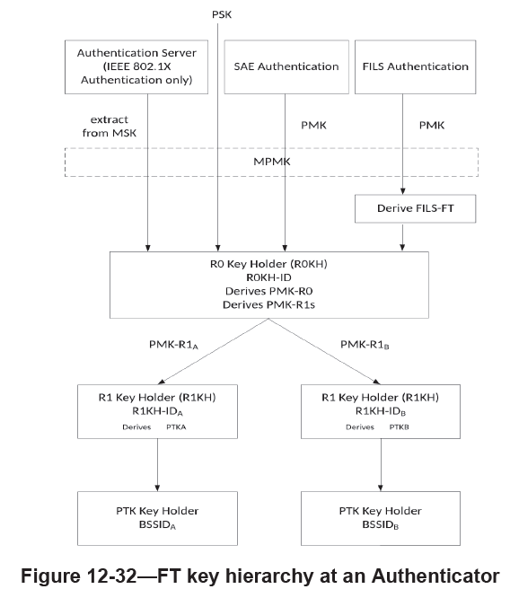
Recap – FT key hierarchy
The FT (fast BSS transition) key hierarchy is also using the non-AP STA’s MAC address. [2]
R0-Key-Data = KDF-Hash-Length(XXKey, “FT-R0”, SSIDlength || SSID || MDID || R0KHlength || R0KH-ID || S0KH-ID)
PMK-R0 = L(R0-Key-Data, 0, Q)
PMK-R0Name-Salt = L(R0-Key-Data, Q, 128)
Length = Q + 128
PMKR0Name = Truncate-128(Hash(“FT-R0N” || PMK-R0Name-Salt))
MDID: the Mobility Domain Identifier field from the Mobile Domain element (MDE) that was used during FT initial mobility domain association
R0KH-ID: the identifier of the holder of PMK-R0 in the Authenticator
S0KH-ID: the Supplicant’s MAC address (SPA)
PMKR0Name: used to identify the PMK-R0
Clause 4.5.3.4 Reassociation [2]:
Only the fast BSS transition facility can move an RSNA during reassociation. Therefore, if FT is not used, the old RSNA is deleted and a new RSNA is constructed.

Slide 5
Recap – Proxy ARP service
Again, Proxy ARP service is using the non-AP STA’s MAC address too.
Clause 4.3.19.13 Proxy ARP: The Proxy ARP service enables an AP to respond to ARP and Neighbor Discovery frames on behalf of associated non-AP STAs. Associated STAs do not receive ARP or IPv6 Neighbor Discovery frames. The Proxy ARP service enables associated STAs to remain in power save for longer periods of time. [2]
Clause 11.21.14 Proxy ARP service: When an AP receives an ARP request from one associated STA or from the DS with a target IP address that corresponds to a second associated STA, the AP shall insert the second STA MAC address as the Sender’s MAC Address in the ARP response packet. [2]
Clause 11.21.14 Proxy ARP service: When an IPv6 address is being resolved, the Proxy ARP service shall respond with a Neighbor Advertisement message (Section 4.4, IETF RFC 4861) on behalf of an associated STA to an Internet Control Message Protocol version 6 (ICMPv6) Neighbor Solicitation message (Section 4.3, IETF RFC 4861). When MAC address mappings change, the AP may send unsolicited Neighbor Advertisement Messages on behalf of a STA. [2]

Slide 6
Recap – Possible relevant use case
4.6 Grocery store frequent shopper notifications [3]
A very different use case from the grocery store foot traffic analysis, is a grocery store that wants to recognize and reward frequent shoppers. This is likely to be an “opt-in” service, where the shoppers that are interested in participating with the store indicate that they are willing to have the store know some identity that the store can use (possibly not their true or complete identity, however). For maximum effectiveness, such programs need to recognize when the customer enters (or approaches) the store, and provide information (such as daily specials for frequent shoppers) without any action on the user’s part. Additionally, the store could be able to build a profile of the user, and push content (with a cellular text, perhaps, since the customer may not be associated to the store’s network) such as items that of likely interest to the customer and are on sale/special, when the customer is near those items in the store.
If this scenario is limited to opt-in uses, and it can be assumed that the device will have been configured to associate to the grocery store infrastructure when in range, then the scenario can be handled with an “opt-in” method for providing a device or user identification that is hidden from third party snooping, and provided only to trusted infrastructure (for example, where RSN has been established).
Any broader solution (not explicitly “opt-in”, not secured from snooping, or not restricted to trusted infrastructure) is considered out of scope for 802.11bh.
This may be a scenario of re-associating.

Slide 7
Proposal
Issue: If AP cannot establish the mapping from the MAC address using for association to the ramdomized MAC address after association, the features mentioned could not work properly.
Proposal: We should consider a mechanism (e.g., signature method mentioned in 21/1083r0) to assist the AP to identify the non-AP STA when the STA uses a randomized MAC address or changes its MAC address.
note: “identify the non-AP STA” means “establish the mapping from the MAC address using for association to the ramdomized MAC address after association”.

Slide 8
SP 1
Do you agree that TGbh should consider a mechanism to assist the AP to identify the re-associating (with or w/o FT) non-AP STA when the non-AP STA uses a randomized MAC address or changes its MAC address, while not exposing any new user privacy concern.
Chaoming Luo (OPPO)

Slide 9
Reference
[1] P802.11bh-par
[2] IEEE Std 802.11-2020
[3] 11-21-0332-13-00bh-issues-tracking
Chaoming Luo (OPPO)

