Slide 1
MAC features impacted by RCM
Date: 2021-07-27
Authors:
Name | Affiliation | Address | Phone | Email
Chaoming Luo | OPPO |  |  | luochaoming@oppo.com
Lei Huang
Liuming Lu
Pei Zhou
Chaoming Luo (OPPO)

Slide 2
Introduction
As stated in the PAR, many references in IEEE Std 802.11 to MAC address were made at times where the assumption of a unique assocation between a STA and a MAC address was strong. There is a need to ensure that IEEE Std 802.11 provisions that refer to a STA MAC address remain valid when that MAC address is random or changes. [1]
This contribution recaps some features in IEEE Std 802.11 that identify a STA by its MAC address, and draws the group’s attention to solve the related issue when using random MAC address.

Slide 3
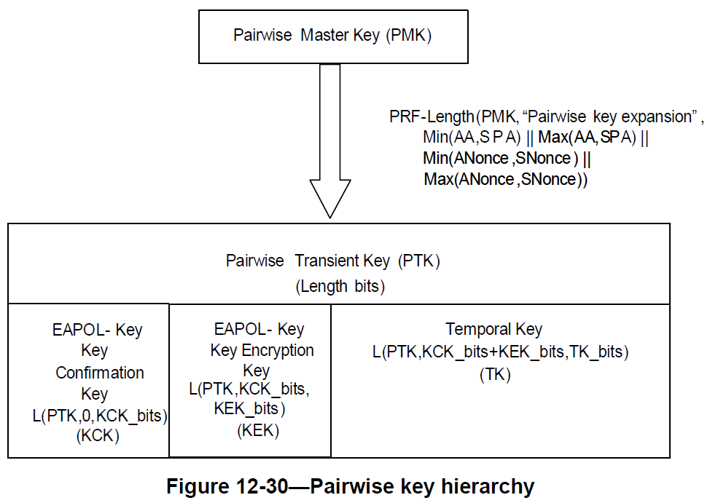
Recap - Pairwise key hierarchy
The Pairwise key hierarchy is using the non-AP STA’s MAC address. [2]
In infrastructure bss, typically:
Authenticator MAC address (AA) is AP’s MAC address
Supplicant’s MAC address (SPA) is non-AP STA’s MAC address

Slide 4
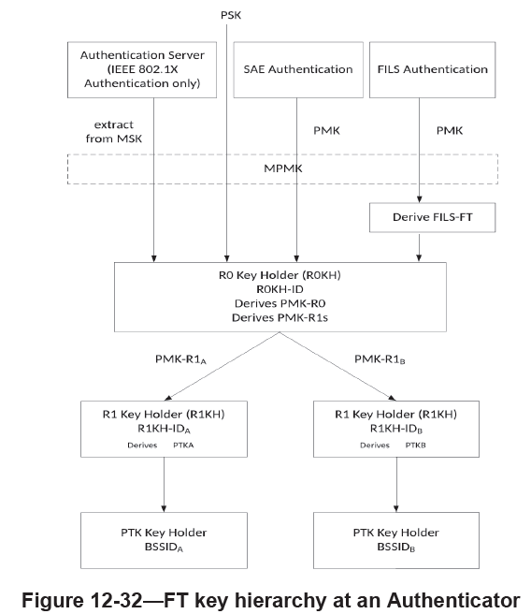
Recap – FT key hierarchy
The FT (fast BSS transition) key hierarchy is also using the non-AP STA’s MAC address. [2]
R0-Key-Data = KDF-Hash-Length(XXKey, “FT-R0”, SSIDlength || SSID || MDID || R0KHlength || R0KH-ID || S0KH-ID)
PMK-R0 = L(R0-Key-Data, 0, Q)
PMK-R0Name-Salt = L(R0-Key-Data, Q, 128)
Length = Q + 128
PMKR0Name = Truncate-128(Hash(“FT-R0N” || PMK-R0Name-Salt))
MDID: the Mobility Domain Identifier field from the Mobile Domain element (MDE) that was used during FT initial mobility domain association
R0KH-ID: the identifier of the holder of PMK-R0 in the Authenticator
S0KH-ID: the Supplicant’s MAC address (SPA)
PMKR0Name: used to identify the PMK-R0

Slide 5
Recap – FILS authentication
Similarly, when FILS (fast initial link setup) authentication is used, the pairwise keys are also derived by using the non-AP STA’s MAC address. [2]
FILS-Key-Data = PRF-X(PMK, “FILS PTK Derivation”, SPA || AA || SNonce || ANonce [ || DHss ])
ICK = L(FILS-Key-Data, 0, ICK_bits)
KEK = L(FILS-Key-Data, ICK_bits, KEK_bits)
TK = L(FILS-Key-Data, ICK_bits + KEK_bits, TK_bits)
FILS-FT = L(FILS-Key-Data, ICK_bits + KEK_bits + TK_bits, FILS-FT_bits)

Slide 6
Recap – Proxy ARP service
Again, Proxy ARP service is using the non-AP STA’s MAC address too.
Clause 4.3.19.13 Proxy ARP: The Proxy ARP service enables an AP to respond to ARP and Neighbor Discovery frames on behalf of associated non-AP STAs. Associated STAs do not receive ARP or IPv6 Neighbor Discovery frames. The Proxy ARP service enables associated STAs to remain in power save for longer periods of time. [2]
Clause 11.21.14 Proxy ARP service: When an AP receives an ARP request from one associated STA or from the DS with a target IP address that corresponds to a second associated STA, the AP shall insert the second STA MAC address as the Sender’s MAC Address in the ARP response packet. [2]
Clause 11.21.14 Proxy ARP service: When an IPv6 address is being resolved, the Proxy ARP service shall respond with a Neighbor Advertisement message (Section 4.4, IETF RFC 4861) on behalf of an associated STA to an Internet Control Message Protocol version 6 (ICMPv6) Neighbor Solicitation message (Section 4.3, IETF RFC 4861). When MAC address mappings change, the AP may send unsolicited Neighbor Advertisement Messages on behalf of a STA. [2]

Slide 7
Proposal
Issue: If AP cannot establish the mapping from the MAC address using for association to the ramdomized MAC address after association, the features mentioned could not work properly.
Proposal: We should consider a mechanism (e.g., signature method mentioned in 21/1083r0) to assist the AP to identify the non-AP STA when the STA uses a randomized MAC address or changes its MAC address.
note: “identify the non-AP STA” means “establish the mapping from the MAC address using for association to the ramdomized MAC address after association”.

Slide 8
SP 1
Do you agree that TGbh should consider a mechanism to assist the AP to identify the non-AP STA when the STA uses a randomized MAC address or changes its MAC address.
Chaoming Luo (OPPO)

Slide 9
Reference
[1] P802.11bh-par
[2] IEEE Std 802.11-2020
Chaoming Luo (OPPO)

