Slide 1
Data Driving Hybrid Channel Model for WLAN Sensing
Date: 2021-07-26
Authors:
 | Affiliation | Address | Phone | Name
Yi Lv | Huawei Technologies Co. Ltd | F3, Huawei Base, Shenzhen, China |  | lvyi6@huawei.com
Xiaohui Peng
Rui Du
Mengshi Hu
Hailiang Xie
Rui Wang | Southern University of Science and Technology
Shuai Wang
Zezhong Zhang
Guoliang Li

Slide 2
Outline
1. Abstract
2. Motivation
3. Approach
3.1 Overall flowchart
3.2 Details on target related channel modeling
3.3 Details on target unrelated channel modeling
3.4 Hybrid channel model
4. Evaluation
4.1 Quantitative
4.2 Qualitative
5. Conclusion and Future Work
6. References

Slide 3
1. Abstract
In [1][2], a general hybrid channel model was presented, including
Ray tracing and other possible approaches (e.g., measurement campaigns).
Take into account non-stationarity characteristics of the propagation channel arising from device-free moving target(s) in both sub 7GHz and 60GHz.
In [3][4], a hybrid channel model for WLAN sensing was presented as
Deterministic propagation channels due to reflections over macro-objects, which are generated with ray tracing methods.
Diffuse channels by introducing stochastic objects with a material library.
Temporal consistency is preserved by modelling the moving WLAN modes or targets in the software,.
May mismatch the real situations where unexpected interference exists.

Slide 4
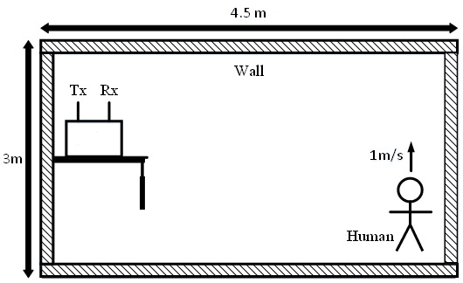
2. Abstract
In this contribution, the following points will be further discussed:
The necessity of adopting hybrid channel model for WLAN sensing.
Initial evaluation results for hybrid WLAN sensing channel models.
1. Apply the ray tracing method to model the target related channel.
Target related Channel
2. Apply the autoregressive statistical method to model the target unrelated channel.
3. Leverage real datasets to capture both the power of physics-based and learning-based modelling.
Scatters
Target unrelated Channel

Slide 5
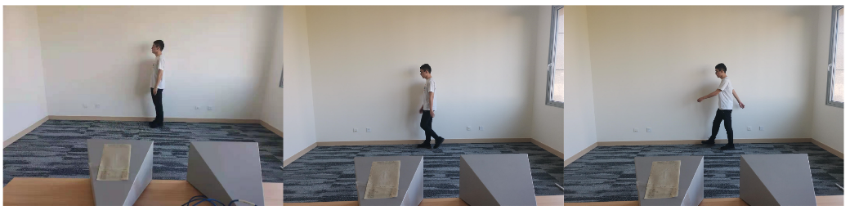
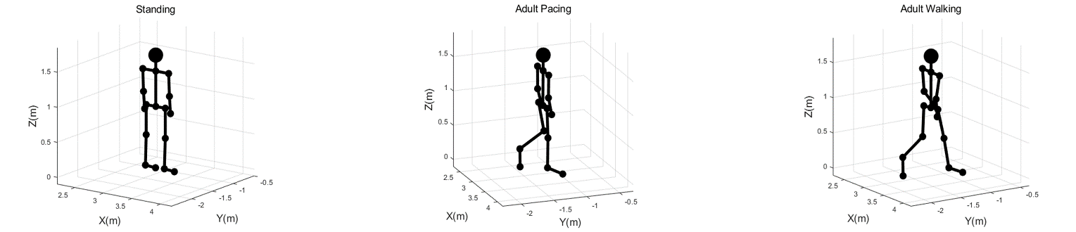
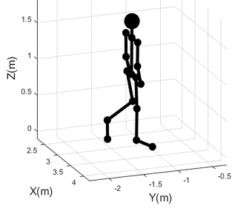
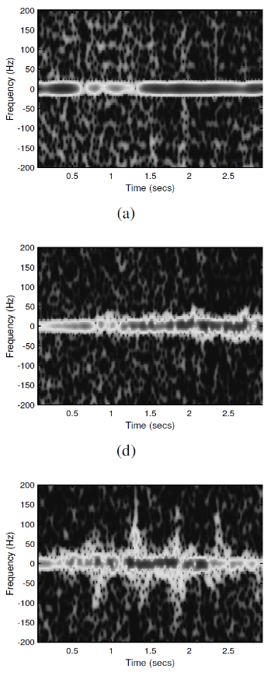
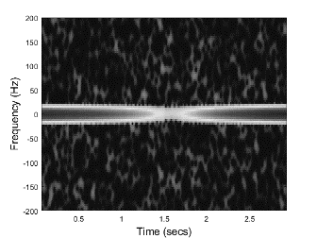
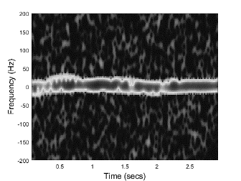
2. Motivation
Ray tracing method cannot represent the sensing uncertainty (due to higher order reflections among the wall and body parts, unpredictable movements of other objects, random perturbations of scatters; these reflections belong to target unrelated rays).
The real dataset and the simulated dataset (ray-tracing) are different, including:
Pattern spike: The middle pattern of real spectrogram images have spikes while the simulated ones are clean; (background noise comes from receiver, but the spike comes from channels)
Sensing performance: Machine learning achieves 100% accuracy on the simulated dataset but only 94.67% accuracy on the real dataset.
Pattern spikes
Smooth pattern
Real Dataset
Simulated Dataset

Slide 6
3. Approach (Why Hybrid?)
Why Hybrid: Hybrid channel models can support
  Sensing uncertainty: unpredictable object movement and perturbed scatters for target unrelated rays.
  Lower complexity compared with ray tracing as only rays from the target are computed.
Scenario considered:
Both AP (TX) and STA (RX) are fixed;
Fixed scatters in the environment exist;
A device-free target is moving;
Sub 7GHz；
Bandwidth ：40MHz；
Sampling rate：100MHz
r channel models covering, e.g.

Slide 7
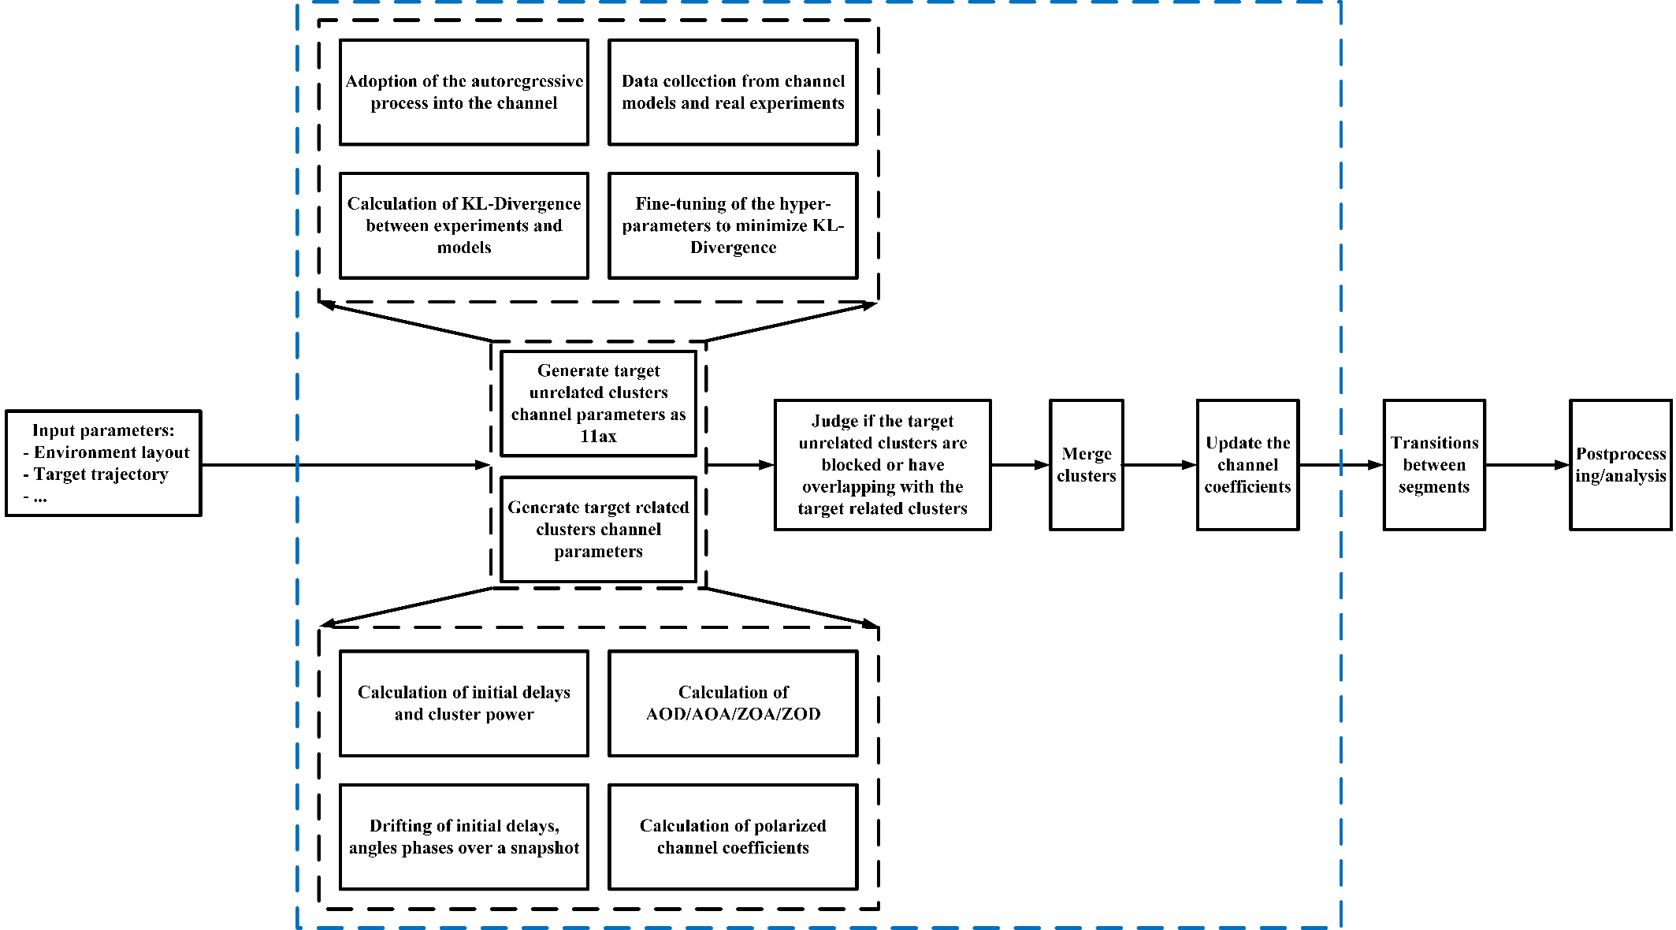
3. Approach (Overall)
(1) Target Unrelated:
Clusters reflected from fixed objects with perturbed scatters.
(2) Target Related:
Clusters reflected from the moving targets.

Slide 8
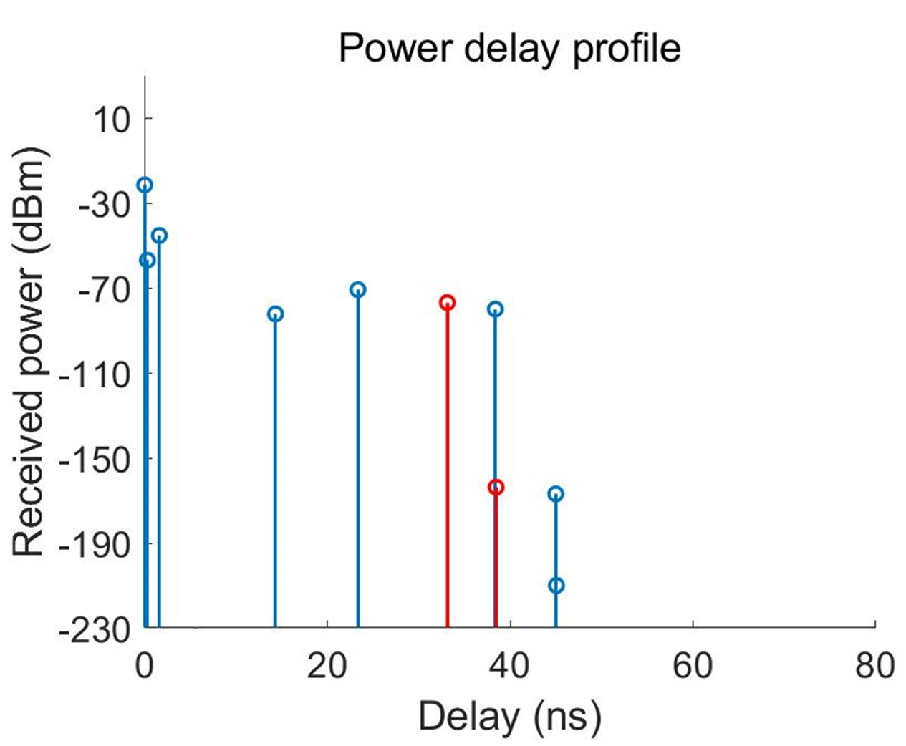
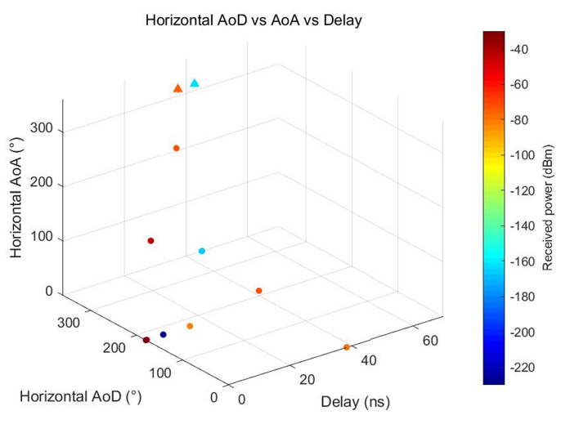
3. Approach (Details)
For the target related clusters, our approach is based on the ray-tracing approach [2].

Slide 9
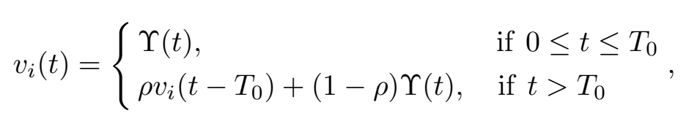
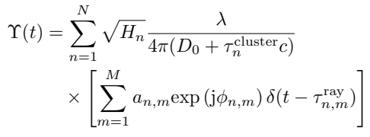
3. Approach (Details)
For the target unrelated clusters, our approach is based on the auto-regressive model [5] and 11ax channel model [6].
Auto-regressive model:
11ax channel model
Target unrelated channel
Changing weight
Hyper-parameter (1)
Channel of the
last moment
Coherent time
Hyper-parameter (2)
11ax channel model [3]:

Slide 10

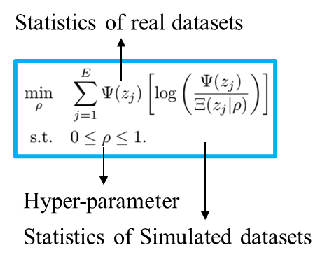
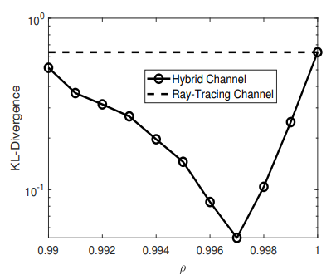
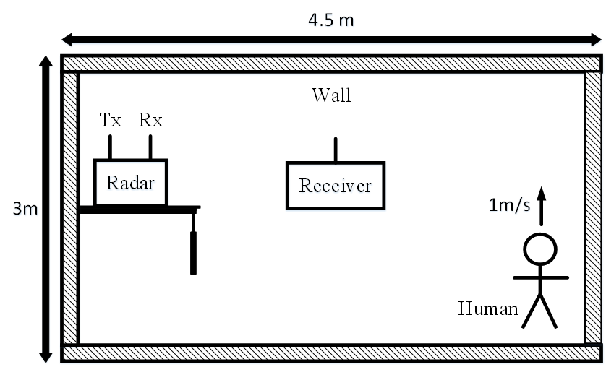


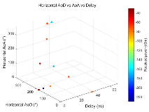

3. Approach (Details)
Data collection from real experiments
Calculation of KL-divergence between real and simulated data
Real
Channel
Fine-tuning the hyper-parameters to match the target domain
Autoregressive model and IEEE 802.11 model
Fine-tuning the hyper-parameters to minimize KL-Divergence
Target
Unrelated
Channel
When $0≤t≤T_{0}$
$$v_{i}\left(t\right)=Υ(t)$$
When $t>T_{0}$
$$v_{i}\left(t\right)=ρv_{i}\left(t−T_{0}\right)+(1−ρ)Υ(t)$$
Data generated from simulations
Ray Tracing
Target
Related
Channel
+
Output Channel

Slide 11
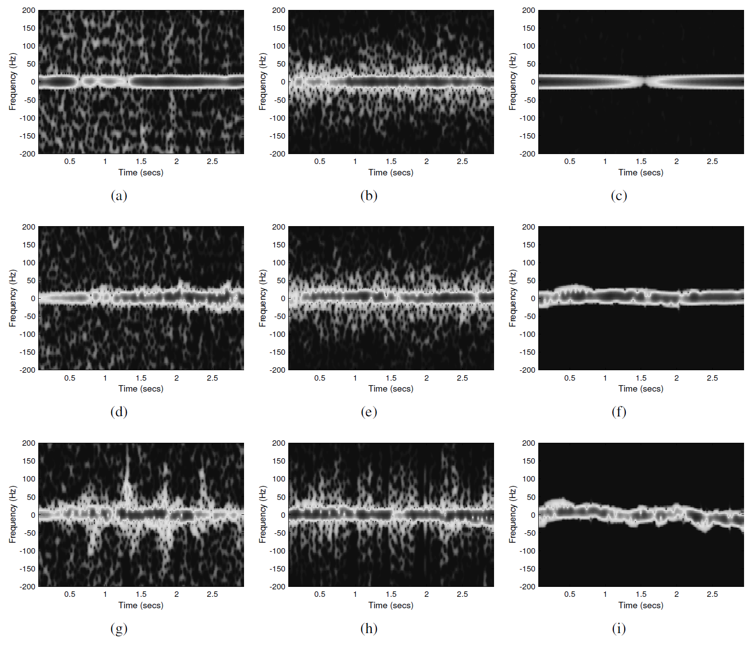
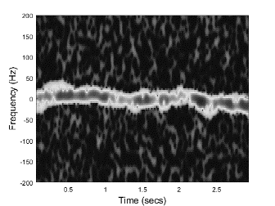
4. Model Evaluation (Qualitative)
The middle patterns of the experimental data and the simulated data based on the hybrid channel model are noisy.
However, the middle pattern of the simulated data based on ray-tracing is smooth.
Real Scenario
Virtual Scenario
Real Spectrogram
Hybrid Model
Ray Tracing
Pattern spikes
Smooth pattern

Slide 12
4. Model Evaluation (Quantitative)
In [7], Uber, MIT, and University of Toronto propose to use the metric, called detection agreement, to evaluate the LiDAR simulators.
This metric represents the gap between the testing performance on real-world datasets and that on simulation datasets [7].
We adopt sensing agreement as the benchmark metric to evaluate SENS channel models:
Performance gap between sensing in real-world and sensing in model-based simulation.

Slide 13
4. Model Evaluation (Quantitative)
The hybrid channel model achieves significantly higher sensing agreement than that of ray-tracing.
94.67%
96.67%
300 testing
samples
100%
Each epoch consists of 300 training samples
Gap 5.33%
Gap 2%

Slide 14
5. Conclusion
Conclusion
  In this slides, the necessity of hybrid channel modelling for sub 7 GHz is analysed.
  Initial thinking about
    1) how to model the sensing uncertainty,
    2) how to reduce the computation time,
    3) how to evaluate the channel models,
  for SENS are presented and discussed.
Future work
  Extension to 60 GHz hybrid model based on 11ay [8].
  Benefits to integrated sensing and communication systems should be further discussed.

Slide 15
6. References
[1] 11-20-0906-00-SENS-discussion-of-channel-model-for-wlan-sensing.pptx
[2] 11-21-0782-02-00bf-channel-models-for-wlan-sensing-systems
[3] 11-21-0746r0-Q-D-simulation-&-modeling-framework-for-sensing
[4] 11-21-0747r0-a-preliminary-channel-model-using-ray-tracing-to-detect-human-presence
[5] ``Characterizing indoor wireless channels via ray tracing combined with stochastic modeling,” IEEE Trans. Wireless Commun., vol. 8, no. 8, pp. 4165–4175, Aug. 2009
[6] 11-14-0882-04-00ax-tgax-channel-model-document.docx
[7] S. Manivasagam et. al., “LiDARsim: Realistic LiDAR simulation by leveraging the real world,” in Proc. IEEE CVPR, 2020
[8] 11-15-1150-09-00ay-channel-models-for-ieee-802-11ay.docx

