Slide 1
Random access using capture
Date: 2021-07-19
Authors:

Slide 2
Abstract
Random access can be improved outside of resource efficiency
It is also important to consider what random access is used for
In the case where random access is used for delivering BSR it is important to consider the delay
We propose a method that could improve the delay when using UORA to deliver BSR using capture and power ramping

Slide 3
Background
Random access for 11be has been discussed in several contributions
  [1] considers improving UORA by utilizing spatial streams potentially increasing the number of resources by the number of spatial streams per RU
  [2] considers reusing NFRP procedures borrowed from 11ax to increase the capacity to notify the AP that the STA needs to be scheduled
  Both of the contributions considers the random access efficiency to be low
In order to improve random access, it should be considered how random access is used

Slide 4
Random access use case in 11be
One of the main use cases for 11ax UORA is to deliver Buffer Status Reports
  This is particularly useful when there are many devices in the BSS whose data may arrive at any point and the AP uses OFDMA to schedule its users
  The BSRP trigger frame may include a field that makes the BSR transmitted using UORA
  This allows the AP to control the BSS to reduce contention, which allows for more efficient operations through AP control – this is key if there are a lot of devices
  In this case not only UORA efficiency is important but also the uplink delay distribution caused by UORA

Slide 5
Random access in 11be
In UORA there may be collisions between STAs
As the received power is controlled by the AP - if two devices collide it is likely that none of the UORA transmissions will be correctly decoded
  This means that a collision will cause two failures
However if the received power levels from the two STAs would be different - “capture” might be possible
  If the received power level are more than 3 dB it is likely that a collision would result in one failure and one success
Thus we suggest that UORA introduce the ability for devices to have different powers
  This we envision could be done through power ramping

Slide 6
Random access with capture and power ramping
Different received powers in UORA can be achieved through
  Power ramping
    Thus a STA starts at a lower transmitted power level and ramps it up successively until it succeeds
    This can be done by for instance having a set of AP received power levels to use with each attempt
  Randomly selecting powers
    The powers can be from a set of AP received power levels
This should on average reduce the delay of random access as a collision may only cause one failure rather than two

Slide 7
Simulation setup
Consider the use case of delivering BSR using UORA
Consider the following:
  Single BSS scheduling using UORA
  A set of sensor STAs with sensor traffic model
    The STAs have sensor data arriving every 10 ms
    In this traffic scenario, OFDMA vastly outperfoms EDCA
  The BSRP that triggers UORA is sent every 10 ms
  We thus look at the delay for the STA to deliver the uplink data packet

Slide 8
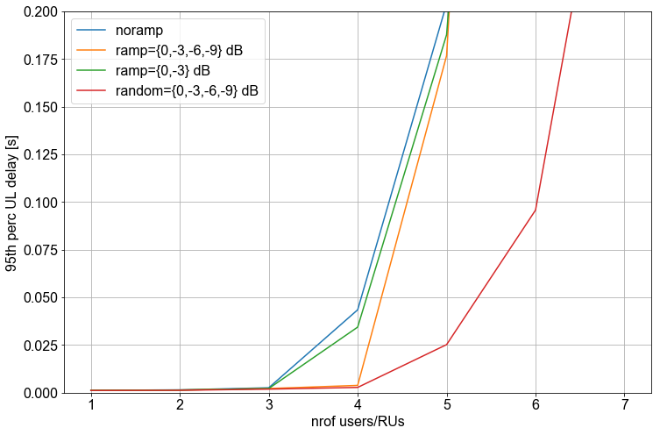

Simulation setup cont
We test the following:
  No ramping nor capturing applied
  Ramping 1: Ramping with 4 steps = {0, -3, -6, -9} dB
  Ramping 2: Ramping with 2 steps = {0, -3} dB
  Random 1: Random values selected from set of 4 values = {0, -3, -6, -9} dB
We also look at the 50th and 95th percentile
  We can see that 50th and 95th percentile UL delay is improved compared to no ramping

Slide 9
References
[1] 11/21-0400r0 Enhanced UORA, Yanyi Ding
[2] 11/20-1903r3 Random access for 11be, Stephane Baron

