Slide 1
Repurposing Directional Multi-Gigabit (DMG)
Beamforming Training Measurements for WLAN Sensing
Date: 2021-07-13
Authors:
Name | Affiliation | Address | Phone | Email
Pu (Perry) Wang | Mitsubishi Electric Research Laboratories (MERL) | 201 Broadway, Cambridge, MA 02139, USA | 617-621-7567 | pwang@merl.com
Philip V. Orlik
Notes:
September 2012

Slide 2

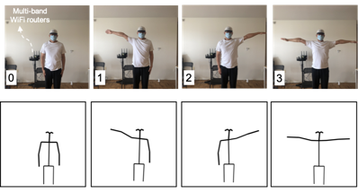
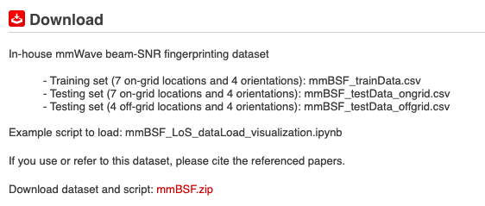
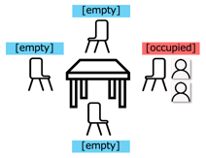
Abstract
This contribution is a continuation of
  20/1074r1 WLAN Localization and Sensing With Mid-Grained Channel Measurements
  20/1741r1 Feasibility study of human pose and occupancy classification using mmWave WiFi beam attributes
  21/0407r3 Multi-Band WiFi Fusion for WLAN Sensing
  which adopts directional multi-gigabit (DMG) beamforming training measurements, e.g., beam SNRs, at 60-GHz for WLAN sensing.
This contribution revisits DMG beamforming training (BFT) protocols at the 802.11ad & ay standards and repurpose these DMG BFT measurements for WLAN Sensing.
Occupancy Sensing
Open dataset for mid-grained WiFi channel measurements
Pose recognition
https://www.merl.com/demos/mmBSF

Slide 3
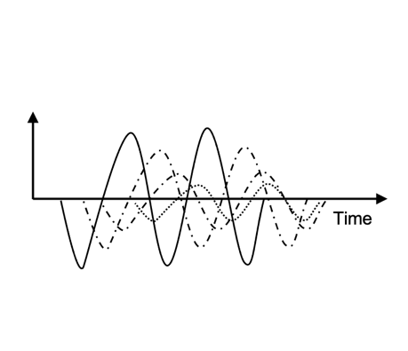
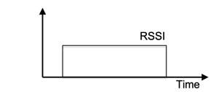
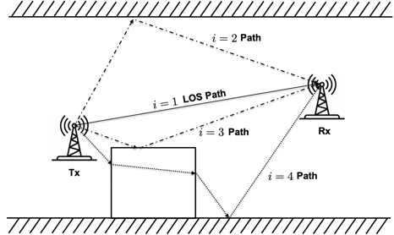
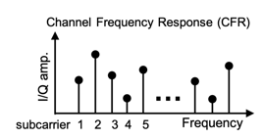
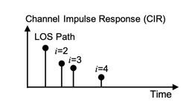
Channel Measurements at Sub-7 GHz
Multiple WiFi channel measurements are considered for WLAN Sensing
  RSSI: single value signal strength indicator
  CSI or compressed version: Complex amplitudes at freq.-domain OFDM subcarriers (802.11g/n/ac at sub-7 GHz)
  Power delay profile or truncated version: can be obtained via inverse FFT (coarse resolution) or time-reversal methods (fine resolution)
coarse-grained RSSI
fine-grained CSI
Delay profile
Multipath propagation at sub-7 GHz
Echo signals at sub-7 GHz
Channel Measurements at sub-7 GHz

Slide 4
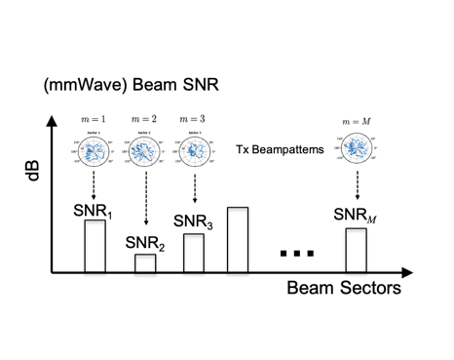
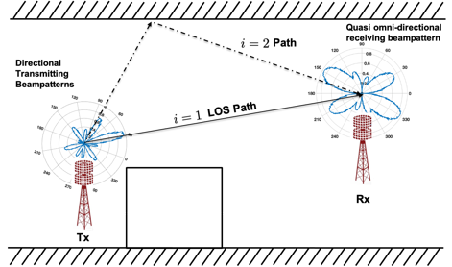
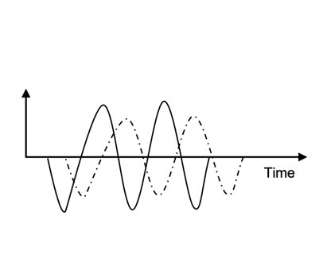
Channel Measurements at 45+ GHz
All previous measurements can be defined also at 60 GHz
  RSSI: single value signal strength indicator
  CSI: Complex amplitudes at freq.-domain OFDM subcarriers (802.11g/n/ac at sub-7 GHz)
  Power delay profile: can be obtained via inverse FFT (fine resolution due to wider bandwidth) or time-reversal methods (fine resolution)
  DMG Beamforming Training (BFT) Measurements: Spatial-domain channel measurements at mmWave bands, weighted by beam patterns (sectors)
DMG beamforming training measurements
Echo signals at 45+ GHz
Channel measurements at 45+ GHz
(during beam training)
Multipath propagation at 45+ GHz

Slide 5
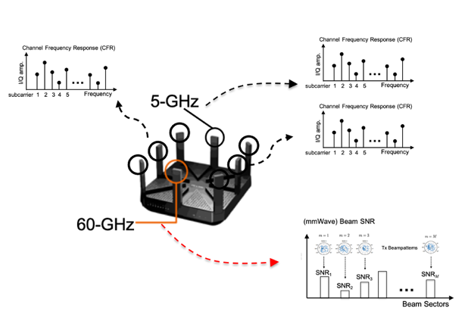
Comparisons
CSI at sub-7 GHz | DMG BFT Measurements at 60 GHz
frequency-domain CFR; delay-domain CIR | spatial-domain link quality over beamforming patterns
sensitive to both subtle & large motions | sensitive to only large motions/distinct patterns (*if the coarse beampatterns at commercial devices)
cover large areas (pass through walls) | cover small areas (blocked by obstacles)
richer multipath | sparse propagation paths (with cluster/group structures)
Limited number of antennas with omnidirectional beampatterns | Phased array with directional beampatterns
inconsistent measurements (channel fading, sensitive to environmental dynamics – pet, movable home appliances) | more repeatable (even in the presence of disturbance)
high dimension (no. subcarriers x no. antennas) | medium/low dimension (no. of beampatterns)

Slide 6
Revisiting 802.11bf PAR
Scope of WLAN Sensing
  Defines modifications to the IEEE 802.11 medium access control layer (MAC) and to the Directional Multi Gigabit (DMG) and enhanced DMG (EDMG) PHYs to enhance Wireless Local Area Network (WLAN) sensing (SENS) operation in license-exempt frequency bands between 1 GHz and 7.125 GHz and above 45 GHz.
  Enables stations to perform one or more of the following:
    to inform other stations of their WLAN sensing capabilities,
    to request and setup transmissions that allow for WLAN sensing measurements to be performed,
    to indicate that a transmission can be used for WLAN sensing,
    to exchange WLAN sensing feedback and information
  Defines WLAN sensing measurements to be obtained using transmissions that are requested, unsolicited, or both
  Enables a MAC service interface for layers above the MAC to request and retrieve WLAN sensing measurements.

Slide 7
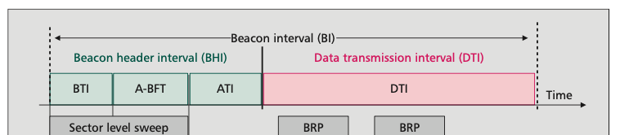
DMG Beacon at 60 GHz (802.11ad/ay)
Beacon interval (BI) was amended at 802.11ad & ay for network announcements , coordination, and parameter exchange with directional antenna sectors.
  Beacon header interval (BHI) for bi-directional beamforming training and schedule/ medium access parameter management;
  Data Transmission Interval (DTI) for data communications with contention-based/contention-free periods.
BHI has up to three sub-intervals
  Beacon transmission interval (BTI) consists of multiple beacon frames for network announcements over different beam sectors and train beam sectors of AP/Initiator
  Association beamforming training (A-BFT) is used to train beam sectors of stations (SLS)
  Beam Refinement phase (BRP) can be added during the DTI.

Slide 8
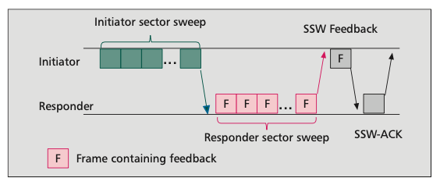
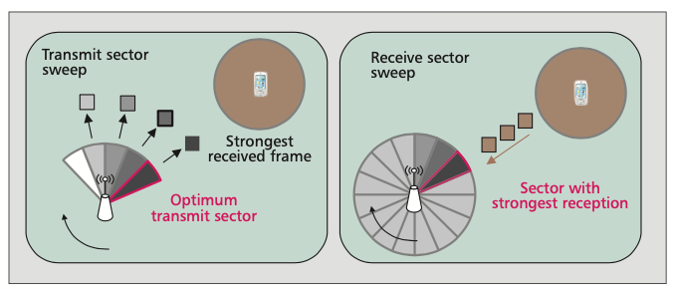
802.11ad/ay Beamforming Training Protocols
Beamforming training determines the appropriate receive and transmit antenna sectors for a pair of stations. It has two sub-phases:
  Mandatory sector-level sweep (SLS): identify coarse-grained antenna sector configuration and
  Optional beam refinement phase (BRP): fine-tunes the selected sectors
During SLS, either initiator or responders uses multiple sector sweep (SSW) frames to train either TXSS or RXSS
  Transmit sector sweep (TXSS): Tx sends directional beam sectors and Rx with quasi-omnidirectional beam patterns; For instance, the Rx calculate the beam sector SNR for each transmitted beam sectors.
  Receive sector sweep (RXSS): Tx sends omni-directional beam patterns and Rx with directional beam sectors.
  Initiator TXSS, Responder RXSS, Initiator RXSS, and Responder TXSS
  Feedback to the initiator (e.g., Initiator TXSS) is done by every Responder SSW frame with feedback
  Feedback to the responder (e.g., responder TXSS) is done with a single SSW feedback frame.

Slide 9
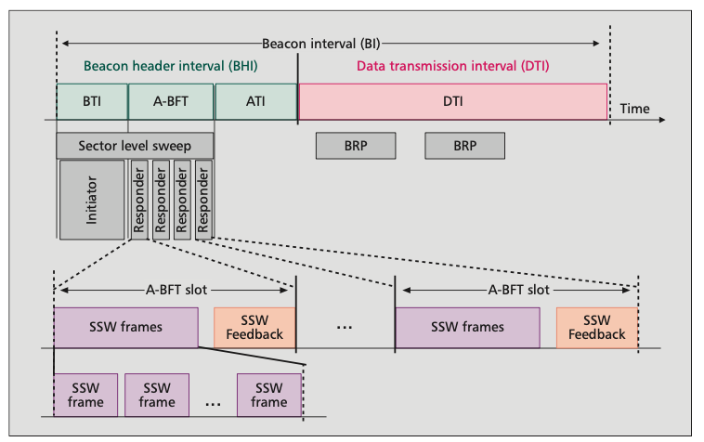
802.11ad/ay Beamforming Training Protocols
During Association beamforming training (A-BFT), the A-BFT interval is divided into multiple responder slots (A-BFT slot)
Each A-BFT slot consists of a number of responder SSW frames.
To allow multiple responders, a contention-based scheme is used
  Contending stations randomly select which slot to access
  A collision is detected by a missing SSW Feedback frame from the AP.

Slide 10


Example: Initiator collects all types of BFT measurements
  Time
AP
(Initiator SLS)
STA
(Responder SLS)
Initiator TXSS
(AP: directional Tx sectors;
Client: quasi-omni Rx)
Initiator RXSS
(AP: directional Rx sectors;
Client: quasi-omni Tx)
Initiator RXSS
(AP: quasi-omni Tx;
Client: directional Rx sector)
Responder TXSS
(AP: quasi-omni Rx;
Client: directional Tx sectors)
Responder computes BFT data
(Initiator Tx beam SNRs)
Initiator computes BFT data
( Initiator Rx beam SNRs)
Responder computes BFT data (Responder Rx beam SNRs)
Initiator computes BFT data
(Responder Tx beam SNRs)
Feedback previous responder BFT data to Initiator

Slide 11
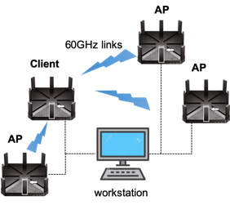
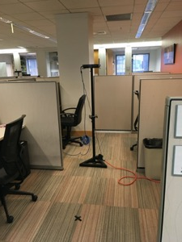
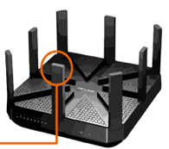

Feasibility Study using DMG BFT Measurements from Commercial-Off-The-Shelf mmWave Routers
Client at one location
  32-element array in one finger
  Time
AP 1
(Initiator SLS)
Client
(Responder SLS)
AP 2
(Initiator SLS)
Client
(Responder SLS)
Initiator TXSS
(AP: directional Tx sectors;
Client: quasi-omni Rx)
Initiator TXSS
(AP: directional Tx sectors;
Client: quasi-omni Rx)
Responder computes BFT data
(Initiator Tx beam SNRs)
Responder computes BFT data
(Initiator Tx beam SNRs)
  Responder (client) sends BFT data via ethernet cable to workstation

Slide 12
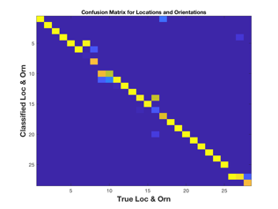
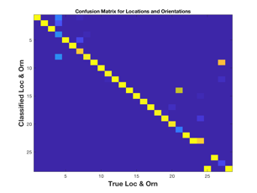
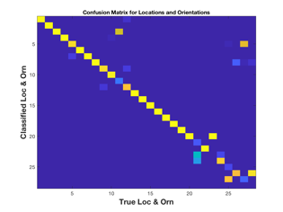
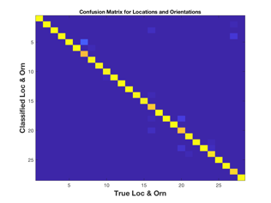
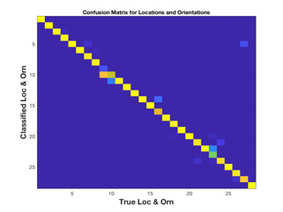
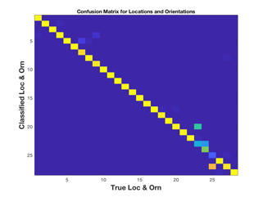
Localization Performance
(over 7 locations)
AP 1
AP 2
AP 3
AP 1 + AP 2
AP 1 + AP 3
AP 2 + AP 3

Slide 13
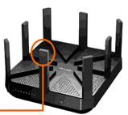



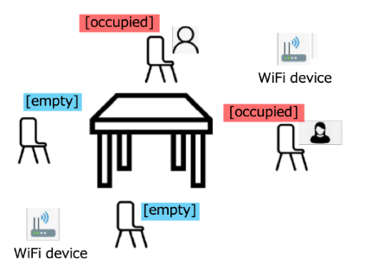
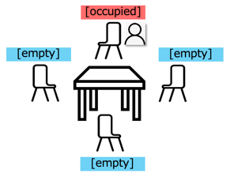
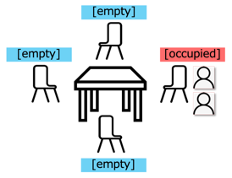
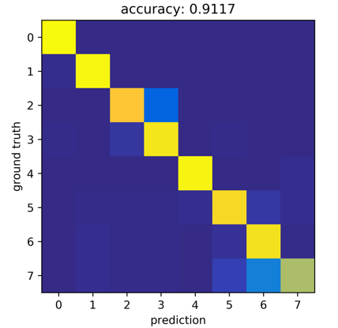
Occupancy Sensing Performance (over 8 patterns)
Picture source: TP-Link
DMG-BFT Measurements
Pu (Perry) Wang, MERL

Slide 14
Conclusions
This contribution revisits DMG beamforming training protocols at 802.11ad/ay standards and propose to repurpose the DMG BFT measurements for WLAN Sensing.
Our earlier feasibility studies (localization, pose recognition, and indoor occupancy sensing) show the potential value of repurposing the DMG BFT measurements for WLAN sensing.
Additional PHY modifications can be introduced to further facilitate the exchange of DMG BFT measurements among sensing initiator, responders, transmitters, receivers, and processors.

Slide 15
References
[1] CSI-based Wi-Fi Sensing: Results and Standardization Challenges, IEEE 802.11-19/1769r1
[2] 802.11 sensing: Applications, feasibility, standardization, IEEE 802.11-19/1626r1
[3] Wi-Fi sensing in 60GHz band, IEEE 802.11-19/1551r1
[4] Wi-Fi sensing, IEEE 802.11-19/1164
[5] Wi-Fi sensing: cooperation and standard support, IEEE 802.11-19/1416
[9] D. Steinmetzer, D. Wegemer, M. Schulz, J. Widmer, and M. Hollick, ‘‘Compressive millimeter-wave sector selection in off-the-shelf IEEE 802.11ad devices,’’ in Proc. 13th Int. Conf. Emerg. Netw. EXperiments Technol., Nov. 2017
[10] D. Steinmetzer D. Wegemer and M. Hollick Talon Tools: The Framework for Practical IEEE 802.11ad Research 2018 [online] Available: https://seemoo.de/talon-tools/
[11] M. Schulz D. Wegemer and M. Hollick Nexmon: The C-Based Firmware Patching Framework 2017
[15] T. Koike-Akino, P. Wang, M. Pajovic, H. Sun and P. V. Orlik "Fingerprinting-based indoor localization with commercial mmWave WiFi: A Deep Learning Approach”, IEEE Access, Vol. 8, pp. 84879-84892, 2020.
[16] J. Yu, P. Wang , T. Koike-Akino, Y. Wang, and P. V. Orlik " Human Pose and Seat Occupancy Classification with Commercial mmWave WiFi”, GLOBECOM Workshop on JSAC, December, 2020.
[17] WLAN Localization and Sensing With Mid-Grained Channel Measurements, IEEE 802.11-20/1074r1
[18] Feasibility study of human pose and occupancy classification using mmWave WiFi beam attributes, IEEE 802.11-20/1741r1
[19] Multi-Band WiFi Fusion for WLAN Sensing, IEEE 802.11-21/0407r3
[20] IEEE 802.11 WG, “IEEE 802.11ad, Amendment 3: Enhancements for Very High Throughput in the 60 GHz Band,” Dec. 2012.
[21]T. Nitsche et al., "IEEE 802.11ad: directional 60 GHz communication for multi-Gigabit-per-second Wi-Fi [Invited Paper]," in IEEE Communications Magazine, vol. 52, no. 12, pp. 132-141, December 2014.
[22] P. Zhou et al., "IEEE 802.11ay-Based mmWave WLANs: Design Challenges and Solutions," IEEE Communications Surveys & Tutorials, vol. 20, no. 3, pp. 1654-1681, 2018.
[23] IEEE 802.11ay, Amendment 7: Enhanced throughput for operation in license-exempt bands above 45 GHz, IEEE Std 802.11ay/Draft 0.5-2017, pp. 1-364, Aug. 2017.

Slide 16
Straw Poll 1
Should 802.11bf TG consider directional multi-gigabit (DMG) beamforming training (BFT) measurements at 45+ GHz as one type of sensing measurements for WLAN Sensing?
Yes:
No:
Abstain:
Related Document (SP): 21/0407r3 (Y/N/A: 18/4/16)
Beamforming training includes Initiator TXSS, Initiator RXSS, Responder TXSS, Initiator RXSS during BHI (beacon header interval) and DTI (data transmission interval).
Pu (Perry) Wang, MERL

