Slide 1
A Signature-based Method for Identifying STAs with Randomized MAC Addresses
Date: 2021-07-09
Authors:
Name | Affiliation | Address | Phone | Email
Liuming Lu | OPPO |  |  | luliuming@oppo.com
Lei Huang
Chaoming Luo
Pei Zhou
Liuming Lu (OPPO)

Slide 2
Introduction
To avoid the functional failure caused by the RMA changing (e.g., (re)association rejection, BSS transition failure, post-association access control failure , post-association failure for home automation), this contribution introduces the ‘address signature’ method for the station identification.
For the STA using RMA, the ‘address signature’ can replace the MAC address role for STA identification, even if the STA changes MAC address among transmissions.
Notes:
新增：地址签名方法的优势，签名方式的优势主要就是用签名来识别MAC地址变化

Slide 3
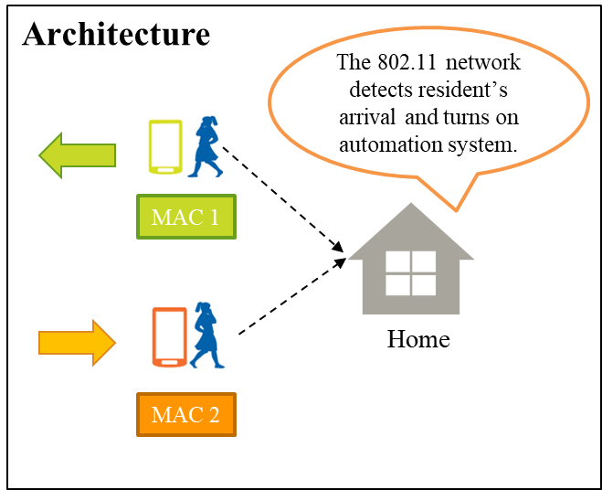
Home Automation Detection Assisting
Motivation
For home automation the automation system can be turned on when detecting the resident’s arrival. This resident’s arrival detection can be done through the MAC identification by the 802.11 network. However, when the STA uses the randomized MAC, the 802.11 network cannot identify the STA, and this function would fail.
Therefore, when applying the MAC address identification for assisting home automation, it needs a scheme to identify STA with RMA

Slide 4
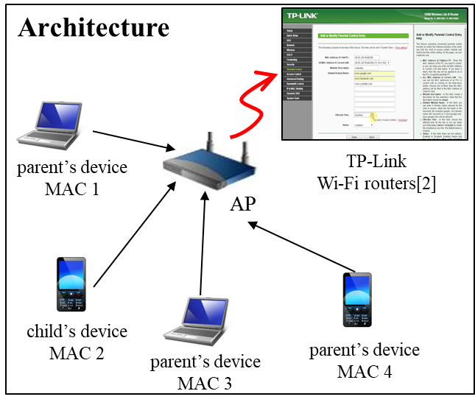
Router parental control
Motivation
802.11 routers offer ‘parental control’ option for the Internet access control. It relies on the MAC to identify device. However, when the STA uses the randomized MAC, this function would fail.
Therefore, when using the ‘parental control’ , it needs a scheme to uniquely identify STA with RMA

Slide 5
Background
Public Key
STA
AP
Data
Verify
Private Key
Data
Sign
Sign
Sign
Digital Signature[3]
The STA has a pair of private key and public key, and the private key is never disclosed. The private key is used to generate the signature, and signature signed by the “private key” can be verified only by the “public key”.
The STA transmits the public key to an AP.
The STA generates its signature by its private key, and sends the signature to the AP.
The AP verifies the signature by the STA's public key.
Notes:
建议增加一个或多个PPT，首先对签名方法有个high level的介绍，然后再谈具体的步骤 答复：已增加

Slide 6
MAC Address Signature Overview (1)
STA
AP
RMA
Private Key
RMA
Address
Sign
Public Key
Verify
Address
Sign
Sign
The STA transmits its public key to an AP, and AP caches the public key.
The STA signs the RMA with its private key to generate an address signature.
The AP verifies the Address signature by the STA's public key.

Slide 7
MAC Address Signature Overview (2)
STA
AP
RMA
Private Key
RMA
Address
Sign
Public Key
Verify
Verify
Address
Sign
Sign
RMA
STA
Public Key
Address
Sign
Private Key
RMA
Address
Sign
Sign
The AP distinguishes different STAs by STA's public key.

Slide 8
Procedure for Address Signature (1)
Step 1: the AP advertises its RMA capability in Beacon and Probe Response frames.
Step 2: the STA carries its certificate in Authentication frame to the AP
The STA’s certificate contains public key
The AP caches the STA’s certificate if authentication is passed
STA
AP
MAC address 1
AP advertises RMA capability
STA Carries certificate in Authentication frame
AP caches STA’s certificate
MAC address 2

Slide 9
Procedure for Address Signature (2)
Step 3: the STA generates address signature by private key and carries address signature in (Re)Association Request frame
The AP utilizes the cached certificate to verify address signature. If successful, the association can be allowed
STA
AP
MAC address 1
AP advertises RMA capability
STA carries certificate in Authentication frame
AP caches STA’s certificate
MAC address 2
STA carries address signature
in (Re)Association Request frame
AP verifies STA’s address signature
Step 4: after the association, the STA can carry its MAC address signature in data transmission for STA identification when RMA changes.
Liuming Lu (OPPO)

Slide 10
Summary
RMA changing would cause association rejection, BSS transition failure, post-association access control failure, post-association failure for home automation if no STA identification method other than MAC address is adopted.
This contribution introduces the ‘address signature’ method for identifying STAs with RMA when the STA’s RMA changes
Liuming Lu (OPPO)

Slide 11
Straw Poll
Do you agree to use the address signature method for identifying STAs with Randomized MAC Addresses?
Y/N/A
Liuming Lu (OPPO)

Slide 12
References
[1] 11-21-0332r8 Issues Tracking
[2] 11-21-0804r2 Parental Control Examples
[3] 11-19-0451r5 EBCS Frame Authentication Proposal
Liuming Lu (OPPO)

