Slide 1
Threshold Based Sensing Measurement Follow up
Date: 2021-07-09
Authors:
Name | Affiliation | Address | Phone | Email
Mengshi Hu | Huawei Technologies Co. Ltd | F3, Huawei Base, Shenzhen, China |  | humengshi@huawei.com
Rui Du
Chenchen Liu
Yi Lv
Danny Kai Pin Tan

Slide 2
Introduction (1/2)
In [1], a threshold based sensing procedure was proposed to help find the receivers with large CSI variations.
The CSI variation measured at the receiver is used to indicate the motions of objects.
Only the receiver detecting a large CSI variation compared with the threshold will be triggered to have a further feedback in Procedure B.
The overhead reduction results from the reduced number of receivers triggered in Procedure B.
Procedure A
Overhead A (small)
Procedure B
Overhead B (large)

Slide 3
Introduction (2/2)
A motion related to the above threshold based procedure has passed [2]:
In this contribution, we further give discussions on the details of the threshold based procedure.
Discussion on the 4th subbullet of the motion.
Whether the threshold is predefined, or defined by the sensing receiver, transmitter, initiator or responder is TBD.
Discussion on how to estimate the CSI variation.
“Having formulas for it” or “Implementation specific”.
The 11bf amendment defines an optional threshold based measurement and reporting procedure in which
The difference between the current measured CSI and the previous measured CSI is quantified. The difference is referred to as CSI variation.
A threshold value to be used by the sensing receiver in the threshold based procedure is defined.
By comparing the CSI variation with the threshold, the sensing receiver can send a feedback resulting from the large CSI variation to the sensing transmitter.
Whether the threshold is predefined, or defined by the sensing receiver, transmitter, initiator or responder is TBD.
The threshold based procedure is not always required (Procedure A in 21/0351r5 is not always required).

Slide 4
Which Device Determines the Threshold? (1/2)
We propose to let the initiator determine the threshold.
If the sensing transmitter is the initiator, we can say the threshold is determined by the initiator/transmitter.
If the sensing transmitter and the initiator are two different devices, it is more natural that the initiator determines the threshold.
The design of how to tell the threshold is TBD. One example is that telling the threshold in the Feedback Request frame. It can also be given in the Setup phase, Measurement phase, etc.
Procedure A
Overhead A (small)
Procedure B
Overhead B (large)
Send threshold

Slide 5
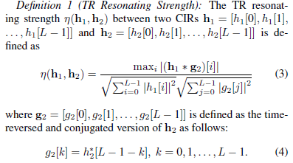
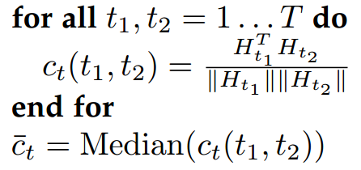
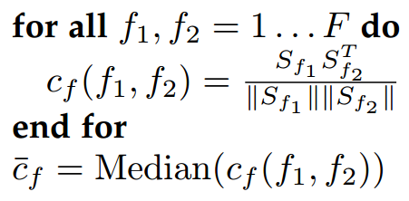

Estimation of CSI Variation
After the threshold discussion, here we turn to the discussion on how to estimate the CSI variation at the receiver. Two options are provided:
Option 1: Define formulas for the estimation of CSI variation.
Option 2: No given formulas (implementation specific).
Option 1: Define formulas for the calculation
There exist some methods for the estimation of CSI variation.
TRRS (Time-Reversal Resonating Strength) [3]
WiSH (Wireless Sensing of Human Detection) [4]
etc.
Temporal Correlation
Frequency Correlation
TRRS method [3]
WiSH method [4]

Slide 6
Estimation of CSI Variation
Option 2: No given formulas
The estimation of CSI variation can also be implementation specific. Different devices can have different methods to determine the CSI variation.
Although it is implementation specific, the following rules shall be defined for the estimation of CSI variation, which are beneficial to the adjustment of the threshold:
The estimation value of the CSI variation needs to be normalized to a closed interval [0, 1].
A larger estimation value indicates a larger CSI variation degree (strictly increasing)
Value 0 of the CSI variation denotes no CSI variation
Value 1 of the CSI variation denotes the largest variation
Examples for threshold (“Estimation value> Threshold” indicates the CSI variation is large enough)
The threshold set to 0 indicates all the CSI variation larger than 0 is large enough. (Feed back “Met”)
The threshold set to 1 indicates all the CSI variation is relatively small (Feed back “Not met”)

Slide 7
Option Comparison
In the following, we further discuss the pros and cons of the above two options for the estimation of CSI variation.
Options | Define formulas (Option 1) | No formulas (Option 2)
Pros | Because of the same estimation method, the same value in different devices can indicate the same CSI variation degree, which is beneficial to the setting and adjustment of the threshold. | May have some better designs for estimating the CSI variation. Different calculation complexity. Can adjust the balance between the complexity and variation estimation.
Cons | There may exist some better designs for estimating the CSI variation. A fixed method will prohibit those designs. Same calculation complexity. | The same value in different devices may indicate different CSI variation degrees.

Slide 8
Summary
Which device determines the threshold?
The initiator
Two options were provided for the estimation of CSI variation:
Opt. 1: Define formulas
Opt. 2: Implementation specific (but some rules need to be followed)

Slide 9
References
[1] 11-21-0351-05-00bf-threshold-based-sensing-measurement
[2] 11-20-1874-13-00bf-tgbf-motions-list
[3] Z. Wu , et al., A Time-Reversal Paradigm for Indoor Positioning System, in IEEE Transactions on Vehicular Technology, vol. 64, no. 4, pp. 1331-1339, April 2015.
[4] T. Hang, et al., WiSH: WiFi-based real-time human detection, in Tsinghua Science and Technology, vol. 24, no. 5, pp. 615-629, October 2019.

Slide 10
Straw Poll 1
Do you agree that in the threshold based sensing measurement and reporting procedure, the threshold compared with the CSI variation value is determined by the initiator?
Y
N
A

Slide 11
Straw Poll 2
Which option do you prefer to estimate the CSI variation in the threshold based sensing measurement and reporting procedure?
Option 1: Define formulas for the estimation of CSI variation.
Option 2: No given formulas (implementation specific).
Not for SFD.
Option 1
Option 2
A

Slide 12
Straw Poll 3
Do you agree that an explicit method including the formulas is given for the estimation of CSI variation in the threshold based sensing measurement and reporting procedure?
Y
N
A

Slide 13
Straw Poll 4
Do you agree that in the threshold based sensing measurement and reporting procedure, the estimation method of CSI variation is implementation specific but the estimation result shall follow the following rules?
The estimation value of the CSI variation shall be normalized to a closed interval [0, 1].
A larger estimation value indicates a larger CSI variation degree (strictly increasing).
Value 0 of the CSI variation denotes no CSI variation.
Value 1 of the CSI variation denotes the largest variation.
Y
N
A

