Slide 1
Legacy Support in 11bf
Date: 2021-07-01
Authors:
Name | Company | Address | Phone | Email
Rojan Chitrakar | Panasonic Corporation |  |  | rojan.chitrakar@sg.panasonic.com
Rajat Pushkarna
Yanyi Ding
Yoshio Urabe
Chris Beg | Cognitive Systems

Slide 2
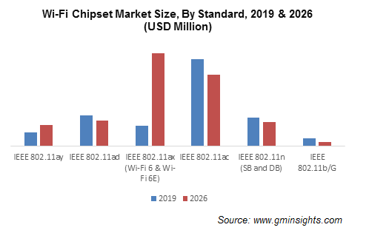
Overview
As per one Wi-Fi Chipset Market Size estimation, by the time 802.11bf standard is approved in 2024, 802.11ax is expected to have the dominant market share for sub-7 GHz Wi-Fi Chipsets. However, it is also expected that 802.11ac and 802.11n will continue to have significant share of the market, especially for low end and IOT devices. [1]

Slide 3
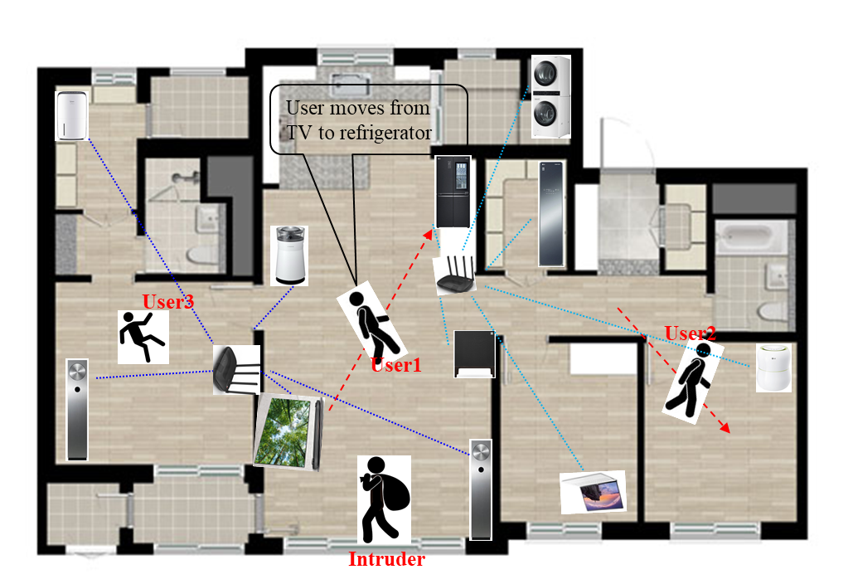
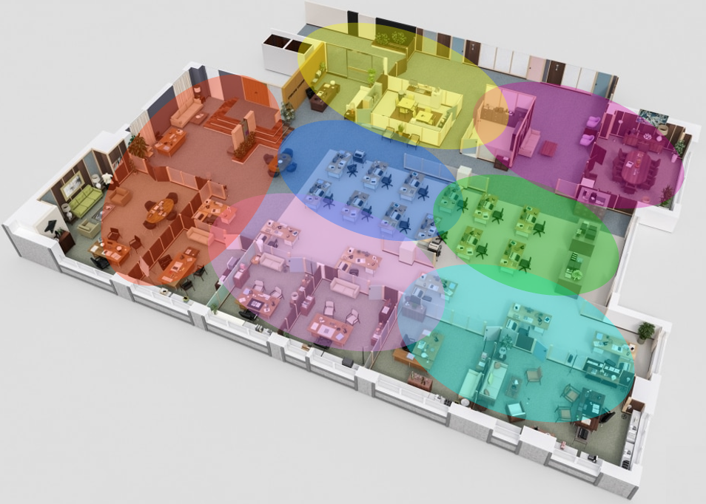
Discussion
Many sub-7 GHz WLAN Sensing use cases, especially those categorized as Room Sensing in [4] involves IOT devices (e.g., TV sets, smart home appliances such as Washing machines, Refrigerators, Air conditioners etc., Wi-Fi enabled vending machines etc.) to perform sensing measurement.
Home Use case [2]
Enterprise Use case [3]
Many of these devices have comparatively long shelf lives and hence we can expect legacy WLAN devices (11ac in 5 GHz band, 11n in 2.4/5 GHz bands) to be part of the WLAN Sensing eco system for a good number of years.
Support of 11bf on 802.11 devices with legacy PHYs will encourage earlier and wider adoption of standardized WLAN Sensing.

Slide 4
Background
As per the 11bf PAR [5], the 11bf modification are limited to the MAC layer and PHY service interfaces for the sub-7 GHz.
The 11bf MAC modifications currently being discussed, e.g., Sensing Discovery, Sensing Setup, basic Sensing Measurements can be considered upper MAC modifications, which are typically implemented in software/firmware (i.e., not implemented in hardware).
This means, legacy sub-7 GHz devices could be upgraded with 11bf modifications either during factory installations or even post-deployment through firmware updates and/or patches, which are very common these days.
While the 11bf PAR also requires backward compatibility and coexistence with legacy IEEE 802.11 devices operating in the same band for data communication, it is not clear from the 11bf PAR whether 11bf supports participation of legacy devices in WLAN Sensing.

Slide 5
Proposal
11bf shall ensure at least one mode of operation in which 11bf can be supported on devices with legacy PHYs (11n, 11ac) and they can participate in WLAN Sensing.
  This requires that 11bf features that assume newer PHY (e.g., HE/EHT PHY, 11az PHY enhancements like secure LTFs) shall not be mandatory for 11bf.
Note: There are numerous examples of existing CSI based Wi-Fi sensing solutions that use 11n, 11ac devices; however, they may not be capable of interoperating. [6]

Slide 6
Possible impact on 11bf
The following phases are being considered for 11bf. [7]
Discovery, Negotiation and Teardown are performed in the MAC layer and can be performed over any supported PHY.
Measurement phase is PHY dependent, and some considerations/restrictions may be required for devices with legacy PHYs.
Sensing Initiator
Sensing Responder
Discovery
Negotiation
Measurement exchange
Sensing
session
Teardown
Slide 6

Slide 7
Example* Sensing measurements
Some possible configurations for Sensing measurements are given in [8]:
  Configuration 1: STA that uses the measurements obtains them itself.
Upon receiving a Request frame from the Sensing Initiator, STA transmits a NDP frame that is used by the Initiator to perform sensing measurement.
Legacy devices need to support reception of Request frame.
For simplicity, one Request frame may solicit a single NDP.
Note: Alternatives to Request frame may also be possible, e.g., timer based NDP transmissions.
Slide 7

Slide 8
Example Sensing measurements
Configuration 2: STA that uses the measurements obtains them through reporting.
Legacy Sounding protocols can be reused for this configuration. Sensing Initiator obtains sensing measurement based on the feedback from Sensing Responders.
Slide 8

Slide 9
Example Sensing measurements
Other hybrid configurations may also be possible, for example the Non-TB sounding procedure discussed in [9], [10].
TB based procedures may not be suitable for devices with legacy PHYs due to the lack of support for OFDMA.
NOTE - All these frame sequence are only examples and subject to further discussions.
Slide 9

Slide 10
Conclusion
In this contribution, we discussed the benefits of supporting 11bf on 802.11 devices with legacy PHYs.
We proposed that 11bf shall ensure at least one mode of operation in which 11bf can be supported on devices with legacy PHYs (11n, 11ac) and they can participate in WLAN Sensing.
We also discussed the possible impact on 11bf to realize this and consider the impact to be minimal for basic operation.

Slide 11
Straw Poll 1
Do you agree that 11bf should be supported on devices with legacy PHYs (11n, 11ac) and that such devices can participate in WLAN Sensing?
  Y/N/A

Slide 12
References
https://www.gminsights.com/pressrelease/wi-fi-chipset-market
20/1239r0, Use Cases for Wireless LAN Sensing, Dongguk Lim et. al.
20/1266r9, WLAN Sensing Procedures and Use Cases, Claudio da Silva et. al.
20/1712r2, WLAN Sensing Use Cases, Assaf Kasher et. al.
19/2103r11, 802.11 SENS SG Proposed PAR, Claudio da Silva
WiFi Sensing with Channel State Information: A Survey, Y Ma et. al.
20/1851r0, Overview of Wi-Fi sensing protocol, Cheng Chen et. al.
21/0357r0, Discussion of Sensing Measurement Result Types, Claudio da Silva et. al.
21/0990r0, Discussions on sensing measurement flows, Cheng Chen et. al.
21/1015r0, Non-TB and TB measurement procedure for WLAN sensing, Dongguk Lim et. al.

