Slide 1
Multi-AP: TWT Information Sharing
Date: 2021-09-07
Authors:

Slide 2
Abstract
In this contribution, we propose the facilitation of TWT coordination for Multi-AP operation

Slide 3
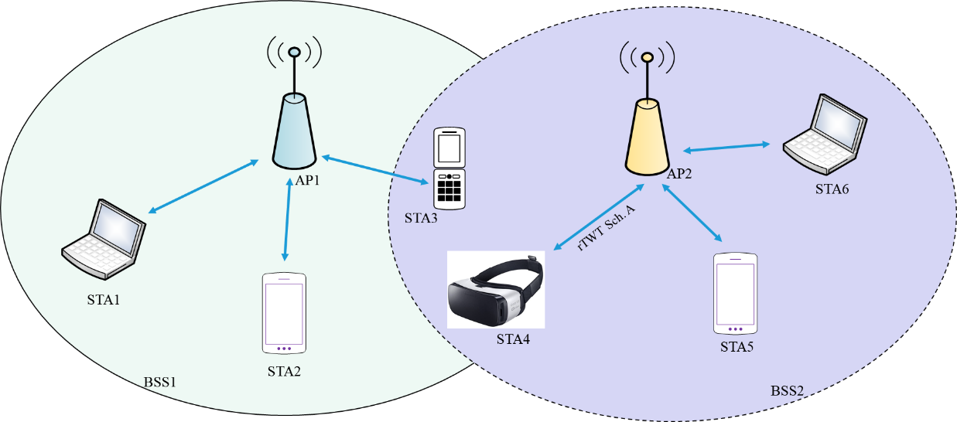
Background
Multi-AP operation is an essential feature in R2 for dense networks [3]
An EHT AP which obtains a TXOP and initiates the multi-AP coordination is the sharing AP while an EHT AP which is coordinated for the multi-AP transmission by the sharing AP is the shared AP.
STAs in overlapping areas suffer extra interference (e.g., STA3 and STA4)
shared
sharing
Frequency/time resources of an obtained TXOP will be shared between sharing AP and a set of APs participating in multi-AP coordination [3], [4]
Joint sequential NDP sounding shall be supported as an optional mode in multi-AP systems [3]

Slide 4
Motivation
Victim links (such as AP1-STA3 or AP2-STA4 links) can be part of TWT or restricted TWT schedule or may have some other power saving mode (PSM)
This means that those links are awake for a known service period (SP) time and in doze state the rest of the time
Coordination of interfering links based on their
wake-up times and durations is useful
Such coordination requires announcing TWT
schedule of the victim link by the sharing AP
Once shared APs receive TWT/restricted TWT
schedule of the victim link, APs can coordinate
interfering links transmission by either
muting them during victim’s link SP,
by orthogonalizing their transmission in time with SP of the victim link, or
power backoff during these durations (i.e., time-selective spatial reuse).

Slide 5
Summary
In this contribution, we propose the coordination of TWT in multi-AP operation
This can help both legacy and non-legacy links to utilize MAP coordination
Latency-sensitive traffic can also be further protected by TWT coordination

Slide 6
SP 1
Do you agree that sharing power saving parameters (such as TWT or rTWT parameters) of victim links (i.e., links suffering from extra interference from OBSS) can be beneficial for multi-AP coordination in 11be in R2
Yes
No
Abstain

Slide 7
SP 2
Do you agree that TWT information sharing should be supported for interference mitigation and for better protection of latency-sensitive traffic in multi-AP operation in R2 in 11be
Yes
No
Abstain

Slide 8
References
[1] IEEE P802.11ax/D8.0 – 10.47 (Target wake time - TWT)
[2] IEEE P802.11be/D1.0 – 35.6 (Restricted TWT)
[3] IEEE 802.11-19/1935r30, “Compendium of straw polls and potential changes to the Specification Framework Document - Part 2”, June 2021
[4] IEEE 802.11-19/1582r2, “Coordinated AP Time/Frequency Sharing in a Transmit Opportunity in 11be”, Jan 2020

