Slide 1
Sensing-specific feedback using NDPA and trigger frames
Date: 2021-09-15
Authors:

Slide 2
Abstract
This submission presents a sensing-specific feedback configuration for NDPA and trigger frame procedure for different sensing scenarios
Definitions and scenarios in this contribution are detailed in [1-2]
We focus on 4 main sensing scenarios – the cases which include sensing initiator acting as standalone are not considered.

Slide 3
Introduction
Trigger based sounding protocol in 11ax/be may be used for sensing
The NDPA frame of 802.11ax/be only allows communication specific feedback, i.e. CQI/compressed beamforming
The NDPA frame in 11ax does not allow sensing specific feedback information.
In 802.11be, reserved bits of the STA info field may be utilized for indicating sensing specific feedback information
This contribution discusses NDPA frame as well as possible trigger frame based sensing procedures for different sensing scenarios

Slide 4
Feedback Information Types
WLANs (e.g. 802.11ax, .11be) with embedded sensing capabilities may require sensing-specific feedback information, such as:
High precision CSI matrix
Time difference of arrival (TDOA)
Angle of arrival (AoA)
Received signal strength (RSS)
Location and/or Doppler
The sensing transmitter may send the indication of sensing feedback information, i.e. sensing feedback indicator, to the sensing receiver(s), depending on the sensing session requirements
The type of sensing feedback (measurement result) requested by sensing transmitter in a sensing session shall be decided by its initiator
Table 1(a):NDPA frame of 802.11be
Table 1(b): STA info field of 802.11be

Slide 5
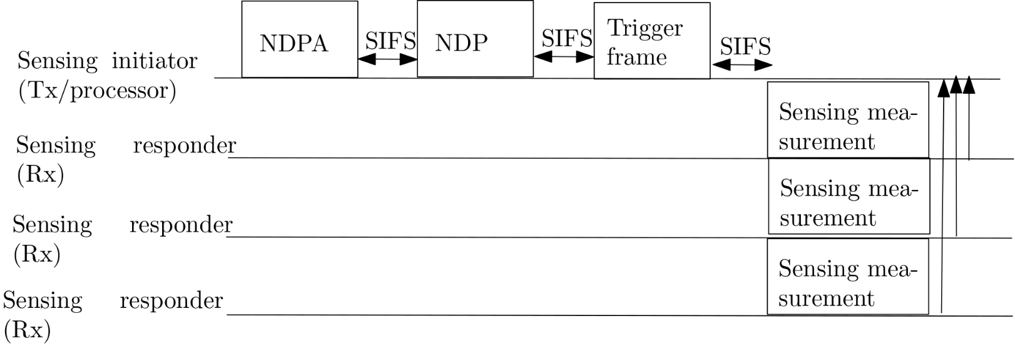
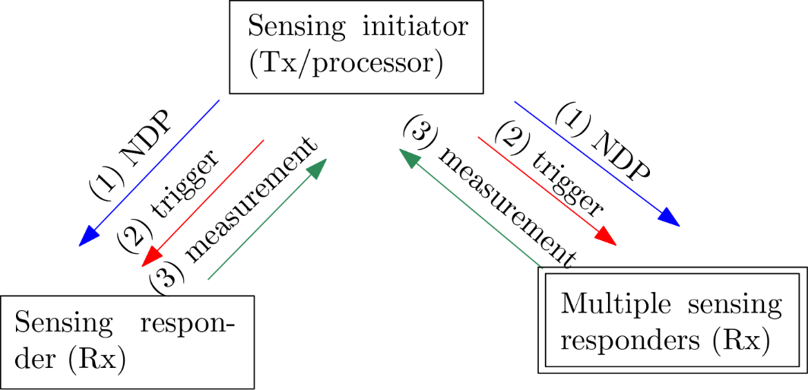
Sensing Scenario 1
Sensing initiator (Tx/processor) sends NDPA as well as trigger frame to all STAs identified as sensing responders (Rx)
Sensing Rxs send measurement report to sensing initiator/processor that processes all received measurements
This is same as basic trigger-based sounding procedure in 802.11ax/be [3]

Slide 6
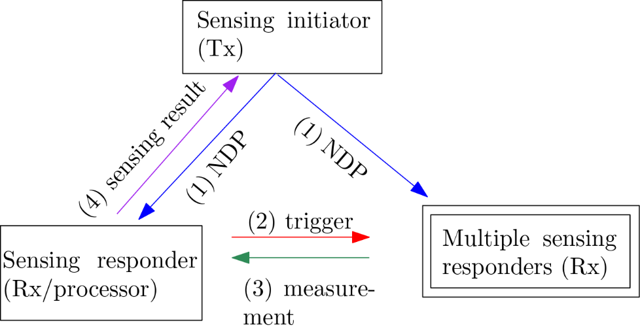
Sensing Scenario 2
Sensing initiator (Tx) sends NDPA that contains sensing-specific feedback indicator to all STAs that are identified as sensing responders (Rx)
Sensing Rx that is also a sensing processor sends sensing trigger frame to all other sensing responders (Rx).
Sensing Rxs send measurement report to sensing Rx/processor that processes all received measurements

Slide 7
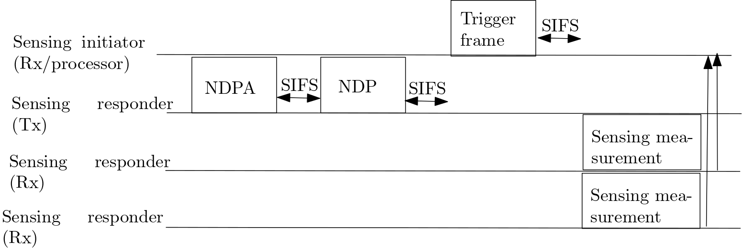
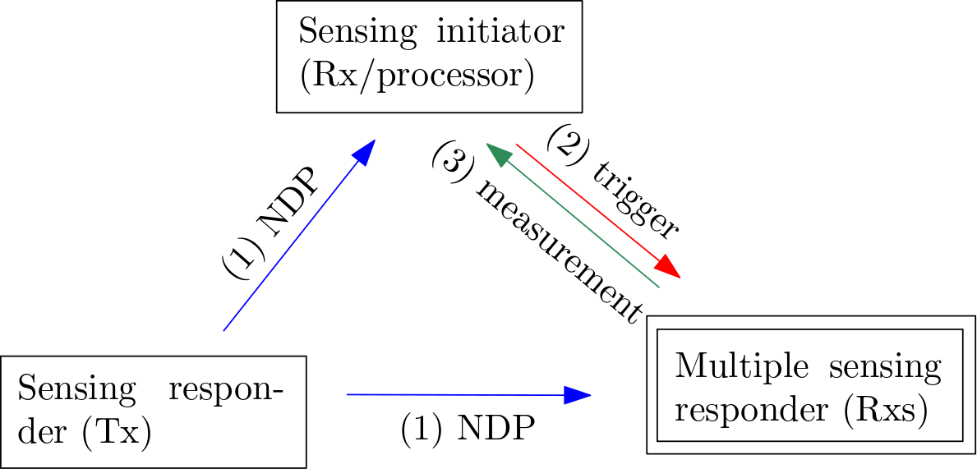
Sensing Scenario 3
Sensing responder (Tx) sends NDPA to STAs that sensing initiator (Rx/processor) identified as sensing responders (Rx) as well as sensing initiator (Rx/processor)
Sensing initiator (Rx) sends trigger frame to all sensing Rx.
Sensing Rxs send measurement report to sensing initiator (Rx/processor) that processes all received measurements

Slide 8
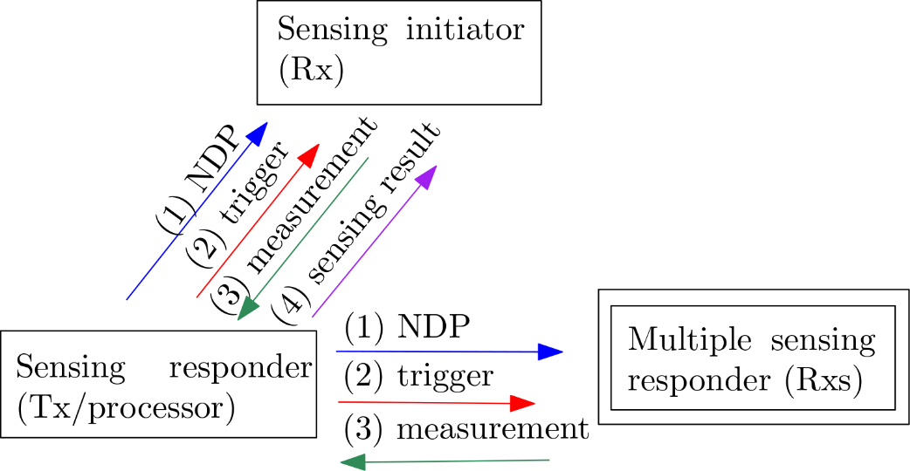
Sensing Scenario 4
Sensing responder (Tx) sends NDPA to sensing responder (Rxs) as well as sensing initiator (Rx)
Sensing initiator (Rx) sends trigger frame to all sensing Rxs
Sensing Rxs send measurement report to sensing Tx/processor that processes all received measurements

Slide 9
NDPA Frame as an Option
One of the options for indicating the sensing feedback type may be using NDPA frame
In 802.11be, the feedback information type and Ng subfield as well as codebook size of the STA info field together is 3 bits
The NDPA frame may also indicate the sensing feedback information that sensing responder (Rx) has to respond with
Table 2: STA info field of the NDPA frame example in the context of 802.11be
sensing- specific information

Slide 10
Conclusion
Trigger based sounding protocol in 11ax/be may be used for sensing
Depending on the application a sensing session may have different sensing feedback types in different measurement phases
NDPA frame as one of the options may be used for indicating sensing feedback type in each measurement phase
For example, in 802.11be, reserved bits of the STA info field may be utilized for indicating sensing specific feedback information

Slide 11
References
[1] IEEE 802.11-21/0147r0
[2] IEEE 802.11-20/1849r1
[3] Wireless LAN MAC and PHY Specifications, IEEE P802.11ax™/D8.0

Slide 12
Recap for Agreements related to Sensing Session
A sensing session may be comprised of multiple burst instances [motion #14]
A STA can assume multiple roles in one sensing session [motion #9]
The type of measurement result reported in a sensing session shall be decided by its initiator [motion #13]
The 11bf amendment may define more than one type of sensing measurement results [motion #12]
There may be multiple measurement phases during a sensing session [also implicit from motion #14]

Slide 13
Comments & Responses
1. What is the role of the RX/processor? We never discussed the processor role and there is no agreements.
R. Sensing processor described in this contribution is the same as the one defined in the 11-21/0035r0. It is defined as device who processes the sensing measurements and gets sensing result.
Sensing processor could be the same device with sensing initiator, which means sensing measurements are processed at sensing initiator.
Sensing processor also could be different device with sensing initiator (could be sensing transmitter and/or receiver), which means sensing measurements are processed and the sensing results are further feedback to sensing initiator.
During the sensing session, there could be more than one sensing processor.
There may be no need to define it in the SFD/Spec. We just use this term to facilitate the discussion.

Slide 14
Comments & Responses
2. The processor: does it keep the results to itself or what?
R. No, it feedbacks the final sensing result to the sensing initiator
3. Motion states that sensing feedback type is indicated by initiator, but here sensing responder Tx is indicating the sensing feedback type.
R. We assume there is a previous step in the sensing setup, where sensing initiator identifies the sensing feedback type and informs the sensing feedback type to sensing responder Tx
4. Is 3 bits enough to indicate all different sensing measurements?
R. We have total 4 bits reserved in the NDPA of 11be, which is in total 16 combinations

Slide 15
Comments & Responses
5. Which NDPA do you want to change, VHT/HE/EHT or proposing a new Sensing NDPA?
R. 802.11bf is an amendment which is supposed to add to the existing 802.11 specs. Several options may be considered. For example,
Define a new NDPA variant for SENS
Use EHT variant (this is explained in the presentation already)
For Legacy devices (VHT/HE), define a special STA Info field with a special ID to indicate that this field is for sensing
Other ideas are possible. Need further discussion
6. The type of sensing information can be identified in the setup phase. Why do we need to change it dynamically in the NDPA?
R. We believe it would be beneficial to allow dynamic sensing feedback within a sensing session. Setting sensing feedback type in the setup phase might be not efficient for some applications.

Slide 16
Dynamic Sensing Feedback within a Sensing Session: Use Cases
Each measurement phase may require different sensing feedback – depending on the sensing application
Use case 1:
Within a sensing session:
Sensing initiator may first want to identify motion of an object;
Following the motion identification of an object, sensing initiator may want to identify the Doppler/velocity of the object depending on the application
Use case 2:
Within a sensing session:
Coarse sensing: Sensing initiator may first want to identify coarse location of an object(s);
Fine sensing: Sensing initiator may want to discriminate the objects identified in the coarse location

Slide 17
SP1
Do you agree that a sensing session may have different sensing feedback types in different measurement phases?

Slide 18
SP2
Do you agree that NDPA frame may be used as one of the options to indicate the sensing feedback type during measurement phases in a sensing session?

