Slide 1
Sensing-specific feedback using NDPA and trigger frames
Date: 2021-06-30
Authors:

Slide 2
Abstract
This submission presents a sensing-specific feedback configuration for NDPA and trigger frame procedure for different sensing scenarios
Definitions and scenarios in this contribution are detailed in [1-2]
  We focus on 4 main sensing scenarios – the cases which include sensing initiator acting as standalone are not considered.

Slide 3
Introduction
Trigger based sounding protocol in 802.11ax/be may be used for sensing
The NDPA frame of 802.11ax/be only allows communication specific feedback, i.e. CQI/compressed beamforming
The NDPA frame in 802.11ax does not allow sensing specific feedback information
In 802.11be, reserved bits of the STA info field may be utilized for indicating sensing specific feedback information
This contribution discusses NDPA frame as well as possible trigger frame based sensing procedures for different sensing scenarios

Slide 4
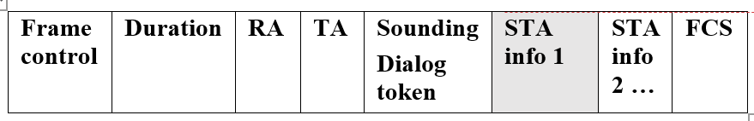
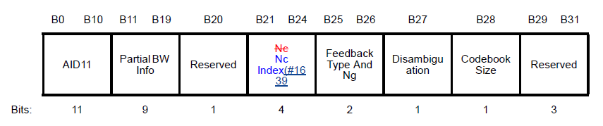
Feedback Information Types
WLANs (e.g. 802.11ax, .11be) with embedded sensing capabilities may require sensing-specific feedback information, such as:
  High precision CSI matrix
  Time difference of arrival (TDOA)
  Angle of arrival (AoA)
  Received signal strength (RSS)
  Location and/or Doppler
The sensing transmitter may send the indication of sensing feedback information, i.e. sensing feedback indicator, to the sensing receiver(s), depending on the sensing session requirements
  802.11be has reserved bits in the NDPA frame which may be utilized for indicating sensing feedback information
Table 1(a):NDPA frame of 802.11be
Table 1(b): STA info field of 802.11be

Slide 5
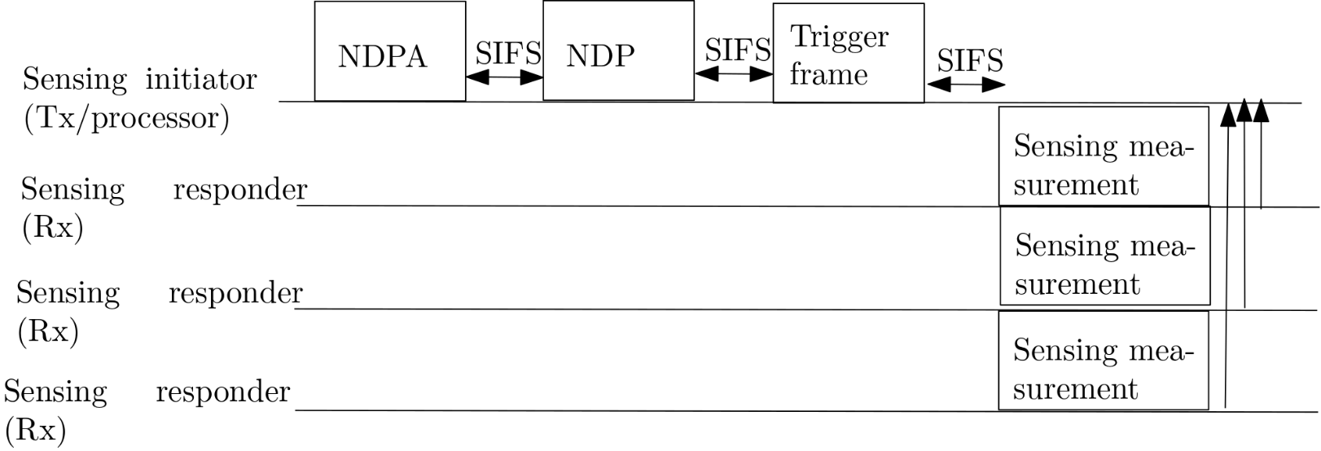
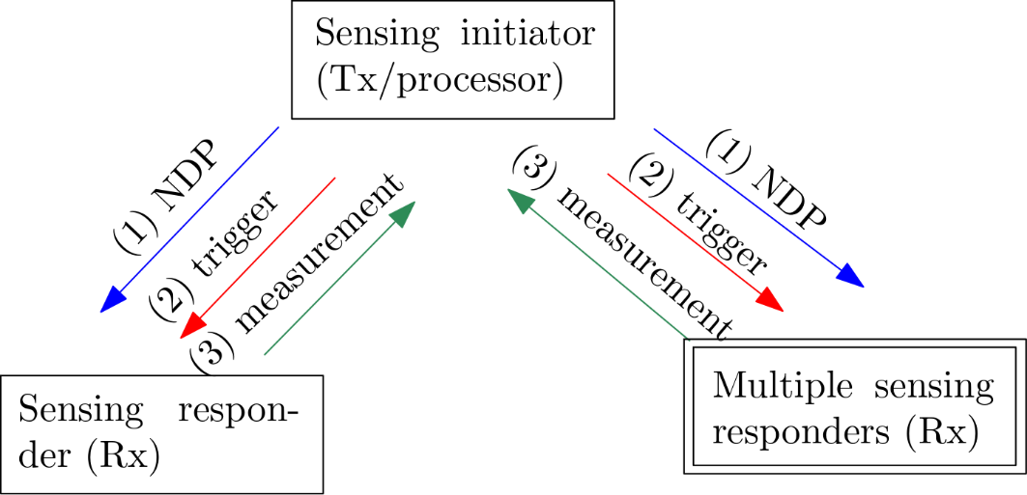
Sensing Scenario 1
Sensing initiator (Tx/processor) sends NDPA as well as trigger frame to all STAs identified as sensing responders (Rx)
Sensing Rxs send measurement report to sensing initiator/processor that processes all received measurements
This is same as basic trigger-based sounding procedure in 802.11ax/be [3]

Slide 6
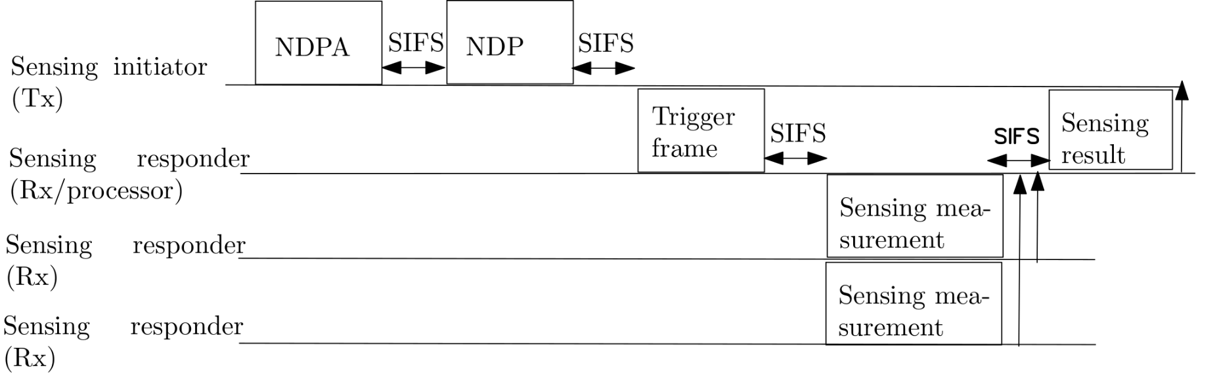
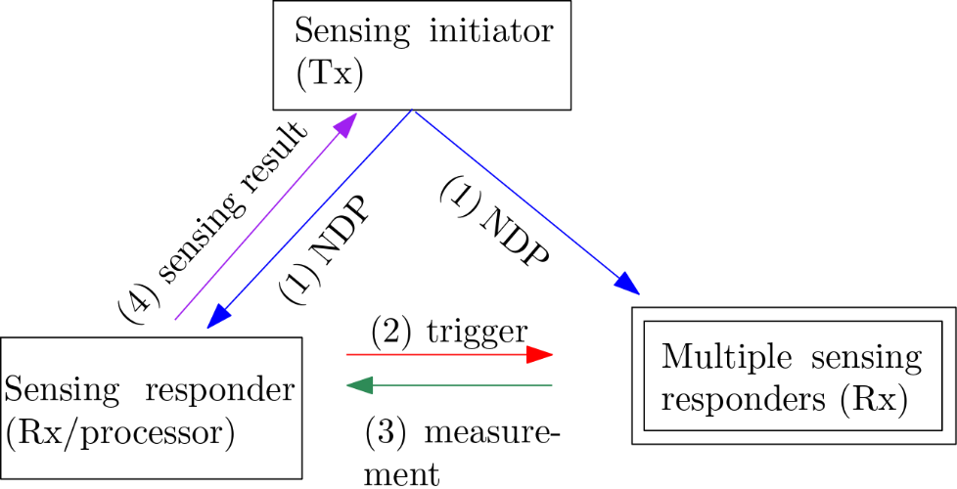
Sensing Scenario 2
Sensing initiator (Tx) sends NDPA that contains sensing-specific feedback indicator to all STAs that are identified as sensing responders (Rx)
Sensing Rx that is also a sensing processor sends sensing trigger frame to all other sensing responders (Rx).
Sensing Rxs send measurement report to sensing Rx/processor that processes all received measurements

Slide 7
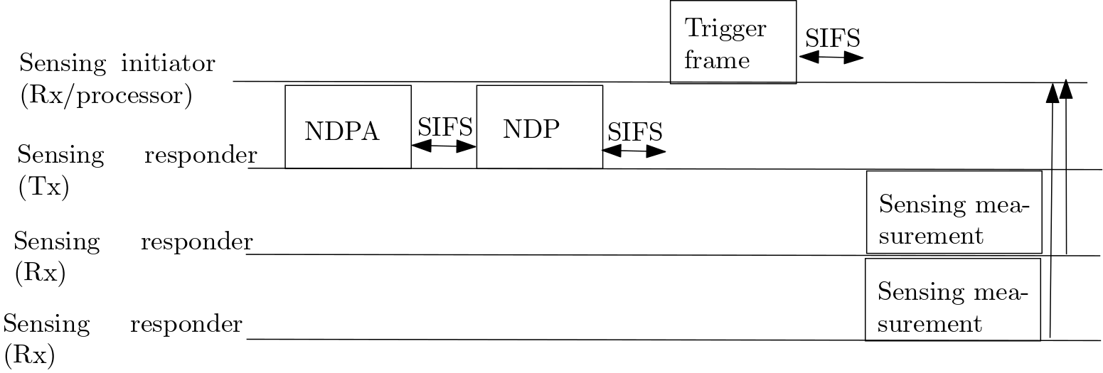
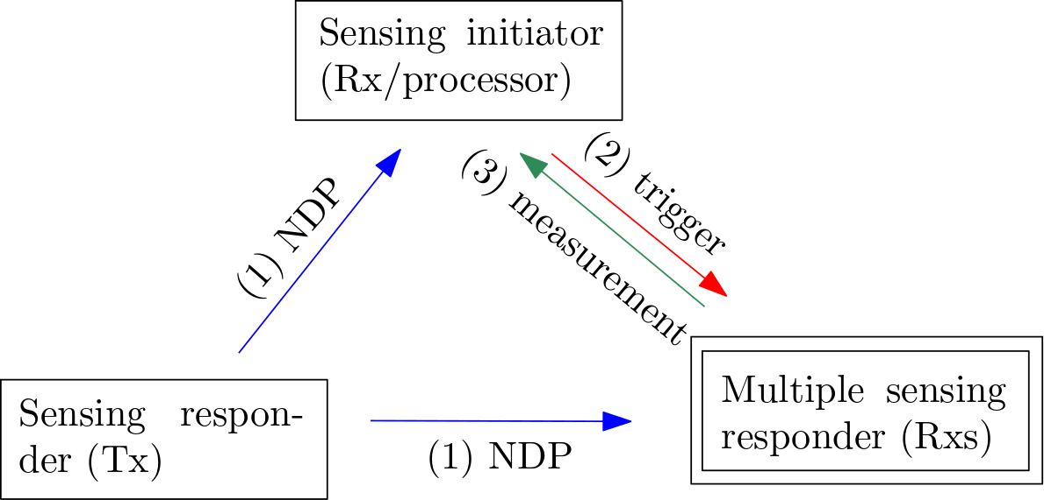
Sensing Scenario 3
Sensing responder (Tx) sends NDPA to STAs that sensing initiator (Rx/processor) identified as sensing responders (Rx) as well as sensing initiator (Rx/processor)
Sensing initiator (Rx) sends trigger frame to all sensing Rx.
Sensing Rxs send measurement report to sensing initiator (Rx/processor) that processes all received measurements

Slide 8
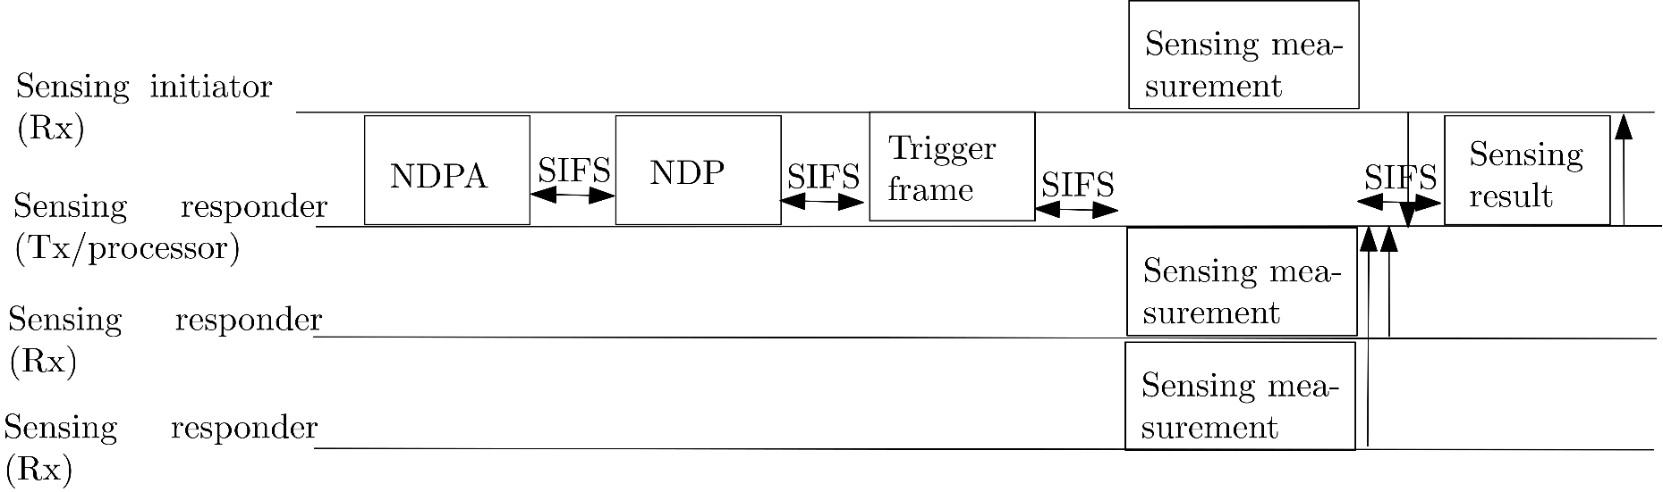
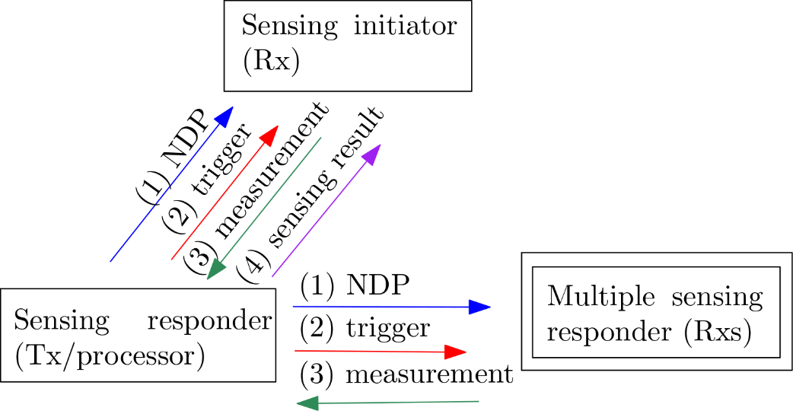
Sensing Scenario 4
Sensing responder (Tx) sends NDPA to sensing responder (Rxs) as well as sensing initiator (Rx)
Sensing initiator (Rx) sends trigger frame to all sensing Rxs
Sensing Rxs send measurement report to sensing Tx/processor that processes all received measurements

Slide 9
Exemplary NDPA Frame
In 802.11be, the feedback information type and Ng subfield as well as codebook size of the STA info field together is 3 bits
The NDPA frame may also indicate the feedback information that sensing responder (Rx) has to respond with
The feedback type may include sensing measurement metrics such as time of flight (ToF), time difference of arrival (TDOA), full CSI, compressed CSI, angle of arrival, and other processed sensing signal information
Table 2: STA info field of the NDPA frame example in the context of 802.11be
sensing- specific information

Slide 10
Conclusion
Trigger based sounding protocol in 802.11ax/be may be used for sensing
Sensing specific feedback information may be indicated in the NDPA frame
In 802.11be, reserved bits of the STA info field may be utilized for indicating sensing specific feedback information

Slide 11
SP1
Do you agree to add the following into 11bf SFD?
  In measurement phase of sensing session, an NDP Announcement frame can include sensing-specific information in sub 7Ghz band.
    The sensing-specific information is TBD
    NDPA format for sensing is TBD.

Slide 12
SP2
Do you agree that within a sensing session, a trigger frame may be sent by sensing processor for collecting sensing measurements from multiple sensing receivers?

Slide 13
References
[1] IEEE 802.11-21/0147r0
[2] IEEE 802.11-20/1849r1
[3] Wireless LAN MAC and PHY Specifications, IEEE P802.11ax™/D8.0

