Slide 1
IEEE 802.11ay Awards
Date: 2021-07-20
Author:

Slide 2
Abstract
This presentation contains the list of awards for the P802.11ay project.

Slide 3
WG and TGay Officer Awards
Name | Officer Position and contributions to TGay
Dorothy Stanley | WG Chair
Jon Rosdahl | WG Vice Chair
Robert Stacey | WG Vice Chair
Stephen McCann | WG Secretary
Edward Au | TGay Chair
Sang Kim | TGay Vice Chair
Jeorge Hurtarte | TGay Secretary
Carols Cordeiro | TGay Editor
SangHyun Chang | Former TGay Vice Chair
Yan Xin | Former TGay Vice Chair, major contribution to EDMG PHY and comment resolution

Slide 4
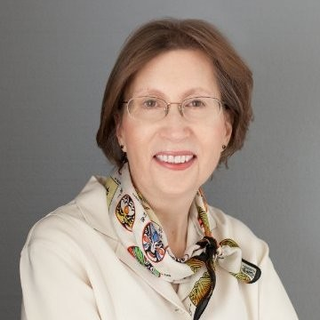
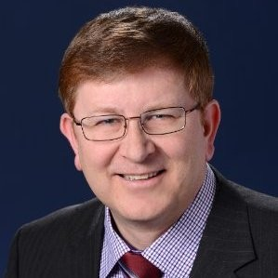
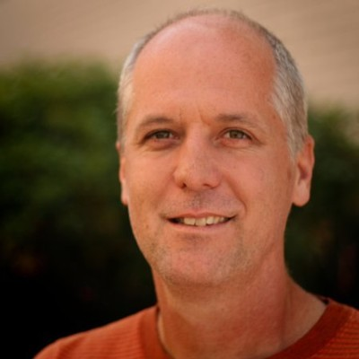
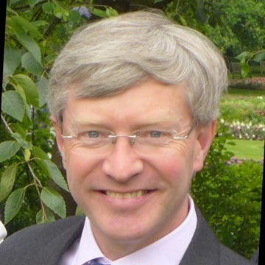
WG Officers
Dorothy Stanley
Jon Rosdahl
Robert Stacey
Stephen McCann

Slide 5
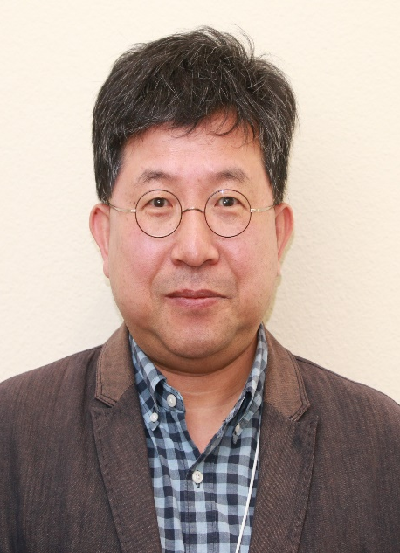
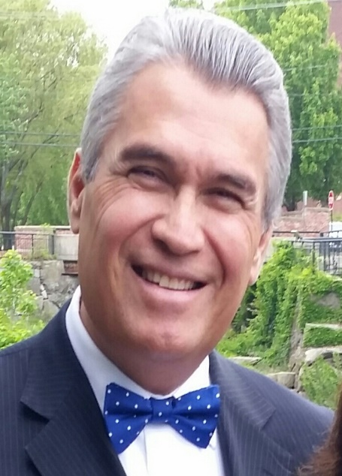
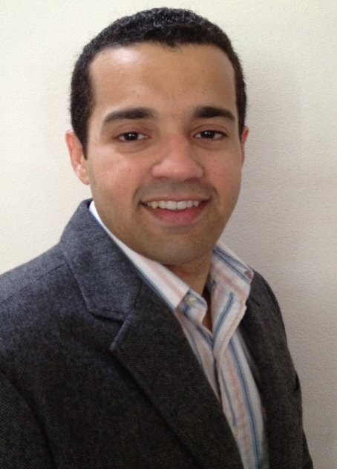
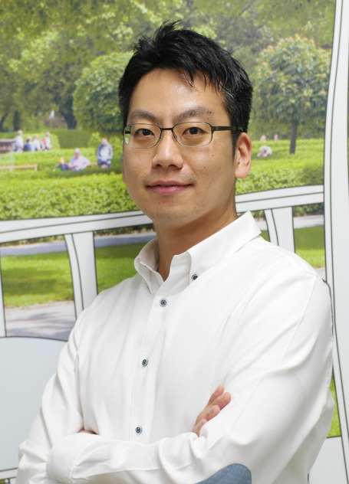

TG Officers
Sang Kim
Jeorge Hurtarte
Carols Cordeiro
SangHyun Chang
Yan Xin

Slide 6
TGay Significant Contributor Awards
Name | Contributions to TGay
Claudio da Silva | For significant contribution to EDMG PHY, coexistence assurance document, and comment resolution
Alecsander Eitan | For significant contribution to EDMG PHY and comment resolution
Lei Huang | For significant contribution to EDMG PHY and comment resolution
Assaf Kasher | For significant contribution to EDMG MAC and comment resolution
Artyom Lomayev | For significant contribution to EDMG channel modelling, EDMG PHY, and comment resolution
Alexander Maltsev | For significant contribution to EDMG channel modeling and EDMG PHY
Payam Torab | For significant contribution to TDD millimeter wave distribution networks
Solomon Trainin | For significant contribution to EDMG MAC and comment resolution

Slide 7

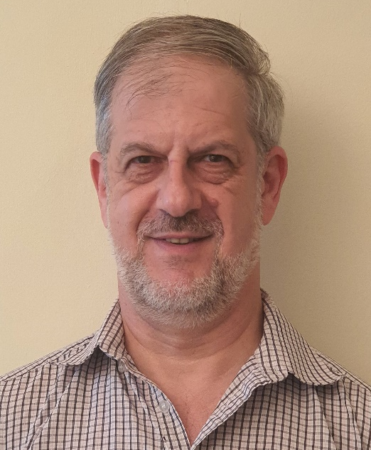
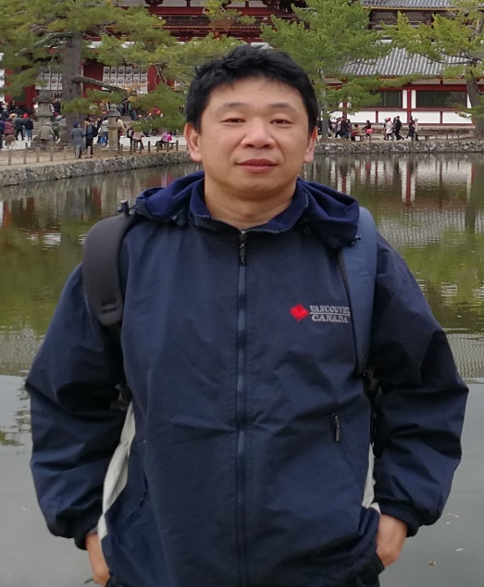
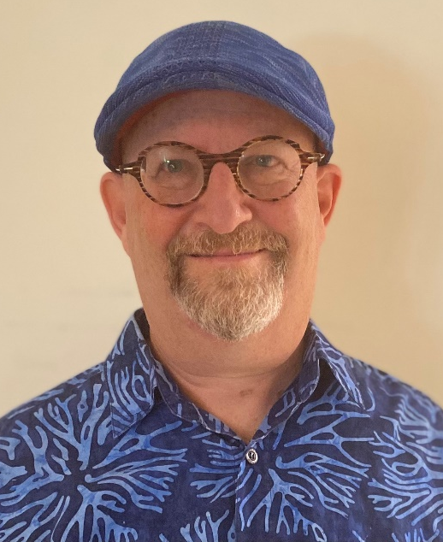
TGay Significant Contributors (1/2)
Claudio da Silva
Alecsander Eitan
Lei Huang
Assaf Kasher

Slide 8
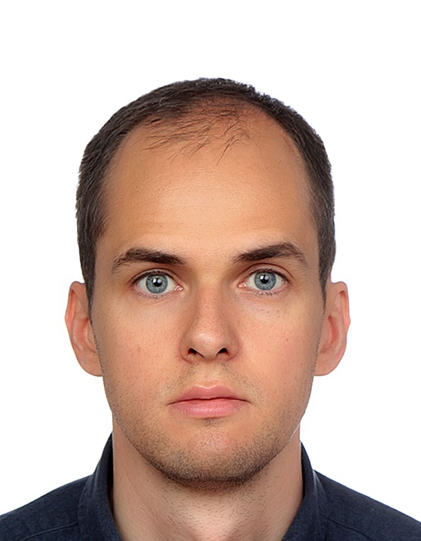
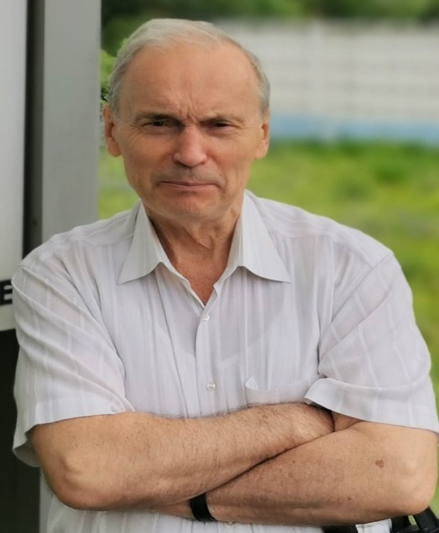
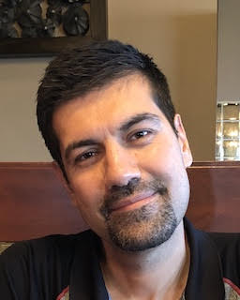
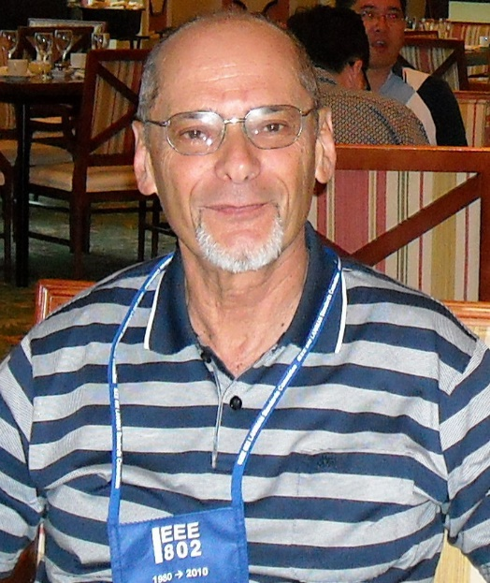
TGay Significant Contributors (2/2)
Artyom Lomayev
Alexander Maltsev
Payam Torab
Solomon Trainin

Slide 9
TGay Major Contributor Awards
Name | Contributions to TGay
Hiroyuki Motozuka | For major contribution to EDMG PHY comment resolution
Kome Oteri | For major contribution to EDMG PHY and comment resolution
Ilya Bolotin | For major contribution to EDMG MAC and comment resolution
Cheng Chen | For major contribution to EDMG MAC, TDD millimeter wave distribution networks, and comment resolution
James Wang | For major contribution to EDMG MAC and comment resolution
Al Petrick | For major contribution to comment resolution
Rui Yang | For major contribution to comment resolution
Rob Sun | For major contribution to use case document and comment resolution

Slide 10
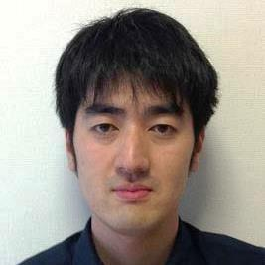
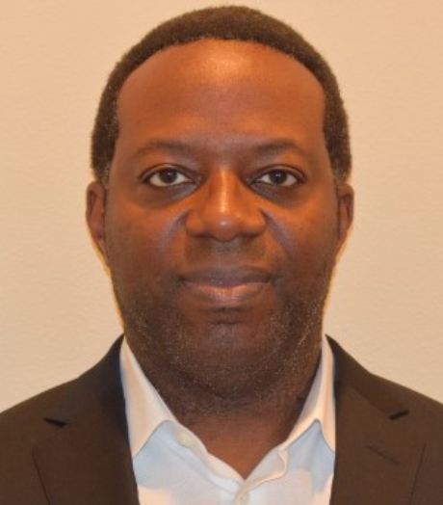
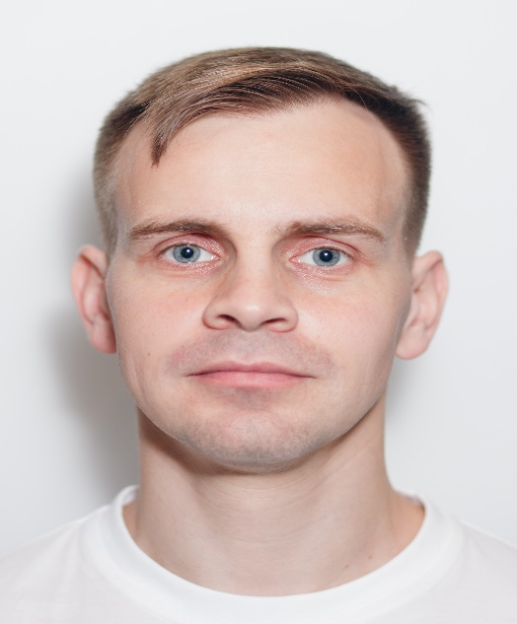
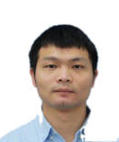
TGay Major Contributors (1/2)
Hiroyuki Motozuka
Kome Oteri
Ilya Bolotin
Cheng Chen

Slide 11
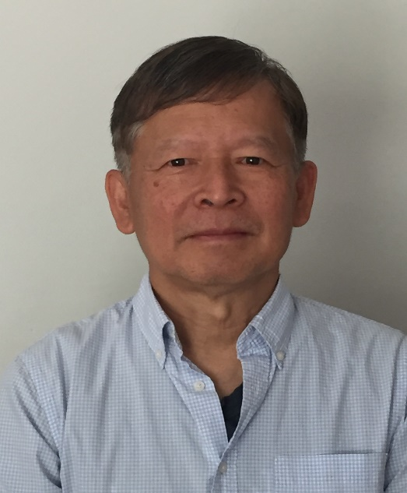

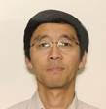
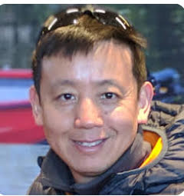
TGay Major Contributors (2/2)
James Wang
Al Petrick
Rui Yang
Rob Sun

Slide 12
TGay PHY Contributor Awards
Name | Contributions to TGay
Nelson Costa | For contribution to comment resolution
Thomas Handte | For contribution to EDMG PHY and comment resolution
Takenori Sakamoto | For contribution to EDMG PHY and comment resolution
Sunwoong Yun | For contribution to EDMG PHY

Slide 13
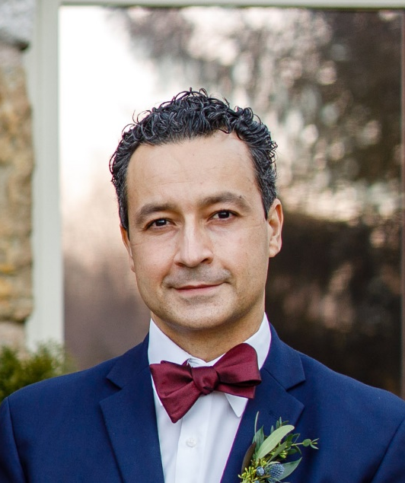
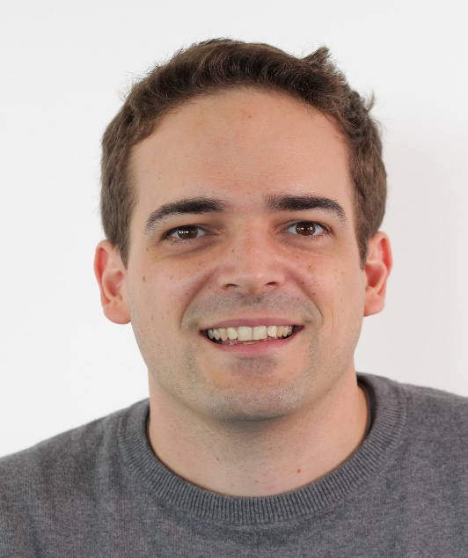
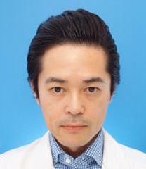

TGay PHY Contributors
Nelson Costa
Thomas Handte
Takenori Sakamoto
Sunwoong Yun

Slide 14
TGay MAC Contributor Awards (1/2)
Name | Contributions to TGay
Djordje Tujkovic | For contribution to TDD millimeter wave distribution networks
Mohamed Abouelseoud | For contribution to EDMG MAC comment resolution
Saehee Bang | For contribution to EDMG MAC and comment resolution
George Calcev | For contribution to EDMG MAC comment resolution
Tony Xiao Han | For contribution to EDMG MAC
Chris Hansan | For contribution to EDMG MAC comment resolution
Kyungtae Jo | For contribution to EDMG MAC
Oren Kedem | For contribution to EDMG MAC and comment resolution
Jinmin Kim | For contribution to EDMG MAC and comment resolution

Slide 15
TGay MAC Contributor Awards (2/2)
Name | Contributions to TGay
Dejian Li | For contribution to EDMG MAC comment resolution
Sungjin Park | For contribution to EDMG MAC and comment resolution
Kazuyuki Sakoda | For contribution to EDMG MAC comment resolution
Li-Hsiang Sun | For contribution to EDMG MAC comment resolution

Slide 16
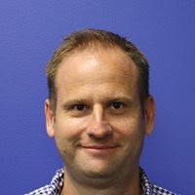
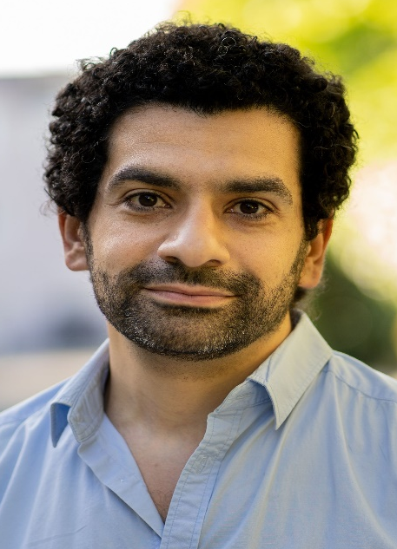
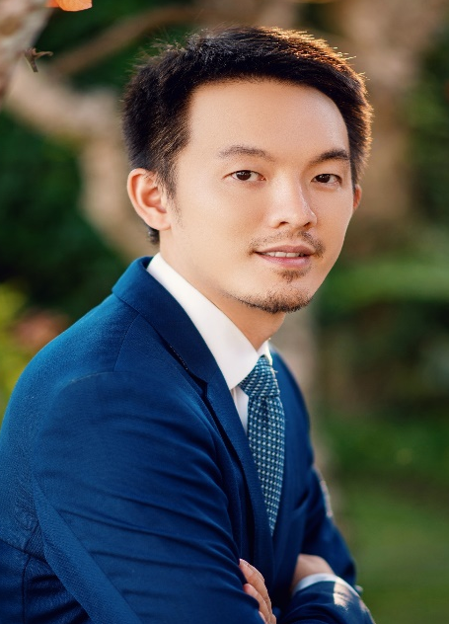
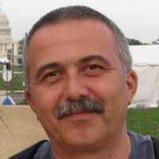
TGay MAC Contributors (1/3)
Djordje Tujkovic
Mohamed Abouelseoud
Saehee Bang
George Calcev
Tony Han

Slide 17
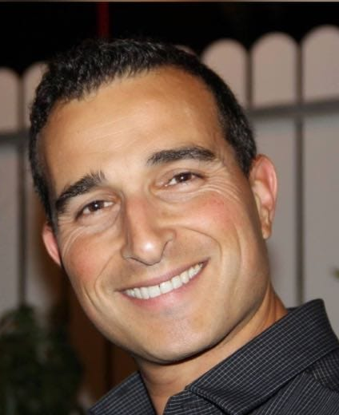
TGay MAC Contributors (2/3)
Chris Hansen
Kyungtae Jo
Oren Kedem
Jinmin Kim

Slide 18
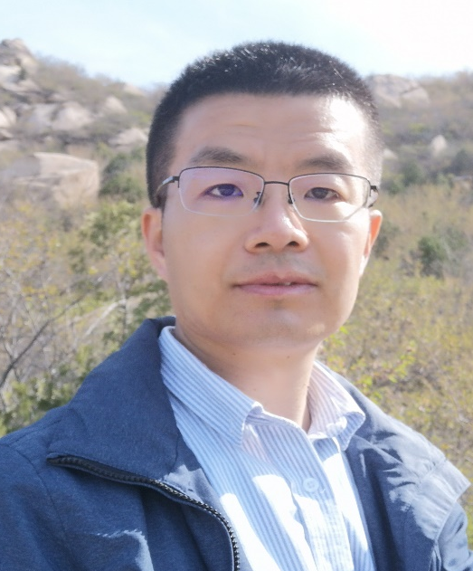
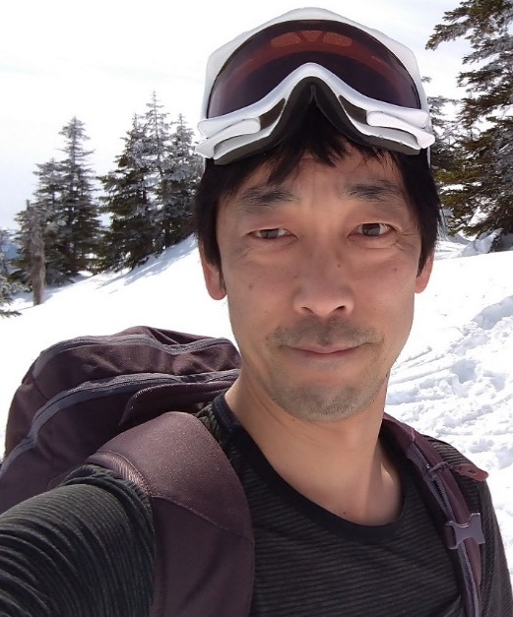
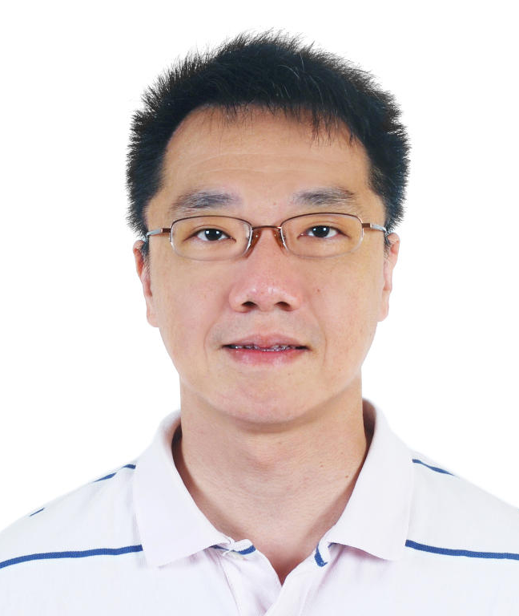
TGay MAC Contributors (3/3)
Dejian Li
Sungjin Park
Kazuyuki Sakoda
Li-Hsiang Sun

Slide 19
References

