Slide 1
Discussions on sensing measurement flows
Date: 2021-06-16
Authors:
Name | Affiliations | Address | Phone | Email
Cheng Chen | Intel |  |  | cheng.chen@intel.com
Claudio da Silva |  |  |  | claudio.da.silva@intel.com
Carlos Cordeiro |  |  |  | carlos.cordeiro@intel.com
Notes:
September 2012

Slide 2
Motivation and background
11bf has generally agreed on the framework of the sensing protocol.
  A sensing session is composed of one ore more of the following phases: setup phase, measurement phase, reporting phase, and termination phase. [Motion 15]
    In the measurement phase, sensing measurements are performed.
  NDP based measurement procedure is supported for channel measurement in the sub-7 GHz band for 11bf. [SP1 in DCN 419r1]
In this contribution, we continue the discussions on sensing measurement flows.
  As a reference, DCN419r1 has already presented some ideas on sensing measurement sequence.
  We focus on sensing measurement flow in this contribution, and therefore assume sensing setup is already done. Moreover, we do not consider sensing reporting and sensing termination.

Slide 3
Assumptions
In this contribution, we make the following assumptions
  We assume STAs involved in the sensing measurement are either associated to the AP or have established security context with the AP in an unassociated state.
  We currently only focus on scenarios without non-AP STA to non-AP STA sensing.
    Scenarios with non-AP STA to non-AP STA sensing might be covered in a future contribution.
  We consider NDP based sensing measurement in the sub-7 GHz.

Slide 4
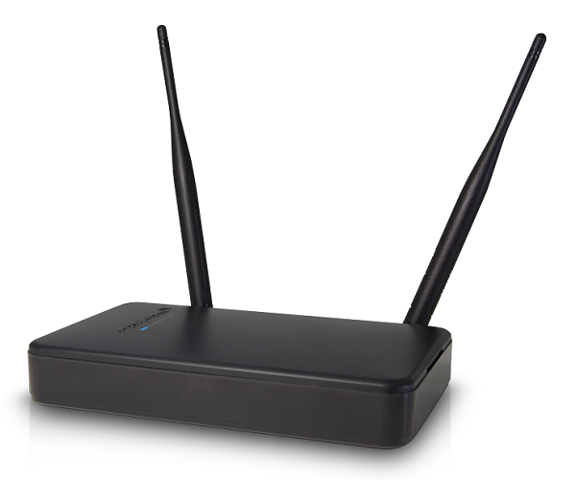


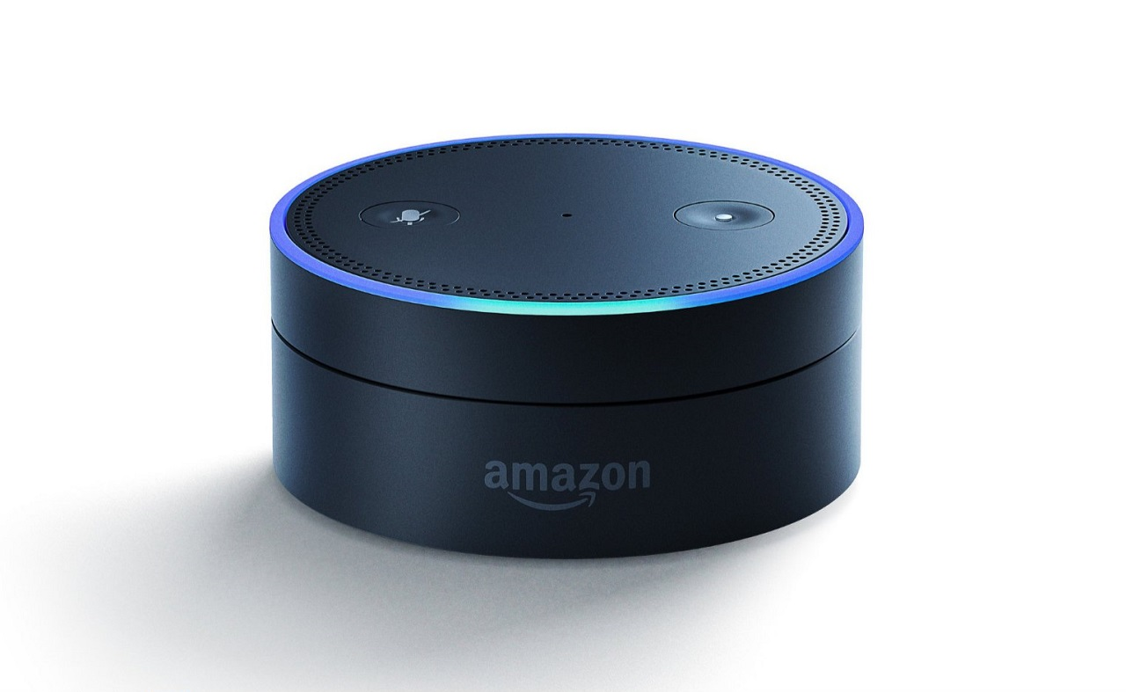
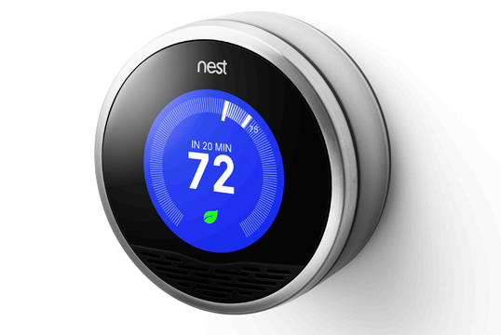
AP initiator
When the sensing initiator is an AP, it may have multiple sensing sessions established with different STAs.
  It is possible that these sensing responder STAs are all sensing transmitters, or all sensing receivers, or a mix of sensing transmitters and sensing receivers.
Nonetheless, the AP could employ its MU capabilities to perform sensing with multiple STAs in one sensing measurement instance.
  The AP could perform DL sensing with multiple sensing receivers at the same time or perform UL sensing with multiple sensing transmitters at the same time.
Sensing PPDU transmission
Sensing Initiator
Sensing Receiver
Sensing Initiator
Sensing Transmitter
AP
AP
Sensing Responders
Sensing Transmitters
Sensing Responders
Sensing Receivers
STA1
STA2
STA3
STA4
STA1
STA2
STA3
STA4

Slide 5
Proposal: A unified sensing measurement flow for AP initiator scenarios
Polling
UL sensing sounding
DL sensing sounding
Key update
AP
TF to STA1-5
Sensing Poll
TF to STA1-2
Sensing Sounding
NDPA to STA3-4
NDP
Secure LTF info update
STA1
CTS-to-self
NDP
Sensing
Transmitters
STA2
CTS-to-self
NDP
STA3
CTS-to-self
NDP
Sensing
Receivers
STA4
CTS-to-self
NDP
STA5
SIFS
SIFS
SIFS
SIFS
SIFS
Polling should always be here to check the availability
of responder STAs before performing the actual sensing
measurement.
Here STA1-4 respond with CTS-to-self to confirm
they will participate in upcoming sensing sounding.
STA5 does not send CTS-to-self back, so AP will not
include STA5 in upcoming sensing sounding.
UL sensing sounding is optionally present,
conditioned on at least one sensing transmitter
responds in the polling.
AP sends a TF to STA1-2 to solicit NDP
packet transmission to do UL sensing sounding.
NDP from STA1-2 could be transmitted
simultaneously in UL-MIMO/UL-OFDMA.
DL sensing sounding is optionally
present, conditioned on at least one
sensing receiver responds in the
polling.
AP sends NDPA+NDP to STA3-4
to perform DL sensing sounding.
Key update is optionally
Present if secure LTF info
needs to be updated and
communicated to STAs. (See
next slide)
The updated information
can be carried in an action or
management frame.

Slide 6
Key update for sensing
In 11az, secure ranging was defined for an ISTA and an RSTA to perform ranging using randomized LTF sequences with enhanced PHY security.
  The information of secure LTF is included in Secure LTF Parameters element, which is optionally carried in the iFTM frame that is exchanged during the negotiation phase for initial secure LTF measurement setup, as well as the LMR frame for any key updates.
In sub-7 GHz that uses LTF to perform sensing measurement, if we want to define secure sensing with enhanced PHY security, we also need to rely on secure LTF sequences.
  In this case, if there is any key updates, the AP needs to distribute the updated key information to responder STAs.

Slide 7
Benefits of the proposed sensing measurement flow for AP initiator
It is a unified flow capable of covering different scenarios where the AP is the initiator.
  Conditioned on whether the participating STAs include at least one sensing transmitter or sensing receiver, UL sensing sounding or DL sensing sounding is present. If participating STAs include both, then both UL and DL sensing sounding are present.
It reuses most of the existing TB Ranging protocol flow defined in 11az.
  The main difference is that in TB Ranging protocol flow, both the UL and DL sounding are always there, while in the proposed sensing measurement flow, both of them are optionally present depending on the roles of sensing responder STAs.
  Of course, some of the frames, like the
  TF and NDPA frame, may need to be
  redesigned to accommodate sensing
  parameters.
TB ranging measurement exchange

Slide 8
Non-AP initiator
If the sensing initiator is a non-AP STA, we assume at least one responder is an AP. Two different cases to consider:
  The sensing measurement only involves the non-AP STA and an AP responder.
  The sensing measurement involves an AP responder and other non-AP STA responders.

Slide 9
Proposal: Sensing measurement flow for non-AP initiator and single AP responder
Option 1: Also use the flow proposed in Slide 5.
  Similar to TB Ranging defined in 11az.
  This is applicable in scenarios where the AP already knows all the sensing schedules and parameters, for example, through sensing negotiation with the STA.
  Again, both UL sensing sounding and DL sensing sounding are optionally present depending on the role of the STA initiator.
Polling
UL sensing sounding
DL sensing sounding
Key update
AP
TF to STA1
Sensing Poll
TF
Sensing Sounding
NDPA
NDP
Secure LTF info update
STA1
CTS-to-self
NDP
SIFS
SIFS
SIFS
SIFS
SIFS
AP
STA1
Sensing PPDU transmission
AP
STA1
Sensing Responder
Sensing Transmitter
Sensing Initiator
Sensing Receiver
Sensing Responder
Sensing Receiver
Sensing Initiator
Sensing Transmitter

Slide 10
Proposal: Sensing measurement flow for non-AP initiator and single AP responder
Option 2: Define a flow similar to Non-TB ranging in 11az.
  This flow fits better in some scenarios, for example, where sensing takes place in an opportunistic and on-demand manner.
    Similar ideas were presented in DCN 0842r0.
  Again, both UL sensing sounding and DL sensing sounding are optionally present depending on the role of the STA initiator.
UL sensing sounding
DL sensing sounding
Key update
AP
NDP
Secure LTF info update
STA1
NDPA
NDP
SIFS
SIFS
Sensing PPDU transmission
AP
STA1
AP
STA1
Sensing Initiator
Sensing Receiver
Sensing Responder
Sensing Transmitter
Sensing Responder
Sensing Receiver
Sensing Initiator
Sensing Transmitter

Slide 11
Non-AP initiator, AP responder + other non-AP responders
We assume the other non-AP STA responders are associated to the AP responder.
Note that we do not consider non-AP STA to non-AP STA sensing in this contribution, so in this case, it will be either non-AP STAs transmits sensing PPDUs to the AP, or the AP transmits sensing PPDUs to non-AP STAs.
In this case, the STA initiator will have to rely on the AP responder for all the scheduling work.
  This means the AP will have to know all the sensing parameters and sensing schedules with each non-AP STA responder.
Sensing PPDU transmission
Sensing Responder
Sensing Receiver
Sensing Responder
Sensing Transmitter
AP
AP
Sensing Initiator
Sensing Transmitter
Sensing Responders
Sensing Transmitters
Sensing Initiator
Sensing Receiver
Sensing Responders
Sensing Receivers
STA1
STA2
STA3
STA4
STA1
STA2
STA3
STA4

Slide 12
Proposal: Sensing measurement flow for non-AP initiator and single AP responder + other non-AP responders
Since the AP knows all the parameters and schedules, we can simply use the flow as proposed in Slide 5.
  Again, both UL sensing sounding and DL sensing sounding are optionally present depending on the role of the STA initiator, and the roles of the other non-AP responders.
Polling
UL sensing sounding
DL sensing sounding
Key update
AP
TF to STA1-5
Sensing Poll
TF to STA1-2
Sensing Sounding
NDPA to STA3-4
NDP
Secure LTF info update
Sensing
Transmitters
STA1
CTS-to-self
NDP
STA2
CTS-to-self
NDP
STA3
CTS-to-self
NDP
Sensing
Receivers
STA4
CTS-to-self
NDP
SIFS
SIFS
SIFS
SIFS
SIFS

Slide 13
Benefits of the proposed sensing measurement flow for non-AP STA initiator
It reuses most of the existing TB Ranging protocol flow and non-TB Ranging protocol defined in 11az.
  The main difference is that in both the TB Ranging protocol and non-TB ranging protocol flow, both the UL and DL sounding are always there, while in the proposed sensing measurement flow, both of them are optionally present depending on the roles of STAs.
  Of course, some of the frames, like the TF and NDPA frame, may need to be
  redesigned to accommodate sensing parameters.
11az TB ranging measurement exchange
11az Non-TB ranging measurement exchange

Slide 14
Conclusions
In this contribution we presented further discussions on sensing measurement flows.
  We currently only consider sensing measurement either from AP to non-AP STA, or from non-AP STA to AP, but do not consider sensing between non-AP to non-AP STA.
  Depending on the initiator is an AP or non-AP STA, the sensing measurement flows may be different.
  We propose to define similar sensing flows to existing TB and non-TB Ranging flows in 11az.

Slide 15
SP1
Do you agree with the following?
  11bf shall define a Trigger-based sensing measurement including the following:
    A polling process where an AP sends a Trigger frame to check the availability of STAs. If a STA is available, it responds with a CTS-to-self.
    An optional UL sounding where an AP sends a Trigger frame to solicit NDP transmission(s) from STA(s).
      The UL sounding is present if at least one STA that is a sensing transmitter responds in the polling.
    An optional DL sounding where an AP sends NDPA frame followed by NDP to STA(s).
      The DL sounding is present if at least one STA that is a sensing receiver responds in the polling.
    The order of the UL and DL sounding is TBD.
    The details of the format of the Trigger frame and the NDPA frame are TBD.

