Slide 1
11be spectral mask floor
Date: 06/04/21
Authors | Email
Xiaogang Chen | Xiaogang.c.chen@intel.com
Shahar Gross
Noam Lavi
Eliakim Dahan
Ehud Reshef
Hassan Yaghoobi

Slide 2
Background
The transmit spectrum shall not exceed the maximum of the interim transmit spectral mask and X dBm/MHz at any frequency offset.
  X = -59/-56/-53dBm/MHz are too tight and may never take effect for a reasonable Tx power
BW(MHz) | Abs PSD Floor (dBm/MHz) | Assuming 23dBm EIRP -40dBr PSD(dBm/MHz) | Tx_Pwr to reach X(dBm)
20 | -53 | -30 | 0
40 | -56 | -33 | 0
80 | -59 | -36 | 0
160 | -59 | -39 | 3
320 | -59 | -42 | 6

Slide 3
Considerations of changing the absolute PSD floor
Requirements from the regulatory;
  ETSI/FCC.
Requirements from the peer technology;
  5GNR.
Coexistence.
  WiFi & NR;
  WiFi & WiFi.

Slide 4
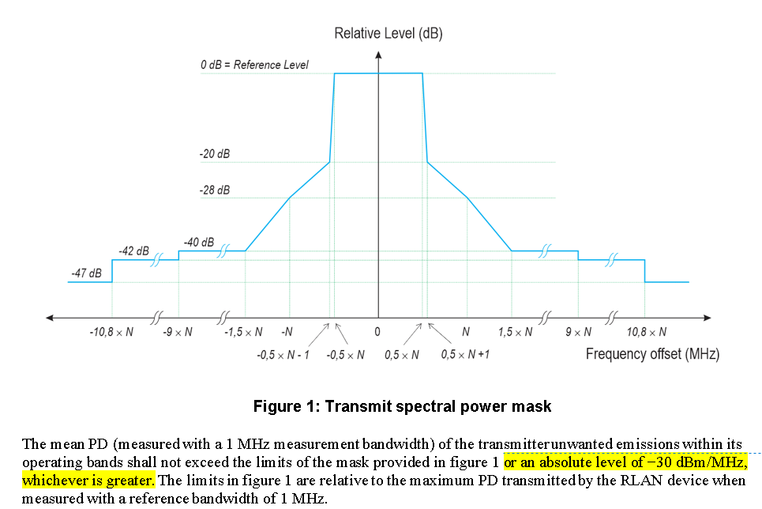
ETSI
Note: Spurious emission is capped at -30dBm/MHz in ETSI

Slide 5
FCC
(5) For transmitters operating within the 5.925-7.125 GHz band: Any emissions outside of the 5.925-7.125 GHz band must not exceed an e.i.r.p. of −27 dBm/MHz.
(6) For transmitters operating within the 5.925-7.125 GHz bands: Power spectral density must be suppressed by 20 dB at 1 MHz outside of channel edge, by 28 dB at one channel bandwidth from the channel center, and by 40 dB at one- and one-half times the channel bandwidth away from channel center. At frequencies between one megahertz outside an unlicensed device's channel edge and one channel bandwidth from the center of the channel, the limits must be linearly interpolated between 20 dB and 28 dB suppression, and at frequencies between one and one- and one-half times an unlicensed device's channel bandwidth, the limits must be linearly interpolated between 28 dB and 40 dB suppression. Emissions removed from the channel center by more than one- and one-half times the channel bandwidth must be suppressed by at least 40 dB.
(7) The emission measurements shall be performed using a minimum resolution bandwidth of 1 MHz. A lower resolution bandwidth may be employed near the band edge, when necessary, provided the measured energy is integrated to show the total power over 1 MHz.

Slide 6
3GPP_OOB Emission
Instead of the general spectrum emission mask requirement in clause 6.5.2.2, when operating with shared spectrum channel access the relative power of any UE emission shall not exceed the levels specified in Table 6.5F.2.2-1 for the specified channel bandwidth or -30 dBm/MHz whichever is the greatest.

Slide 7
3GPP_Spurious emission
6.5F.3.1 General spurious emissions
The requirements for general spurious emission requirements in clause 6.5.3.1 apply. -30dBm/MHz
6.5F.3.2 Spurious emissions for UE co-existence
Spurious emissions requirements for UE coexistence are not applicable to bands restricted to stand-alone operation with shared spectrum channel access as identified in Table 5.2-1.
For 5G network, it requires the spurious emission as low as -50dBm/MHz but not applicable to contention based channel.
6.5F.3.3 Additional spurious emissions
These requirements are specified in terms of an additional spectrum emission requirement. Additional spurious emission requirements are signalled by the network to indicate that the UE shall meet an additional requirement for a specific deployment scenario as part of the cell handover/broadcast message.
Almost all requirements are >-30dBm/MHz; one case requires -41dBm/MHz

Slide 8
Summarize of comparisons
Note of the measurement difference: RMS detector vs. Peak detector may have a gap of 10dB. IEEE doesn’t specify the measurement, but RMS should be reasonably assumed. Regulator also use RMS detector.

Slide 9
Co-existence
WiFi with WiFi
  -40dBr
    20MHz and 160MHz transmission with 23dBm Tx Power can be up to -30dBm/MHz and -39dBm/MHz respectively
    AP with high Tx power has higher PSD level.
    Note: -39dBm/MHz = 23dBm(max EIRP_ETSI) – 40dBr – 10log10(160MHz).
  Given the -30-ish dBm/MHz bond is already exist in the current WiFi system, relax the absolute PSD floor to be -40~-30 dBm/MHz should not impact the coex between WiFi network.
WiFi with non-WiFi
  Peer technology which sharing the same spectrum has a much-relaxed PSD requirement comparing with WiFi.
  The fairness issue is obvious.

Slide 10
SP
Do you agree that
For the transmit spectral mask, the absolute PSD floor is defined as a fixed value of -39 dBm/MHz.
  This value doesn’t scale with the PPDU BW.
  This value is applied to 5GHz and 6GHz band.

