Slide 1
Sensing Measurements: Interfaces and Reporting
Date: 2020-05-30
Authors:

Slide 2
Abstract
The P802.11bf PAR defines that the amendment enables a “MAC service interface for layers above the MAC to request and retrieve WLAN sensing measurements.”
In this contribution, we outline the main definitions necessary for (1) the PHY inform the MAC of obtained sensing measurements and (2) a sensing receiver report sensing measurements to a second STA.
We consider the specific case in which the sensing measurements are channel estimates (CSI). Our focus is on sub-7 GHz WLAN sensing.
Refer to 21/0357r1 for a discussion on the value of CSI measurements for WLAN sensing.

Slide 3
Overview
SME
New primitive(s)
MLME SAP interface
Sensing measurement report frame
Control field
Formatted measurements
MAC
RXVECTOR parameter reported to the MAC if corresponding MIB attribute is activated.
PHY

Slide 4
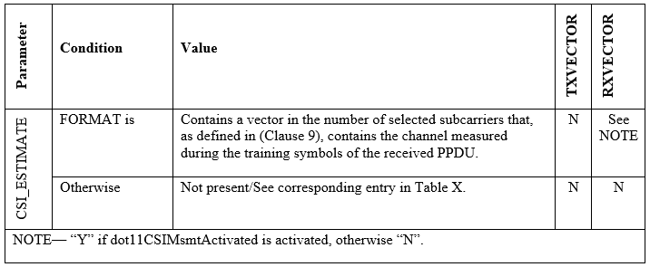
RXVECTOR
A new RXVECTOR parameter would have to be defined to carry CSI measurements.
Example:
Format of the parameter is defined in Clause 9.
Worth noting that the PAR defines that the amendment defines modifications “…to the PHY service interface” of sub-7 GHz PHYs.

Slide 5
Frames
To allow a sensing receiver report sensing measurements to a second STA, a “Sensing Measurement Report frame” would have to be defined (Clause 9).
Proposal:
Action No Ack frame of category Public
At least two fields:
A measurement report control field: Contains information necessary for a receiving STA to interpret the measurement report field.
Measurement report field: Carries CSI measurements obtained by a sensing receiver as described in (Clause 11).
Also possible/advisable to create a companion protected frame.

Slide 6
Report control field
Contains information necessary for a receiving STA to interpret the CSI Measurement Report field.
Subfields necessary may include:
Bandwidth
Number of receive chains
Number of space-time streams
Number of bits

Slide 7
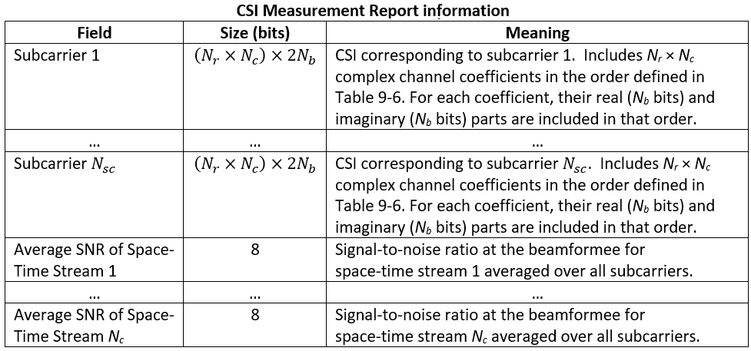
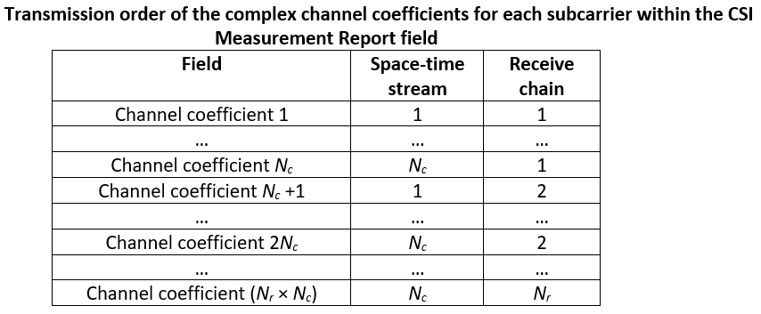
Measurement report field
Possible format, which borrows from the compressed beamforming definition, could be:

Slide 8
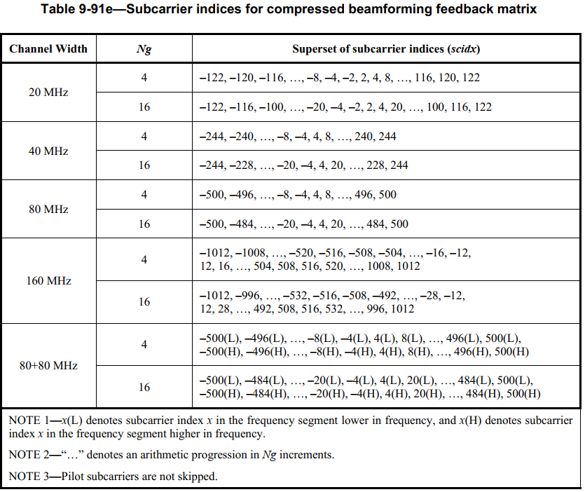
Measurement report field
For subcarrier ordering and to define grouping factors, we could re-use values defined for beamforming feedback.
Example:

Slide 9
Conclusions
There is consensus on the importance of defining CSI as a sensing measurement type for sub-7 GHz sensing.
In this contribution, we outlined the main definitions necessary to enable
The PHY to inform the MAC of obtained CSI measurements and
A sensing receiver to report CSI measurements to a second STA.
Our goal is to bring a more detailed contribution that builds upon the framework here described and that addresses comments and suggestions made by TGbf.
We welcome comments and suggestions.

