Slide 1
EBCS Architecture
Date: 2021-06-22
Authors:

Slide 2
Abstract
This presentation describes EBCS architecture.
R1: Add slides 9-13

Slide 3
Control Plane
EBCS
filter
SME Configuration
SME
MLME-EBCSINFO.request
MLME
EBCS
EBCS Content List

Slide 4
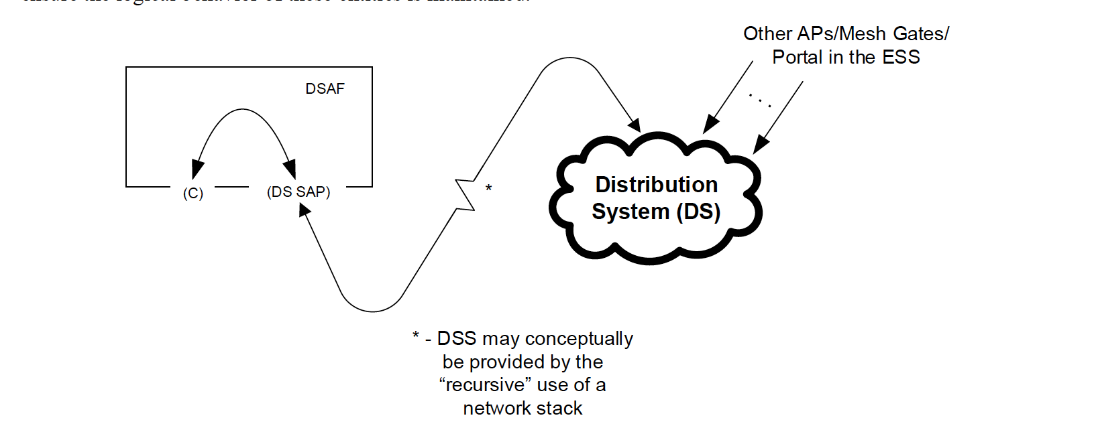
Data Plane
EBCS filter
(EBCS SAP)
(C no-restriction)
EBCS Service

Slide 5
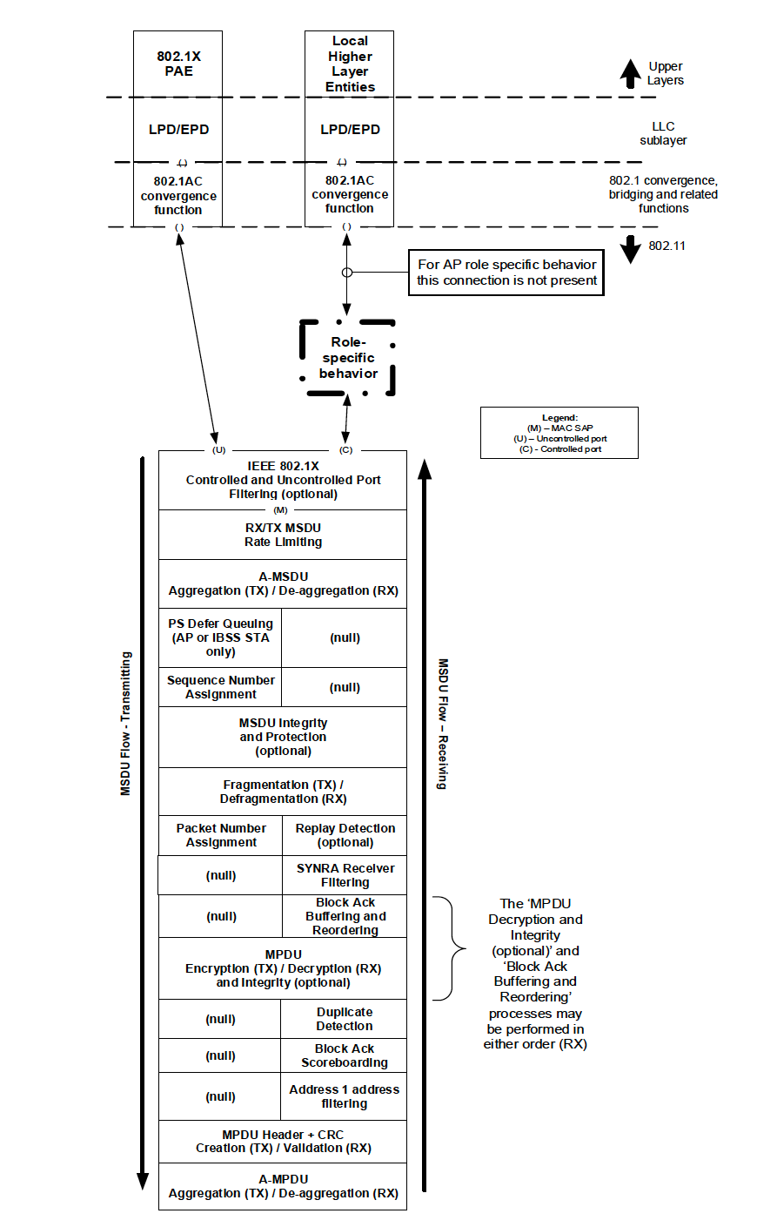
Control Plane with MIB
EBCS
filter
SME Configuration
SME
MIB
dot11EBCSContentList
MA-UNITDATA.request
(EBCS content ID)
MLME
EBCS
EBCS Content List
Content ID | Title | HLP Destination | HLP Source | Authentication Algorithm | TX Rate | Negotiation Method | …
get
search
search
get
PHY-TXSTART.request

Slide 6
EBCS
EBCS provides 2 types of services.
EBCS DL:
An EBCS AP distributes multicast contents to both associated and unassociated EBCS receivers with origin authenticity.
EBCS UL:
The EBCS UL Service procedure allows a non-AP STA to transmit an EBCS UL frame with the expectation that one or more EBCS APs in the neighborhood would relay the HLP payload carried in the frame to a destination specified in the frame.

Slide 7
DL Use Case: Stadium Video Distribution
Topology/Architecture
Stakeholders
Stadium system operators
Stadium audience, coaches and referees
Broadcasters, e.g., Live TV
Manufacturers of semiconductor, networking and mobile devices
Contents
Server
Network
Service scene
An eBCS AP provides eBCS for videos to a large number of densely located STAs, which may be mobile devices.
An eBCS AP provides multiple eBCSs for multiple video streams, e.g.:
live video feed/Video Highlights Replay
Videos from different angles of the game (e.g., in soccer)
Videos of different sport activities that take place in parallel (e.g., athletics)
AP
STA
STA
STA
STA
STA
Required function
Providing enhanced Broadcast Services (eBCS) for videos to a large number of densely located STAs. These STAs may be associated, or unassociated with the AP or may be STAs that do not transmit.
Expected benefits:
Ability to broadcast simultaneous information to a large number of users
Reuse existing technology while reducing cost and implementation complexity

Slide 8
UL Use Case: Low Power Sensor UL Broadcast
Topology/Architecture
Stakeholders
Users of IoT devices
IoT System Operators
Manufacturers of semiconductor, APs, IoT devices, networking and mobile devices
STA 1
AP 1
Internet
Server
Service scene
An eBCS AP provides forwarding service for eBCS non-AP STAs that are not associated with itself to end-servers
eBCS STAs have pre-configured keys to enable secure message delivery
eBCS non-AP STAs are expected to generate low rate data: e.g., 100bps short burst once a day
eBCS APs may enforce service policy
STA 2
AP 2
Zero Setup Sensor
STA 1
@ t=T₁
AP 1
Internet
Server
Sensor on the move
STA 1
@ t=T₂
AP 2
Required function
Pre-configured IoT devices automatically connect to the end server through eBCS APs with zero setup action required
Low power IoT devices in mobility report to their servers through eBCS APs without scanning and association
Expected benefits:
Ability to broadcast information destined to the end server
Ability to reduce cost and implementation complexity
Ability to enable low power sensor STA operations

Slide 9
Frame Types
EBCS DL
EBCS Info frame (Public Action frame):
Key, Content information…
EBCS Data frame (Data frame, Class 1):
Content
EBCS UL
EBCS UL frame (Public Action frame):
Content, Key…
Public Action frames does not affect data plain architecture.

Slide 10
EBCS DL
Server
AP
Receiver
Dst MAC
RA
IPv4 Multicast
(RFC1112)
01:00:5e:xx:xx:xx
01:00:5e:xx:xx:xx
IPv6 Multicast
(RFC2464)
33:33:xx:xx:xx:xx
33:33:xx:xx:xx:xx
If the combination of the source IP address, the destination IP address and the destination UDP port of the packet is in the dot11EBCSContentList,
the AP uses EBCS to forward the frames.
Otherwise, the AP uses GTKSA to forward the frames. (If associated STA exists)

Slide 11
DL Architecture Option 1
EBCS
Proxy
LPD/EPD
802.1AC
convergence
function
EBCS Proxy function
TX
Filtering packets according to
Higher layer information (IP addresses, port number…) of the packets
MIB variable dot11EBCSContentList
Forwarding packets to MAC
RX
Forwarding packets to upper layers
Pass through for EBCS
Common to PKFA and HCFA
No encryption / decryption
Integrity check only
PKFA
Key is set by MLME-EBCSINFO.request (TX) and is gotten from eBCS Info frame (RX)
HCFA
Keys are generated in MAC (TX) and are gotten from MPDU (RX)
HLSA
Pass through
Figure 5-1—MAC data plane architecture

Slide 12
EBCS
filter
EBCS
traffic
non-EBCS
traffic
EBCS
AP
Legacy
AP
?
Associated
Associated
EBCS
GTKSA
STA
unassociated
STA
STA
Data plane

Slide 13
Traffic Category
Category # | Can consume EBCS traffic stream | Can request over the air TX of EBCS traffic stream to AP | Note
1 | All STAs regardless association state | - | Antonio 1, Hitoshi 1
2 | All STAs regardless association state | All STAs regardless association state | Antonio 2
3 | All STAs regardless association state | Associated STAs only | Antonio 3/4, Hitoshi 2
4 | Associated STAs only | Associated STAs only | Hitoshi 3, Out of scope
Category 1 is transmitted over the air by the AP without the need of a request from STAs
Category 2/3/4 will not be transmitted over the air by AP without previous request by a STA
“consume” means decode and optionally authenticate the EBCS traffic stream in IEEE 802.11 layer.

Slide 14
AP (Category 1)
EBCS
filter
SME Configuration
Content list is required by the EBCS Info frame, EBCS ANQP element and EBCS filter.
Which is better the SME to inform content list to MLME via MIB variable or MLME-SAP?
Which is better the SME to inform content list to EBCS filter via MIB variable or direct configuration?
SME
MLME-EBCSINFO.request
MLME
EBCS
EBCS Content List

Slide 15
Share
PHY
MAC address
Beacon

Slide 16
AP (Category 2)
SME Configuration
Association state
SME
EBCS Content List
Write
EBCS STA
(associated/
unassociated)
MIB
dot11EBCSContentList
EBCS Request frame
Local Higher Layer Entities
MLME-EBCSNEGOTIATION.indication
MLME-EBCSINFO.request
Read
MLME
EBCS Info frame
MSDU Rate Limiting
A-MSDU Aggregation
EBCS
filter
EBCS
LPD
EPD
802.1AC
convergence
function
MA-UNITDATA.request
EBCS
Data plane
Stack
PS Defer Queuing
Sequence Number Assignment
TX MSDU Flow
(temporal)
Packet Number Assignment
MPDU Integrity
MPDU Header + CRC Creation
Non-EBCS
LPD
EPD
802.1AC
convergence
function
MA-UNITDATA.request
Legacy
Data plane
Stack
A-MPDU Aggregation
Data plane

Slide 17
AP (Category 3)
SME Configuration
Association state
SME
EBCS Content List
Write
EBCS STA
(associated/
unassociated)
MIB
dot11EBCSContentList
EBCS Request frame
Local Higher Layer Entities
MLME-EBCSNEGOTIATION.indication
MLME-EBCSINFO.request
Read
MLME
EBCS Info frame
MSDU Rate Limiting
Router
A-MSDU Aggregation
EBCS
filter
EBCS
LPD
EPD
802.1AC
convergence
function
MA-UNITDATA.request
EBCS
Data plane
Stack
PS Defer Queuing
Sequence Number Assignment
TX MSDU Flow
(temporal)
Packet Number Assignment
MPDU Integrity
MPDU Header + CRC Creation
Non-EBCS
LPD
EPD
802.1AC
convergence
function
MA-UNITDATA.request
Legacy
Data plane
Stack
A-MPDU Aggregation
Data plane
Higher Layer (i.e. HTTPS, SNMP) API to control SME (start/stop forwarding)
or
IGMP to control router

Slide 18
Content List Item (Enhanced Broadcast Services Tuple field, Figure 9-839b)
Control
Content ID
Negotiation Method
Next Tx Schedule
(Optional)
Time To Termination
(Optional)
Content Authentication Algorithm
Content Address Type (Optional)
Content Address (Optional)
Title Length
(Optional)
Title
(Optional)
B0
B1
B2
B3
B4
B5
B6-7
Next Tx Schedule Present
Time To Termination Present
Content Address Present
Title
Present
Association Required
Active
Reserved

Slide 19
Option 2: EBCS role
EBCS AP role
Higher Layer Entity
EBCS receiver role
(EBCS SAP)
DA address
filtering
EBCS DL traffic
EBCS DL traffic
(C no-restriction)
(C)
EBCS filter
(EBCS
bypass)
Non-EBCS traffic
(DS SAP)
Non-EBCS traffic

Slide 20
Option 2: EBCS role
EBCS AP role
Higher Layer Entity
(EBCS SAP)
EBCS DL traffic
(C no-restriction)
(C)
EBCS filter
Non-EBCS traffic
(DS SAP)

Slide 21
EBCS filter
(EBCS SAP)
(C no-restriction)
EBCS Service

Slide 22
Define New eBCS Data frame (Copied from 11-19/1506r3)
Add a definition for Class 1 frames in 11.3.3 like following.
3) Data frames
i) Data frames between IBSS STAs
ii) Data frames within PBSS
iii) eBCS Data frames
One or more subtype value(s) for Frame Control field should be assigned.

Slide 23
EBCS AP MIB Variables
dot11EBCSInfoInterval
dot11EBCSHCFAKeyChangeInterval
dot11EBCSHCFAHashDistance
dot11EBCSInfoTxRate
dot11EBCSDataTxRate
dot11EBCSContentList (will be added in D1.03)

Slide 24
EBCS AP MLME SAP interfaces
MLME-EBCSINFO.request (6.3.200.2)
Request to transmit EBCS Info frame.

Slide 25
EBCS receiver MLME SAP interfaces
MLME-EBCSINFO.indication (6.3.200.3)
Indicates EBCS Info frame reception.
MLME-EBCSRECEIVE.request (not in D1.02)
Request to receive specified EBCS traffic stream.

