Slide 1
EBCS Architecture
Date: 2021-06-03
Authors:

Slide 2
Abstract
This presentation describes EBCS architecture.
R1: Add slides 9-13

Slide 3
EBCS
EBCS provides 2 types of services.
  EBCS DL:
    An EBCS AP distributes multicast contents to both associated and unassociated EBCS receivers with origin authenticity.
  EBCS UL:
    The EBCS UL Service procedure allows a non-AP STA to transmit an EBCS UL frame with the expectation that one or more EBCS APs in the neighborhood would relay the HLP payload carried in the frame to a destination specified in the frame.

Slide 4
DL Use Case: Stadium Video Distribution
Topology/Architecture
Stakeholders
  Stadium system operators
  Stadium audience, coaches and referees
  Broadcasters, e.g., Live TV
  Manufacturers of semiconductor, networking and mobile devices
Contents
Server
Network
Service scene
  An eBCS AP provides eBCS for videos to a large number of densely located STAs, which may be mobile devices.
  An eBCS AP provides multiple eBCSs for multiple video streams, e.g.:
    live video feed/Video Highlights Replay
    Videos from different angles of the game (e.g., in soccer)
    Videos of different sport activities that take place in parallel (e.g., athletics)
AP
STA
STA
STA
STA
STA
Required function
Providing enhanced Broadcast Services (eBCS) for videos to a large number of densely located STAs. These STAs may be associated, or unassociated with the AP or may be STAs that do not transmit.
Expected benefits:
  Ability to broadcast simultaneous information to a large number of users
  Reuse existing technology while reducing cost and implementation complexity

Slide 5






UL Use Case: Low Power Sensor UL Broadcast
Topology/Architecture
Stakeholders
  Users of IoT devices
  IoT System Operators
  Manufacturers of semiconductor, APs, IoT devices, networking and mobile devices
STA 1
AP 1
Internet
Server
Service scene
  An eBCS AP provides forwarding service for eBCS non-AP STAs that are not associated with itself to end-servers
  eBCS STAs have pre-configured keys to enable secure message delivery
  eBCS non-AP STAs are expected to generate low rate data: e.g., 100bps short burst once a day
  eBCS APs may enforce service policy
STA 2
AP 2
Zero Setup Sensor
STA 1
@ t=T₁
AP 1
Internet
Server
Sensor on the move
STA 1
@ t=T₂
AP 2
Required function
Pre-configured IoT devices automatically connect to the end server through eBCS APs with zero setup action required
Low power IoT devices in mobility report to their servers through eBCS APs without scanning and association
Expected benefits:
  Ability to broadcast information destined to the end server
  Ability to reduce cost and implementation complexity
  Ability to enable low power sensor STA operations

Slide 6
Frame Types
EBCS DL
  EBCS Info frame (Public Action frame):
    Key, Content information…
  EBCS Data frame (Data frame, Class 1):
    Content
EBCS UL
  EBCS UL frame (Public Action frame):
    Content, Key…
Public Action frames does not affect data plain architecture.

Slide 7
EBCS DL
Server
AP
Receiver
Dst MAC
RA
IPv4 Multicast
(RFC1112)
01:00:5e:xx:xx:xx
01:00:5e:xx:xx:xx
IPv6 Multicast
(RFC2464)
33:33:xx:xx:xx:xx
33:33:xx:xx:xx:xx
If the combination of the source IP address, the destination IP address and the destination UDP port of the packet is in the dot11EBCSContentList,
the AP uses EBCS to forward the frames.
Otherwise, the AP uses GTKSA to forward the frames. (If associated STA exists)

Slide 8
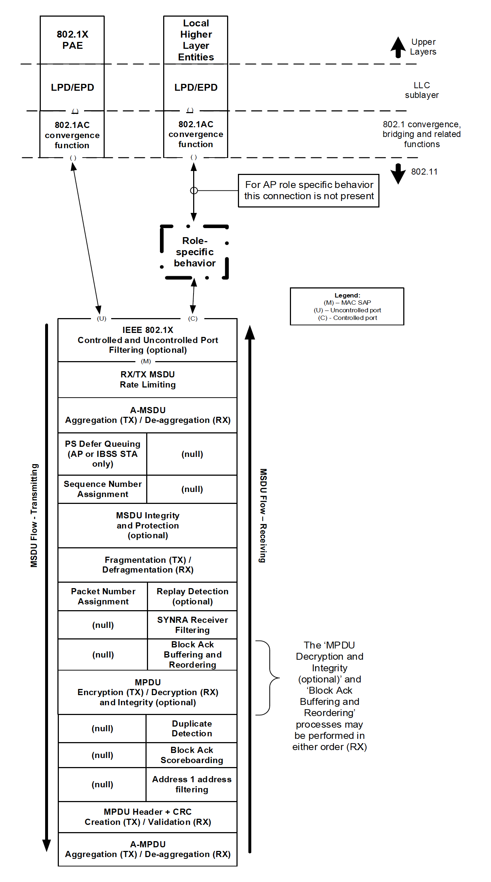
DL Architecture Option 1
EBCS
Proxy
LPD/EPD
802.1AC
convergence
function
EBCS Proxy function
TX
  Filtering packets according to
    Higher layer information (IP addresses, port number…) of the packets
    MIB variable dot11EBCSContentList
  Forwarding packets to MAC
RX
  Forwarding packets to upper layers
Pass through for EBCS
Common to PKFA and HCFA
No encryption / decryption
Integrity check only
PKFA
Key is set by MLME-EBCSINFO.request (TX)
and is gotten from eBCS Info frame (RX)
HCFA
Keys are generated in MAC (TX) and are gotten from MPDU (RX)
HLSA
Pass through
Figure 5-1—MAC data plane architecture

Slide 9
EBCS
filter
EBCS
traffic
non-EBCS
traffic
EBCS
AP
Legacy
AP
?
Associated
Associated
EBCS
GTKSA
STA
unassociated
STA
STA
Data plane

Slide 10
Traffic Category
Category 1: Any STAs within the range of the AP can consume.
Category 2: Any STAs within the range of the AP can consume.
Only associated STAs can control (on/off).
Category 3: Only associated STAs can consume.
Only associated STAs can control (on/off).
Should category 3 traffic be supported in EBCS?
  Current EBCS DL does not support restricting receivers to only associated STAs.
  Use GTKSA or new security scheme.

Slide 11
AP (Category 1)
SME Configuration
Which is better?
SME
EBCS Content List
Write
MIB
dot11EBCSContentList
Local Higher Layer Entities
MLME-EBCSINFO.request
Read
MLME
TX EBCS Info frame
MSDU Rate Limiting
A-MSDU Aggregation
EBCS
filter
EBCS
LPD
EPD
802.1AC
convergence
function
MA-UNITDATA.request
EBCS
Data plane
Stack
PS Defer Queuing
Sequence Number Assignment
TX MSDU Flow
(temporal)
Packet Number Assignment
MPDU Integrity
MPDU Header + CRC Creation
Non-EBCS
LPD
EPD
802.1AC
convergence
function
MA-UNITDATA.request
Legacy
Data plane
Stack
A-MPDU Aggregation

Slide 12
AP (Category 2)
SME Configuration
As only associated STAs can control SME, higher layer protocol can be used.
Should this function be provided in IEEE 802.11 layer?
Which is better?
SME
EBCS Content List
Write
MIB
dot11EBCSContentList
Local Higher Layer Entities
MLME-EBCSINFO.request
Read
Router
MLME
TX EBCS Info frame
MSDU Rate Limiting
A-MSDU Aggregation
EBCS
filter
EBCS
LPD
EPD
802.1AC
convergence
function
MA-UNITDATA.request
EBCS
Data plane
Stack
PS Defer Queuing
Sequence Number Assignment
TX MSDU Flow
(temporal)
Packet Number Assignment
MPDU Integrity
MPDU Header + CRC Creation
Non-EBCS
LPD
EPD
802.1AC
convergence
function
MA-UNITDATA.request
Legacy
Data plane
Stack
A-MPDU Aggregation
Associated
STA
Higher Layer (i.e. HTTPS, SNMP) API to control SME (start/stop forwarding)
or
IGMP to control router

Slide 13
AP (Category 3)
SME Configuration
Which is better?
SME
EBCS Content List
Multicast traffic only for the associated STAs can use existing GTKSA.
Can we assume?
  STAs that can associate know which contents are available.
  STAs that can associate know how to control SME.
Write
MIB
dot11EBCSContentList
Local Higher Layer Entities
MLME-EBCSINFO.request
Read
Router
MLME
TX EBCS Info frame
MSDU Rate Limiting
A-MSDU Aggregation
EBCS
filter
EBCS
LPD
EPD
802.1AC
convergence
function
MA-UNITDATA.request
EBCS
Data plane
Stack
PS Defer Queuing
Sequence Number Assignment
TX MSDU Flow
(temporal)
Packet Number Assignment
Category 1/2
MPDU Integrity
MPDU Header + CRC Creation
Non-EBCS
LPD
EPD
802.1AC
convergence
function
MA-UNITDATA.request
Legacy
Data plane
Stack
A-MPDU Aggregation
Category 3
Associated
STA
Higher Layer (i.e. HTTPS, SNMP) API to control SME (start/stop forwarding)
or
IGMP to control router

Slide 14
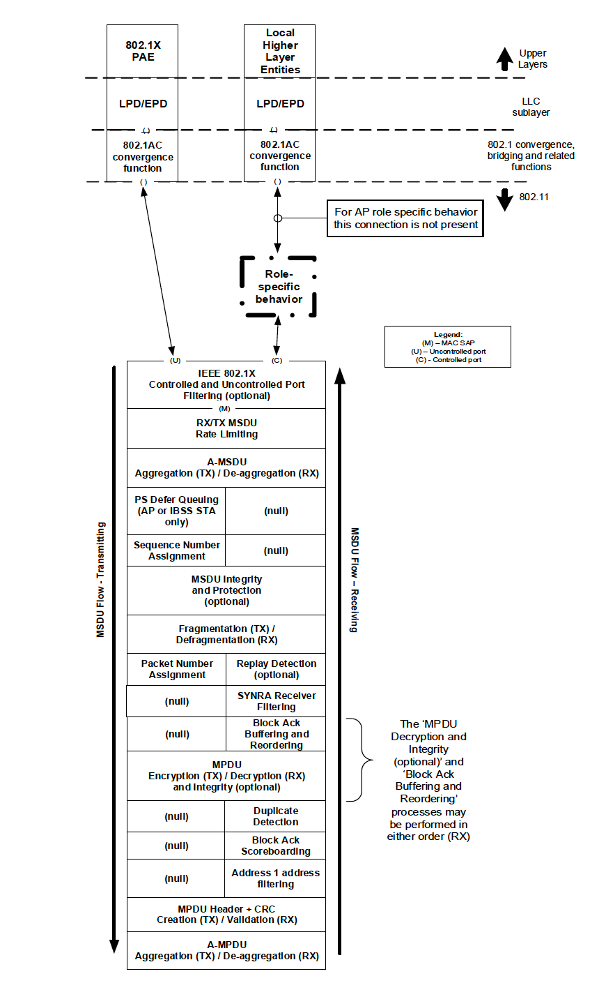
Option 2: EBCS role
EBCS AP role
EBCS receiver role
DA address
filtering
EBCS filter
EBCS DL traffic
EBCS DL traffic
(C)
(C)
(DS SAP)
(EBCS
bypass)
Non-EBCS traffic
Non-EBCS traffic

Slide 15
Define New eBCS Data frame
(Copied from 11-19/1506r3)
Add a definition for Class 1 frames in 11.3.3 like following.
3) Data frames
i) Data frames between IBSS STAs
ii) Data frames within PBSS
iii) eBCS Data frames
One or more subtype value(s) for Frame Control field should be assigned.

Slide 16
EBCS AP MIB Variables
dot11EBCSInfoInterval
dot11EBCSHCFAKeyChangeInterval
dot11EBCSHCFAHashDistance
dot11EBCSInfoTxRate
dot11EBCSDataTxRate
dot11EBCSContentList (will be added in D1.03)

Slide 17
EBCS AP MLME SAP interfaces
MLME-EBCSINFO.request (6.3.200.2)
  Request to transmit EBCS Info frame.

Slide 18
EBCS receiver MLME SAP interfaces
MLME-EBCSINFO.indication (6.3.200.3)
  Indicates EBCS Info frame reception.
MLME-EBCSRECEIVE.request (not in D1.02)
  Request to receive specified EBCS traffic stream.

