Slide 1
Fast Acquisition of EBCS Services
Date: 2021-07-09
Authors:
Name | Affiliation | Address | Phone | Email
Pei Zhou | OPPO |  |  | zhoupei1@oppo.com
Lei Huang |  |  |  | huang.lei1@oppo.com
Chaoming Luo
Liuming Lu

Slide 2
Introduction
Enhanced Broadcast Services Request/Response can be used for the acquisition of EBCS services.
However, if the EBCS data are authenticated by the PKFA or HCFA algorithm, non-AP STAs still cannot authenticate the EBCS data before receiving the EBCS Info frame. This would degrade the EBCS data acquisition performance in terms of delay.
This contribution intends to modify the Enhanced Broadcast Services Request/Response field, when using them for fast acquisition of EBCS data.

Slide 3
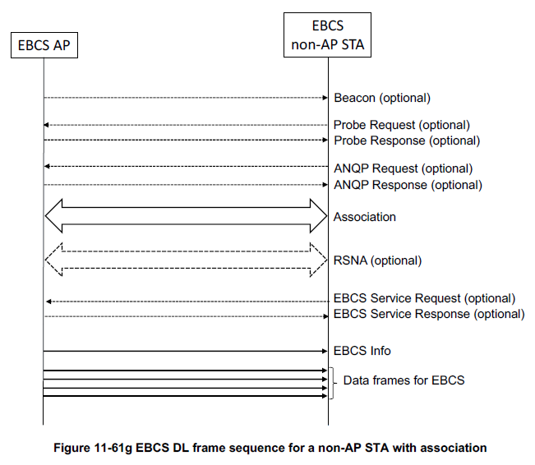
Recap: EBCS DL Procedures
The non-AP STA with association transmits EBCS Request frame to an EBCS AP to request EBCS services.
The EBCS AP periodically broadcasts EBCS Info frames for assisting EBCS data authentication.
The EBCS Info frame includes EBCS AP’s Certificate, EBCS Signature, Authentication Algorithm, HCFA authentication information (optional), etc.
Issue:
Communication Delay: If the EBCS data are authenticated by the PKFA or HCFA algorithm, non-AP STAs cannot authenticate the EBCS data before receiving the EBCS Info frame.

Slide 4
Proposal: Modification of the EBCS Request field
Add Request Authentication Info subfield into the EBCS Request Info Control subfield of EBCS Request Info subfield.

Slide 5
Proposal: Modification of the EBCS Response field
Add Authentication Info Present subfield into the EBCS Response Info Control subfield.
Then, add Authentication Info subfield into the EBCS Response Info subfield if Authentication Info Present subfield equals to 1.

Slide 6
Proposal: Modification of the EBCS Response field (cont.)
The newly added Authentication Info subfield optionally contains Content Authentication Algorithm, Certificate Length, Certificate, Allowable Time Difference, EBCS Info Interval, HCFA Base Key, HCFA Key Change Interval, Number Of Instant Authenticators, Hash Distance and Hash Value fields.
Authentication Algorithm Value | EBCS Data Authentication Method | Components of Authentication Info field
0 | HLSA | \
1 | PKFA | Certificate Length, Certificate and Allowable Time Difference
2 | HCFA without instant authentication | Allowable Time Difference, EBCS Info Interval, HCFA Base Key and HCFA Key Change Interval
3 | HCFA with instant authentication | Allowable Time Difference, Number Of Instant Authenticators, and Instant Authenticator List (Hash Distance and Hash Value)
4-255 | Reserved

Slide 7
Summary
If the EBCS data are authenticated by the PKFA or HCFA algorithm, the EBCS non-AP STA cannot authenticate the EBCS data before receiving the Info frame. This would degrade the EBCS data acquisition performance in terms of delay.
We modified the EBCS Service Request/Response field, when using them for fast acquisition of EBCS data. The EBCS non-AP STA can authenticate the EBCS data before receiving the Info frame.

Slide 8
Straw Poll
Do you agree to make the following changes to the EBCS Request/Response field (as shown in slide 4 and 5 of 11-21/897r1)?
For EBCS Request field:
Add Request Authentication Info subfield into the EBCS Request Info Control subfield.
For EBCS Response field:
Add Authentication Info Present subfield into the EBCS Response Info Control subfield.
Add Authentication Info subfield into the EBCS Response Info subfield if Authentication Info Present subfield equals to 1.
Y/N/A

Slide 9
Reference
[1] Draft P802.11bc_D1.03

