Slide 1
Fast Acquisition of EBCS Services
Date: 2021-06-01
Authors:
Name | Affiliation | Address | Phone | Email
Pei Zhou | OPPO |  |  | zhoupei1@oppo.com
Lei Huang |  |  |  | huang.lei1@oppo.com
Chaoming Luo
Liuming Lu

Slide 2
Introduction
EBCS Request/Response ANQP-element and Enhanced Broadcast Services Request/Response element can be used for the acquisition of EBCS services. However, if the EBCS data are authenticated by the PKFA or HCFA algorithm, non-AP STAs still cannot authenticate the EBCS data before receiving the EBCS Info frame. This would degrade the EBCS data acquisition performance in terms of delay.
This contribution intends to modify the EBCS Request/Response ANQP-element and Enhanced Broadcast Services Request/Response element, when using them for fast acquisition of EBCS data.

Slide 3
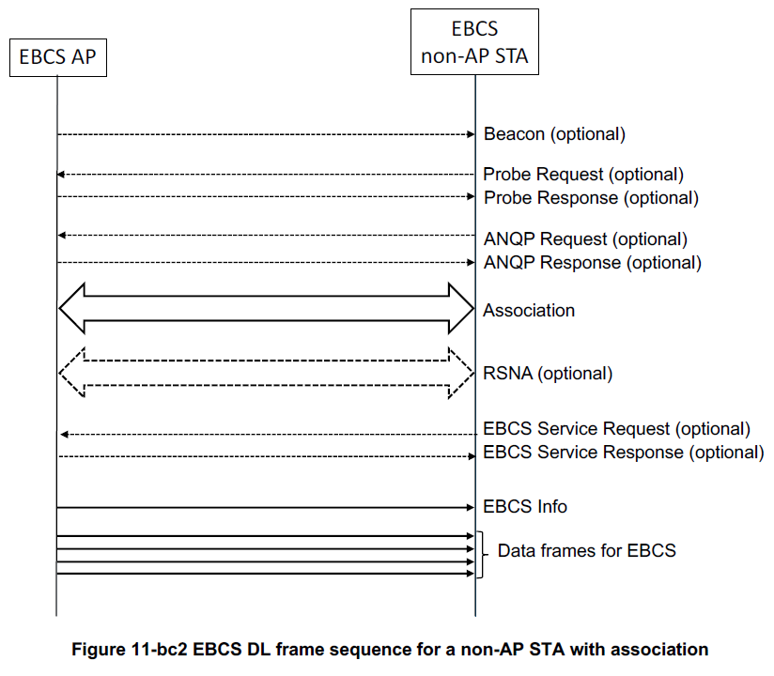
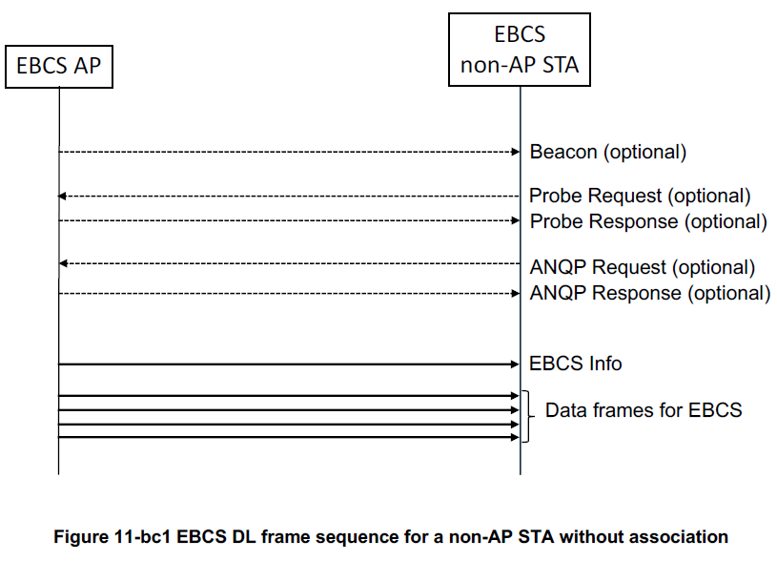
Recap: EBCS DL Procedures
The non-AP STA without association transmits ANQP Request to an EBCS AP to request EBCS services.
The non-AP STA with association transmits EBCS Request to an EBCS AP to request EBCS services.
The EBCS AP periodically broadcasts EBCS Info frames for assisting EBCS data authentication.
  The EBCS Info frame includes EBCS AP’s Certificate, EBCS Signature, Authentication Algorithm, HCFA authentication information (optional), etc.
Issue: If the EBCS data are authenticated by the PKFA or HCFA algorithm, non-AP STAs cannot authenticate the EBCS data before receiving the EBCS Info frame.

Slide 4
Proposal 1: Modification of the EBCS Request element
Add Request Authentication Info subfield into the EBCS Request Info Control subfield.

Slide 5
Proposal 1: Modification of the EBCS Response element
Add Authentication Info Present subfield into the EBCS Response Info Control subfield.
Then, add Authentication Info subfield into the EBCS Response Information Set field if Authentication Info Present subfield equals to 1.

Slide 6
Proposal 1: Modification of the EBCS Response element (cont.)
The Authentication Info subfield optionally contains Content Authentication Algorithm, Certificate Length, Certificate, Allowable Time Difference, EBCS Info Interval, HCFA Base Key, HCFA Key Change Interval, Number Of Instant Authenticators, Hash Distance and Hash Value fields.
Authentication Algorithm Value | EBCS Data Authentication Method | Components of Authentication Info field
0 | HLSA | \
1 | PKFA | Certificate Length, Certificate and Allowable Time Difference
2 | HCFA without instant authentication | Allowable Time Difference, EBCS Info Interval, HCFA Base Key and HCFA Key Change Interval
3 | HCFA with instant authentication | Allowable Time Difference, Number Of Instant Authenticators, and Instant Authenticator List (Hash Distance and Hash Value)
4-255 | Reserved

Slide 7
Proposal 2: Modification of the Enhanced Broadcast Services Request ANQP-element
Add Request Authentication Info subfield into the Enhanced Broadcast Services Request Control subfield of the Enhanced Broadcast Services Request Tuples field.
Note: The subfields in blue are added as per Straw Poll #30 (doc:11-21-0599/r1).

Slide 8
Proposal 2: Modification of the Enhanced Broadcast Services Response ANQP-element
Add Enhanced Broadcast Services Response Control subfield and Authentication Info subfield into the Enhanced Broadcast Services Response Tuples field.
Add Authentication Info Present subfield into the Enhanced Broadcast Services Response Control subfield.
Note: More details of the Authentication Info field can refer to slide 6.

Slide 9
Summary
If the EBCS data are authenticated by the PKFA or HCFA algorithm, the EBCS non-AP STA cannot authenticate the EBCS data before receiving the Info frame. This would degrade the EBCS data acquisition performance in terms of delay.
We modified the EBCS Request/Response element and Enhanced Broadcast Services Request/Response ANQP-element, when using them for fast acquisition of EBCS data.

Slide 10
Straw Poll
Do you agree to make the following changes to the EBCS Request/Response element (as shown in slide 4 and 5 of 11-21/897r0) and Enhanced Broadcast Services Request/Response ANQP-element (as shown in slide 7 and 8 of 11-21/897r0)?
  For EBCS Request element:
    Add Request Authentication Info subfield into the EBCS Request Info Control subfield.
  For EBCS Response element:
    Add Authentication Info Present subfield into the EBCS Response Info Control subfield.
    Add Authentication Info subfield into the EBCS Response Information Set field if Authentication Info Present subfield equals to 1.
  For Enhanced Broadcast Services Request ANQP-element:
    Add Request Authentication Info subfield into the Enhanced Broadcast Services Request Control subfield of the Enhanced Broadcast Services Request Tuples field.
  For Enhanced Broadcast Services Response ANQP-element:
    Add Enhanced Broadcast Services Response Control subfield and Authentication Info subfield into the Enhanced Broadcast Services Response Tuples field.
    Add Authentication Info Present subfield into the Enhanced Broadcast Services Response Control subfield.
  Note: Enhanced Broadcast Services Request Control subfield is added into the Enhanced Broadcast Services Request Tuples field as per Straw Poll #30 (doc:11-21-0599/r1).
Y/N/A

Slide 11
Reference
[1] Draft P802.11bc_D1.02

