Slide 1
TGbc – Handovers in 802.11bc
Date: 2021-05-01
Authors:
Name | Affiliations | Address | Phone | email
A. De la Oliva | InterDigital, UC3M | Avda. De la Universidad 30, Leganes, Madrid, Spain | +34 91 6248803 | aoliva@it.uc3m.es
Xiaofei Wang | InterDigital, Inc.

Slide 2
Problem
Associated and un-associated STAs may be receiving an EBCS traffic stream while moving across different APs.
Several problems arise:
  What neighbor AP is transmitting the EBCS traffic stream the STA is listening to
  Content IDs may or may not be local to the AP (therefore need to listen to some indication of it)
  Providing a list of neighbor APs increases substantially the overhead.
    Consider 3 services, 4 APs, each AP needs to tx 4x48x3 bits (576bits).
  A fixed list of neighbors per service is not flexible enough to accommodate dynamic EBCS.

Slide 3
Possible solutions: the notion of Group ID
One possible way of providing a low overhead indication of APs broadcasting the same services is a Group ID
Group ID: APs sharing the same Group ID are assume to have the same EBCS available.
  Group ID can be transmitted as part of the EBCS Parameter element (beacons)
  Group ID can be for example an Octet, therefore not adding a large overhead to the discovery system.
Group ID will help STAs to discover neighbor APs which can provide the EBCS.

Slide 4
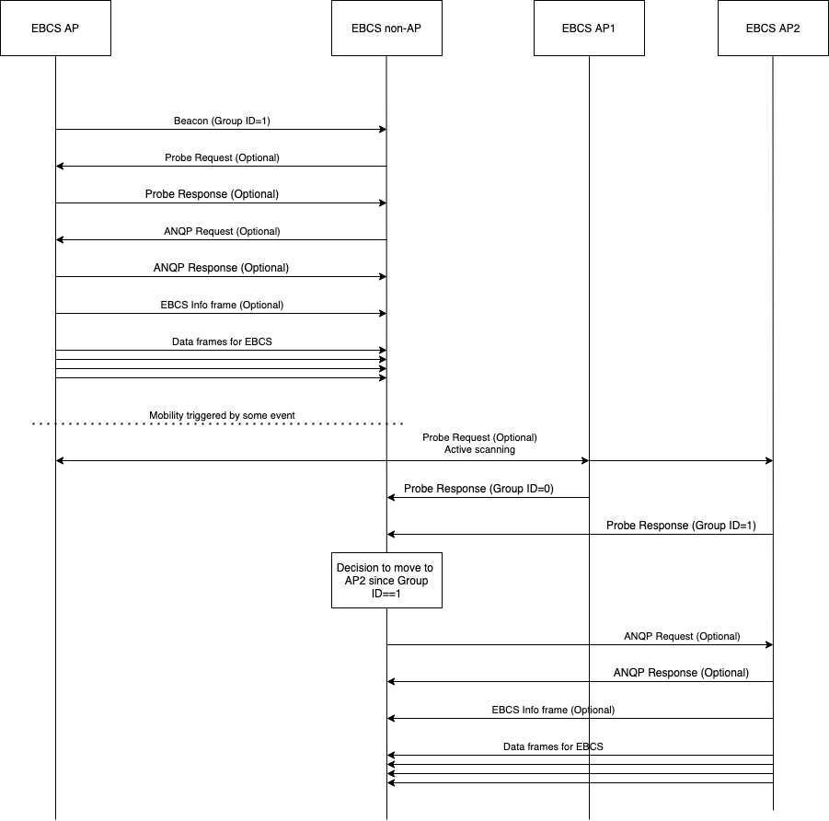
Example
STA starts receiving an EBCS traffic stream from EBCS AP
This is done using standard procedure for un-associated STAs
The STA notes that the EBCS AP belongs to group with Group ID 1.
When moving, it scans for EBCS APs.
  Two EBCS APs are discovered, one with Group ID 0 and another with Group ID 1
  STA known Group ID 1 will be able to provide the service, so it connects to it.
  Since Content ID may be different, it needs to discover the service list through e.g., Enhanced Broadcast Services ANQP-element, and maybe request it (using ANQP Request).
  It can also wait for EBCS Info frame

Slide 5
Some other questions
EBCS Info frame provides information on the transmitted EBCS or the available EBCS?
  If an EBCS appears in the Info frame, do we assume the STA does not need to request for it?
  If not, shall we signal that the EBCS is being transmitted?→maybe through a bit in the EBCS Info frame

Slide 6
Why do we need an indication of the EBCS provided by an AP in the handover case
In the current case, when a STA wants to change AP it is receiving an EBCS from, it needs to:
  Check for APs nearby that support EBCS (check beacon or probe, EBCS Parameters element)
  Decide what AP to associate/listen to
    Currently we do not have any mechanism to optimise this step in bc→ main idea of Group ID proposal
  Gain knowledge of the EBCS available in the new AP
    Waiting for EBCS Info frame
      If we assume Hitoshi proposal (certificate linked to Content ID), the Info frame will guarantee you the EBCS is the same
      Need to wait for an Info frame, it can be long
    Requesting using Enhanced Broadcast Service ANQP-element
      Since Content ID is local, may not provide guarantees of the same EBCS.
  If the EBCS is not available, try again with a different AP

Slide 7
Group ID != ESSID
Group ID indicates the set of APs sharing the same available EBCS.
May have APs with different ESSID exposing the same EBCS
  E.g., in Europe we have a common academic network, called eduroam. At my University some of the APs for eduroam and the university network are the same.
    Same set of EBCS can be made available at both networks
    Using ESSID to select the AP for EBCS consumption, will lock you out of one of the networks
May have APs with different ESSID exposing different EBCS
  E.g., you have a network of multiple APs with same ESSID but only some of them provide EBCS
    Administrative behavior enforced due to the need of different security levels (just example reason)

