Slide 1
802.1AS time synchronization support for TM/FTM
May 2021
Date: 2020-11-01
Authors:

Slide 2
Abstract
This submission proposes a mechanism to support 802.1AS time exchange within 802.11

Slide 3
Background – 802.1AS Clock Synchronization
802.1AS is a Standard prepared by the Time-Sensitive Networking Task Group of IEEE 802.1, and which goal is Timing and Synchronization for Time- Sensitive Applications
The Standard defines procedures by which two or more devices connected over an IEEE 802 network can exchange time information to synchronize their time
This synchronization is crucial to time, delay and jitter-sensitive applications (e.g., industrial settings, AR/VR, gaming and more)
Clause 12 applies to time exchange over 802.11 links, and leverages exiting procedures in 802.11-2020, namely 11.21.5 (Timing Measurement) and 11.21.6 (Fine Timing Measurement)
The intent is that, beyond sharing timestamps (t₁,t₄), the peer STA / RSTA also sends a “FollowUp Information” field that includes host time and synchronization information (called preciseOriginTimestamp, rateRatio, correctionField, etc.)

Slide 4
TM / FTM for ranging vs. TM/FTM for clock Synchronization
Problem 1: the STA does not know if the AP is TM/FTM capable for the purposes of time synchronization
The AP only announces support for TM/FTM in general, but not support for FollowUp Information, making TM/FTM mostly unusable for clock synchronization outside of specialized settings (a ‘normal’ STA must guess whether the AP will share time sync information)
Problem 2: the STA starts by sending a Timing Measurement Request or Initial Fine Timing Measurement Request. But the AP does not know if the goal is ranging or time synchronization -> the AP cannot know if the STA expects FollowUp Information for this exchange
Problem 3: the FollowUp Information is currently sent as VSIE. Although VSIE is an easy vehicle to carry anything, it may make sense to define a proper IE for this usage, to facilitate TSN extension and integration into 802.11

Slide 5
Summary of the Contribution Proposal
Goal:
Define an 802.11 IE for FollowUp Information that can be used to carry 1AS time sync information
Define a capability element expression for time synchronization requests over TM/FTM

Slide 6
1AS FollowUp Information Element
We propose to add a new Information Element to clause 9.4.2, as follows:
  9.4.2.248: 1AS FollowUp Information element
  The 1AS FollowUp Information element is used to carry timing synchronization information in contexts where a STA needs to align its time precisely with that of a reference server. The format of the 1AS FollowUp Information element is shown in figure 9-xxx (1AS FollowUp Information element).
  The Element ID and Length are defined in 9.4.2.1 (General). The 1AS FollowUp Information field is defined in [ref].
(in Clause 2, insert [ref] IEEE Std 802.1ASTM-2020, Timing and Synchronization for Time- Sensitive Applications. )
  The structure of the element is strictly defined in 802.1AS-2020. However, in order to account for future evaluation of the standard, and avoid double-definition of each subfield, we suggest to not describe the 1AS FollowUp Information field in 802.11.
Element ID
Length
1AS FollowUp Information
Octets: 1 1 variable

Slide 7
Support for 1AS FollowUp Information Element
  (Insert at the end of clause 9.4.2.26 as shown below)
  (in table 9-153-Extended Capabilities field)
  (In dot11WirelessMgmtOptions TABLE (in C.3)
  At bottom of Dot11WirelessMgmtOptionsEntry ::= SEQUENCE {, insert)
  dot11TimingSynchronizationActivated TruthValue
dot11TimingSynchronizationActivated OBJECT-TYPE SYNTAX TruthValue
MAX-ACCESS read-write
STATUS current
DESCRIPTION
"This is a control variable.
It is written by an external management entity or the SME.
Changes take effect at the next occurrence of an MLME-START.request or MLME-JOIN.request primitive.
This attribute, when true, indicates that the station capability for 1AS timing information exchange is enabled. False indicates the station has no 1AS timing information exchange capability or that the capability is present but is disabled."
DEFVAL { false}
::= { dot11WirelessMgmtOptionsEntry 53 }
Bit | Information | Notes
86 | 1AS Timing Synchronization | The AP sets the 1AS Timing Synchronization field to 1 when dot11TimingSyncrhonizationActivated is true and set to 0 otherwise

Slide 8
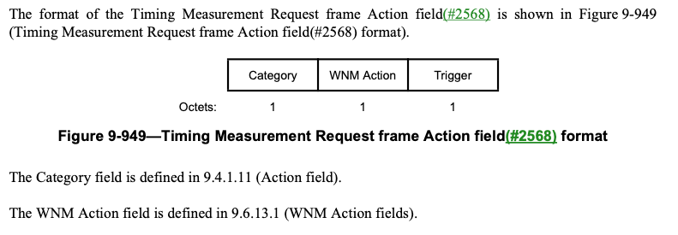
1AS FollowUp Information Timing Measurement Support
We propose to add support for the 1ASFollowUp Information element query as an optional addition to the Timing Measurement Request frame in clause 9.6.13.28, as follows:
The Trigger field set to the value 1 indicates that the sending STA requests a timing measurement procedure at the receiving STA as defined in 11.21.5 (Timing measurement procedure). The Trigger field set to the value 0 indicates that the sending STA requests that the receiving STA stop sending Timing Measurement frames. The Trigger field set to the value 2 indicates that the sending STA requests that the receiving STA includes the 1AS FollowUp Information element in the TM frame(s). Trigger field values 23–255 are reserved.

Slide 9
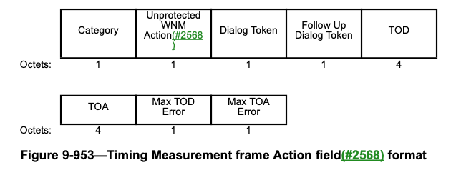
1AS FollowUp Information Timing Measurement Support (Cont.)
We propose to add support for the 1ASFollowUp Information element as an optional addition to the Timing Measurement frame in clause 9.6.14.3, as follows:
The 1AS FollowUp field is optionally present. If present, it contains the 1AS FollowUp Information element as defined in 9.4.2.248 (1AS FollowUp Information element).
AS FollowUp Information
(optional)
…/…

Slide 10
1AS FollowUp Information Timing Measurement MLME Support
Update clause 6.3.55.2.2, and clause 6.3.55.3.2, as follows:
Update clause 6.3.55.4.2, and clause 6.3.55.5.2, as follows:
MLME-TIMINGMSMT.request(
Peer MAC Address,
Dialog Token,
Follow Up Dialog Token,
t1,
Max t1 Error,
t4,
Max t4 Error,
1AS FollowUp Information
VendorSpecific )
Name | Type | Valid Range | Description
Trigger | Integer | 0-12 | The trigger to identify the action
MLME-TIMINGMSMT.indication(
Peer MAC Address,
Dialog Token,
Follow Up Dialog Token,
t1,
Max t1 Error,
t4,
Max t4 Error,
1AS FollowUp Information
VendorSpecific )
Name | Type | Valid Range | Description
1AS FollowUp Information | As defined in 9.4.2.248 (1AS FollowUp Information element) | As defined in 9.4.2.248 (1AS FollowUp Information element) | Optional element containing the 1AS FollowUp Information time synchronization information

Slide 11
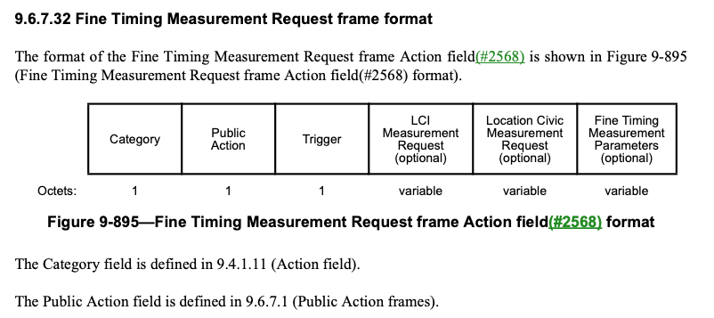
1AS FollowUp Information Fine Timing Measurement Support
We propose to add support for the 1ASFollowUp Information element query as an optional addition to the Initial Fine Timing Measurement Request frame in clause 9.6.7.32, as follows:
The Trigger field set to 1 indicates that the initiating STA requests that the responding STA start or continue sending Fine Timing Measurement frames (see 11.21.6 (Fine Timing Measurement (FTM) procedure)). The trigger field set to 0 indicates that the initiating STA requests that the responding STA stop sending Fine Timing Measurement frames. The Trigger field set to 5 indicates that the initiating STA requests that the responding STA start or continue sending Fine Timing Measurement and also send the 1AS FollowUp Information element in the FTM frame(s). Trigger field values 26-255 are reserved.
Notes:
From 802.11az draft 3.0:
When the Trigger field is set to two, an EDMG (#3533, #3535) ISTA initiates a (#3533, #3535)
15 FTM measurement exchange using the first path AWV; 11.21.6.4.2.1.5 First Path AWV for EDCA
16 based ranging measurement exchange; see 11.21.6.4.2.1.5 (First Path AWV for EDCA based
17 ranging measurement exchange). When the Trigger field is set to 3, an EDMG (#3533, #3535)
18 ISTA indicates that the following FTM burst shall contain an LOS assessment measurement. If the
19 FTM burst is performed over the first path AWV and shall contain an LOS assessment
20 measurement, the Trigger field is set to 4. Trigger field values (#1226) 25–255 are reserved.

Slide 12
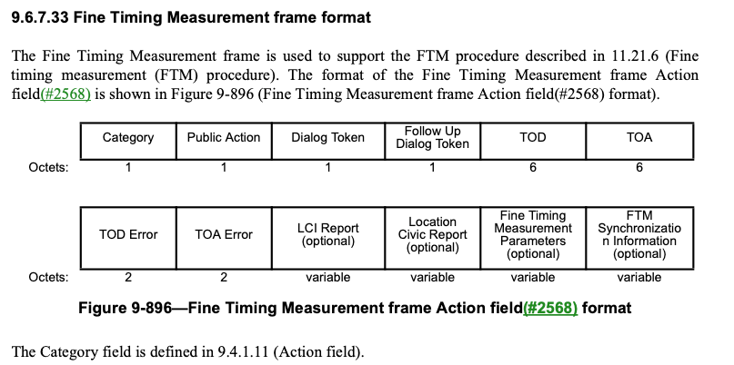
1AS FollowUp Information Fine Timing Measurement Support (Cont.)
We propose to add support for the 1ASFollowUp Information element as an optional addition to the Fine Timing Measurement frame in clause 9.6.7.33, as follows:
The 1AS FollowUp field is optionally present. If present, it contains the 1AS FollowUp Information element as defined in 9.4.2.248 (1AS FollowUp Information element).
1AS FollowUp
Information
(optional)
variable
…/...

Slide 13
1AS FollowUp Information Timing Measurement MLME Support
Update clause 6.3.56.2.2, and clause 6.3.56.3.2, as follows:
Update clause 6.3.56.4.2, and clause 6.3.56.6.2, as follows:
MLME-FINETIMINGMSMT.request(
Peer MAC Address,
Dialog Token,
Follow Up Dialog Token,
t1,
Max t1 Error Exponent,
t4,
Max t4 Error Exponent,
LCI Report,
Location Civic Report,
Fine Timing Measurement Parameters,
1AS FollowUp Information
VendorSpecific )
Name | Type | Valid Range | Description
Trigger | Integer | 0-16 | The trigger to identify the action
MLME-FINETIMINGMSMT.indication(
Peer MAC Address,
Dialog Token,
Follow Up Dialog Token,
t1,
Max t1 Error Exponent,
t4,
Max t4 Error Exponent,
LCI Report,
Location Civic Report,
Fine Timing Measurement Parameters,
1AS FollowUp Information
VendorSpecific )
1AS FollowUp Information | As defined in 9.4.2.248 (1AS FollowUp Information element) | As defined in 9.4.2.248 (1AS FollowUp Information element) | Optional element containing the 1AS FollowUp Information time synchronization information

