Slide 1
Clause 11 Discussion
Date: 2021-05-14
Authors:

Slide 2
Abstract
This presentation describes discussion items to prepare resolutions for Clause 11.

Slide 3
Architecture description
CID | Comment | Proposed Change
1409 | Rgw The architecture for this feature is incomplete (making this draft really difficult to review). For eBCS procedures, some component of the MAC needs to manage these services and provide a protocol endpoint for setup, security and data transfer. Please define this component. | Define a logical component in the AP (and possibly the STA) that acts as the eBCS service instance. It would encapsulate the broadcast traffic streams in eBCS frames, maintain the state of eBCS broadcasts, and on the AP side, forward or receive frames from the broadcast source or destnation in the network.
Describe architecture in 11.100.2.1 for DL and in 11.100.3.1 for UL.
Clause 4.5.x

Slide 4
S1G and DMG
CID | Comment | Proposed Change
1203 | Why would eBCS not be allowed in S1G? | Replace "eBCS is only supported in a non-DMG non-S1G infrastructure BSS" with "eBCS is only supported in a non-DMG infrastructure BSS".
1470 | The sentence states that eBCS is not supported for 60 GHz and sub 1 GHZ operation. Why not? | Delete the cited sentence. New text needs to be added to the draft to describe eBCS operation in both the 60 GHz and sub 1 GHz bands.
1628 | "This subclause describes eBCS procedures that are used for eBCS STAs. eBCS is only supported in a non-DMG non-S1G infrastructure BSS." Not sure why S1G infrastructure BSS cannot support eBCS feature. | Remove the "non-S1G"
“EBCS is only supported in a non-DMG non-S1G infrastructure BSS.”
S1G: For sensor use case?
DMG: DMG is “directional”. It is not suitable for broadcast.
check excluding any PHY mode
check specific wording

Slide 5
OCB or Public Action frame
CID | Comment | Proposed Change
1412 | Its not clear to me why eBCS DL procedures use data frames but eBCS UL procedures use action frames. Given that these frames originate and terminate at the AP and never are bridged to the LAN, it would make more sense to define an Action frame that could be used for either UL or DL. This would also make security protocols easier to define. | Define both uplink and downlink to use the eBCS frame (given that this information is proxied by an AP anyway. If the use of data frames is absolutely necessary, the 802.11 stnadard defines OCB operations which accomplish this task.
1415 | If the AP is sending data frames, how is this different from OCB? The AP? | If eBCS DL uses data frames, if they are part of the BSS they would be no different from other data frames. If they are not part of the BSS, they should be defined as OCB frames.
TGbc discussed about the frame type for DL data transfer in Jan. 2019 meeting.
Minutes: 11-19/2114r0
10. Discussion on frames used for eBCS data
10.1. Straw poll results run during the face to face meeting seems to indicate that the TGbc group wants to:
10.1.1. Use data frames for eBCS data
10.1.2. In the UL case, eBCS data may be piggy-backed in eBCS Info frame (public action frame)

Slide 6
AP-to-AP
CID | Comment | Proposed Change
1000 | eBCS can be useful to support AP-to-AP communication to coordinate certain activities between the APs in the same neighborhood. | Update figure 11-bc1 and spec text under 11.100.2.1 to remove all reference to an unassociated non-AP STA and replace it with an eBCS receiver. Please update other sections of the draft to support this use case
AP
AP
Broadcast
Non-AP
Non-AP
Just non-AP STA functions are co-located in an AP.
Are specific descriptions required?

Slide 7
Multiple APs
CID | Comment | Proposed Change
1002 | An eBCS receiver may be in range of more than one eBCS APs that provides a particular service that the receiver is interested in. | The spec must provide guidance on how the receiver can seamlessly move between APs without causing service disruptions or perform duplicate detection when in range of more than one AP providing the same service.
1003 | When more than one eBCS APs in the neighborhood provides the same service, are the transnmissions coordinated? I suppose not, each AP can transmit independently. Spec should guidance so that the behavior is When more than one eBCS APs in the neighborhood provides the same service, are the transmissions coordinated? I suppose not, each AP can transmit independently. Spec should guidance so that the behavior is deterministic to the receivers | As in comment
1004 | An eBCS receiver may move out of range for an eBCS AP from which it is currently receiving broadcast service. | The spec must provide guidance on how a receiver can seamlessly move between APs without causing service disruptions.
Server
The EBCS receiver can use the same content stream from multiple APs.
e.g. AP advertises the BSSID of the neighbor AP(s) in the Content
Information in the EBCS Info frame for each content.
Neighbor AP: AP that is potentially in the range of the receiver.
Duplicate detection has to be provided by higher layer protocol.
Although the APs are expected to be operated on the same channel, different channel can be used.
IP multicast
AP
AP
EBCS
Non-AP

Slide 8
Complemental Use of Multiple APs
Increase redundancy. (When the receiver failed to receive a frame from AP1 and if it successfully receives the frame from AP2, the receiver can restore the content.)
Receiver can move seamlessly between APs if the cells are properly designed.
Server
Content A
MAC address
ww:ww:ww:ww:ww:ww
IP multicast
MAC address
xx:xx:xx:xx:xx:xx
AP1
CH1
MAC address
yy:yy:yy:yy:yy:yy
AP2
CH1
MAC address
zz:zz:zz:zz:zz:zz
AP3
CH1
AP4
CH6
EBCS Info
EBCS Info
EBCS Info
EBCS Info
Content A
Content A
Content A
Content A
Neighbor List
yy:yy:yy:yy:yy:yy
Neighbor List
xx:xx:xx:xx:xx:xx
zz:zz:zz:zz:zz:zz
Neighbor List
yy:yy:yy:yy:yy:yy
Neighbor List
Receiver
Duplicate detection shall be provided by the HLP.

Slide 9
Is Neighbor List Required?
IP multicast stream can be identified by its source IP address, destination IP address and destination UDP port in general.
In case of using private IP address in the network, if there is another network that uses same private IP address, the receiver may confuse.
Content A
Src: 192.168.0.1 Dst: 232.0.0.1
Port: 12345
Content B
Src: 192.168.0.1 Dst: 232.0.0.1
Port: 12345
Server A
Server B
AP A1
AP B1
AP A2
AP B2
AP A3
AP B3
Receiver
Same or not????

Slide 10
TIM
CID | Comment | Proposed Change
1005 | What is the RA field of an eBCS Data frame set to? If it is set to broadcast address, it means that all STAs including legacy (non-eBCS) STAs would attempt to parse the frame. This can have a power impact on the STAs. It may also confuse legacy STAs when they see broadcast Data frames from its associated AP during non-DTIM intervals. | As in comment
Modify not to use the Traffic Indicator in the TIM element for the EBCS Data frames
(RA: Group address but not broadcast).
(EBCS Info frame uses the Traffic Indicator in the TIM element.)
And
Make EBCS TIM element (similar to the TIM element) for the EBCS Data frames.
EID
Len
Bitmap of Content ID

Slide 11
EBCS DL
Server
AP
Receiver
Dst MAC
RA
IPv4 Multicast
(RFC1112)
01:00:5e:xx:xx:xx
01:00:5e:xx:xx:xx
IPv6 Multicast
(RFC2464)
33:33:xx:xx:xx:xx
33:33:xx:xx:xx:xx
If the combination of the source IP address, the destination IP address and the destination UDP port of the packet is in the dot11EBCSContentList,
the AP uses EBCS to forward the frames.
Otherwise, the AP uses GTKSA to forward the frames. (If associated STA exists)
EID
Len
DTIM Count
DTIM Period
Bitmap Control
Partial Virtual Bitmap
In the current standard, the Traffic Indicator field is set to 1
when one or more group addressed MSDUs/MMPDUs are buffered at the AP.
Existing non-AP STA decides to wait the group addressed traffic by this bit.
TIM element
Traffic Indicator
Bitmap Offset
1bit
My proposal:
Modify not to use the Traffic Indicator in the TIM element for the EBCS Data frames
And
Make EBCS TIM element (similar to the TIM element) for the EBCS Data frames.
EID
Len
Content ID Bitmap
(new) EBCS TIM element

Slide 12
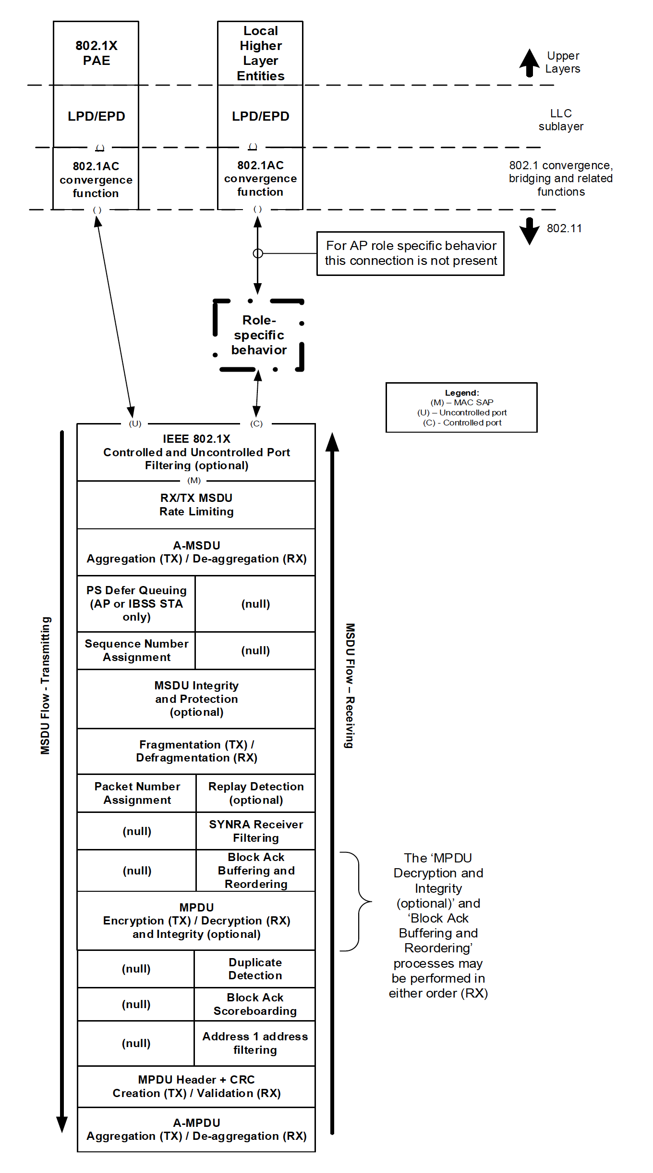
DL Architecture
IP multicast packet
IP addresses and dest port match?
Y
Common to PKFA and HCFA
No encryption / decryption
Integrity check only
PKFA
Key is set by MLME-EBCSINFO.request (TX) and is gotten from eBCS Info frame (RX)
HCFA
Keys are generated in MAC (TX) and are gotten from MPDU (RX)
N
GTKSA
EBCS
Figure 5-1—MAC data plane architecture

