Slide 1
Sub-7 PHY Long Training Field Selection
Date: 2021-04-30
Authors:

Slide 2
Abstract
To identify existing sub-7 GHz PPDU Long Training Field Components and related TX parameters impacting sensing measurements.
Having ability for a Sensing Session to negotiate which Training Field Components and related TX parameters that will be used for by the Sensing Transmitter, allows an application to determine tradeoffs.

Slide 3
Background in PHY Transmission Variables
A number of PHY transmission variables are available which sensing can benefit from. Some parameters have been highlighted in [1]:
  Long Training Field Components (highlighted in this contribution)
  Bandwidth Selection
  Number of Antenna (Spatial Streams)
  Spatial Mapping/Steering Q-Matrix
  TX Power
Options, which if made available in designed MAC protocol, allows application flexibility in achieving use-cases [4][5]

Slide 4
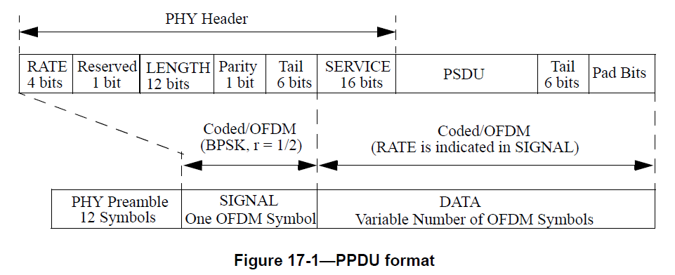
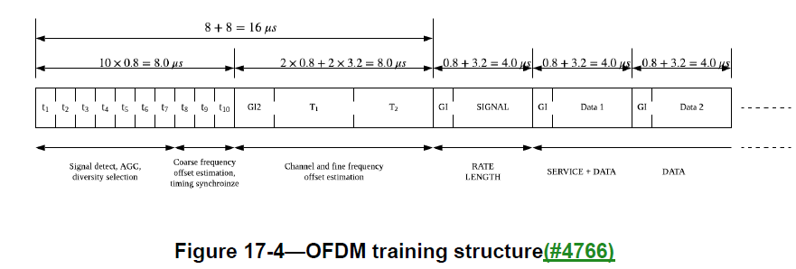
Long Training Fields
For OFDM PHYs, Long Training Fields (LTF) already defined for Channel Estimation, and can be used for Sensing
Different versions available depending on PPDU Type
  Mixed Mode PPDUs contain Legacy and PHY Specific (MIMO) LTF
Each version offers properties which can benefit sensing
  # Spatial Streams, Channel Interpolation, Compatibility, Duration

Slide 5
OFDM PPDU Types (up to AX)
Graphical view of available PPDU preambles and durations.
L-LTF, HT-LTF, VHT-LTF, and HE-LTF defined for channel estimation
NON_HT
HE_SU
HT_MF
HE_MU
HT_GF
HE_ER
HE_TB
VHT

Slide 6

Channel Measurement
Excited subcarriers in LTF used to measure/interpolate channel
Different LTF definitions determine subcarrier excitation
LTF definition is a function of channel bandwidth
MIMO LTF definition is a function of Number Spatial Streams
L-LTF Definition [2] – 20 MHz
Measurement Points with L-LTF:

Slide 7
Legacy LTF (L-LTF)
L-LTF is defined over 20 MHz BW
Higher channel bandwidth transmissions duplicate legacy preamble on each spanning 20 MHz channel (w/ phase rotation)
Benefit is shortest duration PPDU may be used (NON_HT)

Slide 8
HT and VHT LTF
HT and VHT LTF defined as function of BW, utilizing what were previously null subcarriers within L-LTF, providing additional points for channel interpolation
  Additional points useful to improve SNR of channel estimation
  NOTE: VHT-LTF_{-28,28} = HT-LTF_{-28,28} and VHT-LTF_{-58,58} = HT-LTF_{-58,58}
Able to measure spatial streams, providing MIMO estimation
Tradeoff is longer duration PPDU (more air-time required)
[HT/VHT]-LTS
[HT/VHT]-LTS
VHT-LTS
VHT-LTS

Slide 9
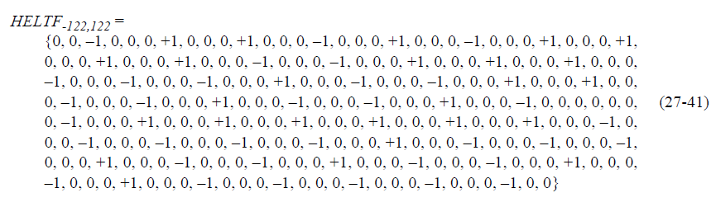
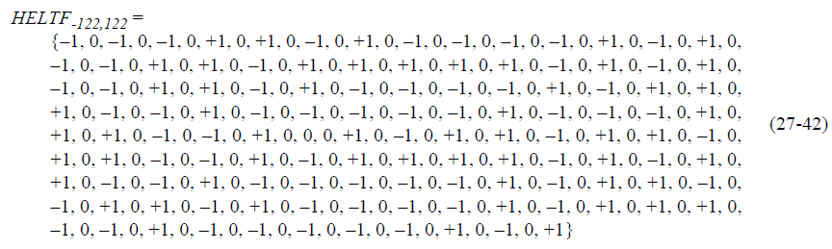
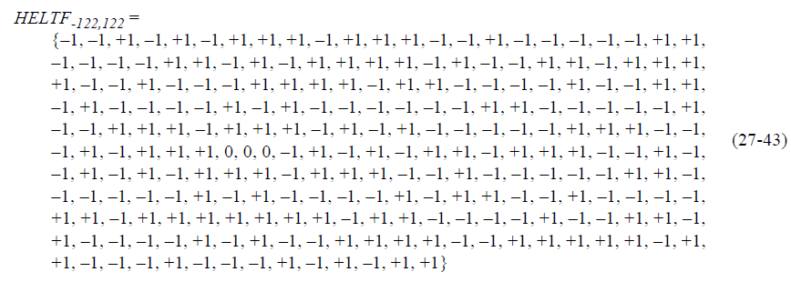
HE LTF
HE LTF allows 1x/2x/4x resolution modes for 20/40/80/160 MHz
  Defined by HE_LTF_TYPE
Result can further improve SNR of channel estimation
Tradeoff is longer duration PPDU (more air-time required)
HE-LTF[3] (1x 20MHz)
HE-LTF[3] (2x 20MHz)
HE-LTF[3] (4x 20MHz)

Slide 10
Summary
Table 1. Long Training Field Presence in PPDU
Table 2. Present Subcarriers
PPDU | L-LTF | HT-LTF | VHT-LTF | HE-LTF
NON_HT | Yes
HT_MF | Yes | Yes
HT_GF |  | Yes
VHT | Yes |  | Yes
HE_SU | Yes |  |  | Yes
HE_MU | Yes |  |  | Yes
HE_ER | Yes |  |  | Yes
HE_TB | Yes |  |  | Yes
LTF | 20 MHz | 40 MHz | 80 MHz | 160 MHz
L-LTF | 52 | 104 | 208 | 416
HT-LTF | 56 * N_{ss} | 114 * N_{ss} | N/A | N/A
VHT-LTF | 56 * N_{ss} | 114 * N_{ss} | 228 * N_{ss} | 456 * N_{ss}
HE-LTF (1x) | 60 * N_{ss} | 122 * N_{ss} | 250 * N_{ss} | 502 * N_{ss}
HE-LTF (2x) | 122 * N_{ss} | 242 * N_{ss} | 498 * N_{ss} | 996 * N_{ss}
HE-LTF (4x) | 242 * N_{ss} | 484 * N_{ss} | 996 * N_{ss} | 1992 * N_{ss}
Table 3. PPDU Preamble Duration
PPDU | Spatial Streams | Preamble Duration
NON_HT | No | 20us
HT_MF | Yes | 32us +N_{ss}*4us
HT_GF | Yes | 24us + (N_{ss}-1)*4us
VHT | Yes | 36us + N_{ss}*4us
HE_SU | Yes | 36us + N_{ss}*T_{HE-LTF}
HE_MU | Yes | 36us + N_{HE-SIG-B}*4us + N_{ss}*T_{HE-LTF}
HE_ER | Yes | 44us + N_{ss}*T_{HE-LTF}
HE_TB | Yes | 40us + N_{ss}*T_{HE-LTF}
Tradeoffs available with LTF Selection
N_{SS} = Number of Spatial Streams
N_{HE-SIG-B} = Number of HE-SIG-B symbols
T_{HE-LTF} = 4us for 1x mode
8us for 2x mode
16us for 4x mode

Slide 11
Remarks
Multiple existing LTFs which can be used for Sensing have been identified.
PPDU presence, preamble duration, and number of measurement points as a function of bandwidth and N_{ss} has been summarized.
Expanding on [1], tradeoffs are available in preamble duration (air time) vs measurement requirements, which can be utilized by applications if negotiation allowed by MAC protocol [5].
Future thinking: at which point does this tradeoff need to be negotiated? At Setup-Phase only, or can existing sessions modify parameters without termination and new session creation?

Slide 12
References
[1] 11-21-0365-02-00bf-wi-fi-sensing-parameters
[2] IEEE 802.11REVme
[3] IEEE Draft P802.11ax 8.0
[4] 11-21-0391-00-00bf-minimizing-impact-as-design-goal
[5] 11-20-1712-02-00bf-wifi-sensing-use-cases

Slide 13
SP #1
Do you agree that during the setup phase of a sensing session, the participants should have the ability to negotiate: PPDU format, Channel Bandwidth, N_{ss} and HE_LTF_TYPE?
Y/N/A?
Results: 15/20/15

Slide 14
SP #2
Do you agree that during the measurement phase of a sensing session, the participants should have the ability to identify which PPDU format, Channel Bandwidth, N_{ss} and HE_LTF_TYPE are used to produce a sensing measurement?
Y/N/A?
Discussed, but not run based on results of SP #1

