Slide 1
Q-D simulation & Modeling framework for sensing
Date: 2021-05-11
Authors:

Slide 2
Outline
Abstract
The NIST Q-D Framework
The NIST Q-D Framework for sensing

Slide 3
Abstract
IEEE 802.11bf PAR [1]: “This amendment defines modifications to the IEEE 802.11 medium access control layer (MAC) and to the Directional Multi Gigabit (DMG) and enhanced DMG (EDMG) PHYs to enhance Wireless Local Area Network (WLAN) sensing (SENS) operation in license-exempt frequency bands between 1 GHz and 7.125 GHz and above 45 GHz”
The NIST Quasi-Deterministic (Q-D) framework [2] is a suite of tools designed to obtain realistic DMG and EDMG performance evaluation (from the channel model to the application layer)
In this contribution, we present our updates to the NIST Q-D framework channel software to enable the evaluation and development of sensing algorithms in the millimeter wave band.

Slide 4
The NIST Q-D framework
Started in 2017
Goal: Develop simulation models to evaluate DMG and EDMG end-to-end performance with high-fidelity channel, antenna model and system-level protocols.
Publicly available and open-source (https://github.com/wigig-tools)
5 software packages
NIST Q-D Channel Realization Software
NIST 802.11ay PHY
ns-3 802.11ad/ay with Q-D channel
Codebook Generator
NIST Q-D Interpreter
Measurements
Channel
System-Level
Antenna Model
NIST Q-D Channel Realization software*
ns-3 802.11ad/ay
with Q-D channel**
Codebook Generator*
PHY
Interpretation
NIST 802.11ay PHY*
NIST
Q-D Interpreter***
* Matlab ** C++ *** Python

Slide 5
The NIST Q-D framework for sensing
Overview of what is required to utilize the NIST Q-D framework in IEEE 802.11bf
In this contribution, we present our updates to the channel model
The PHY and system-level models would also need to be modified to include proposals under consideration by the group
 | NIST Q-D framework | NIST Q-D framework for sensing
Channel | Q-D methodology approach | Adapt the Q-D methodology for sensing applications
PHY | IEEE 802.11ay waveforms | Add IEEE 802.11bf waveform
System-Level | IEEE 802.11ad/ay procedures | Add IEEE 802.11bf sensing procedures
Codebook Generator | Phased-Antenna Array toolbox | ✓
NIST Q-D Channel Realization software
ns-3 802.11ad/ay
with Q-D channel
Codebook Generator
NIST 802.11ay PHY
Q-D Interpreter

Slide 6
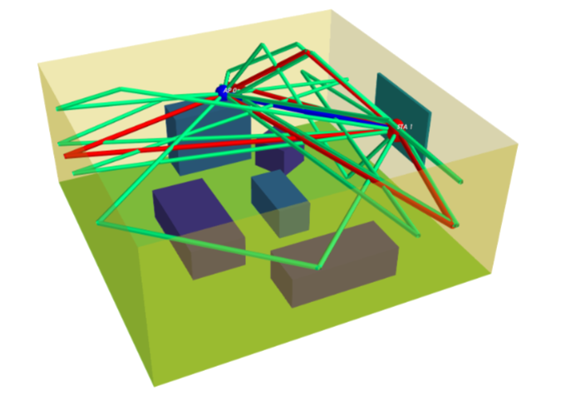
The NIST Q-D Channel realization software
The NIST Q-D Channel Realization software uses the Q-D methodology to generate Multi-Paths
Components (MPCs)
Specular rays: Deterministic approach – Ray tracing (method of images)
Diffuse components: Stochastic approach using a material library (reflectivity, number of pre-post cursors, etc.)
In [3], “A common ‘environment model/channel model’ is needed for the comparison of performance from different contributions. The environment should include:
A few typical scenarios for WLAN sensing
Specific configurations (size of environment, objects properties in the environment, frequency, bandwidth, antenna configuration)
Target(s) to be sensed
Specific configurations (location, trajectory, …) ”
We provide 8 IEEE scenarios [4] (Conference Room, Living Room, etc.)
User can define their own scenario environment and parameters (number of nodes, reflection orders, frequency, bandwidth, etc.)
NIST Q-D channel: Raytracing performed for static environment
=> The NIST Q-D Channel realization software was modified to handle “Target(s) to be sensed”
IEEE Living Room Scenario

Slide 7
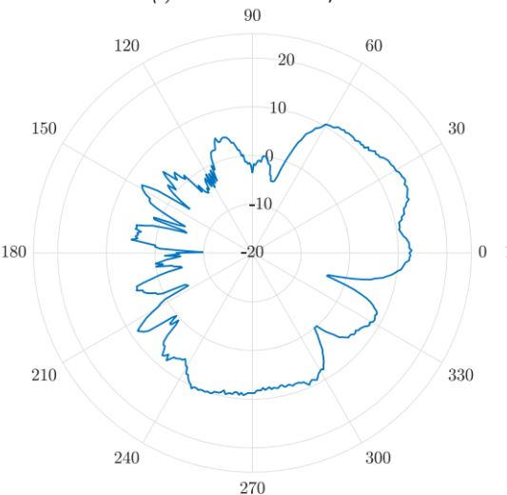
The NIST Q-D Channel realization software for sensing
Introduced the notion of targets
Targets are moving objects/people defined by
Radar Cross Section (shape and dimensions)
Physics of the targets (Reflection coefficient, rough surface parameters)
Trajectory/Velocity
We use a two-steps modeling approach
Ray Tracing of the targets to obtain geometrical parameters, i.e., AOA/AOD, delay (measurements independent) – Presented in this contribution
Target model (measurements dependent)
Loss induced by the target (MPCs gain)
Generate a model from the measurements to the system parameters (RCS)
Targeted to be available for D0.1 (January 2022)
For the remaining of the contribution, we use an omnidirectional RCS
1)
TX
RX
TG
2)
TX
RX

Slide 8
The NIST Q-D Channel realization software for sensing: Targets Ray Tracing
1)
2)
We considered three approaches
Box approximation
Polyhedrons
Points in space
TX
RX
TX
RX
TG
TG
1)
3)
TX
RX
TX
RX
TG
TG
 | Pros | Cons
1) Box approximation | Simple objects to ray trace: scalable | Target could appear as invisible (Snell’s laws) => Need a diffraction and diffuse reflections model (extra-modeling)
2) Polyhedrons | Include blockage | Computationally expensive
3) Points in space | Simple extension of the NIST Q-D software | Does not include blockage
We chose the points in space approach
(a target can be made of multiple points in space)

Slide 9
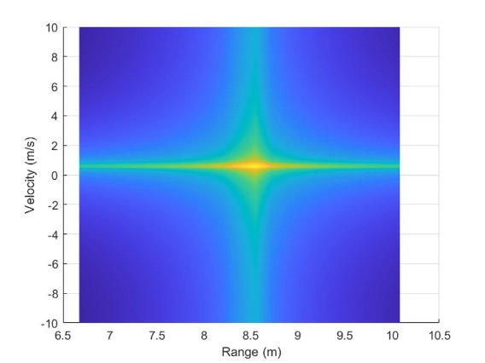
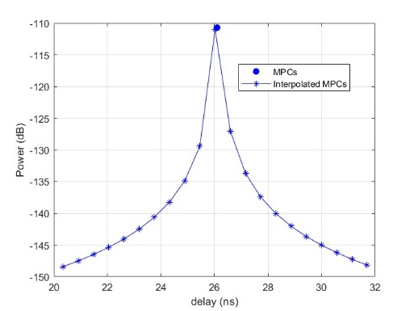
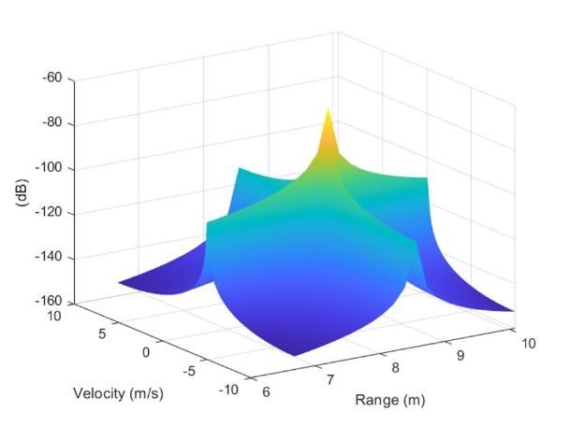
The NIST Q-D Channel realization software for sensing: Sensing targets
Codebook Input
Q-D Input
Phased Antenna Array properties at sensing nodes (number of elements, geometry, elements type, etc.)
Static Environment Geometry
Sensing Nodes Mobility
Targets: Mobility for every points in space and RCS
Codebook Generator
Q-D Output
Sensing Receiver Signal Processing Module
NIST Q-D Channel Realization software with targets support
MPCs (AOA, AOD, Phase, delay and amplitude)
Sensing Nodes Antenna Configuration
Interpolation
fft
Doppler Range
Interpolated Channel
TX
RX
TX
RX
TG
Antenna Configuration
(Snapshot)
TG
MPCs First Order
MPCs (Snapshot)
Interpolation (Snapshot)

Slide 10
The NIST Q-D Channel realization software for sensing: Targets Model (TBD)
Target model will depend on measurements: TBD
TX
RX
TX
RX
TX
RX
TG
1) Ray trace Target points-in-space
2) Apply the target RCS

Slide 11
Summary
We presented the NIST Q-D framework and a first step to enable a sensing channel model at mmWave
We focused on the channel model aspects, but each piece of the framework could be used to evaluate different aspects of IEEE 802.11bf
[5] presents a use-case of human-target detection using the NIST Q-D framework
Next steps
Measurements campaigns, modeling and integration to the NIST Q-D Realization Software

Slide 12
References
[1] https://mentor.ieee.org/802.11/dcn/19/11-19-2103-11-SENS-802-11-sens-sg-proposed-par.docx
[2] https://www.nist.gov/communications-technology-laboratory/wireless-networks-division/radio-resource-allocation-and
[3] https://mentor.ieee.org/802.11/dcn/20/11-20-1642-00-00bf-wlan-sensing-link-level-simulation.pptx
[4] https://mentor.ieee.org/802.11/dcn/15/11-15-1150-09-00ay-channel-models-for-ieee-802-11ay.docx
[5] https://mentor.ieee.org/802.11/dcn/21/11-21-0747-00-00bf-a-preliminary-channel-model-using-raytracing-to-detect-human-presence.pptx

