Slide 1
Test results of Relayed CCA mechanism for UL random access in TGbb
Date: 2021-04-14
Authors:
Name
Company
Address
Phone
E
mail
Nikola
pureLiFi
nikola.serafimovski@purelifi.com
Serafimovski
Tamas Weszely
pureLiFi
tamas.weszely@purelifi.com
Chong Han
pureLiFi
Chong.han@purelifi.com
Mostafa Afgani
pureLiFi
mostafa.afgani@purelifi.com

Slide 2
Abstract
This contribution contains test results of the Relayed CCA mechanism proposed in doc. 11-21/0280r2.

Slide 3
Overview
Test setup
Test results - Throughput
Test results - PER

Slide 4
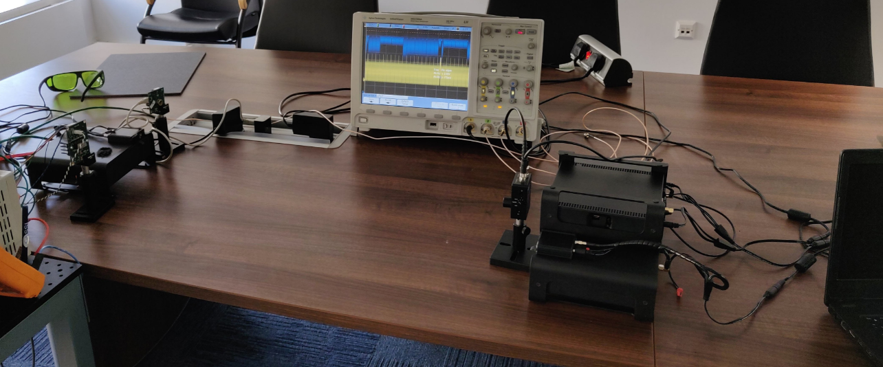
Test setup (1)
Distance between LC AP and
non-AP LC STAs: 0.8m
Chipset: IEEE 802.11ac Wave 2
Channel bandwidth: 80MHz
Traffic model:
satuarated UDP on non-AP LC STA side
RTS/CTS is on all the time
Relayed CCA is switched on/off alternating
LC AP
STAs
(STA1, STA2, STA3)
UL repeater

Slide 5
Test setup (2)
LC AP
UL Repeater
UL traffic only
non-AP LC STA1
non-AP LC STA2
non-AP LC STA3

Slide 6
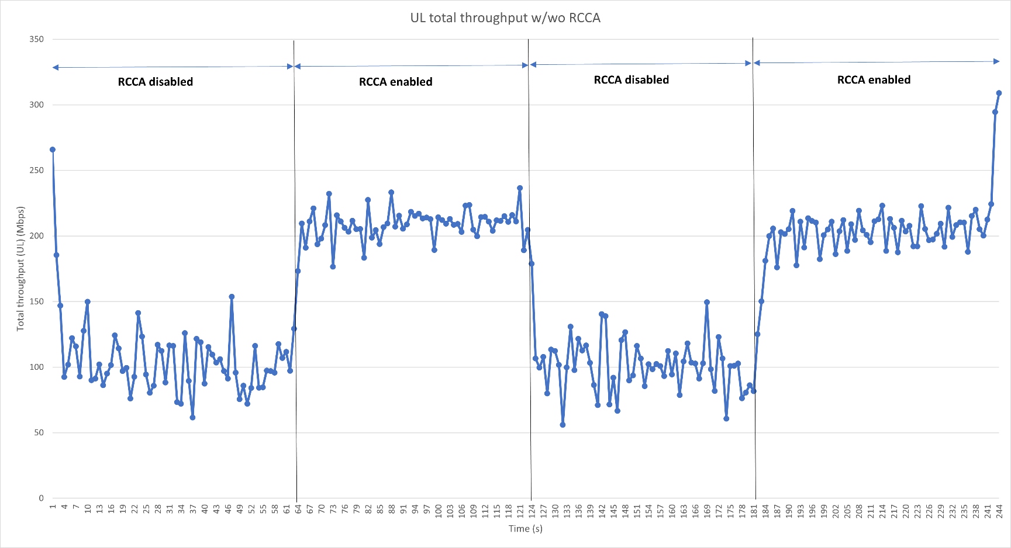
Test results – Throughput (1)
Total UL throughput measured at AP (3 STAs)
100% improvement
Actions:
Turn on the LC AP
Turn on non-AP LC STAs one by one
non-AP LC STA1
non-AP LC STA3
non-AP LC STA2

Slide 7
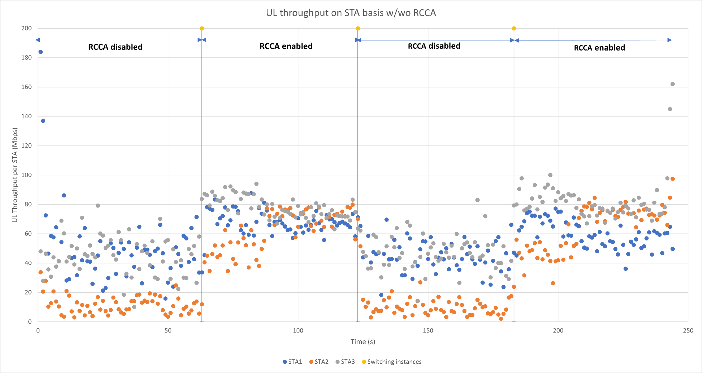
Test results – Throughput (2)
UL throughput performance per STA
Fairness

Slide 8
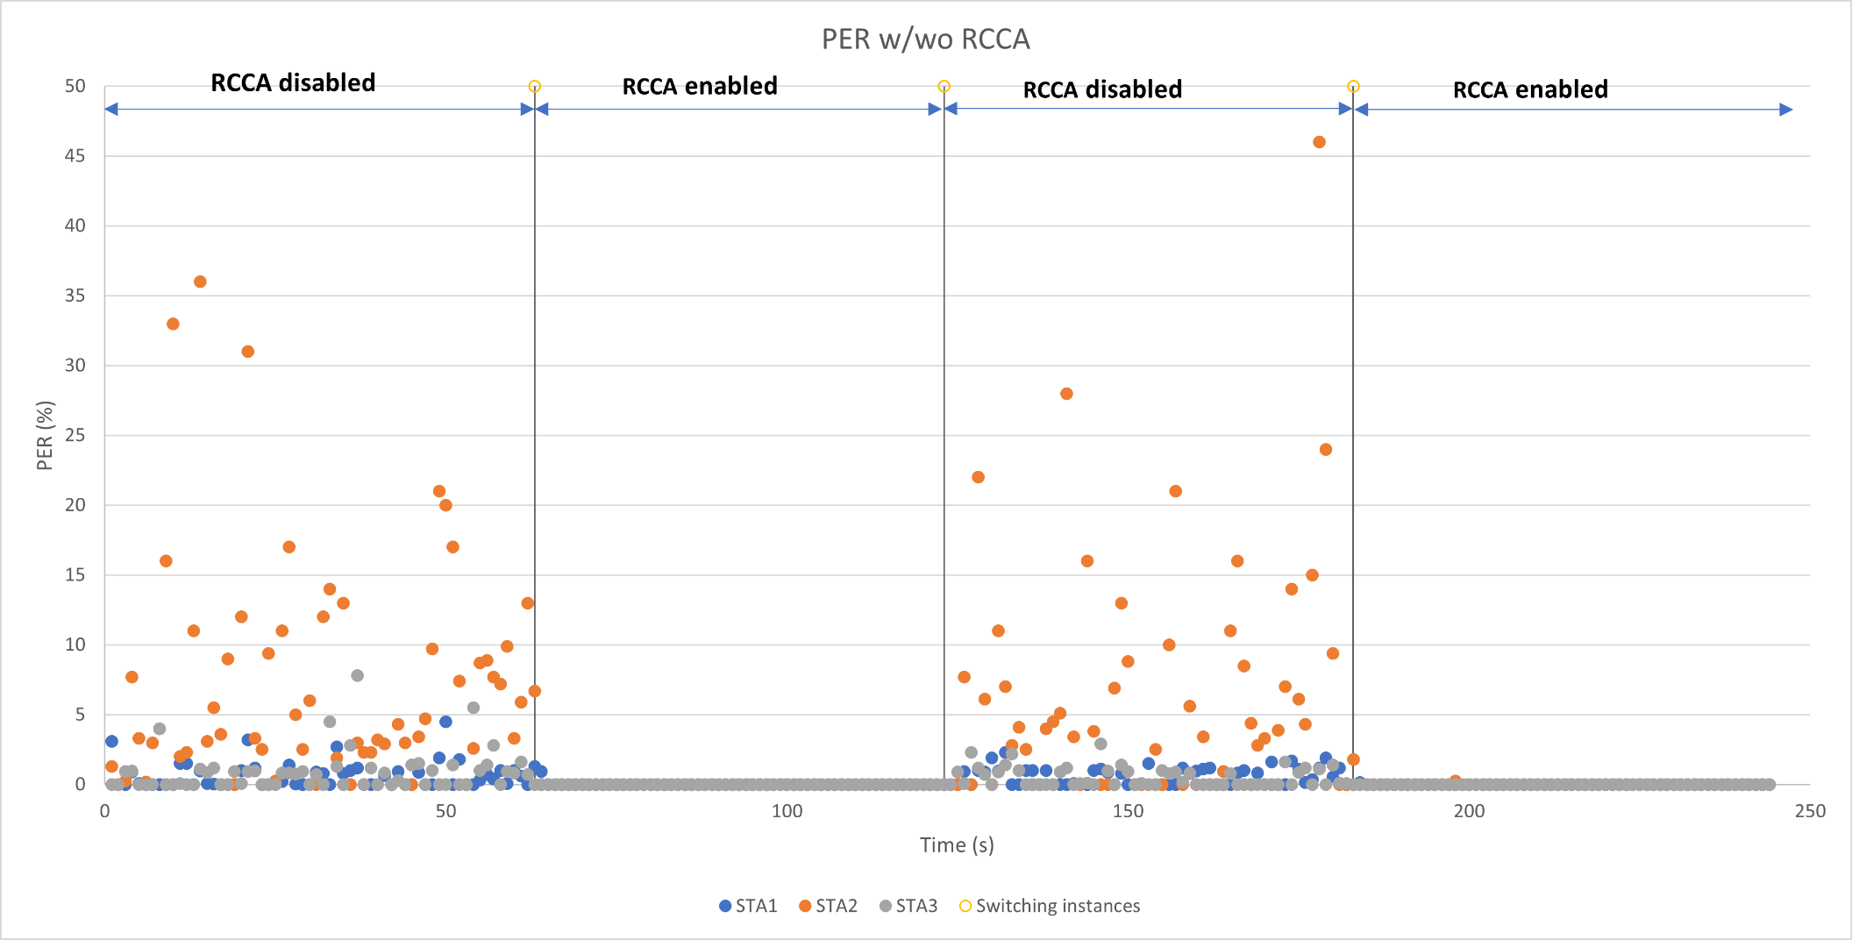
Test results – PER (1)
PER (per STA per second)
Significant loss on QoS

Slide 9
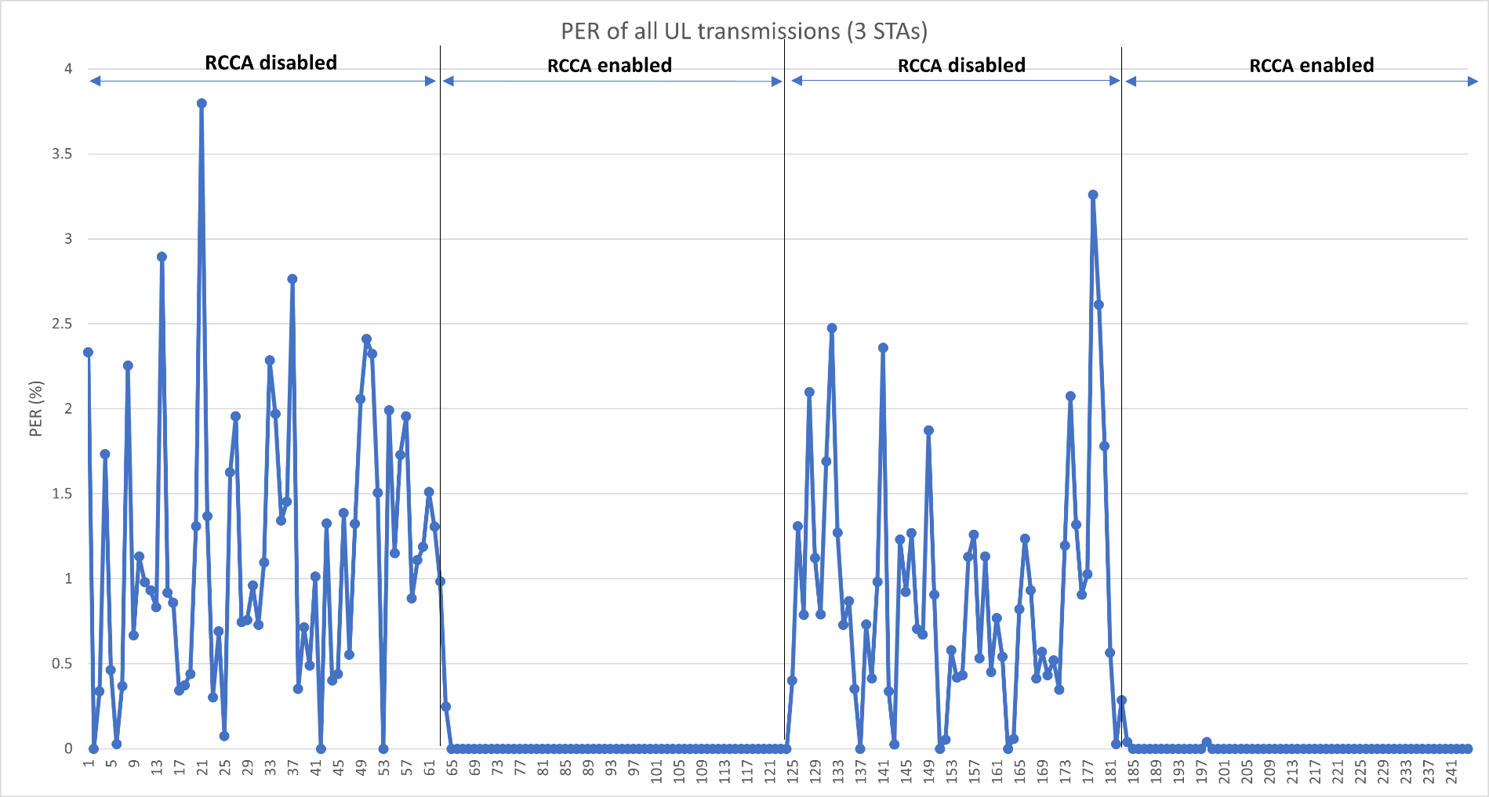
Test results – PER (2)
Average PER of all UL transmissions

Slide 10
Summary
The performance of Relayed CCA mechanism is measured in the tests in terms of throughput and PER.
Comparing to the system with RTS/CTS only, Relayed CCA
enhances the system throughput around 100%
eliminates the unfairness in usage of light medium among STAs
reduces PER substantially
The system performance for TGbb without using Relayed CCA in terms of throughput, PER and fairness will get worse as more non-AP LC STAs connect to an LC AP.

