Slide 1
Simulation and evaluation of the impact of varying ED threshold on performance of 802.11
12 May 2021
Authors:
Name | Affiliations | Phone | email
Gaurav Patwardhan | Hewlett Packard Enterprise |  | gaurav.patwardhan@hpe.com
Eldad Perahia | Hewlett Packard Enterprise |  | eldad.perahia@hpe.com
Stuart Walker Strickland | Hewlett Packard Enterprise | +1(510)358-5246 | stuart.wal.strickland@hpe.com
Slide 1

Slide 2
Context and Motivation
A consensus recently reached in ETSI BRAN:
    establishes a common energy detection (ED) threshold of -72 dBm for all technologies operating in the 6 GHz band
    allows 802.11ax and legacy 802.11 technologies to continue to use an ED threshold of -62 dBm in conjunction with preamble detection (PD) in the 5 GHz band, but requires future technologies, presumptively including 802.11be, to use a common ED threshold of -72 dBm
This contribution explores the implications for 802.11be of operating with an ED threshold of -72 dBm in the presence of legacy equipment operating with an ED threshold of -62 dBm
It also considers the efficiency of adopting a common ED threshold of -72 dBm
Slide 2

Slide 3
Simulation Objectives
Evaluate the impact on the performance of a system operating with an ED threshold of -72 dBm of one or more other co-located systems operating with an ED threshold of -62 dBm
Construct network simulation topologies in which the wanted and unwanted signals of two or more systems may be varied independently
Where more than two systems are simulated, ensure that each hears all others at the same levels
Identify conditions under which performance may vary and measures that may mitigate any observed impact
Slide 3

Slide 4
Topology #1: Simple Coexistence Scenario
Two BSS systems, each with one AP and one associated STA
Full buffer traffic on the uplink
Throughput measured over
  inter-BSS distances (d) corresponding to interfering signals ranging from RSSI levels of -89 dBm to -57 dBm
  intra-BSS distances (d′) corresponding to wanted signals ranging from RSSI levels of -77 dBm to -57 dBm
BSS 1
BSS 2
AP 1
d
AP 2
d′
d′
Uplink Traffic
Uplink Traffic
STA 1
d
STA 2
Slide 4

Slide 5
Runtime Configuration
Both BSS systems model the 802.11ax PHY
    on a common 20 MHz channel
    with a single spatial stream
    and maximum MCS index of 11
    802.11be MCSs 12 and 13 (4096 QAM with coding rates 3/4 and 5/6) are not modelled
Traffic model:
    Uplink traffic only
    1500 MSDU full buffer BE UDP
AP Tx power = STA Tx power = 18 dBm
Each stage of the simulation is run for 30 seconds in real time
Slide 5

Slide 6
Simulation Scenarios
Scenario A establishes a baseline in which both BSS systems employ a common ED threshold of -62 dBm and PD of -82 dBm (as between current 802.11 equipment)
Scenario B considers the effects of reducing the ED threshold of one BSS system to -72 dBm while keeping ED threshold of -62 dBm for the other BSS (as between an 802.11be and legacy 802.11 equipment)
Scenario C considers the effects of reducing the ED threshold of both BSS systems to -72 dBm (as between systems operating in the 6 GHz band)
Inter-BSS distances are varied to measure throughput when each BSS hears the other at levels below PD, between PD and ED, between differing ED thresholds, and above all applicable ED thresholds
Intra-BSS distances are varied to assess the impact of interference at various SNR levels
Scenario | Description | BSS 1 |  | BSS 2 |  | BSS2 hears BSS1 (inter-BSS) | Each AP hears own STA (intra-BSS)
 |  | PD | ED | PD | ED
A | Baseline using current 5 GHz framework | -82 dBm | -62 dBm | -82 dBm | -62 dBm | -57 to -89 dBm | -57 to -77 dBm
B | Future 5 GHz framework | -82 dBm | -62 dBm | -82 dBm | -72 dBm | -57 to -89 dBm | -57 to -77 dBm
C | Future 6 GHz framework | -82 dBm | -72 dBm | -82 dBm | -72 dBm | -57 to -89 dBm | -57 to -77 dBm
Slide 6

Slide 7
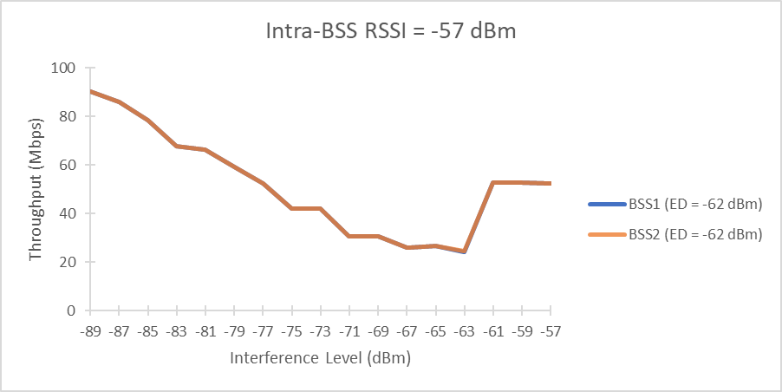
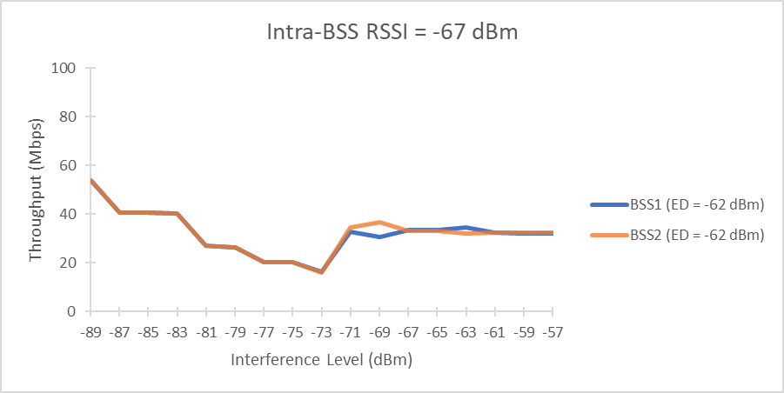
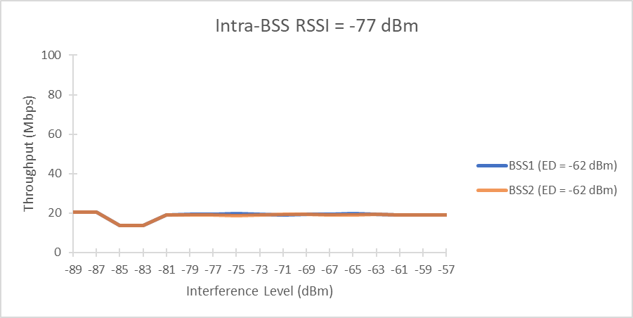
Baseline for the Common ED Threshold of -62 dBm
Efficient sharing of medium above common ED threshold
Reduced throughput below common ED threshold at strong wanted signal levels and at ~5 dB C/I for weaker wanted signals
Significant spatial re-use below PD threshold for strong to moderate wanted signal levels
-62 dBm ED Threshold
-82 dBm PD threshold
C/I trough below PD
~5 dB C/I
Max Single-BSS Throughput: 111 Mbps
Max Single-BSS Throughput: 69.8 Mbps
Max Single-BSS Throughput: 40.65 Mbps
Slide 7

Slide 8
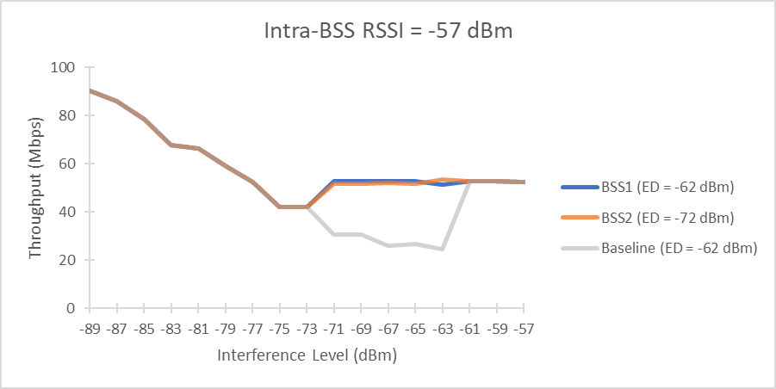
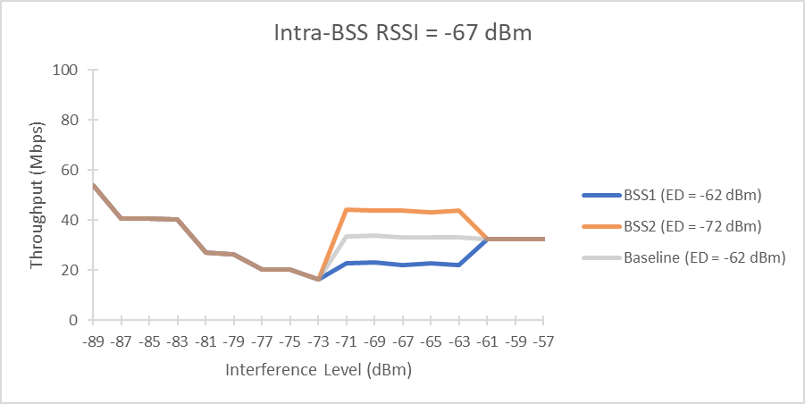
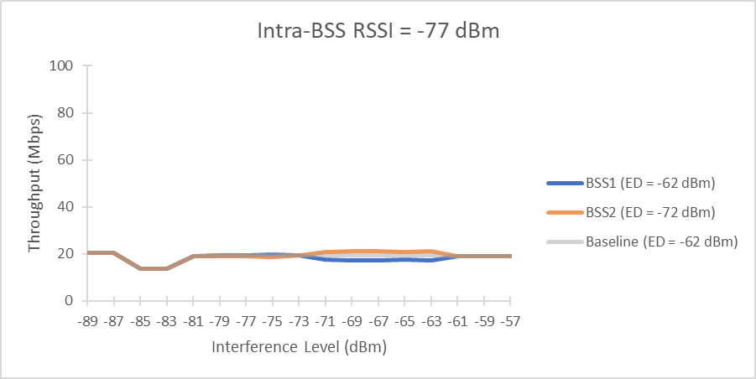
Systems Operating at Different ED Thresholds
Compared with the baseline results, reducing the ED of one BSS to -72 dBm while holding the ED of the other to -62 dBm has little observable effect across all levels of wanted signals when the competing signals are strong (above -62 dBm) or weak (below -72 dBm)
When the ED of one BSS is reduced to -72 dBm and the wanted signals of both BSS systems is strong (-57 dBm), the throughput of both systems is improved throughout the intermediate intra-BSS range between their respective ED thresholds
When the wanted signals are moderate (-67 dBm) or weak (-72 dBm), the system with the lower ED threshold of -72 dBm has an apparent advantage, achieving higher throughput than the system with the higher ED threshold of -62 dBm.
-72 to -62 dBm
Max Single-BSS Throughput: 111 Mbps
Max Single-BSS Throughput: 69.8 Mbps
Max Single-BSS Throughput: 40.65 Mbps
Slide 8

Slide 9
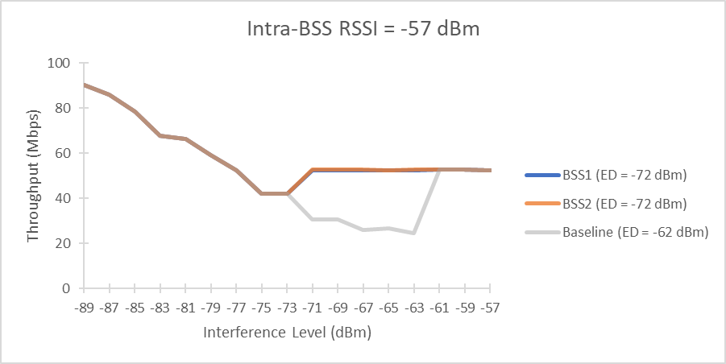
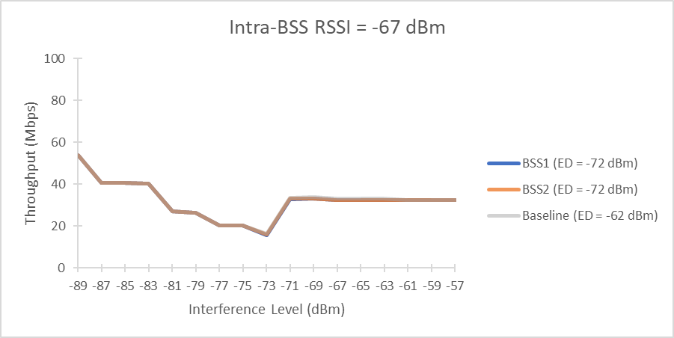
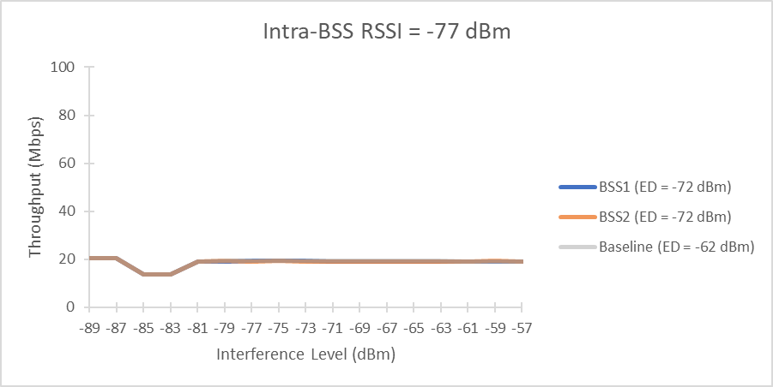
Systems Operating at a Common ED Threshold of -72 dBm
When both systems share a common ED threshold of -72 dBm, results resemble the disparate (-62/-72 dBm) ED scenario when wanted signals are strong and resemble the baseline scenario when signals are weaker
Max Single-BSS Throughput: 111 Mbps
Max Single-BSS Throughput: 69.8 Mbps
Max Single-BSS Throughput: 40.65 Mbps
Slide 9

Slide 10
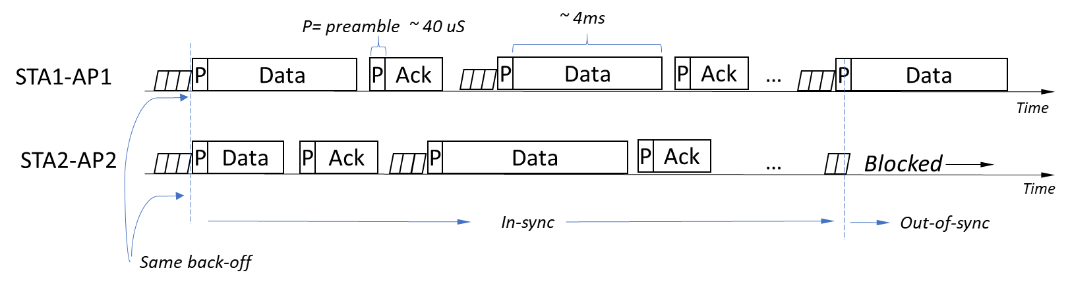
Accounting for Observed Behavior
Very high SINR allows frames to be decoded properly even when transmitted over each other
    → No retries and no backoffs
When both STAs choose the same backoff they fall ‘in-sync’ for a period. This is a function of comparative sizes between preamble and PPDU length
As long as they remain in-sync, preambles are not detected and there is no deferral when the interfering signal lies below the ED threshold
Eventually, a preamble is detected, and the receivers fall out-of-sync, alternating access to the medium
To test this hypothesis, we enable RTS/CTS for all frames, increasing the probability of preamble detection
Slide 10
Notes:
Add diagram

Slide 11
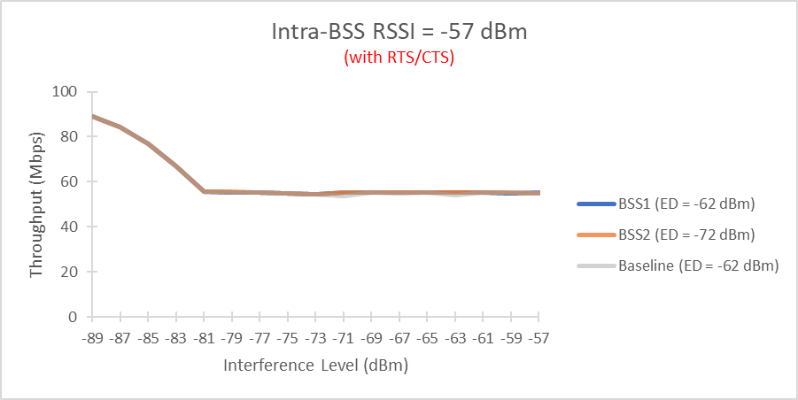
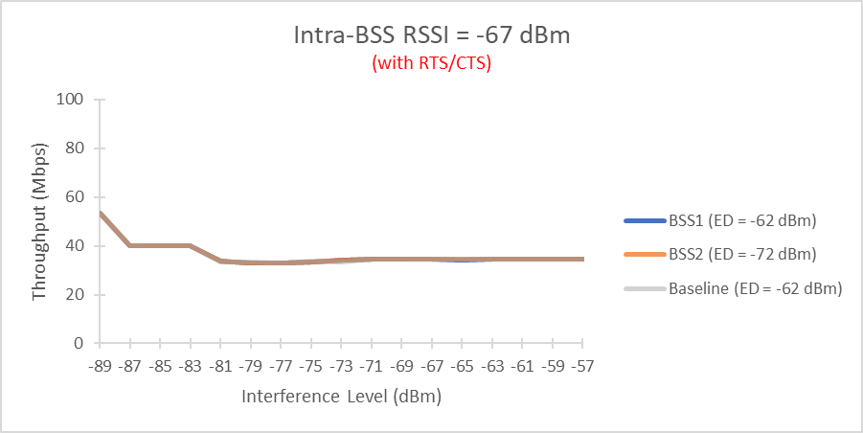
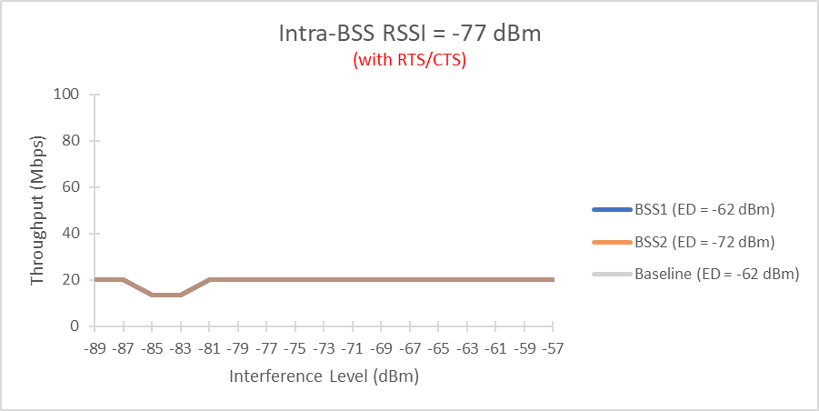
Enabling RTS/CTS Fully Mitigates Effects in Simple Coexistence Scenarios
Max Single-BSS Throughput: 111 Mbps
Max Single-BSS Throughput: 69.8 Mbps
Max Single-BSS Throughput: 40.65 Mbps
Slide 11

Slide 12
Topology #2: Complex Coexistence Scenario
3 BSS systems, each with one AP and one associated STA equidistant from each other
Full buffer traffic on the uplink
Throughput measured over
  inter-BSS distances (d) corresponding to interfering signals ranging from RSSI levels of -89 dBm to -57 dBm
  intra-BSS distances (d′) corresponding to wanted signals ranging from RSSI levels of -77 dBm to -57 dBm
BSS 3
AP3
BSS 1
d
d
BSS 2
AP1
d′
AP2
d
STA3
d′
d′
d
d
STA1
STA2
d
Slide 12

Slide 13
Runtime configuration
All BSS systems model the 802.11ax PHY
    on a common 20 MHz channel
    with a single spatial stream
    and maximum MCS index of 11
    802.11be MCSs 12 and 13 (4096 QAM with coding rates 3/4 and 5/6) are not modelled
Traffic model:
    Uplink traffic only
    1500 MSDU full buffer BE UDP
AP Tx power = STA Tx power = 18 dBm
Each stage of the simulation is run for 120 second in real time
Slide 13

Slide 14
Simulation Scenarios
Scenario 3AP_A establishes a baseline in which both BSS systems employ a common ED threshold of -62 dBm and PD of -82 dBm (as between current 802.11 equipment)
Scenario 3AP_B considers the effects of reducing the ED threshold of one BSS system to -72 dBm while keeping ED threshold of -62 dBm for the other BSS (as between an 802.11be and legacy 802.11 equipment)
Inter-BSS distances are varied to measure throughput when each BSS hears the other at levels below PD, between PD and ED, between differing ED thresholds, and above all applicable ED thresholds
Intra-BSS distances are varied to assess the impact of interference at various SNR levels
Scenario | Description | BSS 1 |  | BSS 2 |  | BSS 3 |  | inter-BSS RSSI (dBm) | intra-BSS RSSI (dBm)
 |  | PD | ED | PD | ED | PD | ED
3AP_A | Baseline using current 5 GHz framework | -82 dBm | -62 dBm | -82 dBm | -62 dBm | -82 dBm | -62 dBm | -57 to -89 dBm | -57 to -77 dBm
3AP_B | Future 5 GHz framework | -82 dBm | -62 dBm | -82 dBm | -62 dBm | -82 dBm | -72 dBm |  | -57, -67, -77
Slide 14

Slide 15
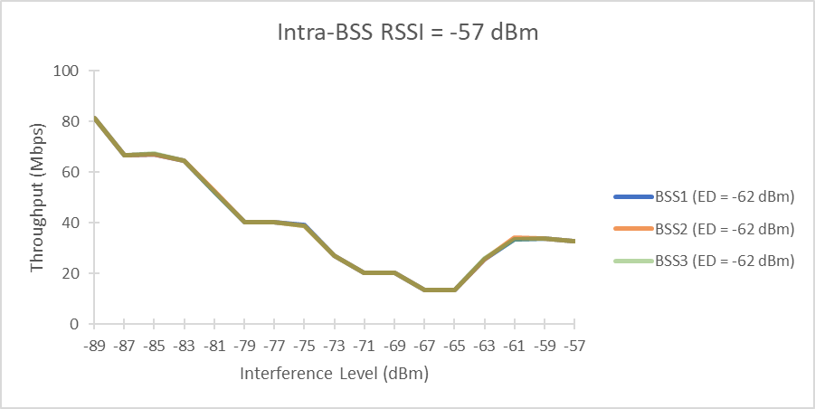
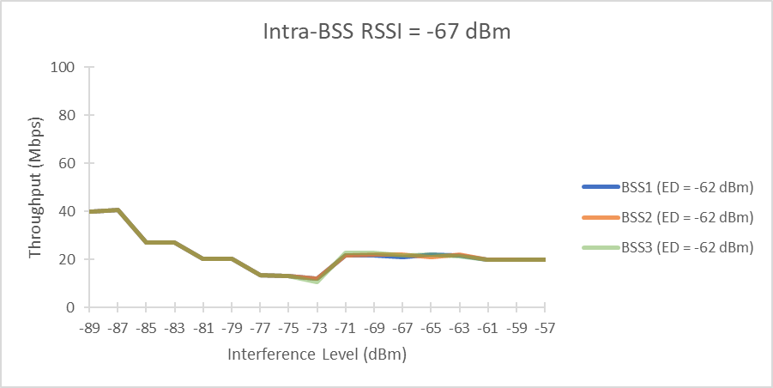
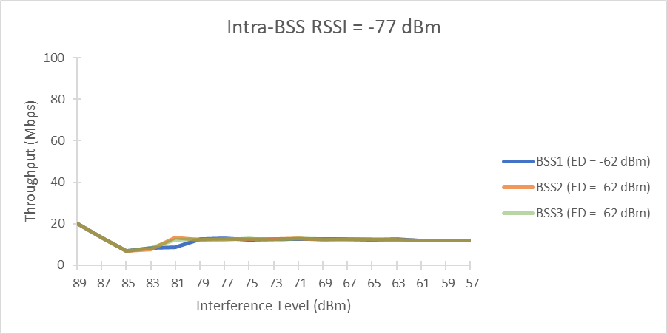
Baseline for 3 Systems Using Common ED Threshold
Results consistent with those observed in the baseline for two BSS systems
Efficient sharing of medium above common ED threshold of -62 dBm
Reduced throughput below common ED threshold at strong wanted signal levels and at ~5 dB C/I for weaker wanted signals
Significant spatial re-use below PD threshold for strong to moderate wanted signal levels
-62 dBm ED Threshold
-82 dBm PD threshold
C/I trough below PD
~5 dB C/I
Max Single-BSS Throughput: 111 Mbps
Max Single-BSS Throughput: 69.8 Mbps
Max Single-BSS Throughput: 40.65 Mbps
Slide 15

Slide 16
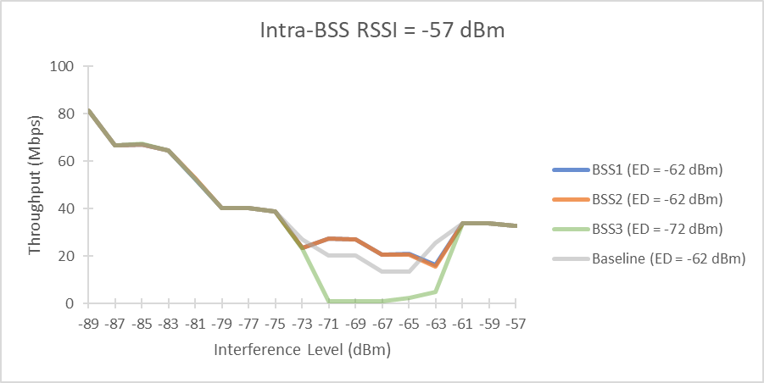
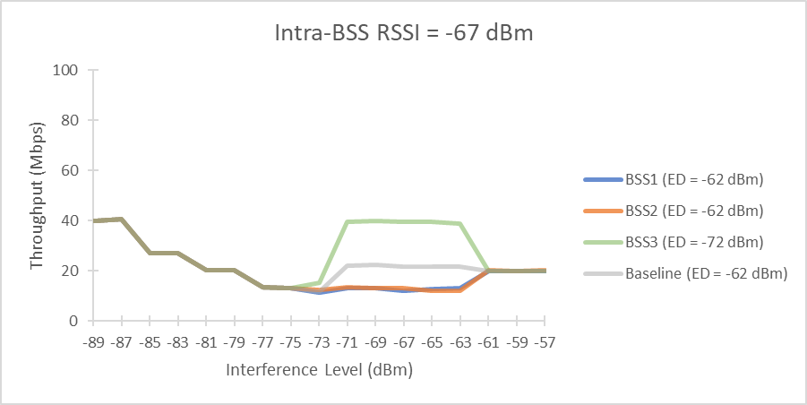
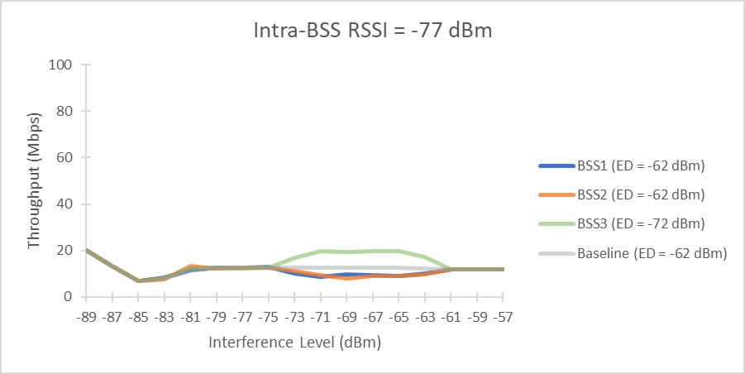
Multiple System Operating at Different ED Thresholds
Throughput of all BSS systems in the presence of interference at levels below -72 dBm and above -62 dBm closely tracks the baseline
At high (-57 dBm) wanted signal levels, the system operating with an ED threshold of -72 dBm appears strongly disadvantaged
However, at moderate (-67 dBm) wanted signal levels, this relationship appears reversed
As the wanted signal is further reduced (-77 dBm), throughput of all systems converges
We resolved to examine this transition more closely
-72 to -62 dBm
Max Single-BSS Throughput: 111 Mbps
Max Single-BSS Throughput: 111 Mbps
Max Single-BSS Throughput: 69.8 Mbps
Max Single-BSS Throughput: 69.8 Mbps
Max Single-BSS Throughput: 40.65 Mbps
Max Single-BSS Throughput: 40.65 Mbps
Slide 16

Slide 17
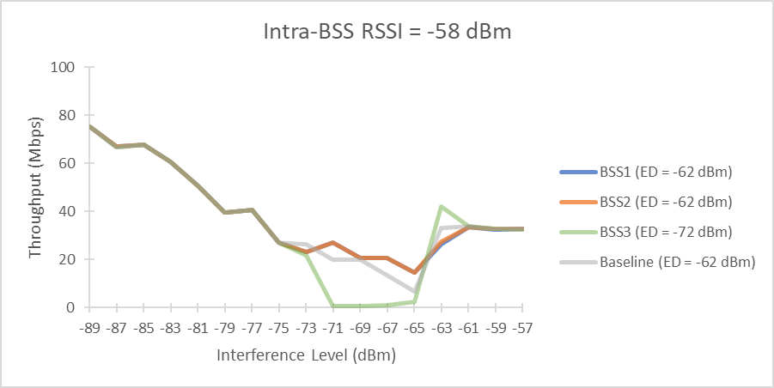
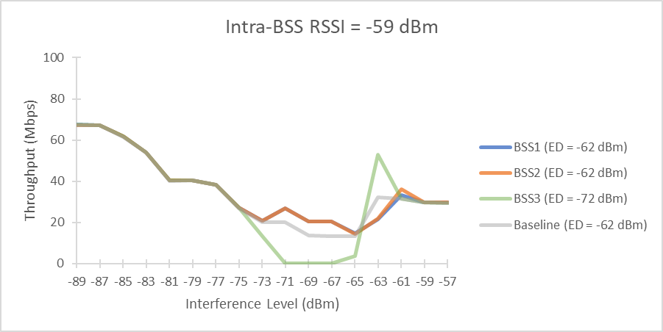
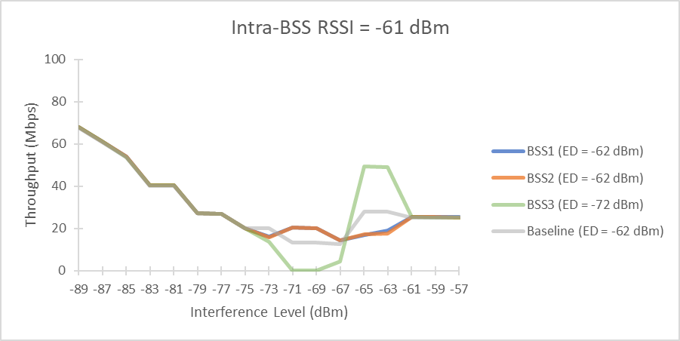
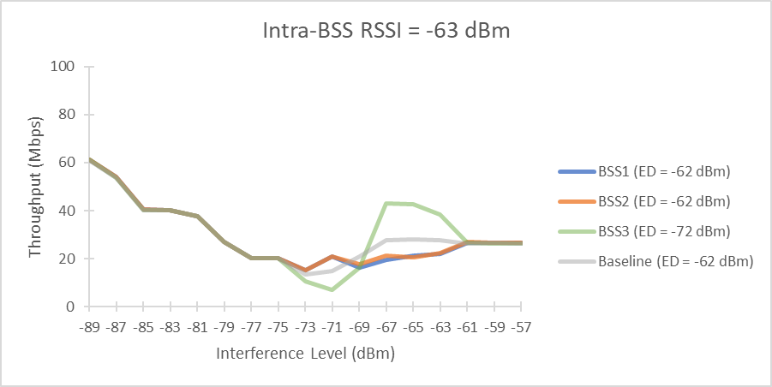
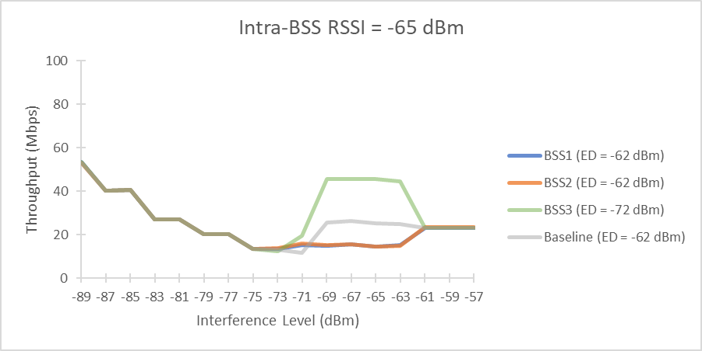
A Closer Look as the Wanted Signal Declines
-72 to -62 dBm
Max Single-BSS Throughput: 111 Mbps
Max Single-BSS Throughput: 109.2 Mbps
Max Single-BSS Throughput: 102.69 Mbps
Max Single-BSS Throughput: 96.1 Mbps
Max Single-BSS Throughput: 90.4 Mbps
Max Single-BSS Throughput: 80.92 Mbps
Patwardhan, Perahia, and Strickland, HPE

Slide 18
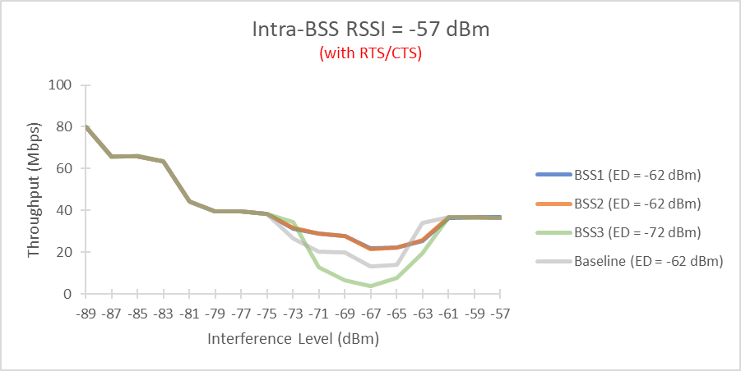
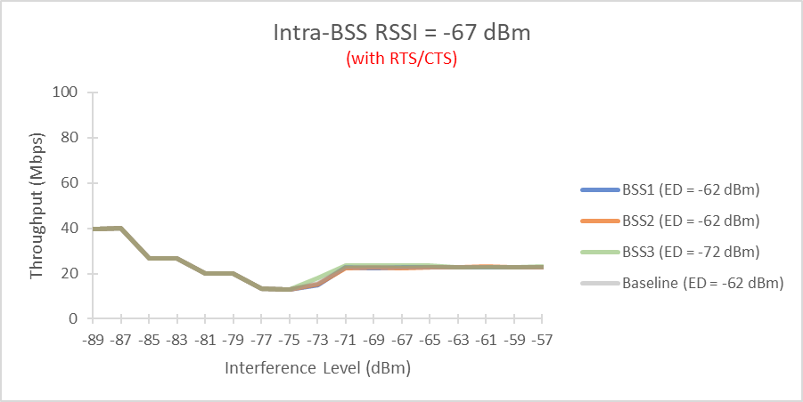
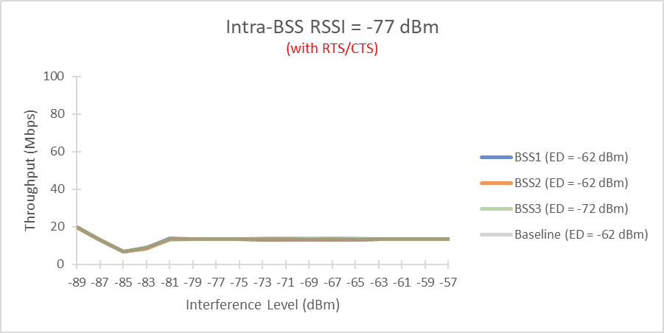
Enabling RTS/CTS Partially Mitigates Effects in Complex Coexistence Scenarios
-72 to -62 dBm
Max Single-BSS Throughput: 111 Mbps
Max Single-BSS Throughput: 111 Mbps
Max Single-BSS Throughput: 69.8 Mbps
Max Single-BSS Throughput: 69.8 Mbps
Max Single-BSS Throughput: 40.65 Mbps
Max Single-BSS Throughput: 40.65 Mbps
Patwardhan, Perahia, and Strickland, HPE

Slide 19
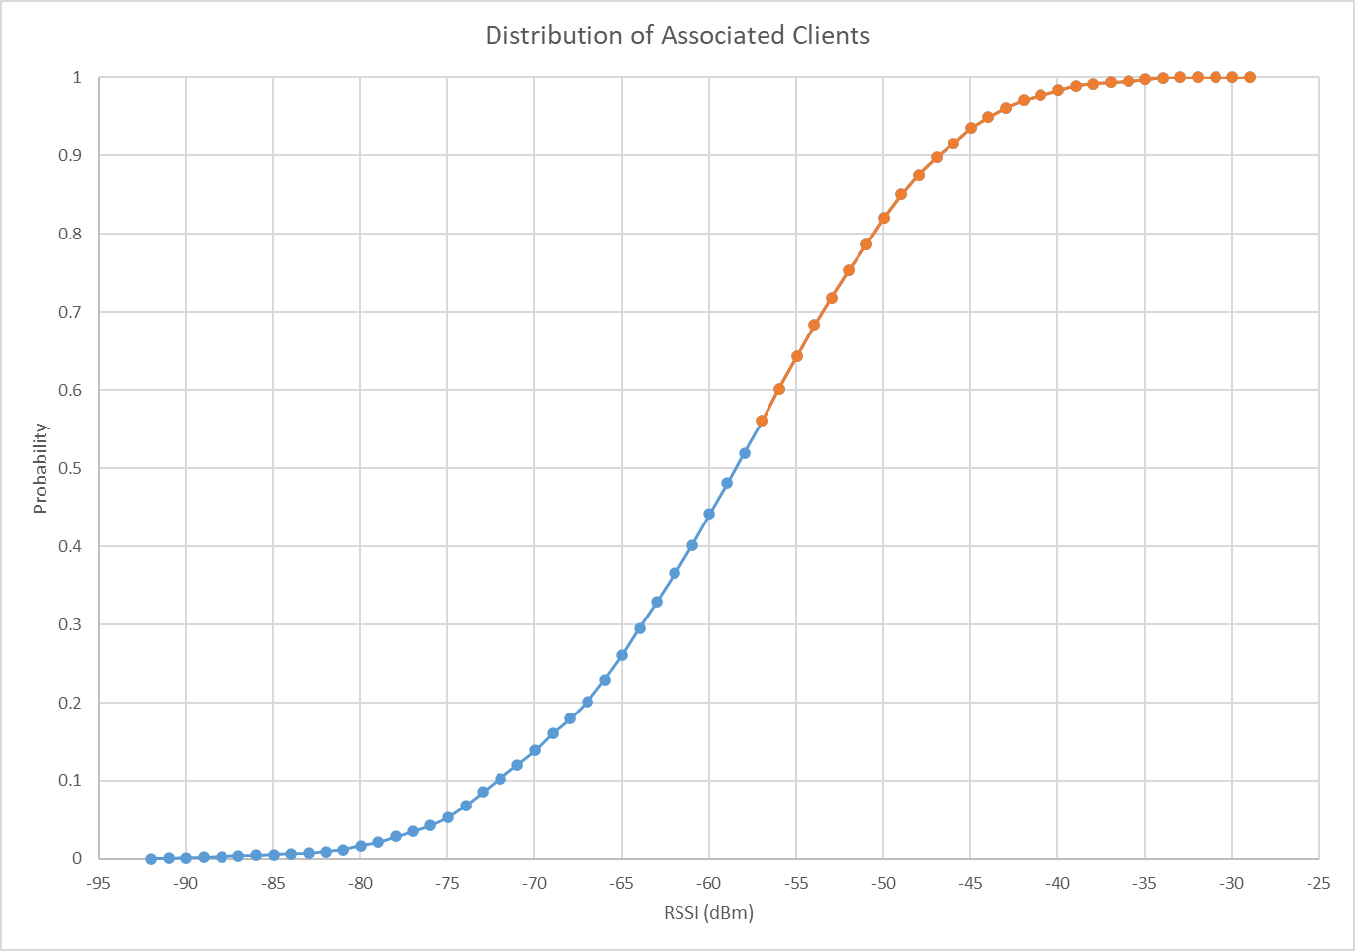
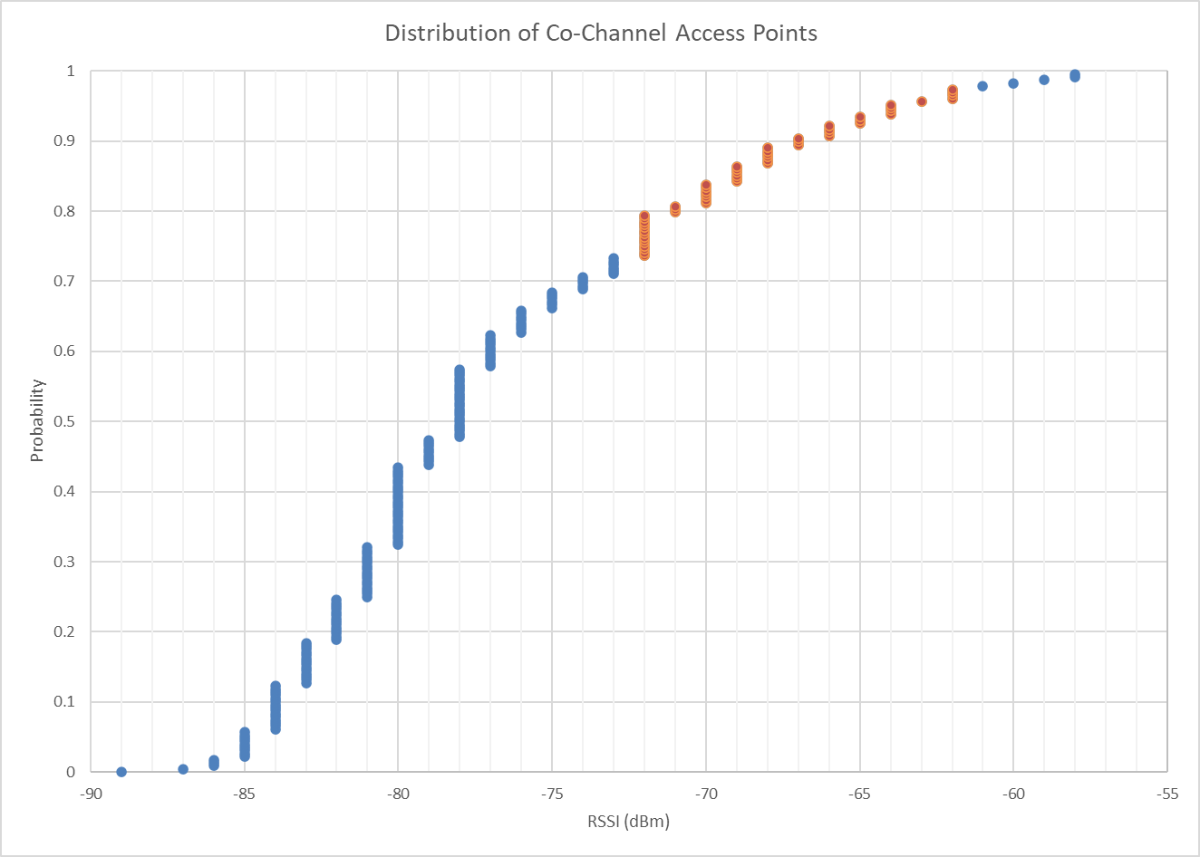
Distributions of Wanted and Interfering Signals in Enterprise Network Environments
Region of Interest: Where strong wanted signals meet interfering signals between ED thresholds
  ~45% of clients have wanted signal levels at or above -57 dBm
  ~25% of visible co-channel APs are heard at levels between -72 dBm and -62 dBm
Data gathered from Aruba corporate headquarters, Santa Clara, CA
Slide 19

Slide 20
Conclusions/Next Steps
The decision by ETSI BRAN to establish a common ED threshold of -72 dBm in 6 GHz will likely have a positive impact on efficient sharing in that band
When using an ED threshold of -72 dBm in 5 GHz, 802.11be would sometimes suffer and sometimes gain an advantage over legacy equipment operating with the current ED threshold
Observed imbalances may be partially mitigated by using RTS/CTS
Data on the distribution of wanted client and interfering co-channel neighbor signals suggest that ~10 to 12% of client traffic may fall within the region where 802.11be would be disadvantaged with respect to legacy equipment by using an ED threshold of -72 dBm
In managed 5 GHz networks where 802.11ax and .11be networks overlap, both systems may benefit from voluntarily operating with a common ED threshold of -72 dBm
The 802.11ax specification (P802.11REVme) will need to accommodate the -72 dBm ED threshold in the 6 GHz band
The 802.11be specification would need to accommodate the -72 dBm threshold in both 5 GHz and 6 GHz

