Slide 1
Discussion on 802.11be features to support TSN capabilities
Date: 2021-04-19
Authors:
Name | Affiliation | Address | Phone | Email
Liuming Lu | OPPO |  |  | luliuming@oppo.com
Lei Huang
Chaoming Luo
Pei Zhou
Liuming Lu (OPPO)

Slide 2
Introduction
802.11be has specified some features, which reduce worst case latency & jitter and provide more predictable latency and/or higher reliability, to support the delivery of the latency sensitive traffic as well as TSN applications.
This contribution provides an overview of the currently specified features for reduced worst case latency to support TSN capabilities and potential extensions to be considered in 802.11be.

Slide 3
802.11be Features to support TSN
Latency sensitive traffic has been defined in 802.11be
Traffic originating from many real time applications has stringent latency requirements including not only very low average and worst case values within certain reliability constraints, of the order of a few to tens of milliseconds, but also small jitter.
1. Increase the throughput
2. Provide multiple paths for traffic delivery
3. Convenient for flexible Traffic scheduling
Enhance medium access protection and resource reservation
1. resource reservation
2. Convenient for flexible Traffic scheduling
802.11be Features
1. Increase the throughput
2.Enhance interference management between OBSSs
TSN requirements
Multi-link Operation
Restricted TWT (Target Wake Time )
Differentiate latency sensitive traffic from other traffic
Low latency
Triggered TXOP sharing
Prioritizes the transmission of latency sensitive traffic
Spatial reuse operation
Traffic differentiation
1. Increase the throughput
2. Enhance anti-interference & Reduce interference
3. Provide multiple paths for traffic delivery
4. Convenient for flexible traffic scheduling
High Reliability
Traffic Prioritization
Multi-AP Operation
6GHz Operation
Provide more manageable channels

Slide 4
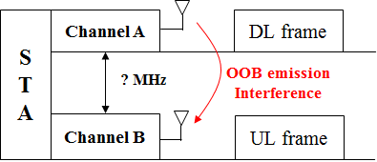
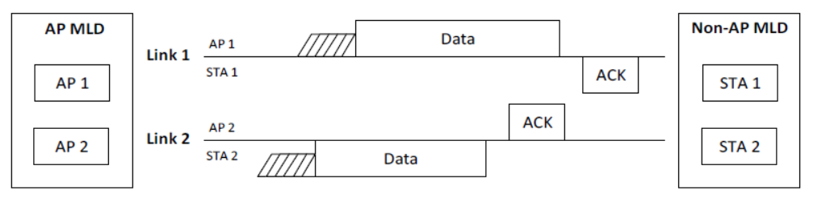
Multi-link operation - issues
Issues
Simultaneous Transmit and Receive across two links may cause the interference by out-of-band (OOB) emission unless their channels are sufficiently away.
Multi-link operation is divided into two types: STR and NSTR ( Nonsimultaneous transmit and receive) operation. NSTR operation may be a general operation due to the low cost hardware requirement and limited operating frequency channels.
Serval rules and mechanisms have currently been specified to solve the problems caused by NSR operation.
PPDU end time alignment - rules for PPDU exchanges
Start time sync PPDUs medium access - rules for simultaneous transmission
Medium synchronization recovery procedure - mechanism to solve channel blindness issue

Slide 5
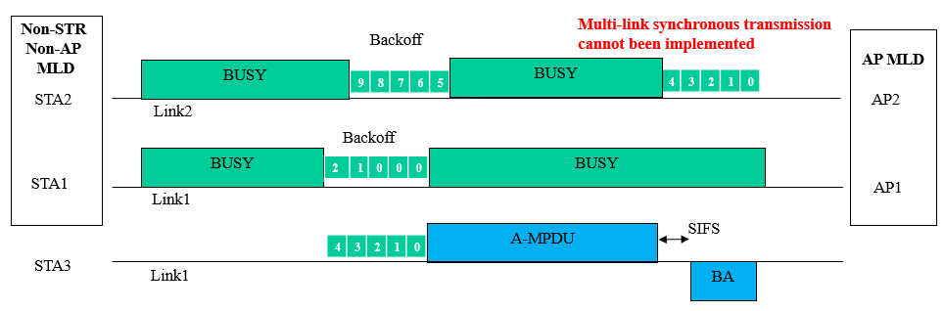
Multi-link operation - issues
Issues
NSTR would decrease the throughput caused by the multi-link operation potentially.
NSTR would reduce the flexibility of traffic scheduling across the multiple links.
The restrictions on the NSTR operation would enlarge the transmission latency in order to follow the rules of the simultaneous transmission and PPDU end time alignment, and solve the blindness issue.
Example
According to the Non-STR MLD channel access procedure for Multi-link synchronous transmission，when the backoff counter of one STA (STA1) in the MLD reaches zero but another STA (STA2) needs more time for backoff, STA1 cannot transmit MPDU and keep its backoff counter at zero. This would enlarge the transmission latency :
  The channel access opportunity is preempted by another STA(STA3) in the same link with STA1, therefore STA1 would lost its transmission opportunity.

Slide 6
Multi-link operation - potential extensions
Enrich the operation modes of multi-link synchronous transmission
The currently specified rules for simultaneous transmission, such as start time sync PPDUs medium access, is mainly based on the operation of non-STR non-AP MLD by itself.
For non-STR non-AP MLD to make the two STAs affiliated with the MLD finish their backoff procedure together and then transmit simultaneously is not a suitable method in some scenarios
In order to reduce transmission latency it can be considered that AP MLD can assist the non-STR non-AP MLD to gain the transmission opportunities and implement the multi-link synchronous transmission.
Expand the operation scenarios for trigger-based TXOP sharing.
Trigger-based TXOP sharing can be used in multi-link synchronous transmission to assist the non-STR non-AP MLD to gain the transmission opportunities.

Slide 7
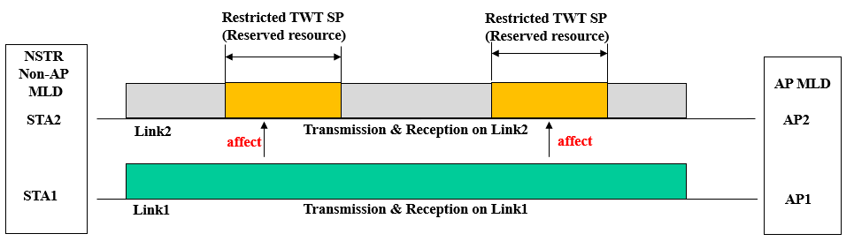
Restricted TWT - issues
Issues
Whether the enhanced medium access protection of Restricted TWT is enough needs to be further considered.
OBSS interferences may exist frequently and would affect the transmission during the TWT service periods (SPs).
Only the non-AP EHT STA which supports Restricted TWT is required to end the TXOP before the start of the restricted TWT service periods in currently specified Restricted TWT.
If there exists a non-AP EHT STA, which doesn’t support Restricted TWT , it would not end its TXOP before the start of the restricted TWT SPs and therefore affect the transmission during the TWT SPs.
If the restricted TWT SPs exist on one link of the NSTR pair of an MLD, the other transmission on the other link of the NSTR pair would affect the transmission on the link during the TWT SPs.

Slide 8
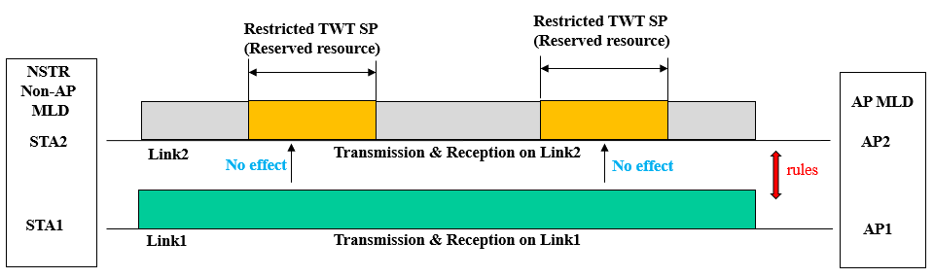
Restricted TWT - potential extensions
Further enhance the medium access protection of Restricted TWT
Mechanism to mitigate the effect on the transmission during the TWT service periods (SPs), caused by the OBSS interferences.
The usage of quiet element can be considered not to be limited to the intervals that overlap with restricted TWT service periods
Rules can be considered to coordinate the transmission during the TWT service periods (SPs) on one link of the NSTR pair and the transmission on the other link for an MLD.

Slide 9
Summary
This contribution gives an overview of the currently specified 802.11be features for reduced worst case latency to support TSN capabilities, further analyzes the possible existing issues of the key features of multi-link operation and restricted TWT, and provides the potential extensions for the specification of the multi-link operation and restricted TWT to be considered in 802.11be.

Slide 10
Reference
[1] IEEE 802.11be Draft 0.4
[2] 11-21-0087-06-00be-pdt-mac-triggered-su
[3] 11-19-1287-01-00be-tsn-support-in-802-11-and-potential-extensions-for-tgbe
[4]11-19-1298-01-00be-ieee-802-1-tsn-an-introduction
[5]11-21-0361-00-00be-ap-assisted-multi-link-synchronous-transmission
Liuming Lu (OPPO)

