Slide 1
PSR-based SR Discussion Follow-up
Date: 2021-06-03
Authors:
Name | Affiliations | Address | Phone | email
Ross Jian Yu | Huawei |  |  | ross.yujian@huawei.com
Jason Yuchen Guo | Huawei
Yunbo Li | Huawei
Yan Chen | Huawei
Ming Gan | Huawei

Slide 2
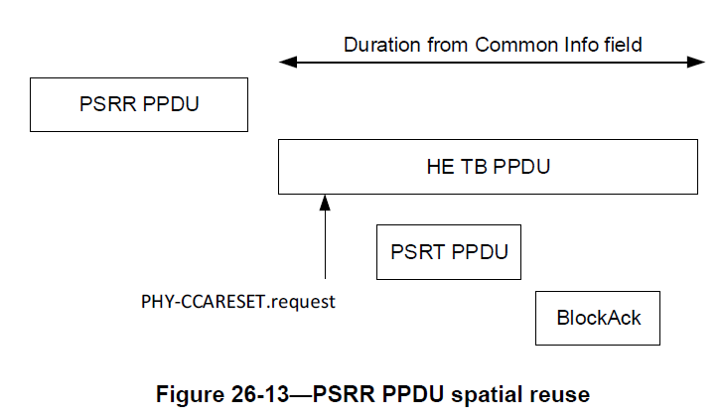
PSR-based SR
AP1
STA1
or EHT TB
AP2
STA2

Slide 3
Background
The following SP has passed to solve the normalization issue of PSR SR [1]:
Do you agree that:
  For TxPower_PSRT, PSR, RPL, the normalization is always per 20MHz regardless of the BW field of the EHT TB PPDU?
  when BW=80MHz,
    Spatial Reuse 1 field applies to each 20MHz subchannel of the first 40 MHz subband of the 80MHz operating band.
    Spatial Reuse 2 field applies to each 20MHz subchannel of the second 40 MHz subband of the 80MHz operating band.
  When BW=160MHz,
    Spatial Reuse 1 field applies to each 20MHz subchannel of the first 80 MHz subband of the 160MHz operating band.
    Spatial Reuse 2 field applies to each 20MHz subchannel of the second 80 MHz subband of the 160MHz operating band.
  When BW=320MHz,
    Spatial Reuse 1 field applies to each 20MHz subchannel of the first 160 MHz subband of the 320MHz operating band.
    Spatial Reuse 2 field applies to each 20MHz subchannel of the second 160 MHz subband of the 320MHz operating band.
  This is for R1, will bring a PDT for P802.11be D0.4

Slide 4
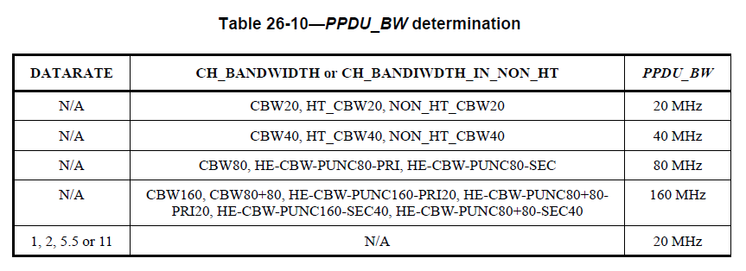
Further issues regarding PSR SR
There are still some issues regarding PSR SR. [2] has proposed two issues:
  Punctured PSRR PPDU and Punctured PSRT PPDU. More discussions are shown below:
  can be rewritten as:
  The PPDU_BW determination doesn’t account for the punctured channel. If assuming the max possible punctured channel percentage is 50%, then the punctured channels will lead to 3dB+3dB Tx Power increase of the PSRT PPDU.

Slide 5
Further issues regarding PSR SR
The punctured channels of PSRT PPDU is known by AP2, which is not a problem.
The number of punctured channels of PSRR PPDU is not always known by AP2.
  Can be known if the PSRR PPDU is an EHT MU PPDU, or an HE MU PPDU (BW=0 to 5), or Non-HT PPDU with static preamble puncturing information in beacon.
Potential solution for PSRR PPDU puncturing:
  Still use PSRR PPDU BW, decrease the Tx Power of PSRT PPDU by 3dB by AP2 (always or if able to identify PSRR PPDU is punctured), or
  If PSRR PPDU is punctured, decrease the UL PSR value by 3dB by AP1 (3dB more margin).
  Define all PSR related parameters per 20 MHz, leave normalization to implementation (see more discussion in slide 8-10).
AP1
or EHT TB
STA1
AP2
STA2

Slide 6
Further issues regarding PSR SR
There are still some issues regarding PSR SR. [2] has proposed two issues:
  2. Multiple EHT SRP (ESR) fields within the range of a PSRT PPDU. [2] proposes to use the minimum value of the two ESR fields.
Another issue is discussed as shown below:
  3. PSRR PPDU BW and Rx BW of AP2 mismatch. There are two cases:
    PSRR PPDU BW=160 MHz, whilst AP2 is only 80 MHz operating STA.
    PSRR PPDU BW=320 MHz-1, whilst AP2’s BSS is in 320 MHz-2.
  Need to account for the BW mismatch. BW_PSRR needs to account for preamble puncturing and also the received portion of the PSRR PPDU BW by AP2.
    Case a, assuming no puncturing, BW_PSRR is 80 MHz.
    Case b, assuming no puncturing, BW_PSRR is 160 MHz.
    Case c: define all PSR related parameters per 20 MHz, leave normalization to implementation
  4. Also, due to BW mismatch of PSRT PPDU and PSRR PPDU, within some 20 MHz subchannel, there exists no corresponding EHT SRP fields, e.g. when PSRR PPDU is 160 MHz, PSRT PPDU is 320MHz-1, or PSRR PPDU is 320-1 MHz, PSRT PPDU is 320MHz-2.
PSRR PPDU
BW:320-1
BW:320-2
PSRT PPDU
PSRR PPDU
BW:320-1
BW:160
PSRT PPDU

Slide 7
Summary
After we decide the normalization is always per 20MHz, there are still some remaining issues regarding PSR SR:
  1a: Puncturing of PSRT PPDU
  1b: Puncturing of PSRR PPDU
  2: Multiple ESR fields within the range of PSRT PPDU
  3: PSRR PPDU BW and Rx BW of AP2 mismatch
  4: PSRT PPDU and PSRR PPDU BW mismatch
Some potential solutions are discussed:
  For PSRT PPDU:
    Normalized by PSRT PPDU effective BW: non-punctured portion of the PSRT PPDU BW
  For PSRR PPDU:
    Normalized by PSRR PPDU effective BW:
      Opt1: within Rx BW of AP2 + non-punctured portion
      Opt2: within Rx BW of AP2 + decrease the Tx Power of PSRT or PSR value by 3dB
    Define RPL as dBm/20 MHz, and leave normalization to implementation.

Slide 8
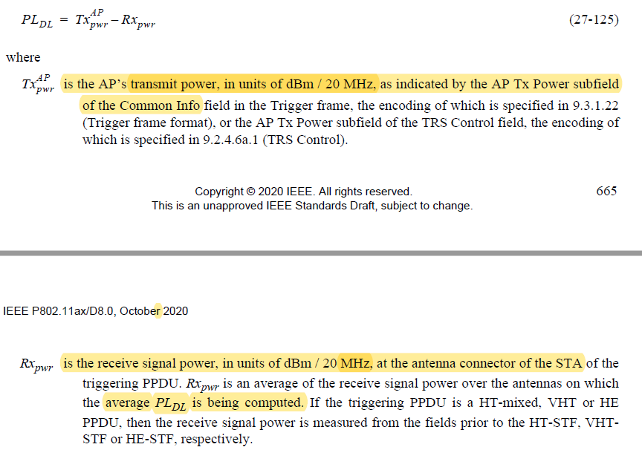
More discussion
Considering the preamble puncturing info of PSRR PPDU BW is not known by AP2, and the BW mismatch problem, an alternative way is to following UL power control, define per 20 MHz parameter, and leave the normalization to implementation:
27.3.15.2 Power pre-correction

Slide 9
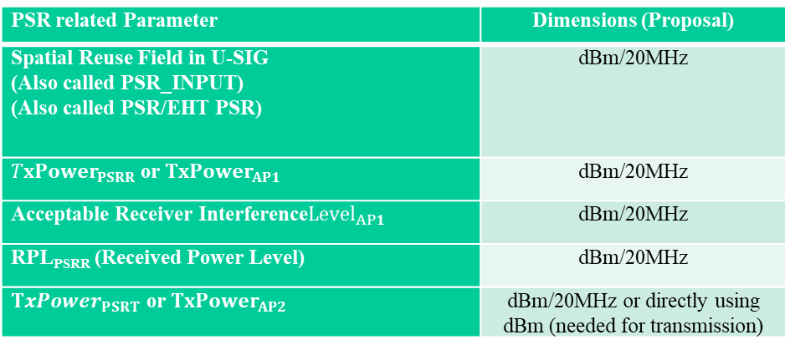

More discussion
Then we have the following PSR related parameters:
PSR related Parameter | Dimensions (Proposal)
Spatial Reuse Field in U-SIG (Also called PSR_INPUT) (Also called PSR/EHT PSR) | dBm/20MHz
${TxPower}_{PSRR}$ or${TxPower}_{AP1}$ | dBm/20MHz
Acceptable Receiver Interference$Level_{AP1}$ | dBm/20MHz
RPL_{PSRR} (Received Power Level) | dBm/20MHz
${TxPower}_{PSRT}$ or${TxPower}_{AP2}$ | dBm/20MHz or directly using dBm (needed for transmission)
Equivalently:
$$RPL_{PSRR,20MHz}$$
is defined in dBm/20MHz. The calculation is implementation specific. It can be measured on only one received 20MHz subchannel, or measured on N received non-punctured 20MHz subchannels of the PSRR PPDU, and normalized by N.
PSR is defined in dBm/20Mhz, and is equal to minimum of multiple PSR values if there exists multiple PSR values within the PSRT PPDU

Slide 10

Straw Poll #1
Do you agree that the intended transmit power of the PSRT PPDU in dBm shall meet the following condition:
  where is 20MHz * number of non-punctured 20MHz subchannels of the PSRT PPDU
  is the received signal power measured in dBm/20MHz. It shall be measured in at least one 20Mhz channel in which the preamble of PSRR PPDU is present. The measurement method is implementation specific.
  PSR is equal to minimum of multiple PSR values if there exists multiple PSR values within the range of PSRT PPDU. PSR is specified per 20MHz.
$$BW_{PSRT,non−punc}$$
$$RPL_{PSRR,20MHz}$$

Slide 11
References
https://mentor.ieee.org/802.11/dcn/21/11-21-0269-01-00be-psr-based-sr-normalization-discussion.pptx
https://mentor.ieee.org/802.11/dcn/21/11-21-0601-00-00be-discussion-on-spatial-reuse-issues.pptx

