Slide 1
PSR-based SR Discussion Follow-up
Date: 2021-04-07
Authors:
Name | Affiliations | Address | Phone | email
Ross Jian Yu | Huawei |  |  | ross.yujian@huawei.com
Jason Yuchen Guo | Huawei
Yunbo Li | Huawei
Yan Chen | Huawei
Ming Gan | Huawei

Slide 2
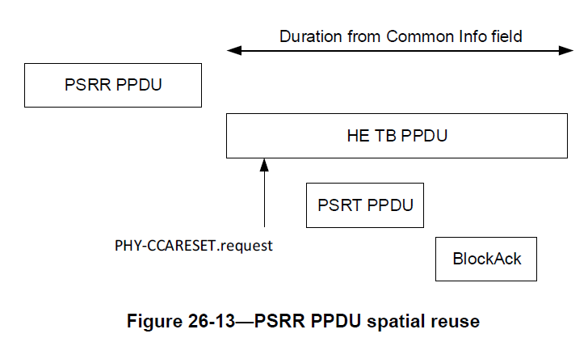
PSR-based SR
AP1
STA1
or EHT TB
AP2
STA2

Slide 3
Background
The following SP has passed to solve the normalization issue of PSR SR [1]:
Do you agree that:
  For TxPower_PSRT, PSR, RPL, the normalization is always per 20MHz regardless of the BW field of the EHT TB PPDU?
  when BW=80MHz,
    Spatial Reuse 1 field applies to each 20MHz subchannel of the first 40 MHz subband of the 80MHz operating band.
    Spatial Reuse 2 field applies to each 20MHz subchannel of the second 40 MHz subband of the 80MHz operating band.
  When BW=160MHz,
    Spatial Reuse 1 field applies to each 20MHz subchannel of the first 80 MHz subband of the 160MHz operating band.
    Spatial Reuse 2 field applies to each 20MHz subchannel of the second 80 MHz subband of the 160MHz operating band.
  When BW=320MHz,
    Spatial Reuse 1 field applies to each 20MHz subchannel of the first 160 MHz subband of the 320MHz operating band.
    Spatial Reuse 2 field applies to each 20MHz subchannel of the second 160 MHz subband of the 320MHz operating band.
  This is for R1, will bring a PDT for P802.11be D0.4

Slide 4
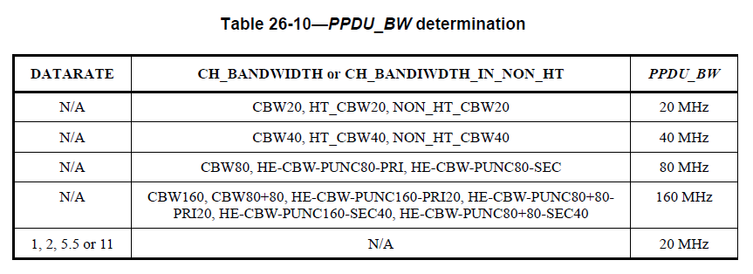
Further issues regarding PSR SR
There are still some issues regarding PSR SR. [2] has proposed two issues:
  Punctured PSRR PPDU and Punctured PSRT PPDU. More discussions are shown below:
  can be rewritten as:
  The PPDU_BW determination doesn’t account for the punctured channel. If assuming the max possible punctured channel percentage is 50%, then the punctured channels will lead to 3dB+3dB Tx Power increase of the PSRT PPDU.

Slide 5
Further issues regarding PSR SR
The punctured channels of PSRT PPDU is known by AP2, which is not a problem.
The number of punctured channels of PSRR PPDU is not always known by AP2.
  Can be known if the PSRR PPDU is an EHT MU PPDU, or an HE MU PPDU (BW=0 to 5), or Non-HT PPDU with static preamble puncturing information in beacon.
Potential solution for PSRR PPDU puncturing:
  Still use PSRR PPDU BW, decrease the Tx Power of PSRT PPDU by 3dB by AP2 (always or if able to identify PSRR PPDU is punctured), or
  If PSRR PPDU is punctured, decrease the UL PSR value by 3dB by AP1.
AP1
STA1
or EHT TB
AP2
STA2

Slide 6
Further issues regarding PSR SR
There are still some issues regarding PSR SR. [2] has proposed two issues:
  2. Multiple EHT SRP (ESR) fields within the range of a PSRT PPDU. [2] proposes to use the minimum value of the two ESR fields.
Another issue is discussed as shown below:
  3. PSRR PPDU BW and Rx BW of AP2 mismatch. There are two cases:
    PSRR PPDU BW=160 MHz, whilst AP2 is only 80 MHz operating STA.
    PSRR PPDU BW=320 MHz-1, whilst AP2’s BSS is in 320 MHz-2.
  Need to account for the BW mismatch. BW_PSRR needs to account for preamble puncturing and also the received portion of the PSRR PPDU BW by AP2.
    Case a, assuming no puncturing, BW_PSRR is 80 MHz.
    Case b, assuming no puncturing, BW_PSRR is 160 MHz.

Slide 7
Summary
After we decide the normalization is always per 20MHz, there are still some remaining issues regarding PSR SR:
  Puncturing of PSRT PPDU
  Puncturing of PSRR PPDU
  Multiple ESR fields within the range of PSRT PPDU
  PSRR PPDU BW and Rx BW of AP2 mismatch
Some potential solutions are discussed:
  For PSRT PPDU:
    Normalized by PSRT PPDU effective BW: non-punctured portion of the PSRT PPDU BW
  For PSRR PPDU:
    Normalized by PSRR PPDU effective BW:
      Opt1: within Rx BW of AP2 + non-punctured portion
      Opt2: within Rx BW of AP2 + decrease the Tx Power of PSRT or PSR value by 3dB

Slide 8
Straw Poll #1
Do you agree that the following problems need to be considered for PSR SR:
  Puncturing of PSRT PPDU
  Puncturing of PSRR PPDU
  Multiple ESR fields
  PSRR PPDU BW and Rx BW of AP2 mismatch

Slide 9
References
https://mentor.ieee.org/802.11/dcn/21/11-21-0269-01-00be-psr-based-sr-normalization-discussion.pptx
https://mentor.ieee.org/802.11/dcn/21/11-21-0601-00-00be-discussion-on-spatial-reuse-issues.pptx

