Slide 1
A Discussion on Measurement Results for Active Radar-Based Applications
Date: 2021-04-20
Authors:

Slide 2
Abstract
In [1], da Silva et al. addressed measurement reporting as a part of WLAN sensing procedure and proposed using CSI matrix as a measurement result
While this measurement result may be suitable for passive sensing applications, it is less suitable in the case of active radar-based sensing applications
In this contribution Range Profile (RP) and Localization Heatmap, both relative measurements for each pair of Tx and Rx, are discussed as measurement results for active radar-based applications

Slide 3
Introduction
In active sensing, using bi/multi-static RADAR configurations, measurement’s reporting is required
Therefore, as suggested by da Silva and al. in [1], measurement results (type and format) should be defined
Two fundamental types of measurements which are often used in ranging and localization applications are the Range Profile (RP) and the Localization Heatmap
In the following, type and format of these measurement results are proposed and an application example is presented

Slide 4
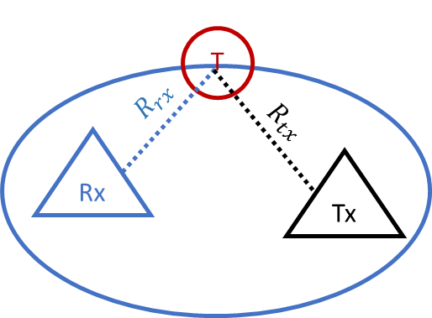

Range Profile (RP) measurement
Type: Range Profile (RP) is the value of the reflected power versus the range relative to each Tx and Rx antenna pair (i.e., $Range=\frac{R_{rx}+R_{tx}}{2}$, where $R_{Tx}$ is the distance from the transmitter to the target and $R_{Rx}$is the distance from the target to the receiver)
RP can be obtained using any radar type including Frequency Modulated Continuous Wave (FMCW) [2], Stepped-Frequency Continuous Wave (SFCW) [3] and Pulsed radar.
Format: RP can be represented as a two-columns table; the first column represents the range while the second one represents the reflected power by target(s) located at that range

Slide 5

Localization Heatmap measurement
Two types of localization heatmap measurements could be defined
Type 1: 2D Localization Heatmap in a fixed plane (e.g., horizontal plane) is the value of the targets’ reflected power versus its location in that plane for each (Tx, Rx) couple.
Format 1: can be represented as an 𝑁𝑥𝑀 table; where 𝑁 is the number of points in the first dimension and 𝑀 is the number of points in the second dimension.
Type 2: 3D Localization in the space is the value of the targets’ reflected power versus its location in that space for each (Tx, Rx) couple. (Worth to notice that a 3D Localization heatmap is made of co-centered ellipsoids having the common Tx and Rx as foci)
Format 2: 3D localization heatmap can be represented as$L$ tables of dimensions $NxM$, where $L$ is the number of points in the third dimension
It should be noted that, in the case where Localization Heatmap is required as a measurement result, a common grid is communicated by the AP to all the STAs participating in the sensing session. Meaning that all the STAs use the same plane or space for calculating their respective Heatmaps.

Slide 6
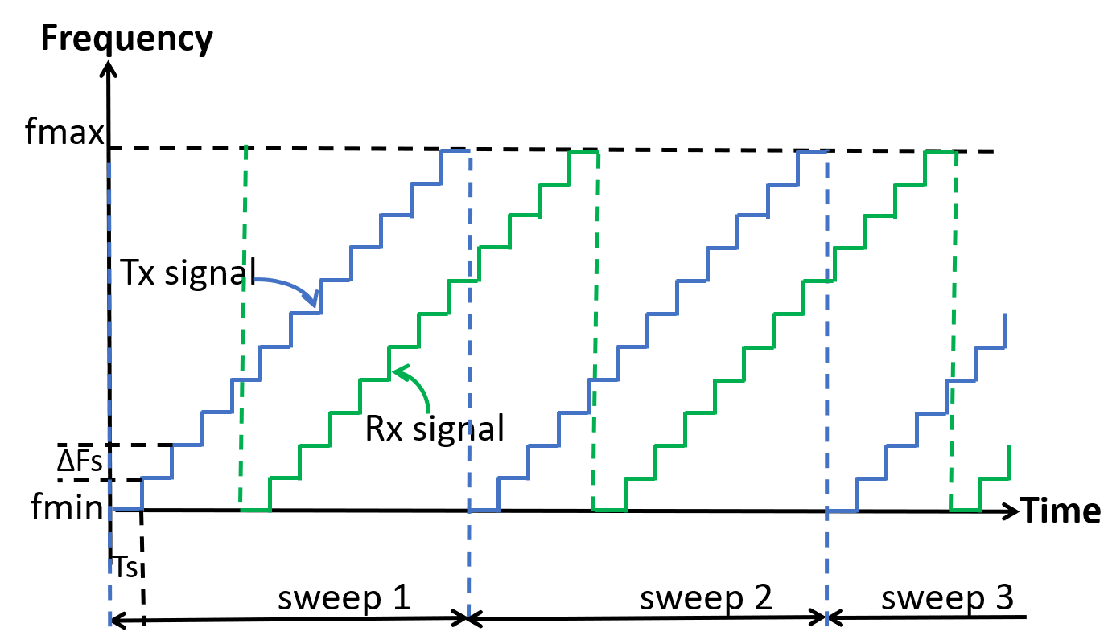
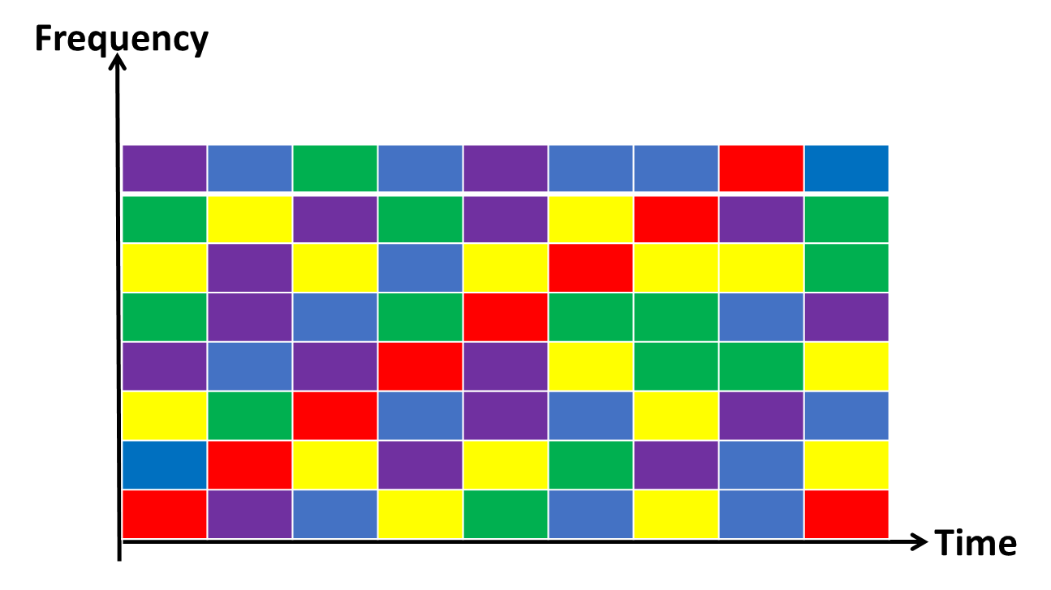
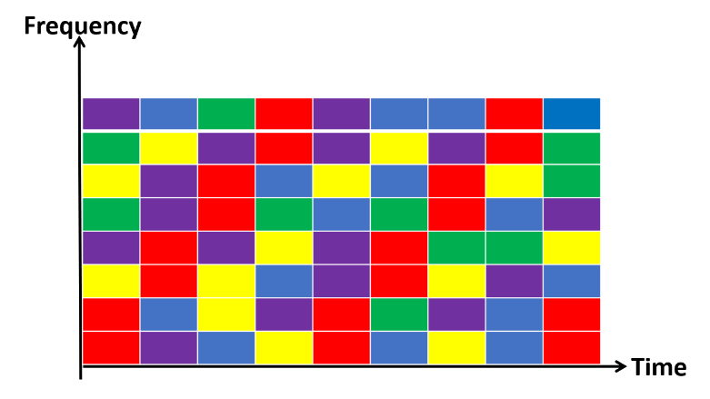
Use Case Example JCS, Approach
In [3], we presented a method for Joint Communication and Sensing (JCS) in OFDMA systems
This method explored the flexibility of frequency-time resource allocation in OFDMA systems to generate a Stepped Frequency Continuous Wave (SFCW)-like radar waveform
By doing radar signal processing on the received echo of the transmitted SFCW waveform, Range Profile (RP) is obtained
Then, the obtained RPs are used for targets’ localization through a collaborative multi-static RADAR method
To support the collaborative multi-static RADAR method, range or/ and localization measurement results should be reported
Every colored block represents a Resource Unit (RU)
Different users’ RUs are given in different colors
The red RUs are used for JCS using SFCW -like waveform
SFCW waveform 1 RU/Ts (long sweeping time) 2 RUs/ Ts (shorter sweeping time)

Slide 7
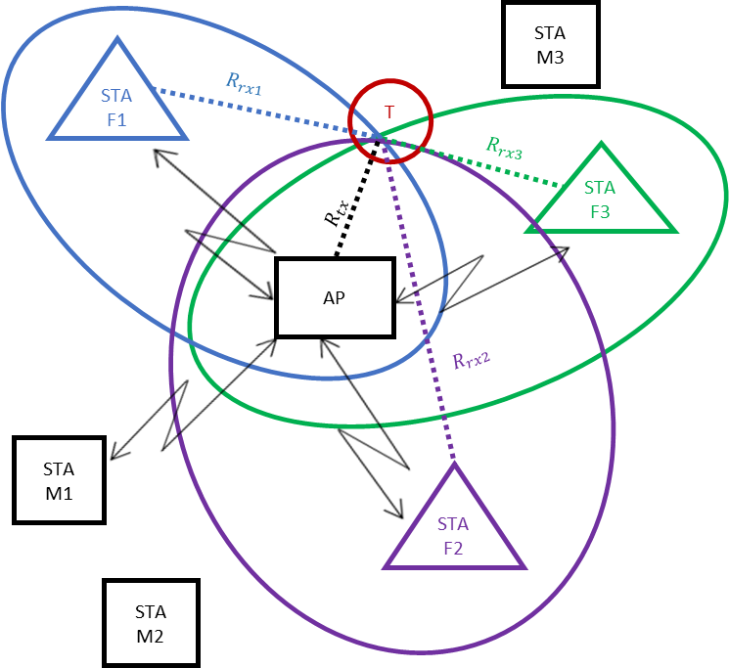
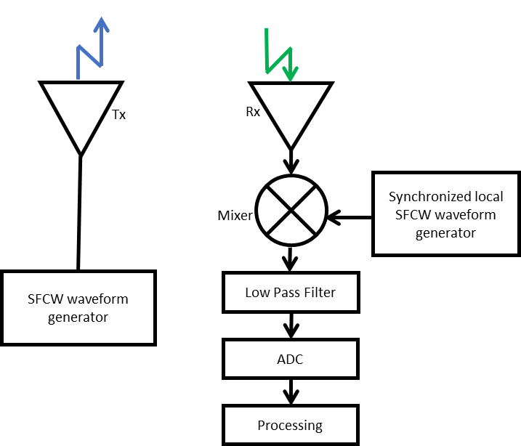
Use Case Example JCS, Localization Method– 1/3
The sensing initiator (AP) generates a single SFCW-like waveform
Every sensing responder (STA Fi , i=1,2,…) uses the reflected waveform and the synchronization information to calculate its RP
Every sensing responder (STA Fi) sends its RP to the sensing initiator (AP) → RP is the measurement result reported
Alternatively, every sensing responder (STA Fi) calculates its Localization Heatmap and sends it to the sensing initiator (AP) → Localization Heatmap is the measurement result reported
The sensing initiator (AP) uses known F STAs location and their RP/ Localization Heatmap to localize the different targets
M → mobile equipment
F → fixed equipment
T→ target

Slide 8
Use Case Example JCS, Localization Method– 2/3
The following figures show the simulated scenario and the obtained results in [2]
First, the sensing initiator (Tx1) designates the sensing responders (Rxi) participating in the sensing session (Figure (a))
Then, the sensing initiator transmits an SFCW waveform (Figure (b))
(a) Simulated scenario (b) generated waveform (sweep time=0.23ms)

Slide 9
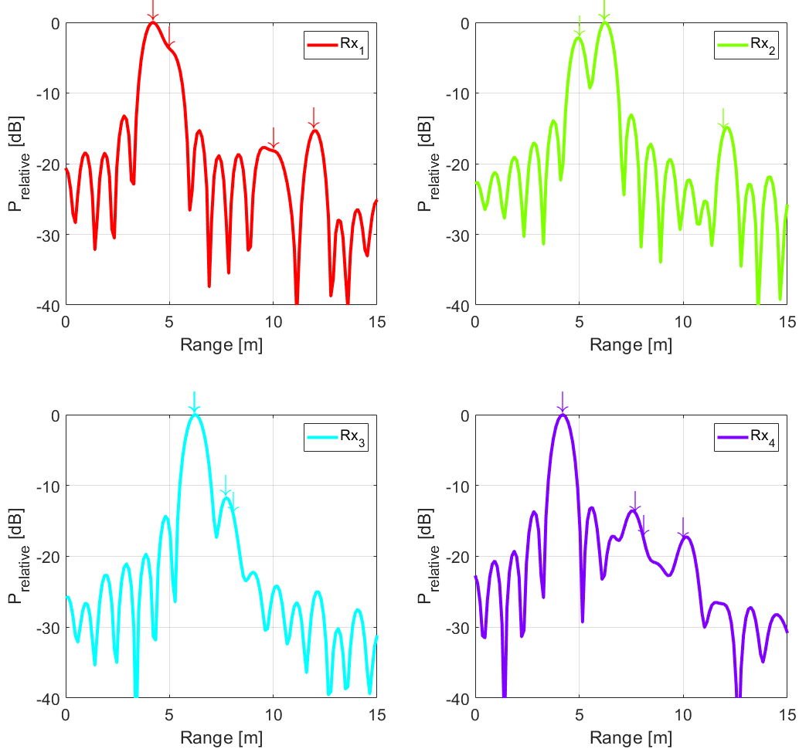
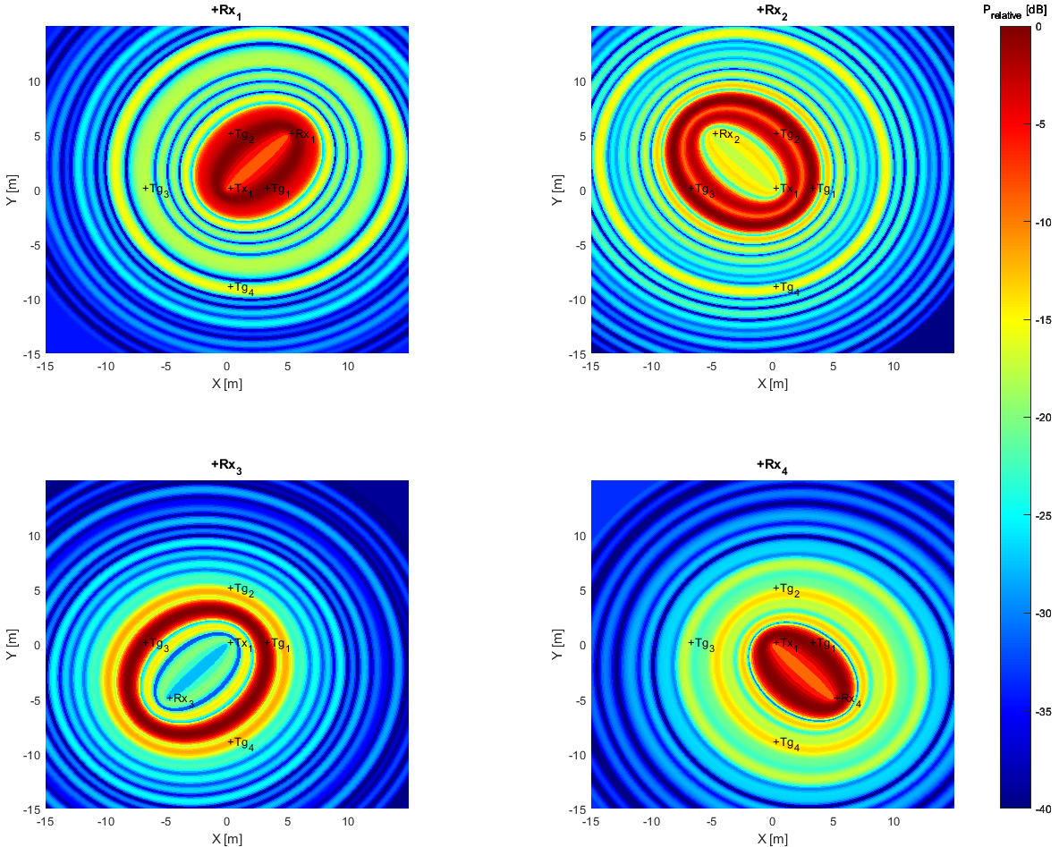
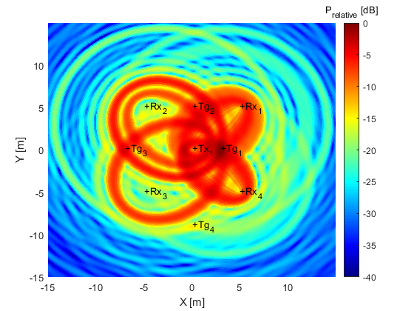
Use Case Example JCS, Localization Method– 3/3
Next, each sensing responder calculates its RP and sends it to the sensing initiator (RP is relative to each Tx and Rx antenna pair) (Figure (c))
Alternatively, every sensing responder calculates its Localization Heatmap and sends it to the sensing initiator (Figure (d))
Last, the sensing initiator calculates the total Localization Heatmap based on the RPs/ Localization Heatmaps and the known sensing responders' positions (Figure (e))
(c) Obtained RPs for the different Rxs (d) obtained Localization Heatmaps for the different Rxs (e) the total Localization Heatmap

Slide 10
Conclusions
Range Profile (RP) and Localization Heatmap can be relevant representations of a scene that can be obtained using any radar type
In this contribution, these two reports were introduced and discussed as measurement results for WLAN sensing
It is worth to notice that these measurements results could be used in applications at both sub-7 GHz and mmWave frequency bands
We welcome comments and suggestions

Slide 11
References
[1] da Silva, “Discussion of Sensing Measurement Result Types”, 21/0357r0.
[2] Pesin, “A Study on the Impact of Radar Range Resolution in Different Use Cases”, 20/1742r0.
[3] Haskou, “Discussion on a Joint Communication and Sensing (JCS) Method”, 21/0066r0.

Slide 12
SP 1
Do you agree to consider Range Profile (RP) as presented in slide 4 as a measurement result type for WLAN sensing in both sub-7GHz and 60GHz frequency bands?
Yes:
No:
Abstain:
SP 2
Do you agree to consider Localization Heatmap as presented in slide 5 as a measurement result type for WLAN sensing in both sub-7GHz and 60GHz frequency bands?
Yes:
No:
Abstain:

