Slide 1
Truncated Power Delay Profile(TPDP)
Date: 2021-05-11
Authors:
Name | Affiliation | Address | Phone | Name
Rui Du | Huawei Technologies Co. Ltd | F3, Huawei Base, Shenzhen, China |  | ray.du@huawei.com
Chenchen Liu
Meihong Zhang
Yingxiang Sun
Danny Kai Pin Tan

Slide 2
Outline
Abstract
Potential sensing measurement result types
New WLAN sensing measurement result type – TPDP
Experimental Validation
Comparison of different measurement result types
Summary
References
SP

Slide 3
1. Abstract
In previous meeting, CSI matrix and compressed CSI had been discussed for their possibility to be adopted in WLAN sensing explicit CSI report[1-3].
Other WLAN sensing measurement result(e.g. beam SNR) also has been discussed at a potential report type at 60GHz[4,5].
In this presentation, a new type of WLAN sensing measurement result is proposed, which could be adopted in sensing explicit CSI report.

Slide 4
2. Potential sensing measurement result types
Types | Operating frequency | Description | Pros | Cons
CSI matrix | Sub 7 GHz | Raw CSI data. | No loss of CFR information. | Large overhead
Compressed CSI | Sub 7 GHz | Givens rotation of V matrix based on the SVD of CSI matrix. | Smaller overhead. | Loss of sensing information.
Beam SNR | 60 GHz | SNR of the PPDU at teach individual angle sector. | Smallest transmission overhead (SNR value per beam sector). | Mid grained information.

Slide 5
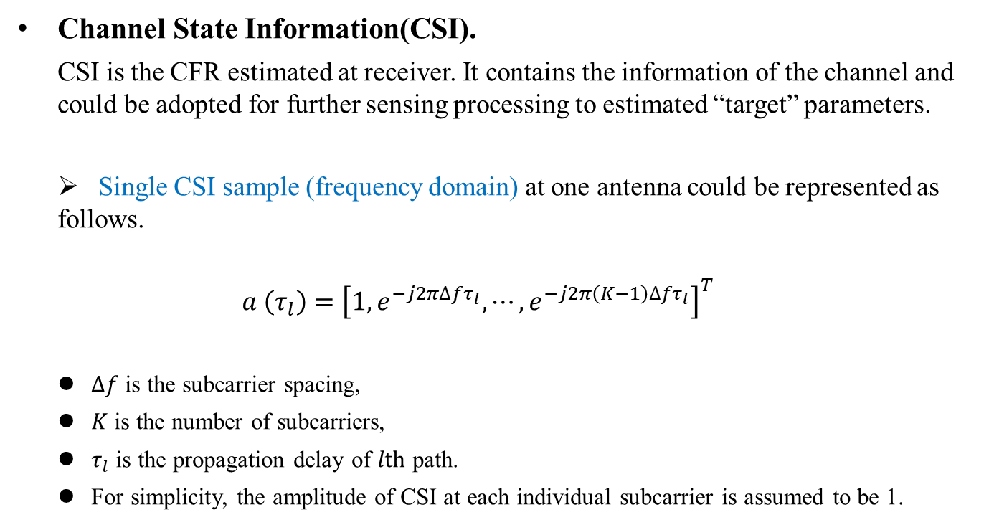
3. TPDP(1)
Channel State Information(CSI).
CSI is the CFR estimated at receiver. It contains the information of the channel and could be adopted for further sensing processing to estimated “target” parameters.
Single CSI sample (frequency domain) at one antenna could be represented as follows.
$$a \left(τ_{l}\right)={\left[1,e^{−j2π∆fτ_{l}},⋯,e^{−j2π\left(K−1\right)∆fτ_{l}}\right]}^{T}$$
$∆f$ is the subcarrier spacing,
$K$ is the number of subcarriers,
$τ_{l}$ is the propagation delay of $lth$ path.
For simplicity, the amplitude of CSI at each individual subcarrier is assumed to be 1.

Slide 6


3. TPDP(2)
With an IFFT conducted to the CSI(frequency domain) described above, a power delay profile(time domain) could be calculated.
$$power_delay_profile=IFFT(a \left(τ_{l}\right))$$
The power delay profile depicts the information of the channel in time domain, and a peak will appear at the delay $τ_{l}$(represents the $lth$ path).
A simple simulation is shown in the
right figure.
Bandwidth: 20MHz
Subcarrier spacing: 78.125kHz
Number of subcarriers: 242
Subcarrier index: [-122:-2, 2:122]
Two paths are simulated: $τ_{1}=15/c$, $τ_{2}=45/c$.

Slide 7
3. TPDP(3)
As it is shown in the above figure, two peaks appear at the corresponding range locations which represent two paths we added in the simulation.
According to 11bf use case document[6], the maximum range of WLAN sensing is 20 meters(i.e. store sensing).
So, after the IFFT processing, the first few complex values of PDP already contains the information we want and could be reported to reduce the overhead.
The new WLAN sensing measurement result type (TPDP) is processed as follows:
Calculating time domain PDP from CSI through Inverse Fourier Transform (usually, could use IFFT) .
Reporting the first few complex values (corresponding to the range of interest) of the time domain PDP.
Because the simple processing(i.e. IFFT), the desired information WLAN sensing needs (the angle velocity, Doppler information are remained) remains.

Slide 8
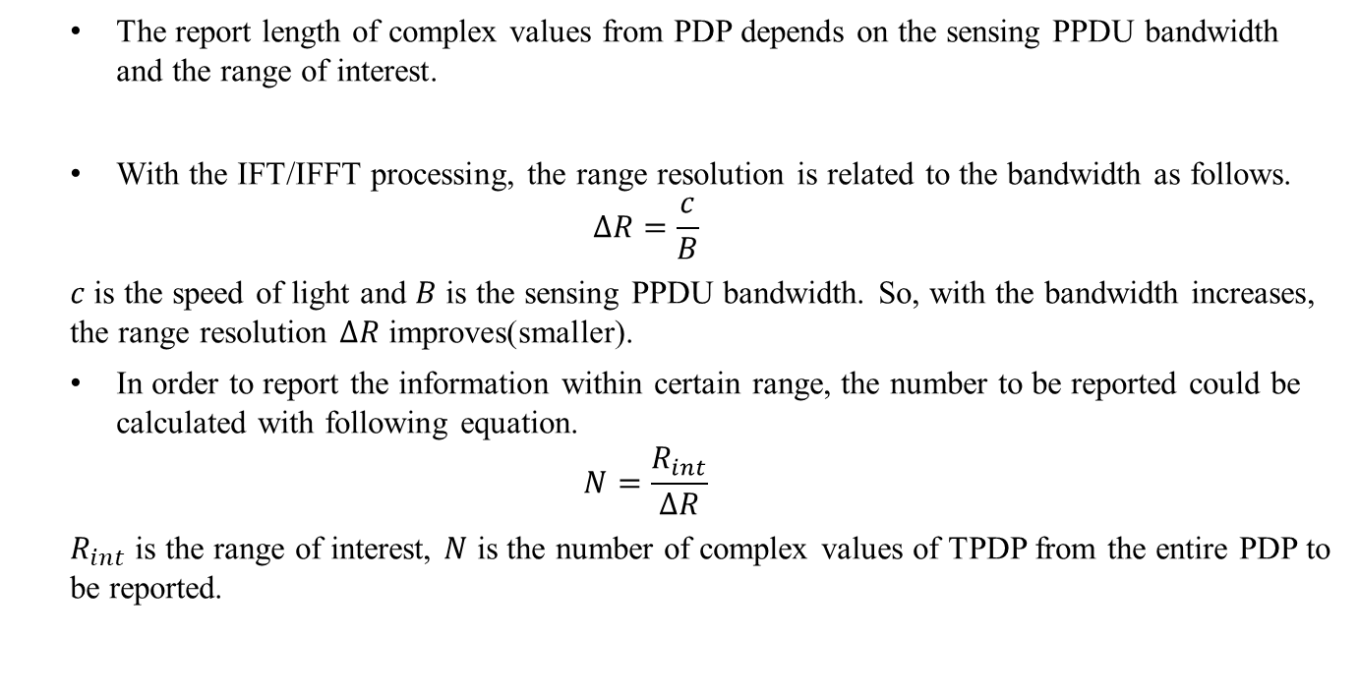
3. TPDP(4)
The report length of complex values from PDP depends on the sensing PPDU bandwidth and the range of interest.
With the IFT/IFFT processing, the range resolution is related to the bandwidth as follows.
$$∆R=\frac{c}{B}$$
$c$ is the speed of light and $B$ is the sensing PPDU bandwidth. So, with the bandwidth increases, the range resolution $∆R$ improves(smaller).
In order to report the information within certain range, the number to be reported could be calculated with following equation.
$$N=\frac{R_{int}}{∆R}$$
$R_{int}$ is the range of interest, $N$ is the number of complex values of TPDP from the entire PDP to be reported.

Slide 9
4. Experimental Validation(1)
Signal parameters
Parameters | Values
Signal Form | 802.11ax
Bandwidth | 20MHz
Carrier Frequency | 5GHz
Antennas Number | 1Tx 2Rx
Subcarriers | 242
The system architecture is shown in the left figure. One transmitter and two receivers are adopted in the experimental validation. During the experiment, Tx is transmitting HE NDP periodically and Rx1/Rx2 are receiving the NDP and estimate the channel.
Based on the CSIs estimated at two receivers, further signal processing is conducted to track the movement of a finger.
During the experiment, target human is standing near the system and drawing “star” in the air with single finger.

Slide 10
4. Experimental Validation(2)
Result based on Raw CSI (242 subcarriers/
242 complex values)
Phased rotation of the finger
Trajectory of the finger
The left figure shows the phase rotation of the finger during the movement, and the right figure shows the trajectory of the finger in a 2D coordinate system.
Result with the first PDP complex value
(1 complex value )
Equivalent performance has been achieved with single(the first) complex value from PDP!
Phased rotation of the finger
Trajectory of the finger
The left figure shows the phase rotation of the finger during the movement, and the right figure shows the trajectory of the finger in a 2D coordinate system.

Slide 11
5. Comparison of different measurement result types
Types | Operating frequency | Description | Pros | Cons
CSI matrix | Sub 7GHz | Raw CSI data. | No loss of CFR information. | Large overhead
Compressed CSI | Sub 7GHz | Givens rotation of V matrix based on the SVD of CSI matrix. | Small transmission overhead. | Loss of sensing information.
Beam SNR | 60 GHz | SNR of the PPDU at teach individual angle sector. | Smallest transmission overhead (SNR value per beam sector). | Mid grained information.
TPDP | Sub 7GHz | Power delay profile of the channel. | 1. Small transmission overhead. 2. No loss of information. 3. Small computation burden (IFFT). | /

Slide 12
6. Summary
In this presentation, a new WLAN sensing measurement result type (TPDP) is proposed and discussed.
The TPDP is processed with two steps:
Calculating the PDP(time domain) from CSI (frequency domain) through IFT(usually, IFFT) .
Reporting the first few complex values (corresponding to the range of interest) of the entire PDP.
Experimental validation is conducted to shown the performance of the proposed TPDP.

Slide 13
References
[1] 11-21-0035-00-00bf-definitions-and-scenarios-of-the-wlan-sensing.pptx
[2] 11-21-0147-03-00bf-definitions-and-scenarios-of-the-wlan-sensing-follow-ups.pptx
[3] 11-21-0357-01-00bf-discussion-of-sensing-measurement-result-types.pptx
[4] 11-20-1741-01-00bf-feasibility-study-of-human-pose-and-occupancy-classification-using-mmwave-wifi-beam-attributes.pptx
[5] 11-21-0407-02-00bf-multi-band-wifi-fusion-for-wlan-sensing.pptx
[6] 11-20-1712-01-00bf-wifi-sensing-use-cases.xlsx
[7] Tadayon N, Rahman M T, Han S, et al. Decimeter ranging with channel state information[J]. IEEE Transactions on Wireless Communications, 2019, 18(7): 3453-3468.

Slide 14
SP 1
Do you support that the TPDP calculated as follows should be considered as one of the sensing measurement result ?
Calculating time domain PDP from CSI through Inverse Fourier Transform (usually, could use IFFT) .
Reporting the first few complex values (corresponding to the range of interest) of the time domain PDP.
Yes:
No:
Abstain:

