Slide 1
WLAN Sensing Discovery
Date: 2021-04-16
Authors:
Name | Affiliation | Address | Phone | Email
Pei Zhou | OPPO |  |  | zhoupei1@oppo.com
Lei Huang |  |  |  | huang.lei1@oppo.com
Chaoming Luo
Liuming Lu

Slide 2
Background
Discovery phase should be done before sensing session. [1]
In discovery phase, sensing capabilities (sensing roles, sensing measurement types, etc.) should be exchanged between sensing initiator and sensing responder(s). [1][2]
Multiple-device scenarios are also considered, for example, there can be multiple sensing transmitters and multiple sensing receivers.
In multi-AP deploy scenarios, multiple APs may cooperate for sensing.
In this contribution, we show how to indicate sensing capabilities for both single AP and multi-AP scenarios.

Slide 3
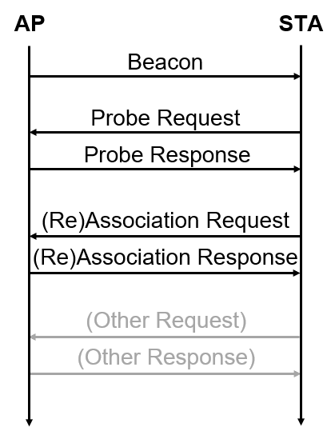
Single AP
Sensing capabilities element* can be carried in Beacon, Probe Request, Probe Response, (Re)Association Request, (Re)Association Response frames, etc.
Passive Scanning:
  Sensing capabilities element of AP can be carried in Beacon frame.
  Sensing capabilities element of STA can be carried in (Re)Association Request frame.
  Active Scanning:
  Sensing capabilities element of STA can be carried in Probe Request frame.
  Sensing capabilities element of AP can be carried in Probe Response frame.
  or
  Sensing capabilities element of STA can be carried in (Re)Association Request frame.
  Sensing capabilities element of AP can be carried in (Re)Association Response frame.
Or new frames may also be designed for sensing capabilities discovery.
Passive Scanning
Active Scanning
* The format of Sensing capabilities element is TBD.

Slide 4
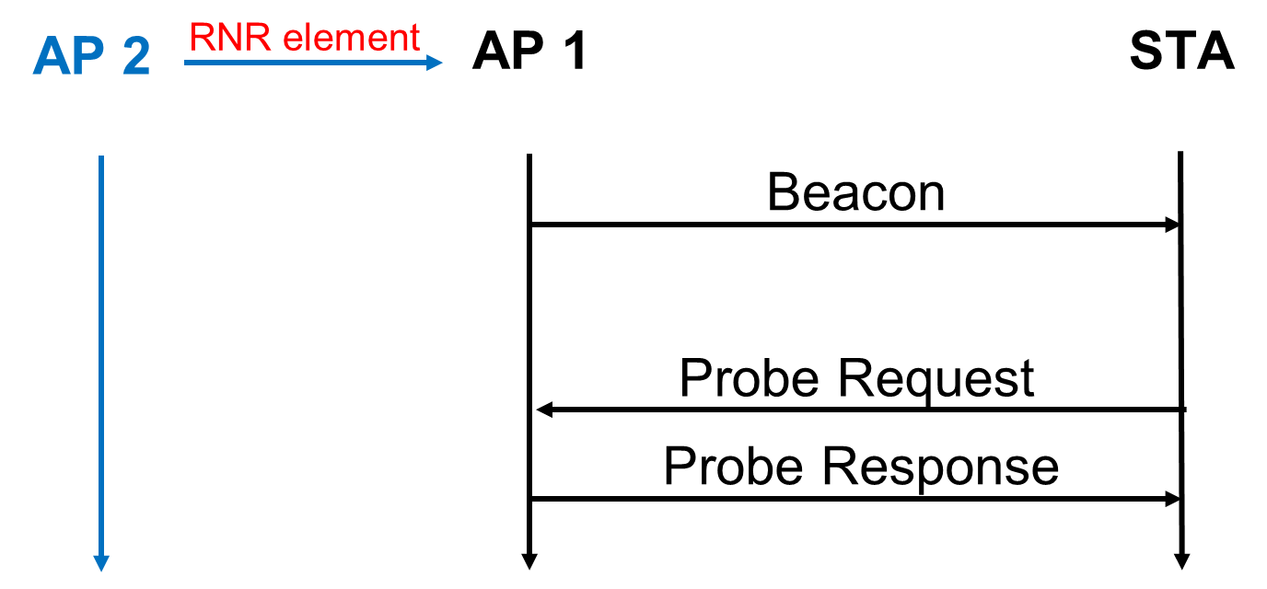
Multi-AP
In order to the accelerate the sensing capabilities discovery, (essential) sensing capabilities of neighboring APs can be contained in the Reduced Neighbor Report (RNR) element.
For example,
Passive Scanning:
  AP 1 transmits Beacon frame to STA, the Beacon frame contains
    Sensing Capabilities element: indicates the sensing capabilities of AP 1.
    RNR element: indicates (essential) sensing capabilities of AP 2.
  Active Scanning:
  STA transmits Probe Request frame to AP 1 to request the sensing capabilities of AP 1 and AP 1’s neighboring APs.
  AP 1 transmits Probe Response frame to STA, the Probe Response frame contains
    Sensing Capabilities element: indicates the sensing capabilities of AP 1.
    RNR element: indicates (essential) sensing capabilities of AP 2.
Passive Scanning
Active Scanning

Slide 5
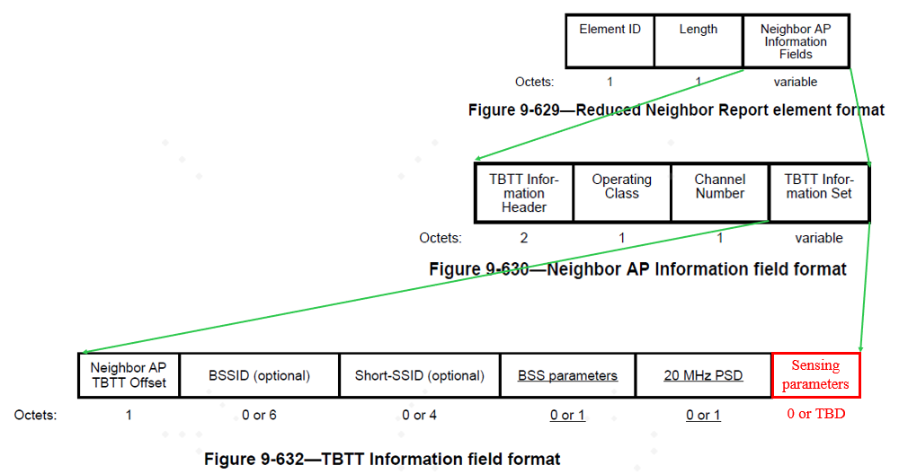
Multi-AP
An example of (essential) sensing capabilities of neighboring APs are contained in the RNR element.
Note: Essential sensing capabilities of neighboring APs are TBD.

Slide 6
Summary
We discussed the sensing capabilities discovery for both single AP and multi-AP scenarios.
The sensing capabilities of STA/AP itself can be contained in the Sensing capabilities element.
The (essential) sensing capabilities of neighboring APs can be contained in the RNR element.

Slide 7
SP #1
Do you agree that the 802.11bf amendment shall define a Sensing Capabilities element to be used by a STA to advertise its support of sensing capabilities?
Y/N/A

Slide 8
SP #2
Do you support that (essential) sensing capabilities of neighboring APs may be contained in the RNR element.
Note: Essential sensing capabilities of neighboring APs are TBD.
Y/N/A

Slide 9
Reference
11-20-1851-04-00bf-overview-of-wi-fi-sensing-protocol
11-21-0370-01-00bf-considerations-of-sensing-negotiation

