Slide 1
MAC address randomization in Android devices
Date: 2021-04-11
Authors:

Slide 2
Abstract
In this contribution, the MAC address randomization features in current Android devices are shared for information purpose.

Slide 3
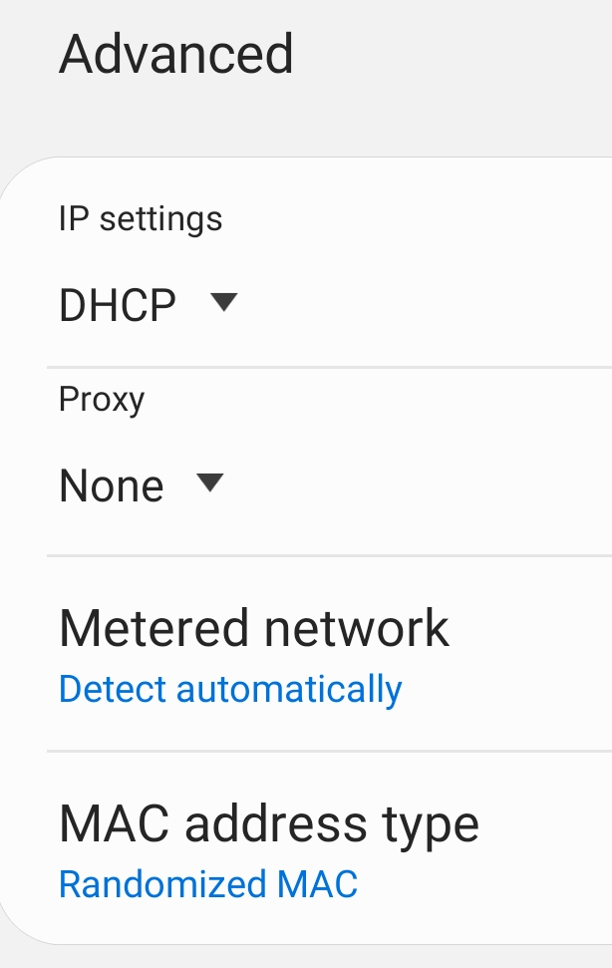
MAC address randomization in Android devices
Information from Android implementation [1]:
  “Starting in Android 8.0, Android devices use randomized MAC addresses when probing for new networks while not currently associated with a network.”
  “In Android 9, a developer option can be enabled (it's disabled by default) to cause the device to use a randomized MAC address when connecting to a Wi-Fi network.”
  “In Android 10, MAC randomization is enabled by default for client mode, SoftAp, and Wi-Fi Direct.”
  “Randomized MAC addresses are generated per SSID and are persistent.”
    Deleting a saved SSID does not result in a new randomized MAC address for the same SSID (persistent).
Android 10 (Samsung)

Slide 4
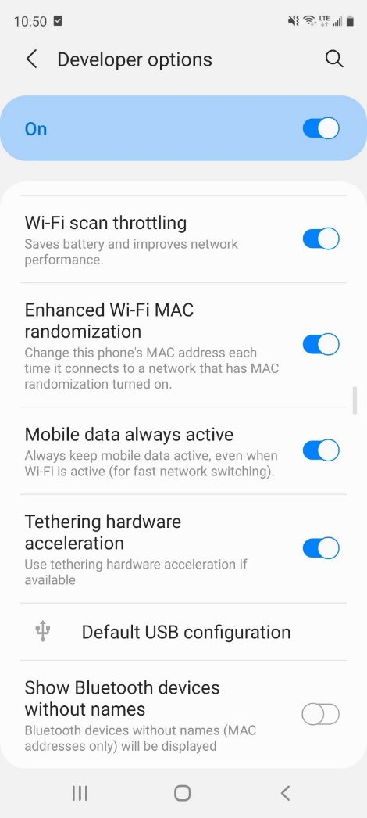
MAC address randomization in Android 11
The same feature as in Android 10 is supported.
However, “Enhanced Wi-Fi MAC randomization” (aka “aggressive MAC randomization”) can be enabled in developer options for Android 11 [2].
It can change/randomize MAC address each time it connects to a SSID, provided MAC address type in setting is set to be “Randomized MAC”, but with the following rules [3][4]:
  The randomized MAC expiration time is based on the DHCP lease duration. It is updated every time DHCP lease information is obtained
  However, the expiration time is at minimum 30min (applied if DHCP lease duration is shorter than 30min) and at maximum 24 hours (applied if DHCP lease duration is longer than 24 hours)
  In addition, MAC address is not changed throughout connection, as well as the 4 hours after disconnection (if the randomized MAC expiration timer as determined above has expired, it is updated to expire 4 hours after disconnect)
  If the previously saved SSID is deleted (forget), a new randomized MAC address is used for the SSID.
Android 11 developer options (Samsung)

Slide 5
MAC address randomization for Wi-Fi Aware
MAC addresses are randomized for Wi-Fi Aware operation [5].
“Android requires the MAC address of the Wi-Fi Aware discovery (NMI) and data interfaces (NDPs) to be randomized and not be identical to the true MAC address of the device.”
“The MAC addresses must be randomized whenever Wi-Fi Aware is enabled or re-enabled.”
“When Wi-Fi Aware is enabled, the MAC address must be randomized at a regular interval configured by a HIDL parameter*. This interval is configured by default to be 30 minutes.”
* NanConfigRequest.macAddressRandomizationIntervalSec

Slide 6
MAC address randomization for Wi-Fi Direct
MAC addresses are randomized for Wi-Fi Direct operation [6].
“Android requires that the Wi-Fi Direct device address and interface address are randomized. They must be different from the true MAC address of the device and must meet the following requirements:
  The Wi-Fi Direct device address must be randomized on interface creation if there is no persistent group saved; otherwise the device address must keep using the last generated MAC address.
  The Wi-Fi Direct interface address, also known as group address, must be randomized every time a connection is established.”

Slide 7
MAC address randomization for Wi-Fi RTT
MAC addresses are randomized for Wi-Fi RTT (IEEE 802.11mc) operation [7].
“To enhance privacy, the MAC address used during Wi-Fi RTT transactions must be randomized, i.e., it must not match the native MAC address of the Wi-Fi interface.”
“However, as an exception, when a device is associated with an AP, it may use the MAC address with which it is associated for any RTT transactions with that AP or with other APs.”

Slide 8
Summary
MAC address randomization features in Android devices are presented for information purpose.
When supported, randomized MAC addresses are generated per SSID and are persistent, by default.
For Android 11 (developer options), there is a more aggressive “Enhanced Wi-Fi MAC randomization” operation (details in slide 4).
MAC address randomization is also implemented for Wi-Fi Aware, Wi-Fi Direct and Wi-Fi RTT operations.

Slide 9
References
[1] https://source.android.com/devices/tech/connect/wifi-mac-randomization
[2] https://r1.community.samsung.com/t5/others/android-11-beta-1-rolled-out-early-part-2/td-p/5253127
[3]https://cs.android.com/android/platform/superproject/+/master:packages/modules/Wifi/service/java/com/android/server/wifi/WifiConfigManager.java;l=513;drc=master
[4]https://cs.android.com/android/platform/superproject/+/master:packages/modules/Wifi/service/tests/wifitests/src/com/android/server/wifi/WifiConfigManagerTest.java;l=2470;drc=master
[5] https://source.android.com/devices/tech/connect/wifi-aware
[6] https://source.android.com/devices/tech/connect/wifi-direct
[7] https://source.android.com/devices/tech/connect/wifi-rtt

