Slide 1
Sensing session and measurement exchange identification
Date: 2021-06-28
Authors:

Slide 2
Abstract
A proposal on how to identify the Sensing Session and the Sensing Measurement exchange

Slide 3
Observation of the coverage
A WLAN sensing measurement collects channel state information from 802.11 compatible PPDUs
Only sensing receiver performs the CSI/sensing measurement
While in the coordinated measurement, the sensing measurement participants may be in the roles of sensing initiator, responder, transmitter, and receiver
One initiator may coordinate multiple responders
The measurement exchange is comprised of four phases setup phase, measurement phase, reporting phase, and termination phase
Negotiation is used to exchange and agree on operational parameters

Slide 4
Observation of the coverage (cont.)
In the setup phase of a sensing session, a sensing session is established, and operational parameters associated with the sensing session are determined and may be exchanged between STAs (Motion 15, 20/1851r4).
More than one sensing responder may participate in the measurement phase and reporting phase (Motion 16, 21/0145r5).
The 11bf amendment shall define an optional negotiation process in the sensing setup phase for a sensing initiator and sensing responder(s) to exchange and agree on operational parameters associated with a sensing session (Motion 17, 20/0370r1).
In the measurement phase of a sensing session, sensing measurements are performed (Motion 15, 20/1851r4).
In the reporting phase of a sensing session, sensing measurement results are reported (Motion 15, 20/1851r4).

Slide 5
Sensing session
Keep the sensing session pairwise as in FTM/.11az
Why?
  The sensing session is identified by pair of the MAC addresses and/or by the pair of AID and AID/UID
    The .11az enables the unassociated STA to participate in the session with AP and it is identified by RSID. The ID of the unassociated STA is named UID in this presentation
  One entity identified by an individual MAC address or associated AID may have a sensing session with more than one other entity identified by the individual MAC address or associated AID/UID
  Add/terminate responders one by one
  Enable pairwise (re)negotiation of the sensing measurement parameters
  Use Association/Authentication and Pre-association security negotiation (PASN) to assert the AID/UID. AID/UID identifies the STA when a single frame addresses multiple STAs.
  Provide pairwise keys for MAC and PHY secure protection
  Reuse existing solution of .11az

Slide 6
Sensing session identification
The Sensing Session is pairwise and is identified by MAC addresses and/or associated AID/UID

Slide 7
Sensing measurement exchange
The measurement exchange may involve many phases. For example, all or part of the following phases may happen in the measurement exchange
  The optional negotiation process is named as the Measurement setup in this presentation
  A Measurement instance may have one or part of the following:
    Polling addressed to multiple stations in one message
    Triggering or Announcement addressed to multiple stations in one message
    Individual reporting

Slide 8
Sensing measurement exchange (cont.)
Some phases, for example, the reporting may be delayed and may happen in the middle of a forthcoming measurement instance
If the renegotiation is required, the measurement instance(s) and the negotiation in which the agreed parameters/attributes are used shall be terminated and the new negotiation and measurement instance shall be initiated
The measurement instances may belong to different sets of the operational parameters/attributes negotiated at any time, independent of the previous negotiations
The identifications of the sensing measurement exchange helps to keep the integrity of different phases in the measurement exchange

Slide 9
Example of the sensing measurement

Slide 10
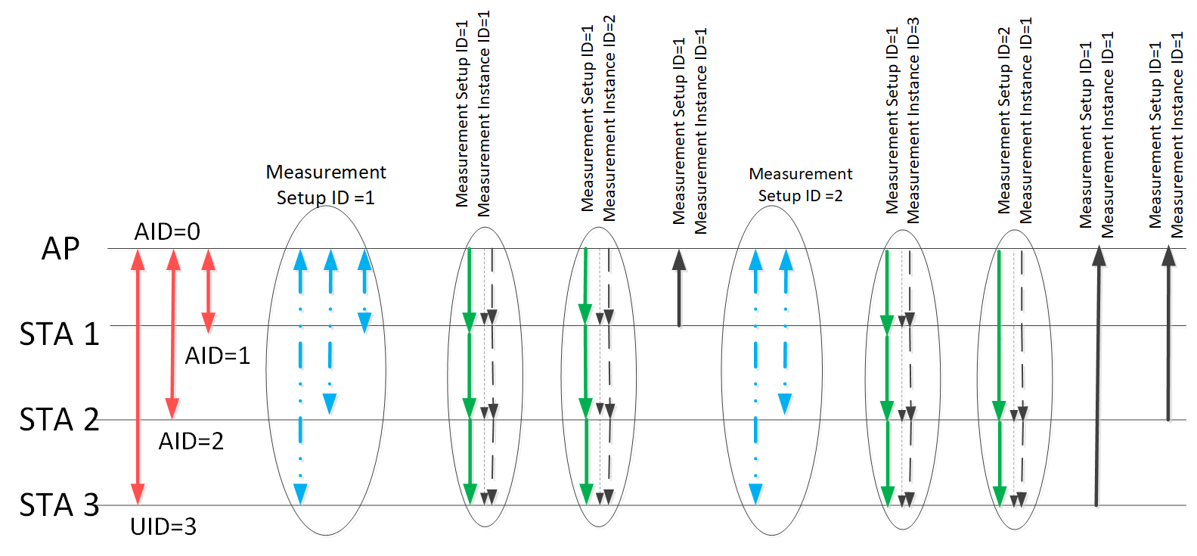
Example of the sensing measurement timeline

Slide 11
Measurement Setup ID
The Measurement Setup ID may be used to identify attributes used in the sensing measurement instance
The measurement setup is provided separately to each responder at the negotiation phase
The Measurement Setup ID is set to the same value among the responders that share the same measurement instances

Slide 12
Measurement Instance ID
The sensing measurement instance may contain several frames (poll, trigger, NDP announcement, NDP, reports) to perform complete measurement among one or more responders
The Measurement Instance ID uniquely identifies the sensing measurement instance per the Measurement Setup ID
The Measurement Instance ID is used to identify the frames that belong to the same sensing measurement instance
The Dialog Token field of the frames used in the measurement instance may contain both the Measurement Setup ID and the Measurement Instance ID

Slide 13
SP1
Do you agree with the following:
The Sensing Session is pairwise and is identified by MAC addresses and/or associated AID/UID?
11bf shall define an optional negotiation process in the sensing setup phase for a sensing initiator and a sensing responder(s) to exchange and agree on operational parameters associated with a sensing session. The initiator may maintain multiple sensing sessions.

Slide 14
SP2
Do you agree with the following:
The Measurement Setup ID may be used to identify attributes of the sensing measurement instances
The Measurement Instance ID may be used to identify the sensing measurement instance that utilizes attributes of the same Measurement Setup ID
The Dialog Token field may be a possibility to contain both IDs

