Slide 1
Wireless TSN in 802.11 and New Requirements for 802.11be and 802.1
Date: 2021-04-08
Authors:

Slide 2
Introduction
There is increasing interest in extending TSN capabilities and standards from wired to wireless
  Many time-sensitive applications can benefit from deterministic performance over Wi-Fi
  Support for TSN enhancements and integration with Ethernet-based TSN is within the scope of the 802.11be project
This presentation reviews the TSN features supported by 802.11, discusses open challenges and topics for further collaboration between 802.11be and 802.1

Slide 3
TSN “toolbox” Overview
Example TSN tools (not a complete list) extended to 802.11 and relevant 802.11 capabilities
Time synchronization (802.1AS profile of IEEE 1588)
TSN toolbox
Redundancy (802.1CB)
Redundant time (802.1AS-Rev)
…
802.1AS over 802.11 TM, FTM
802.11be Multi-link
Synchronization
Reliability
Time-aware scheduling (802.1Qbv)
…
Bounded Latency
TSN Config (802.1Qcc)
Stream reservation (802.1Qat)
…
Scheduling (802.11ax) QoS Enhancements/low latency (802.11be)
802.1Q bridging (802.11ak)
Resource Mgmt

Slide 4
Status of TSN capabilities supported by 802.11
 | Relevant 802.1 and 802.11 features and specifications | Potential topics for 802.11be and/or 802.1
Integration with 802.1Q networks | 802.1Q and 802.11ak | -
Traffic Stream Classification | 802.1Q VLAN ID, 802.11 TCLAS mask for 802.1Q | Mapping 802.1 TSN flow to traffic flow in 802.11be STAs to receive prioritized treatment (ongoing QoS/low latency discussions in 11be)
Time Synchronization | 802.1AS and 802.11 TM and FTM | -
Bounded latency | 802.1Qbv/Qav over 802.11 MAC, scheduling enhancements in 11ax, Predictable low latency via restricted SP in 11be | Enhance Time-aware scheduling in the 802.11be MAC Wireless-aware TSN configuration to handle dynamics of the wireless channel
Reliability | 802.1CB | 802.1CB over 802.11be MLD
Configuration and Resource management |  | Wired-Wireless TSN configuration models

Slide 5
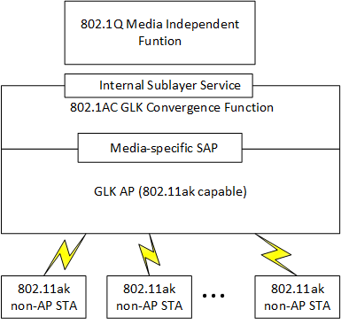
Wired-Wireless 802.1 TSN bridging enabled by 802.11
4.3.28.3.3 Infrastructure BSS with general links and Figure 4-15 in IEEE P802.11 REVmd D5.0
Control plane entities in a centralized management model (802.1 Qcc):
CNC: Central Network Configuration
CUC: Central User Configuration

Slide 6
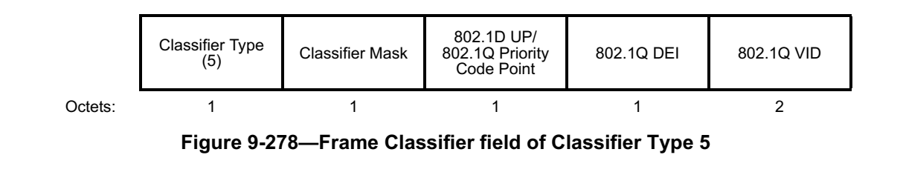
Traffic stream classification and differentiation
Classifying and differentiating Time-sensitive streams from other flows is a fundamental TSN requirement
  802.1Q VLAN tag is used for traffic classification
  Up to 8 traffic classes (queues) per port defined by the Priority Code Point (PCP) field
  Traffic differentiation is used by other TSN features (e.g., 802.1Qbv traffic shaping)
802.11 Stations can identify VLAN tag and PCP fields
  802.11 TCLAS defines an 802.1Q classifier (Already defined, no spec changes needed)

Slide 7
Time Synchronization (802.1AS)
802.1AS Synchronization across wired-wireless TSN
Application example: A PLC’s control cycle can be synchronized with other PLCs/Sensors/Actuators over Ethernet and 802.11 links
Time-Aware traffic shaping (802.1Qbv) operates based on the same reference clock on wired and wireless links
  802.11 defined MAC specific support for 802.1AS:
    Timing Measurement (TM) – IEEE802.11-2012
    Fine Timing Measurement (FTM) – IEEE802.11-2016
Talker
Listener

Slide 8
Bounded latency
802.1Qbv is a TSN tool to achieve determinism via scheduling resources
To support 802.1Qbv, the 802.11 TSN domain needs to deliver packets within deadlines (bounded latency) at deterministic time intervals with high reliability
  Need predictable access for time-critical packets as part of known (periodic) traffic flows
Traffic Class
#
7
Traffic Class
#
6
Traffic Class
#
5
Traffic Class
#
0
-
-
T0
Example Schedule
T0+ 10ms
Timing Data
500 µs
(Guard band)
1 ms
(gate open)
Time-critical
8.5 ms
(gate open)
Other traffic
Gate Control
Gate
Gate
Gate
Gate
Transmission Selection

Slide 9
Current support and gaps for 802.1Qbv in 802.11be
802.11ax scheduled operation enables better control of latency to support 802.1Qbv
Gaps:
  802.1Qbv configuration should be provided to the 802.11be MAC as requirements/input (e.g., for scheduling of Restricted TWT SPs)
  Time-sensitive frames within the 802.11 MAC may be delayed if sharing a queue with other traffic (head of the line blocking & randomness) – 11be MAC need to isolate frames and consider per frame deadlines (time-aware)
The Restricted TWT (being defined in 802.11be) can enhance channel access for more deterministic latency
Restricted TWT SP for low latency traffic
Time-sensitive frame
: Gate Open for time-critical traffic
: Gate Open for other traffic
HOL
Blocking/delay
The scheduled Restricted TWT SPs must align with the 802.1Qbv schedule for the network

Slide 10

Reliability (802.1CB and 802.11be MLD)
802.1CB Frame Replication and Elimination for Reliability (FRER)
802.1CB over two MAC/PHY interfaces
(multiple transmissions and duplicate elimination)
Integration of 802.11be MLD with 802.1CB
(multi-link transmissions and duplicate elimination)
Upper layer
Upper layer
802.1CB FRFE
802.1CB FRER
Media specific Dual MAC/PHY (802.3, 802.11)
Upper MLD MAC
Multi-link transmissions
MAC
MAC
.11be Lower MAC
.11be Lower MAC
PHY
PHY
.11be PHY
.11be PHY
Link 1
Link 2
Link 1
Link 2
Two ports are shown as two interfaces to 802.1CB
802.1CB introduces Redundancy-Tag and handles frame duplication and elimination
802.11be MLD supports transmissions over multiple links and handles duplicate elimination
802.1CB can generate a stream with redundancy-tag
Tx MLD trigger multi-link transmissions based on the redundancy tag
Rx MLD eliminates duplicates based on per MLD BA agreement
Slide 10

Slide 11
Configuration and Resource Management
The time-aware schedule needs to take into account dynamic link states in 802.11
Short term changes to the wireless link cannot be easily managed at the central TSN scheduler - CNC
  802.1Qbv schedules cannot change fast enough
  Short term changes in the wireless channel should be handled by the 802.11 MAC, using 802.11 tools (scheduling, MCS/RU allocations, MLO, rTWT, …)
More flexible configuration models

Slide 12
Conclusions
802.11 is already part of the 802.1 TSN architecture
  802.1 and 802.11 have been collaborating for specifying support required in 802.11 for several TSN features
  802.11be is introducing new latency and reliability enhancements
Introducing more “wireless-awareness” in some of the 802.1 Standards can enable more efficient Wireless TSN operation, configuration and management, for instance:
  802.1CB aware of 802.11be MLD
  802.1Q configuration aware of wireless links

