Slide 1
EVM and SFO/STO
Date: 2021-05-19
Authors:

Slide 2
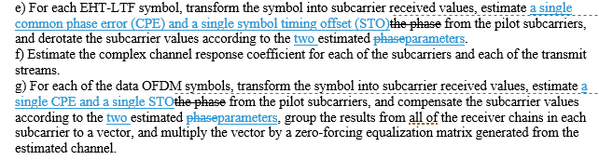
In D0.4, 11be fixed a long-standing problem with SFO/STO in the TX EVM test procedure, but more discussion is requested
There is an 11me comment on the SFO/STO EVM problem in 11a/HT/VHT, but the PHY experts are here and 11be has already taken steps to fix its version of the problem
These steps were made as part of 20/1958r3, which allowed a STA to use 2 RF LOs to transmit 320 MHz (e.g., 160+160 MHz segments), but ultimately this EVM topic is orthogonal to 2 RF LOs.
20/1958r3 added “single” to the TX EVM procedure to make it clear that receivers did not need to perform CFO estimation/correction or pilot estimation per 160 MHz but, at the same time, there was a concern that this “single” would incorrectly harden the language against correction of both CPE and STO, so in D0.4 it was clarified that a single estimate of both CPE and STO was performed:
However, some questions have been raised on these 11be steps, and some wider discussion was requested. E.g., STO can be corrected from CPE without a further estimation.

Slide 3
STO Concerns: the 802.11a/n/ac/ax TX EVM Procedures Miss the Mark on Two Goals
Goal A: Incorrect calculations by the receiving test equipment should not contribute to the numerator (error) quantity in the EVM calculation and thereby penalize the transmitter
Goal B: If two entities (e.g., vendor and customer) independently follow the 802.11 EVM test procedures to test a STAUT, they should both agree if the STAUT passed or failed
Sadly the 802.11beD0.3 TX EVM procedure missed the mark on both these items (the same as for 11a/HT/VHT/HE over 22 years)
Out of necessity, unwritten conventions were adopted, and test equipment vendors provide their customers with a range of modes: a) a mode that complies with the EVM test as defined (with warnings), and b) other modes that avoid the inherent inconsistency of the EVM test as defined, and provide further capabilities [1]

Slide 4
Impact of Oscillator Offsets (1/2)
In 5/6 GHz, STAUTs are allowed to have +-20ppm offset in their reference oscillator
This manifests itself as Carrier Frequency Offset (CFO; aka “frequency offset”) within the mixer and Sampling Frequency Offset (SFO; aka “sampling offset drift”) within the ADCs
The EVM test procedures have always dealt with CFO thoroughly and explicitly:
  Frequency offset is estimated and corrected during the preamble
    Because of various impairments, the test equipment can never estimate CFO perfectly, but the majority of the CFO is removed here
  The effect of any residual CFO (i.e., actual CFO minus estimated CFO) appears as Common Phase Error (CPE) that increases every OFDM symbol.
  The EVM procedure allows this CFO residue (and other impairments such as carrier phase noise) to be estimated and corrected using the pilot tones during the EHT-LTF and Data fields

Slide 5
Impact of Oscillator Offsets (2/2)
The approved EVM test procedures have never dealt with SFO adequately:
  In 11a/HT/VHT, there appears to be no text at all (see backup)
  In HE/EHT, step d) says “Sampling offset drift [=SFO] shall be also compensated”
    There is no text describing how sampling offset drift should be determined, so presumably it is calculated (not independently estimated) from the estimated CFO, since the estimated CFO and known carrier frequency allow the underlying reference oscillator offset (ppm) to be determined
    Because of the position of the text, the strong implication is that the SFO calculation is made one time during the preamble, and the subsequent correction (e.g., digital resampling with a fixed ratio) continues unchanged for the duration of the PPDU
    SFO correction is a natural requirement given the dense subcarriers of HE/EHT, since otherwise ICI dominates the calculated EVM
    Because of various impairments, the test equipment can never estimate the (CFO or) reference oscillator offset perfectly, yet still the majority of the HE/EHT SFO is removed here
  The effect of any residual SFO (i.e., actual SFO minus estimated SFO) appears as Symbol Timing Offset (STO) that increases every OFDM symbol.

Slide 6
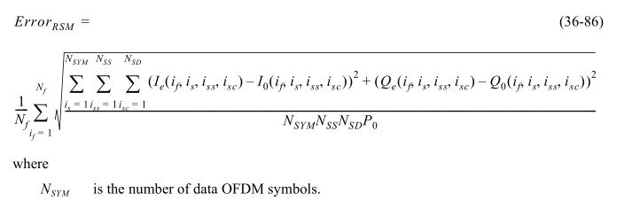
STO Was Not Adequately Addressed by the D0.3 802.11 EVM Test Procedure
STO due to residual SFO increases over time, but
  The simplest interpretation of the EVM test procedure is that residual STO is neither estimated nor corrected per OFDM symbol:
    g) For each of the data OFDM symbols, transform the symbol into subcarrier received values, estimate the phase [CPE] from the pilot subcarriers, and compensate the subcarrier values according to the estimated phase [i.e. CPE-compensation only], group the results from all of the receiver chains in each subcarrier to a vector, and multiply the vector by a zero-forcing equalization matrix generated from the estimated channel
  The PPDUs under test shall be at least 16 (or 32) data OFDM symbols long
  The EVM calculation uses all transmitted OFDM symbols
  .

Slide 7
How Goal A and B Are Not Met
Goal A is not met because STO due to the test equipment making an imperfect estimate of the SFO is not the fault of the transmitter.
  Tolerable only if the EVM contribution due to mis-estimated SFO isn’t “the straw that breaks the camel’s back” and causes the measured EVM to flip from passing to failing (being well below the EVM limit is usually sufficient)
Goal B is not met because EVM is calculated over at least 16 (or 32) OFDM symbols:
  Vendor might test over 16 (or 32) OFDM symbols and report that their product passes
  Customer might test over max OFDM symbols (as they’re entitled to do) and – with bad enough residual STO – report that the vendor’s product fails
  … This doesn’t happen in practice because of unwritten rules such as don’t test EVM over max OFDM symbols
    Unwritten rules mean that the underlying standard is incomplete

Slide 8
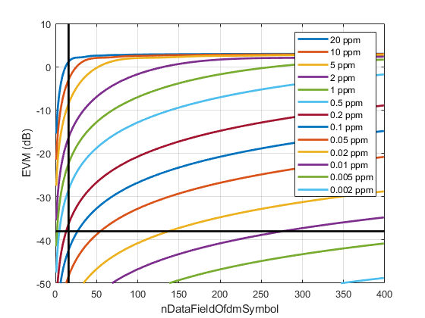
Simulated Impact of Residual SFO for EHT
Plot shows 802.11 EVM versus number of OFDM symbols in the Data field for various TX ppm’s
EVM limit for MCS12/13 is -38 dB
At 16 OFDM symbols, need <0.05ppm residual SFO for its contribution to be negligible (realistic, given HETB also needs to maintain 350 Hz / 7 GHz = 0.05ppm of accuracy)
  But care is still needed: 0.2ppm residual SFO would cause STAUT to fail test
With 399 OFDM symbols, need <0.002ppm residual SFO for its contribution to be negligible, which is surely unrealistic
320MHz, 4KQAM, 1SS, 0.8us GI, 4x EHTLTF, 20 random Data fields, 100ns windowing
No impairments except SFO, ideal CPE correction (0 always) and equalization

Slide 9
Mitigation Options
Option 0: No change to D0.4
  Explicit reference to CPE and STO estimation and compensation during EHTLTFs and Data field
Option 0a: Light update to D0.4
  Explicit reference to CPE estimation and CPE and STO compensation during EHTLTFs and Data field
Option 1: Revert EVM text changes in 20/1958r3, then change “estimate the phase” to “estimate a single phase” for the EHTLTF and Data fields
  i.e., limit 20/1958r3 to fixing 2 RF LOs, and leave EVM with the two Goals unmet and unaddressed; continue the discussion in 11me
Option 1a: i) Allow CPE and STO correction during the EHTLTFs and ii) CPE correction but not STO correction during the Data field
  i.e., limit 20/1958r3 to fixing 2 RF LOs, and leave EVM with the two Goals unmet and unaddressed; continue the discussion in 11me
Option 2: Limit the EVM calculation to the first 16 (or 32 for ru26) OFDM symbols in the Data field
  Though, then EVM degradations after 16/32 symbols in longer PPDUs are untested
(Option 3a: Allow STO correction whenever residual SFO would cause an EVM degradation above EVM threshold – 10 dB
  But how is residual SFO itself estimated? – and if from the pilots, then this is really option 0/0a again)
Option 3b: Allow STO correction after every 16 (or 32 for ru26) OFDM symbols in the Data field
Option 3c: Allow STO correction after every 32 OFDM symbols in the Data field
  Options 3b and 3c are NOT intended to model actual receiver implementations; only that implementations do address STO (in whatever way)
  Options 3b and 3c have the advantage than a) cumulative STO is corrected before it affects EVM, b) the EVM test is well defined however long the PPDU is, c) existing EVM measurements over 16/32 OFDM symbols are still valid, d) this still encourages “clean” transmitters since any STO-related impairments not related to oscillator offset between the 16/32 OFDM symbols need to be kept small

Slide 10
Strawpoll SP1 [Not run]
Do we agree :
  That the current EVM measurement allows measurement over a maximum length PPDU, and
  At least one of the following:
    That it is practically impossible for test equipment to measure SFO to within 0.002 parts per million from the preamble given a STA with permissible TX impairments
    That a minimal receiver should be tolerant of a STA whose SFO happens to wander by more than 0.002 ppm during a PPDU
  Y/N/A

Slide 11
Strawpoll SP2
If we were to change the text from D0.4, vote Y/N/A on each of the following:
  Option 0a: CPE estimation and CPE and STO compensation during EHTLTFs and Data field, every OFDM symbol

Slide 12
Strawpoll SP2a
If we were to change the text from D0.4, vote Y/N/A on each of the following:
  Option 1: Revert EVM text changes in 20/1958r3, then change “estimate the phase” to “estimate a single phase” for the EHTLTF and Data fields

Slide 13
References
  [1] https://www.rohde-schwarz.com/us/manual/r-s-fsw-k91-wlan-user-manual-manuals-gb1_78701-28989.html (and thence https://scdn.rohde-schwarz.com/ur/pws/dl_downloads/pdm/cl_manuals/user_manual/1173_9357_01/FSW_K91_WLAN_UserManual_en_34.pdf ; see pages 72 and 204)

Slide 14
Backup
Sample Language

Slide 15
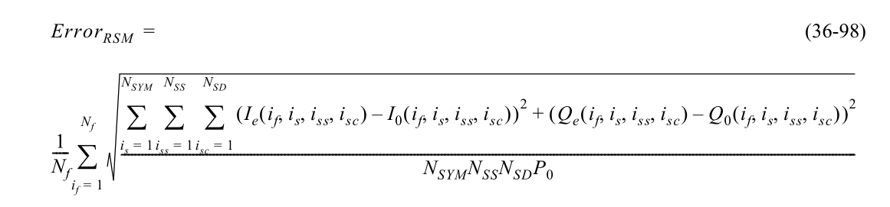
Sample language for Option 0a
…
c) Coarse and fine frequency offsets shall be estimated.
d) Symbols in a PPDU shall be derotated according to a single estimated frequency offset. Sampling offset drift shall be also compensated.
e) For each EHT-LTF symbol, transform the symbol into subcarrier received values, estimate a single phasea single common phase error (CPE) and a single symbol timing offset (STO) from the pilot subcarriers, and derotate the subcarrier values according to the estimated phasetwo estimated parameters. Symbol timing offset (STO) shall be also compensated according to a single parameter per EHT-LTF symbol.
f) Estimate the complex channel response coefficient for each of the subcarriers and each of the transmit streams.
g) For each of the data OFDM symbols, transform the symbol into subcarrier received values, estimate a single phase and a single STO from the pilot subcarriers, compensate the subcarrier values according to the estimated phase, compensate STO according to a single parameter per OFDM symboltwo estimated parameters, then group the results from all of the receiver chains in each subcarrier to a vector, and multiply the vector by a zero-forcing equalization matrix generated from the estimated channel.
…
N_{SYM} is the number of data OFDM symbols.

Slide 16
Sample language for Option 1
…
c) Coarse and fine frequency offsets shall be estimated.
d) Symbols in a PPDU shall be derotated according to a single estimated frequency offset. Sampling offset drift shall be also compensated.
e) For each EHT-LTF symbol, transform the symbol into subcarrier received values, estimate a single phasea single common phase error (CPE) and a single symbol timing offset (STO) from the pilot subcarriers, and derotate the subcarrier values according to the estimated phasetwo estimated parameters.
f) Estimate the complex channel response coefficient for each of the subcarriers and each of the transmit streams.
g) For each of the data OFDM symbols, transform the symbol into subcarrier received values, estimate a single phasea single CPE and a single STO from the pilot subcarriers, and compensate the subcarrier values according to the estimated phasetwo estimated parameters, group the results from all of the receiver chains in each subcarrier to a vector, and multiply the vector by a zero-forcing equalization matrix generated from the estimated channel.
…
N_{SYM} is the number of data OFDM symbols.

Slide 17
Sample language for Option 1a
…
c) Coarse and fine frequency offsets shall be estimated.
d) Symbols in a PPDU shall be derotated according to a single estimated frequency offset. Sampling offset drift shall be also compensated.
e) For each EHT-LTF symbol, transform the symbol into subcarrier received values, estimate a single phasea single common phase error (CPE) and a single symbol timing offset (STO) from the pilot subcarriers, and derotate the subcarrier values according to the estimated phasetwo estimated parameters. Symbol timing offset (STO) shall be also compensated according to a single parameter per EHT-LTF symbol.
f) Estimate the complex channel response coefficient for each of the subcarriers and each of the transmit streams.
g) For each of the data OFDM symbols, transform the symbol into subcarrier received values, estimate a single CPE and a single STO from the pilot subcarriers, and compensate the subcarrier values according to the estimated CPEtwo estimated parameters, group the results from all of the receiver chains in each subcarrier to a vector, and multiply the vector by a zero-forcing equalization matrix generated from the estimated channel.
…
N_{SYM} is the number of data OFDM symbols.

Slide 18
Sample language for Option 2
…
c) Coarse and fine frequency offsets shall be estimated.
d) Symbols in a PPDU shall be derotated according to a single estimated frequency offset. Sampling offset drift shall be also compensated.
e) For each EHT-LTF symbol, transform the symbol into subcarrier received values, estimate a single phasea single common phase error (CPE) and a single symbol timing offset (STO) from the pilot subcarriers, and derotate the subcarrier values according to the estimated phasetwo estimated parameters.
f) Estimate the complex channel response coefficient for each of the subcarriers and each of the transmit streams.
g) For each of the data OFDM symbols, transform the symbol into subcarrier received values, estimate a single phasea single CPE and a single STO from the pilot subcarriers, and compensate the subcarrier values according to the estimated phasetwo estimated parameters, group the results from all of the receiver chains in each subcarrier to a vector, and multiply the vector by a zero-forcing equalization matrix generated from the estimated channel.
…
N_{SYM,EVM} equals 32 data OFDM symbols for occupied RUs with 26 tones and 16 data OFDM symbols for occupied RUs with more than 26 tones.N_{SYM} is the number of data OFDM symbols.
Change N_{SYM} to N_{SYM,EVM}

Slide 19
Sample language for Option 3b/c
…
c) Coarse and fine frequency offsets shall be estimated.
d) Symbols in a PPDU shall be derotated according to a single estimated frequency offset. Sampling offset drift shall be also compensated.
e) For each EHT-LTF symbol, transform the symbol into subcarrier received values, estimate a single common phase error (CPE) and a single symbol timing offset (STO) from the pilot subcarriers, and derotate the subcarrier values according to the two estimated parameters.
f) Estimate the complex channel response coefficient for each of the subcarriers and each of the transmit streams.
g) For each of the data OFDM symbols, transform the symbol into subcarrier received values, and estimate a single CPE and a single STO from the pilot subcarriers. After every N_{SYM,STO} OFDM symbols, calculate a single STO for the next N_{SYM,STO} OFDM symbols. , and cCompensate the subcarrier values according to the estimated CPE and STOtwo estimated parameters, group the results from all of the receiver chains in each subcarrier to a vector, and multiply the vector by a zero-forcing equalization matrix generated from the estimated channel.
Option 3b: N_{SYM,STO} equals 32 for occupied RUs with 26 tones and 16 for occupied RUs with more than 26 tones.
Option 3c: N_{SYM,STO} equals 32 for all occupied RUs.
N_{SYM} is the number of data OFDM symbols.

Slide 20
Backup
EVM Test History

Slide 21
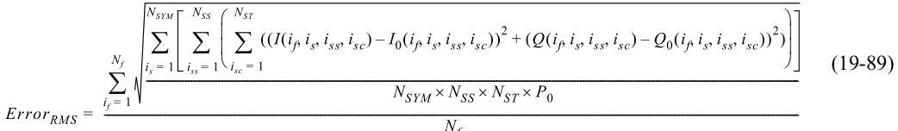
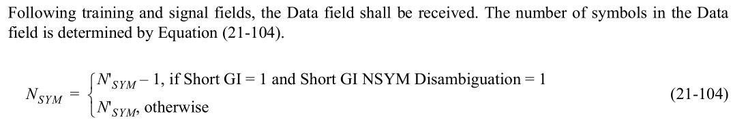
The Situation is Worse for 11a/HT/VHT
Nothing like “Sampling offset drift shall be also compensated.” in step d), so at 5 GHz the residual SFO is +-20ppm
  “b) Transition from short sequences to channel estimation sequences shall be detected, and fine timing (with one sample resolution) shall be established. [HT/VHT are rewordings of this]
  c) Coarse and fine frequency offsets shall be estimated.
  d) Symbols in a PPDU shall be derotated according to estimated frequency offset.”
Again, the plain reading of the EVM test procedure is that residual STO is neither estimated nor corrected per OFDM symbol:
  g) For each of the data OFDM symbols, transform the symbol into subcarrier received values, estimate the phase [CPE] from the pilot subcarriers, derotate the subcarrier values according to the estimated phase [i.e. CPE-compensation only], group the results from all of the receiver chains in each subcarrier to a vector, and multiply the vector by a zero-forcing equalization matrix generated from the estimated channel …
The PPDUs under test shall be at least 16 data OFDM symbols long
The EVM calculation refers to Nsym, which is defined elsewhere as the total number of OFDM symbols in the Data field

Slide 22
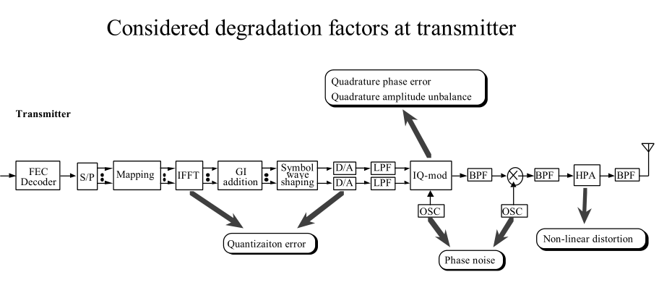
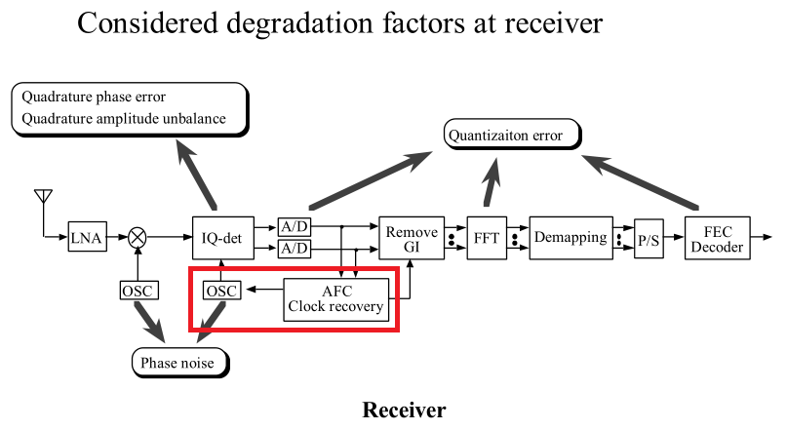
BTW, SFO was not proposed as an TX impairment considered for EVM
When Masahiro Morikura/NTT determined appropriate EVM limits for 802.11a in 11-98/380 and especially 11-99/033, the proposed EVM limit was based on various quantization, phase noise and PA effects, but not any oscillator offsets
Instead, the reference receiver used a VCO to perform SFO correction

Slide 23

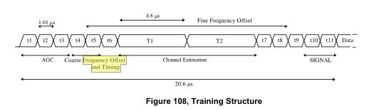
In the 1998 discussions, “timing” had a more general meaning than is assumed today
Closely related, in the merged Van Nee (Lucent) and Masahiro (NTT) proposal for 11a, 11-98/72r5, the term “timing” included STO and SFO correction (there is no other possible interpretation for the following text):
Then it can be inferred that coarse SFO correction appeared early in the preamble (note: its design has since evolved):
During comment resolution, a detailed EVM procedure was added that was silent on SFO correction within the test equipment, but did introduce “16 OFDM symbols”

Slide 24
Backup
Impact of SFO on EVM for various PHYs

Slide 25
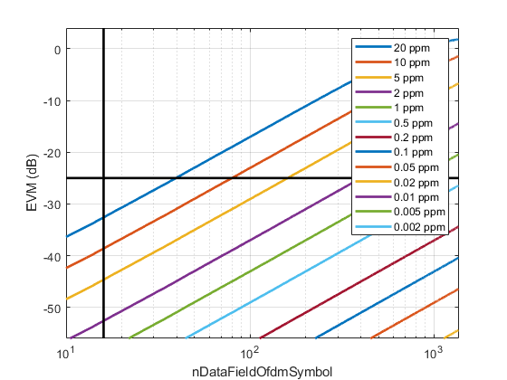
Simulated Impact of Residual SFO for 11a
Plot shows 802.11 EVM versus number of OFDM symbols in the Data field for various TX ppm’s
EVM limit for 54 Mbps is -25 dB
At 16 OFDM symbols, EVM contribution from 20ppm SFO is negligible
  This may be the reason why SFO/STO was not mentioned in the 802.11a EVM procedure
  But the text still says “at least 16 OFDM symbols”
  Was “16 OFDM symbols” added first, to avoid the need to consider SFO, then that background was lost, “16” was presumed to relate to statistical significance then “at least” was added during comment resolution?
  Not enough records / recollections to know
For maximum length PPDUs, need 0.2ppm SFO for its contribution to be negligible
Yet 11a devices are allowed to have up to +-20ppm oscillator offsets
  So there was still a flaw
20MHz, 64QAM, 1SS, 0.8us GI, 20 random Data fields, 100ns windowing
No impairments except SFO, ideal CPE correction (0 always) and equalization

Slide 26
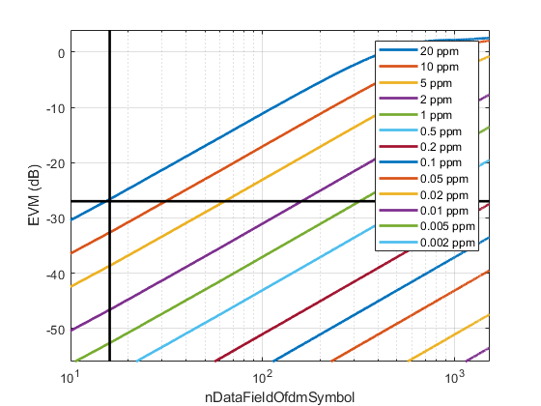
Simulated Impact of Residual SFO for HT
Plot shows 802.11 EVM versus number of OFDM symbols in the Data field for various TX ppm’s
EVM limit for HT MCS7 is -27 dB
At 16 OFDM symbols, need 5-10ppm SFO for its contribution to be negligible
For maximum length PPDUs, need 0.05ppm SFO for its contribution to be negligible
Yet HT devices are allowed to have up to +-20ppm oscillator offsets at 5 GHz
  The flaw continues
40MHz, 64QAM, 1SS, 0.4us GI, 20 random Data fields, 100ns windowing
No impairments except SFO, ideal CPE correction (0 always) and equalization

Slide 27
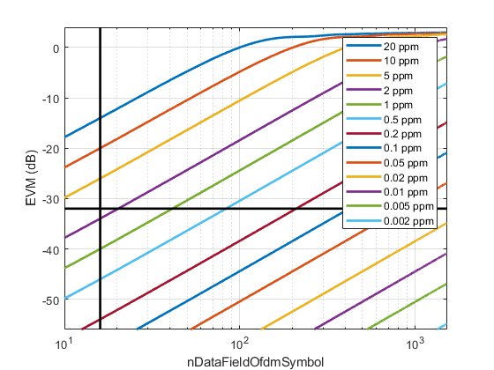
Simulated Impact of Residual SFO for VHT
Plot shows 802.11 EVM versus number of OFDM symbols in the Data field for various TX ppm’s
EVM limit for VHT MCS9 is -32 dB
At 16 OFDM symbols, need 1ppm SFO for its contribution to be negligible
  Different from EHT since EHT has 2x BW, OFDM symbols are 13.6/3.6 = 3.8x longer, EVM requirements for 4KQAM are higher than for 256QAM
For maximum length PPDUs, need 0.01-0.02ppm SFO for its contribution to be negligible
Yet VHT devices are allowed to have up to +-20ppm oscillator offsets
  The flaw continues
160MHz, 256QAM, 1SS, 0.4us GI, 20 random Data fields, 100ns windowing
No impairments except SFO, ideal CPE correction (0 always) and equalization

