Slide 1
Discussion on Enhanced Broadcast Request ANQP-element
Date: 2021-5-12
Authors:
Name | Affiliation | Address | Phone | Email
Pei Zhou | OPPO |  |  | zhoupei1@oppo.com
Lei Huang |  |  |  | huang.lei1@oppo.com
Chaoming Luo
Liuming Lu

Slide 2
Introduction
For associated STAs, the existing EBCS Request element contains ‘Requested Time to Termination’ subfield, which can negotiate for the extension of an EBCS service.
However, for unassociated STAs, the Enhanced Broadcast Request ANQP-element doesn’t contain ‘Requested Time to Termination’ subfield.
This contribution intends to modify the Enhanced Broadcast Request ANQP-element to support the negotiation for the extension of an EBCS for non-AP STAs without association.

Slide 3
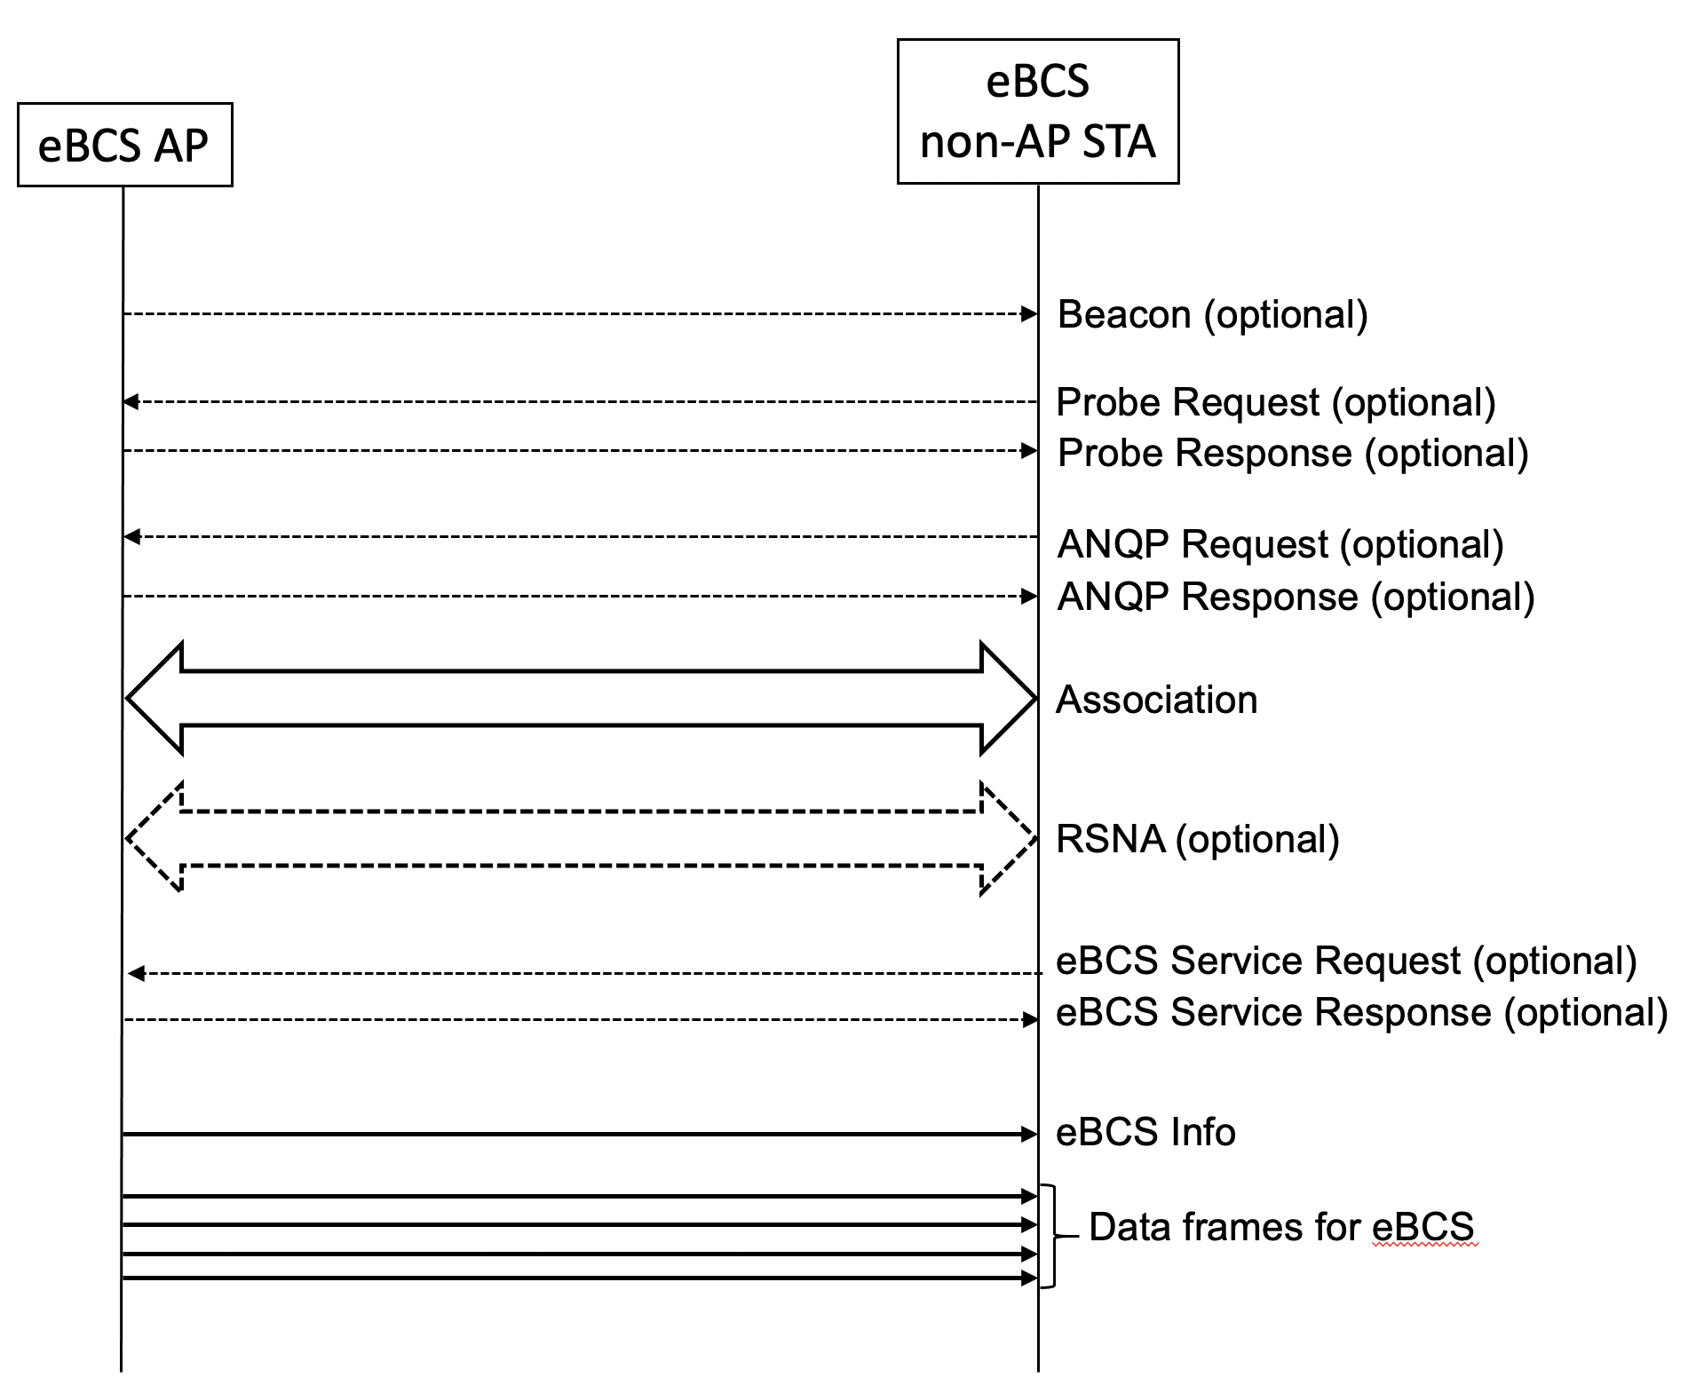
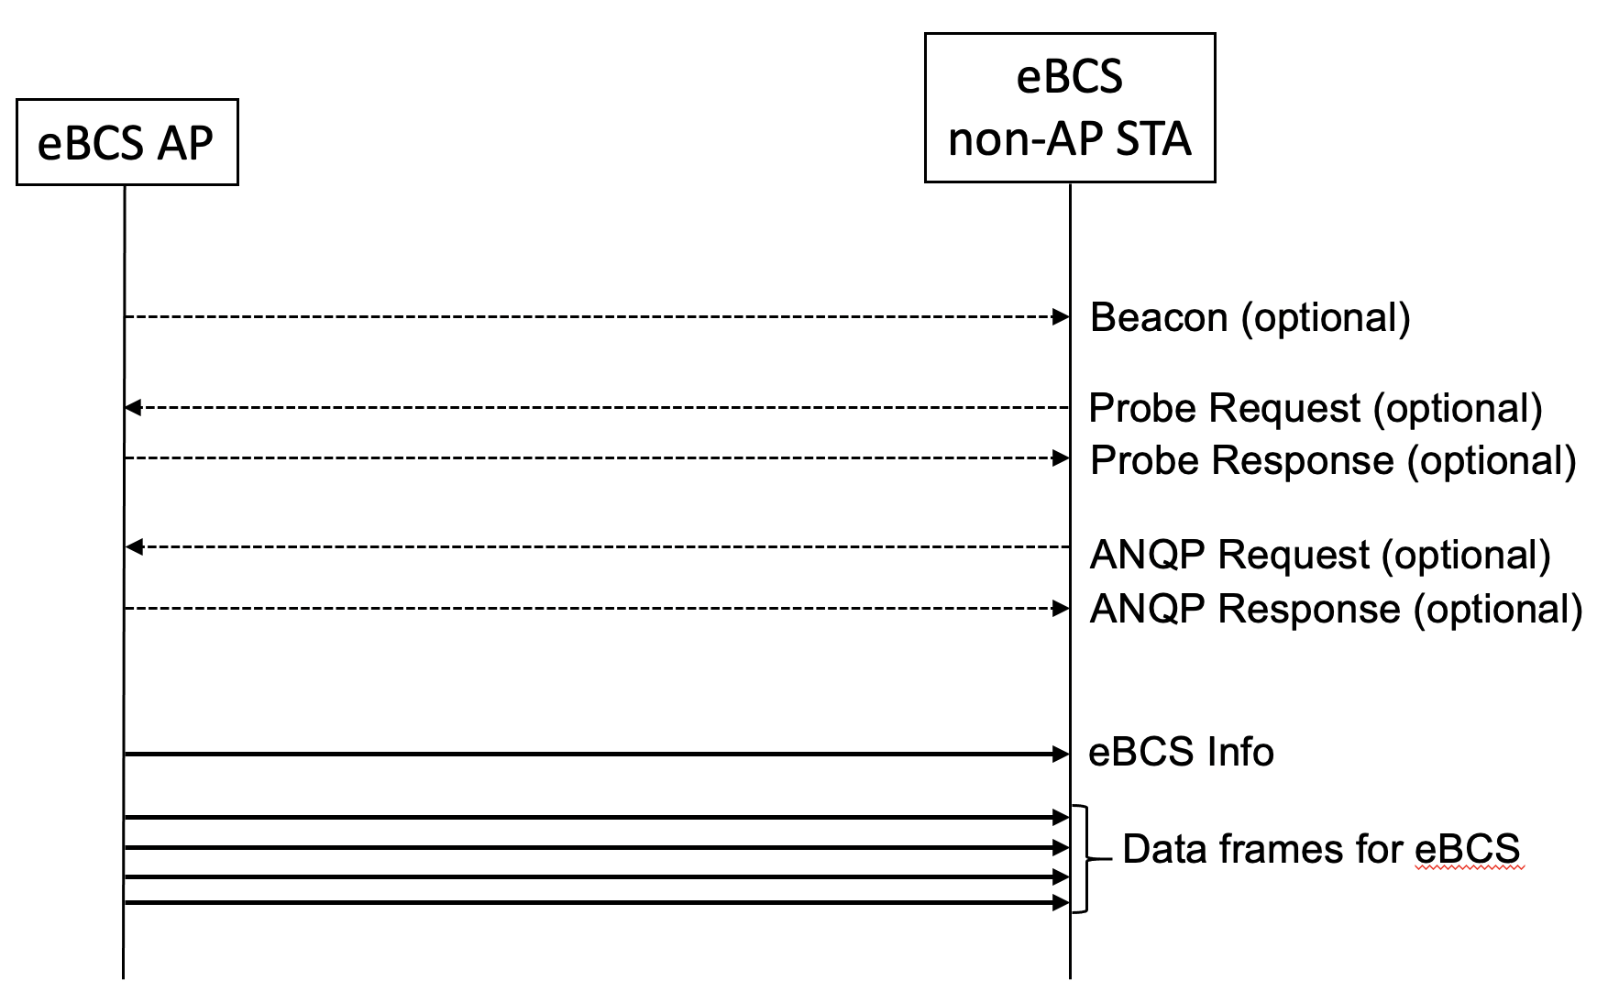
Recap: EBCS DL Procedures
The Enhanced Broadcast Request ANQP-element transmits a register (or de-register) request from a STA to a peer STA to receive (or stop receiving) enhanced broadcast services that are available from the peer STA.
The EBCS Request element is used by an EBCS STA to request one or more EBCSs from its associated AP.
Figure 11-bc1 EBCS DL frame sequence for a non-AP STA without association
Figure 11-bc2 EBCS DL frame sequence for a non-AP STA with association

Slide 4
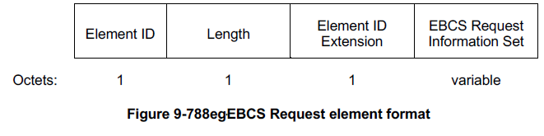
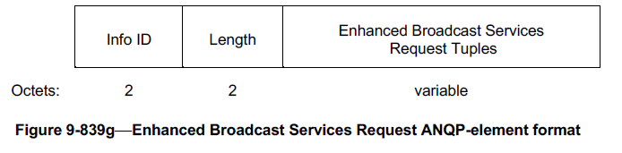
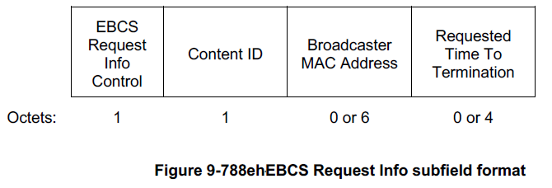
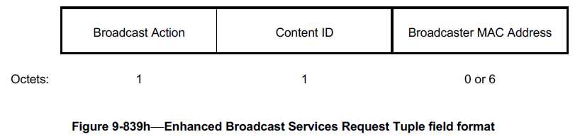
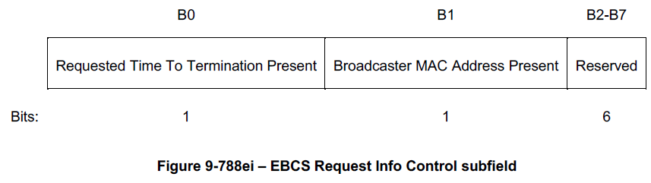
Issue: Requested Time to Termination subfield is not included in the Enhanced Broadcast Request ANQP-element
EBCS Request element
  Contains EBCS Request Info Control subfield and Requested Time to Termination subfield.
Enhanced Broadcast Request ANQP-element
  Doesn’t contain EBCS Request Info Control subfield and Requested Time to Termination subfield.

Slide 5
Proposal: Modification of the Enhanced Broadcast Request ANQP-element
Add the Enhanced Broadcast Services Request Control subfield and the Requested Time to Termination subfield into the Enhanced Broadcast Services Request Tuples field.
The Requested Time to Termination Present subfield is added into the Enhanced Broadcast Services Request Control field.
  A value of 1 in the Requested Time To Termination subfield indicates that a Requested Time To Termination subfield is present in the same Enhanced Broadcast Services Request Tuples field.
  The Requested Time To Termination subfield indicates the period in number of TBTTs during which the EBCS identified by the Content ID included in the same Enhanced Broadcast Services Request Tuples field is being requested.

Slide 6
Summary
We showed the problem that the Enhanced Broadcast Request ANQP-element cannot support the negotiation for the extension of an EBCS for non-AP STAs without association.
To solve the problem, we added the Requested Time to Termination subfield and the Requested Time To Termination Present subfield into the Enhanced Broadcast Request ANQP-element.
In this way, the receiving STA can successfully negotiate a new time to termination value with broadcasting STA through the ANQP Request method.

Slide 7
Straw Poll
Do you agree to modify the Enhanced Broadcast Request ANQP-element to support the eBCS Termination Notice Procedure for the EBCS negotiated through the ANQP method.
Note: the Requested Time to Termination subfield in the Enhanced Broadcast Services Request Tuples is optional.
Y/N/A

Slide 8
Reference
[1] IEEE 802.11bc draft 1.02

