Slide 1
Proposed resolution on the comments of “WLAN/5G interworking report Proposed Way Forward(11-21/0438r0)”
Date: 2021-04-06
Authors:

Slide 2
Abstract
At the March 10 meeting, “WLAN/5G Interworking Report Proposed Way Forward(21/0438r0)” was presented by Robert Stacey, Intel.
There was review contribution on comments(21/0459r0) to clarify them in plenary meeting, March 2021.
This contribution provides proposed resolution on comments from the document (11-21-0438r0). And it is based on draft technical report on interworking between 3GPP 5G network and WLAN(20/0013r11)

Slide 3
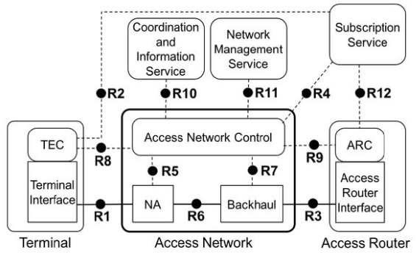
Proposal #1: Terminal types
User equipment (UE) is 3GPP defined terminal. It can support both 3GPP access and WLAN access. In this report, we propose to change the term ‘UE terminal’ into ‘UE’ according to 3GPP specification.
STA is the terminology defined in IEEE 802.11 standard as “a logical entity that is a singly addressable instance of a medium access control (MAC) and physical layer (PHY) interface to the wireless medium (WM)”. In IEEE 802.1CF-2019 standard, a terminal(TE) is defined to support functions of terminal interface (TEI) and terminal control (TEC). Therefore, we propose to change the term ‘STA terminal’ into ‘TE’.
Basic Reference Model(BRM),
Referred from IEEE 802.1CF-2019
“IEEE Recommended Practice for Network Reference Model and Functional Description of IEEE 802® Access Network”

Slide 4
Proposal #2: Delete Fig. 2
We propose to delete figure 2 “ Tightly coupled interworking reference model between 5G core network and WLAN” because it is not typical interworking model from the view of 3GPP standard
We propose to delete the related texts regarding “the tightly coupled and loosely coupled interworking”
Fig.2 Tightly coupled interworking reference model between 5G core network and WLAN

Slide 5
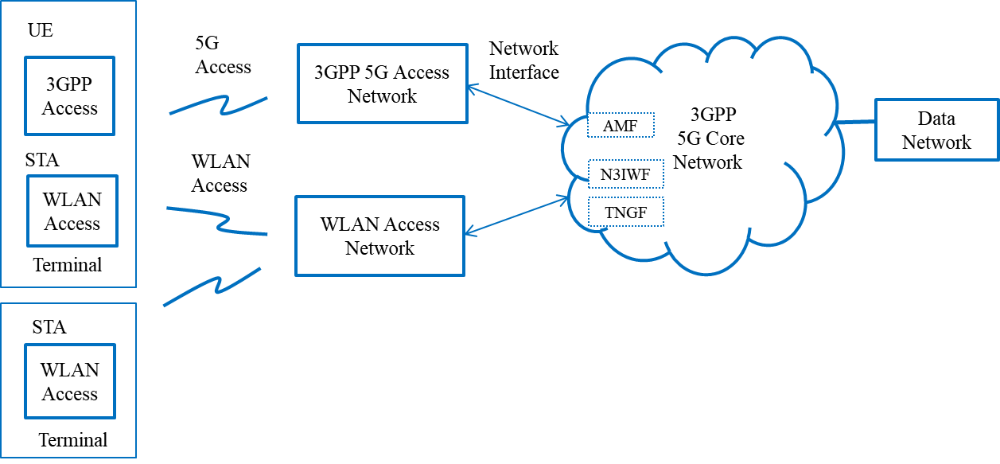
Proposal #3: Fig. 3 update to harmonize 3GPP interworking view
We propose to change the caption of figure 3 from “Loosely coupled interworking reference model between 5G core network and WLAN” to “Interworking model between 5G core network and WLAN”.
We propose to change the terms “UE terminal” and “STA terminal” into “UE” and “TE” respectively.
TE
Fig. 3 Interworking model between 5G core network and WLAN

Slide 6
Proposal #4: Change the term “STA terminal” to “TE” in following figures and related text.
- Fig. 4: Untrusted WLAN interworking reference model with 5G core network
- Fig. 5: Trusted WLAN interworking reference model with 5G core network
- Fig. 6: Control plane between a STA terminal and N3IWF(3GPP TS 23.501)
- Fig. 8: NWu interface
- Fig 9: N1 interface
- Fig. 10: Data plane between a STA terminal and N3IWF(3GPP TS 23.501)
- Fig. 13: QoS mapping and scheduling example of WLAN
- Fig. 15: TSN bridge using WLAN and 5G CN interworking
- Fig. 16: TSN bridge using WLAN only

Slide 7
Proposal #5: Add the following text in section 2 “Introduction”
This report refers terminologies and architectural model from 3GPP (TS 23.501, etc.), IEEE 802.1CF and IEEE 802.11 standards.

Slide 8
Proposal #6: Text update in section 2.2 “Scope”
This report considers two types of an interworking reference models (tightly and loosely coupled), two types of network access (trusted and untrusted) and two types of terminals (a Station (STA) and a combined (User Equipment (UE) and terminal (TE))STA). The two interworking reference models defines how coupled the 3GPP network is to the WLAN access network. The architectural models, necessary functionalities and specific procedures that allow WLAN access networks to interwork with 3GPP 5G core network are discussed for the trusted as well as untrusted case, as defined in TS 23.501 [8], comprising integrated or stand-alone implementations of WLAN and 3GPP 5G access networks and terminals. In this report, a UE terminal is a device that is capable of communicating with 3GPP 5G access network, and a TESTA terminal is a device that is capable of communicating with WLAN access network.
This report considers two types of interworking reference models (tightly and loosely coupled), two types of network access (trusted and untrusted) and two types of terminals (a Station (STA) and a combined User Equipment (UE) and STA). The two interworking reference models define how coupled the 3GPP network is to the WLAN access network. The architectural models, necessary functionalities and specific procedures that allow WLAN access networks to interwork with 3GPP 5G core network are discussed for the trusted as well as untrusted case, as defined in TS 23.501 [8], comprising integrated or stand-alone implementations of WLAN and 3GPP 5G access networks and terminals. In this report, a UE terminal is a device that is capable of communicating with 3GPP 5G access network, and a STA terminal is a device that is capable of communicating with WLAN access network.

Slide 9
Proposal #7: Text update in section 3.1 “WLAN interworking types”
We consider two types of WLAN interworking: tightly coupled and loosely coupled.
The tightly coupled interworking type), as shown in Figure 2, assumes that functional entities in the terminal and the access network are tightly coupled and connect to 3GPP core network via a single network interface. This requires co-located 3GPP access and WLAN access that operate in a coordinated manner to provide wireless services via the 3GPP 5G core network. This interworking model allows for the optimization of overall system performance by integrating the access of the two access networks, enabling improved overall network access to services.
We consider two types of WLAN interworking: tightly coupled and loosely coupled. The tightly coupled interworking type, as shown in Figure 2, assumes that functional entities in the terminal and the access network are tightly coupled and connect to 3GPP core network via a single network interface. This requires co-located 3GPP access and WLAN access that operate in a coordinated manner to provide wireless services via the 3GPP 5G core network. This interworking model allows for the optimization of overall system performance by integrating the access of the two access networks, enabling improved overall network access to services.

Slide 10
Proposal #8: Text update in section 3.1 “WLAN interworking types”
Interworking model between 5G core network and WLAN The loosely coupled interworking type, as shown in Figure 3, assumes that functional entities in the terminal and the access network operate independently and may be either co-located within a device or separated. In this interworking model, two types of terminals are considered: a STA terminal and a combined UE and TESTA terminal. TESTA terminal can only support WLAN access to interwork with 5G core network. The combined UE and STA terminal can support both 3GPP access and WLAN access to interwork with 5G core network. The loosely coupled interworking can provide the same service functions that a tightly coupled interworking type can provide, but since the two access networks will not be coordinated there may be some loss of the ability to optimize overall network performance.
The loosely coupled interworking type, as shown in Figure 3, assumes that functional entities in the terminal and the access network operate independently and may be either co-located within a device or separated. In this interworking model, two types of terminals are considered: a STA terminal and a combined UE and STA terminal. STA terminal can only support WLAN access to interwork with 5G core network. The combined UE and STA terminal can support both 3GPP access and WLAN access to interwork with 5G core network. The loosely coupled interworking can provide the same service functions that a tightly coupled interworking type can provide, but since the two access networks will not be coordinated there may be some loss of the ability to optimize overall network performance.

Slide 11
Summary
Comment #1: Tightly coupled and loosely coupled interworking model(Fig. 2 and 3)
Proposed to change terminal types “UE terminal” and “STA terminal” to “UE” and “TE” by referring to 3GPP and IEEE 802.1CF-2019 standards.
Proposed to delete Fig. 2 “Tightly coupled interworking reference model between 5G and WLAN” and related texts in section 3.1
Proposed to change the caption of Fig. 3 to “Interworking model between 5G core network and WLAN” in section 3.1.
Comment #2, #3, #4: STA terminal
Proposed to change the term “STA terminal” to “TE” in related figures 4,5,6,8,9,10,13,15,16.
Proposed to change text in section 2, 2.2 and 3.1.

