Slide 1
Segment Versus Frequency Subblock
Date: 2021-03-19
Authors:

Slide 2
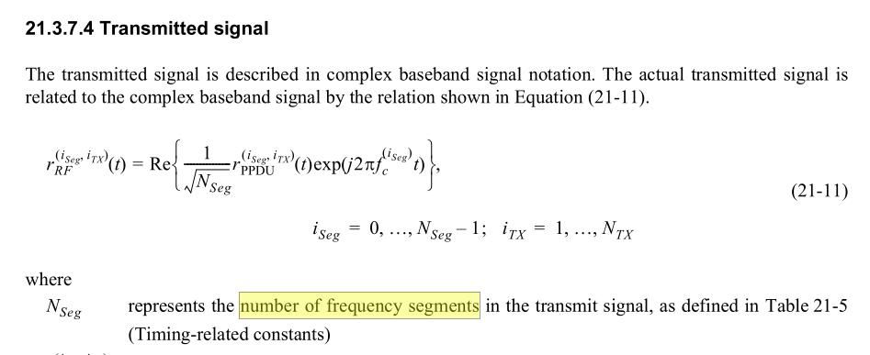
Two Uses of Segment
VHT first introduced “Segment” in association with two different concepts:
Non-contiguous spectrum
Segment parser
Segment parsing is necessary to create two frequency segments
Importantly, for 160 MHz, the Segment Parser output is one frequency segment but two frequency sub-blocks
This name can be confusing because a casual reader expects the output of the segment parser to be segments

Slide 3
Detailed Review Shows Widespread Clarity on Segment versus Frequency Subblock: The output of the segment parser is frequency subblocks
Clause 3
Clause 19
…
Clause 27
…

Slide 4
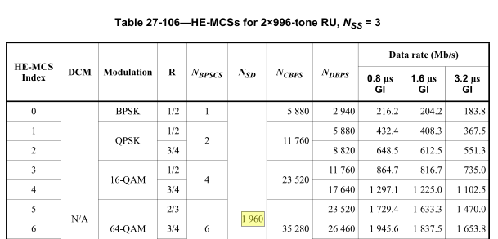
But Lingering Confusion is not a “Victimless Crime”
As late as D7.0 of 11ax there was a fundamental error on this topic: the number of data tones per frequency segment, Nsd, had two incompatible definitions
Nsd in table 27-13 differs for 80+80 vs 160 MHz.
Nsd in section 27.5.7 shows no differentiation between 80+80 and 160 MHz.
Sample 11axD7.0 tables

Slide 5
11be only has one frequency segment: can’t it redefine “segment” for its own purpose?
This would create two problems
802.11be is an amendment to 802.11, and ultimately will be rolled into 802.11. But 802.11 has already defined “frequency segment” (clause 3) and used the term throughout the standard including MAC sections, such as Beacon Report, Neighbor Report, prerequisite fields like VHT/HE Capabilities, Wide Bandwidth Channel Switch, (TVHT Operation), OCI, FILS Discovery, VHT BSS operation, (TVHT BSS operation), FILS Discovery frame transmission, Operating Channel Validation, EAPOL-Key frames(!) …
Using the same term in two different ways would be very burdensome to implementations: e.g., to avoid ambiguity, variables might need to named something like “numFreqSegIfEhtButNumFreqSubblockIfVhtOrHe”

Slide 6
Yet 11beD0.3 uses “segment” in the VHT/HE sense of “frequency-subblock” extensively
Oversights are expected in early drafts
One responsibility of comment resolution is to fix these oversights
Fortunately for us, the kind editor does the lion’s share of the work

Slide 7
Strawpoll 1
Do we agree that the output of the Segment Parser should be called “frequency subblock(s)”
Note: this follows the usage in 802.11me (VHT, TVHT) and HE; and the existing 11beD0.3 sections 36.2.6.2, 36.3.6.10, Table 36-10, 36.3.11.8.6, etc
Y, N, A

Slide 8
Backup
This deck does not propose to change the term "Segment de/parser” despite that the name is confusing/ misleading
By its name, “segment parser” implies it parses its input into one or more segments.
But, for VHT 160 MHz and HE 160 MHz, the so-called Segment parser takes one stream and parses into two frequency subblocks (in one frequency segment).
A comment submitted to 11meD0 recommends changing “Segment Parser” to “Frequency Subblock/Segment Parser” to reduce confusion
Preserves the old name and ensures a search for “segment pars” still succeeds.
We can let that discussion play out in 11me.

