Slide 1
TGaz Next Generation Positioning
May Electronic Meeting Closing Report
Date: 2021-05-17
Authors:

Slide 2
Abstract
This document is the TGaz Next Generation Positioning closing report for the IEEE 802.11 interim electronic meeting, May 2021.

Slide 3
May Progress and Targets Towards the July Meeting
Work completed:
  Reviewed/approved resolution to 36 CIDs.
Targets toward July:
  Complete LB253 comment resolution.
  Generate P802.11az D3.1 adopting resolutions from March and May meetings.
  Respond to MDR findings (Editors).

Slide 4
Timeline – updated past May meeting
2017
2018
2019
2020
2021
2022
2023
.11az requirement freeze
5-2017
SFD
Final
Initial
WG ballot
.11az
D0.1
Mar. 18
July 18
Inter.
comment
collection
D1.0
Jan. 19
.11az
Draft 2.0
11-2019
Recirculation
.11az
Draft 3.0
01-2021
Recirculation
.11az
Draft 4.0
07-2021
Recirculation
1st SA comp.
2nd SA comp.
Publication
No changes made, in preparation to SA ballot
.11az
MDR and SA ballots
07-2021
11az SFD
MDR
Clean
Amendment text
5/17-3/21
LB240 CR
LB249
LB253
Next
LB
1st SA
2nd SA
CC28
SFD Freeze
Initial WG ballot LB240 Pass
LB240 completion/
recirc. init
LB249 completion/
2nd recirculation

Slide 5
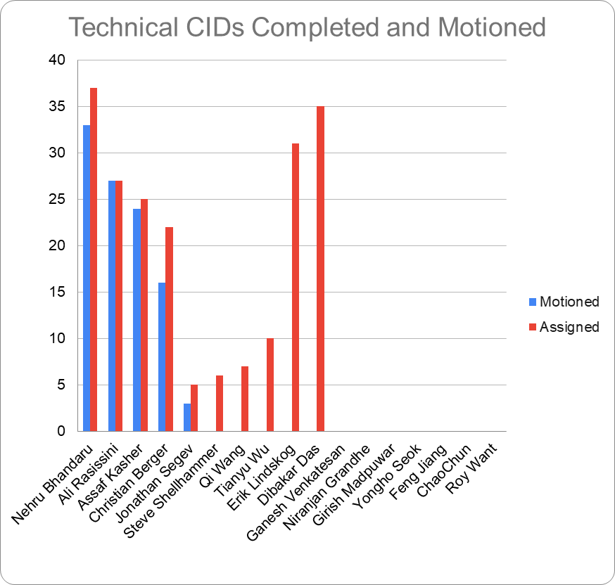
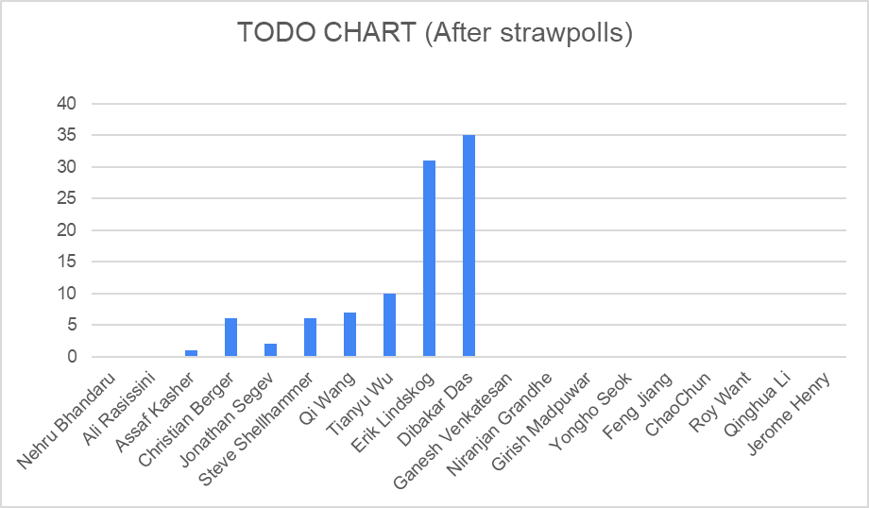
LB253 – Completion Status

Slide 6
Scheduled telecons
May 26* Wed. 13:00 – 15:00 ET
June 2, 9, 16, 23, 30 Wed. 13:00 – 15:00 ET
June 24 ⁺ Thur. 10:00 – 12:00 ET
July 7 Wed. 13:00 – 15:00 ET
*Previously announced.
**WG May meeting is running July 11th – 16th , refer to WG agenda doc.
+ TGaz Plenary (motion) meeting.

