Slide 1
TGaz Next Generation Positioning Agenda for the May Electronic Meeting and the Following Telecons Agenda
Date: 2021-05-25
Authors:

Slide 2
IEEE 802.11 Task Group AZ Next Generation Positioning
May Electronic Meeting Agenda
And telecons meetings running between May and July 2021 electronic meetings
Chair: Jonathan Segev (Intel Corporation)
Vice Chair: Assaf Kasher (Qualcomm)
Technical Editor: Chao Chun Wang (MediaTek), Roy Want (Google)
Secretary (acting): Assaf Kasher (Qualcomm)

Slide 3
Abstract
This submission contains the agenda for IEEE 802.11 TGaz Next Generation Positioning of May Electronic meeting and teleconferences running between the May and July IEEE 802.11 meetings.

Slide 4
Logistics
Attendance:
Please register by logging to IMAT and register your attendance at https://imat.ieee.org/attendance
Attendees are required to register their attendance.
For Webex call use the following designation: [V/NV] First Last (Affiliation)
Motions:
Only IEEE 802.11 voting members may vote on motions, motions are documented and votes are documented in the minutes.
Documentation
https://mentor.ieee.org/802.11/documents, Use “TGaz” folder for documents relating to the TGaz activity.
Meeting coordinates:
We are using WebEx, meeting credentials can be found in the IEEE 802.11 calendar here.

Slide 5
Patent Policy
Following 5 slides

Slide 6
Instructions for the WG Chair
The IEEE-SA strongly recommends that at each WG meeting the chair or a designee:
Show slides #1 through #4 of this presentation
Advise the WG attendees that:
IEEE’s patent policy is described in Clause 6 of the IEEE-SA Standards Board Bylaws;
Early identification of patent claims which may be essential for the use of standards under development is strongly encouraged;
There may be Essential Patent Claims of which IEEE is not aware. Additionally, neither IEEE, the WG, nor the WG Chair can ensure the accuracy or completeness of any assurance or whether any such assurance is, in fact, of a Patent Claim that is essential for the use of the standard under development.
Instruct the WG Secretary to record in the minutes of the relevant WG meeting:
That the foregoing information was provided and that slides 1 through 4 (and this slide 0, if applicable) were shown;
That the chair or designee provided an opportunity for participants to identify patent claim(s)/patent application claim(s) and/or the holder of patent claim(s)/patent application claim(s) of which the participant is personally aware and that may be essential for the use of that standard
Any responses that were given, specifically the patent claim(s)/patent application claim(s) and/or the holder of the patent claim(s)/patent application claim(s) that were identified (if any) and by whom.
The WG Chair shall ensure that a request is made to any identified holders of potential essential patent claim(s) to complete and submit a Letter of Assurance.
It is recommended that the WG Chair review the guidance in IEEE-SA Standards Board Operations Manual 6.3.5 and in FAQs 14 and 15 on inclusion of potential Essential Patent Claims by incorporation or by reference.
Note: WG includes Working Groups, Task Groups, and other standards-developing committees with a PAR approved by the IEEE-SA Standards Board.

Slide 7
Participants have a duty to inform the IEEE
Participants shall inform the IEEE (or cause the IEEE to be informed) of the identity of each holder of any potential Essential Patent Claims of which they are personally aware if the claims are owned or controlled by the participant or the entity the participant is from, employed by, or otherwise represents
Participants should inform the IEEE (or cause the IEEE to be informed) of the identity of any other holders of potential Essential Patent Claims
Early identification of holders of potential Essential Patent Claims is encouraged
Slide #1

Slide 8
Ways to inform IEEE
Cause an LOA to be submitted to the IEEE-SA (patcom@ieee.org); or
Provide the chair of this group with the identity of the holder(s) of any and all such claims as soon as possible; or
Speak up now and respond to this Call for Potentially Essential Patents
If anyone in this meeting is personally aware of the holder of any patent claims that are potentially essential to implementation of the proposed standard(s) under consideration by this group and that are not already the subject of an Accepted Letter of Assurance, please respond at this time by providing relevant information to the WG Chair.
Slide #2

Slide 9
Other guidelines for IEEE WG meetings
All IEEE-SA standards meetings shall be conducted in compliance with all applicable laws, including antitrust and competition laws.
Don’t discuss the interpretation, validity, or essentiality of patents/patent claims.
Don’t discuss specific license rates, terms, or conditions.
Relative costs of different technical approaches that include relative costs of patent licensing terms may be discussed in standards development meetings.
Technical considerations remain the primary focus
Don’t discuss or engage in the fixing of product prices, allocation of customers, or division of sales markets.
Don’t discuss the status or substance of ongoing or threatened litigation.
Don’t be silent if inappropriate topics are discussed … do formally object.
---------------------------------------------------------------
For more details, see IEEE-SA Standards Board Operations Manual, clause 5.3.10 and Antitrust and Competition Policy: What You Need to Know at http://standards.ieee.org/develop/policies/antitrust.pdf
Slide #3

Slide 10
Patent-related information
The patent policy and the procedures used to execute that policy are documented in the:
IEEE-SA Standards Board Bylaws (http://standards.ieee.org/develop/policies/bylaws/sect6-7.html#6)
IEEE-SA Standards Board Operations Manual (http://standards.ieee.org/develop/policies/opman/sect6.html#6.3)
Material about the patent policy is available at
http://standards.ieee.org/about/sasb/patcom/materials.htm
If you have questions, contact the IEEE-SA Standards Board Patent Committee Administrator at patcom@ieee.org
Slide #4

Slide 11
Instructions for Chairs of standards development activities
At the beginning of each standards development meeting the chair or a designee is to:
Show the following slides (or provide them beforehand)
Advise the standards development group participants that:
IEEE SA’s copyright policy is described in Clause 7 of the IEEE SA Standards Board Bylaws and Clause 6.1 of the IEEE SA Standards Board Operations Manual;
Any material submitted during standards development, whether verbal, recorded, or in written form, is a Contribution and shall comply with the IEEE SA Copyright Policy;
Instruct the Secretary to record in the minutes of the relevant meeting:
That the foregoing information was provided and that the copyright slides were shown (or provided beforehand).

Slide 12
IEEE SA Copyright Policy
By participating in this activity, you agree to comply with the IEEE Code of Ethics, all applicable laws, and all IEEE policies and procedures including, but not limited to, the IEEE SA Copyright Policy.
Previously Published material (copyright assertion indicated) shall not be presented/submitted to the Working Group nor incorporated into a Working Group draft unless permission is granted.
Prior to presentation or submission, you shall notify the Working Group Chair of previously Published material and should assist the Chair in obtaining copyright permission acceptable to IEEE SA.
For material that is not previously Published, IEEE is automatically granted a license to use any material that is presented or submitted.

Slide 13
IEEE SA Copyright Policy
The IEEE SA Copyright Policy is described in the IEEE SA Standards Board Bylaws and IEEE SA Standards Board Operations Manual”
IEEE SA Copyright Policy, see Clause 7 of the IEEE SA Standards Board Bylaws https://standards.ieee.org/about/policies/bylaws/sect6-7.html#7 Clause 6.1 of the IEEE SA Standards Board Operations Manual https://standards.ieee.org/about/policies/opman/sect6.html
IEEE SA Copyright Permission
https://standards.ieee.org/content/dam/ieee-standards/standards/web/documents/other/permissionltrs.zip
IEEE SA Copyright FAQs
http://standards.ieee.org/faqs/copyrights.html/
IEEE SA Best Practices for IEEE Standards Development
http://standards.ieee.org/develop/policies/best_practices_for_ieee_standards_development_051215.pdf
Distribution of Draft Standards (see 6.1.3 of the SASB Operations Manual)
https://standards.ieee.org/about/policies/opman/sect6.html

Slide 14
Participant behavior in IEEE-SA activities is guided by the IEEE Codes of Ethics & Conduct
All participants in IEEE-SA activities are expected to adhere to the core principles underlying the:
IEEE Code of Ethics
IEEE Code of Conduct
The core principles of the IEEE Codes of Ethics & Conduct are to:
Uphold the highest standards of integrity, responsible behavior, and ethical and professional conduct
Treat people fairly and with respect, to not engage in harassment, discrimination, or retaliation, and to protect people's privacy.
Avoid injuring others, their property, reputation, or employment by false or malicious action
The most recent versions of these Codes are available at
http://www.ieee.org/about/corporate/governance

Slide 15
Participants in the IEEE-SA “individual process” shall act independently of others, including employers
The IEEE-SA Standards Board Bylaws require that “participants in the IEEE standards development individual process shall act based on their qualifications and experience”
This means participants:
Shall act & vote based on their personal & independent opinions derived from their expertise, knowledge, and qualifications
Shall not act or vote based on any obligation to or any direction from any other person or organization, including an employer or client, regardless of any external commitments, agreements, contracts, or orders
Shall not direct the actions or votes of other participants or retaliate against other participants for fulfilling their responsibility to act & vote based on their personal & independently developed opinions
By participating in standards activities using the “individual process”, you are deemed to accept these requirements; if you are unable to satisfy these requirements then you shall immediately cease any participation

Slide 16
IEEE-SA standards activities shall allow the fair & equitable consideration of all viewpoints
The IEEE-SA Standards Board Bylaws (clause 5.2.1.3) specifies that “the standards development process shall not be dominated by any single interest category, individual, or organization”
This means no participant may exercise “authority, leadership, or influence by reason of superior leverage, strength, or representation to the exclusion of fair and equitable consideration of other viewpoints” or “to hinder the progress of the standards development activity”
This rule applies equally to those participating in a standards development project and to that project’s leadership group
Any person who reasonably suspects that dominance is occurring in a standards development project is encouraged to bring the issue to the attention of the Standards Committee or the project’s IEEE-SA Program Manager

Slide 17
IEEE SA Policy Documents
IEEE Code of Ethics
http://www.ieee.org/about/corporate/governance/p7-8.html
IEEE Standards Association (IEEE-SA) Affiliation FAQ
http://standards.ieee.org/faqs/affiliation.html
Antitrust and Competition Policy
http://standards.ieee.org/resources/antitrust-guidelines.pdf
Letter of Assurance Form
http://standards.ieee.org/develop/policies/bylaws/sect6-7.html#loa
https://development.standards.ieee.org/myproject/Public//mytools/mob/loa.pdf
IEEE-SA Patent Committee FAQ & Patent slides
http://standards.ieee.org/board/pat/faq.pdf and http://standards.ieee.org/board/pat/pat-slideset.ppt

Slide 18
IEEE SA Rules Documents
The current version of the IEEE-SA Standards Board Bylaws is available at:
http://standards.ieee.org/develop/policies/bylaws/index.html (HTML version)
http://standards.ieee.org/develop/policies/bylaws/sb_bylaws.pdf (PDF version)
The current version of the IEEE-SA Standards Board Operations Manual is available at:
http://standards.ieee.org/develop/policies/opman/index.html (HTML version)
http://standards.ieee.org/develop/policies/opman/sb_om.pdf (PDF version)

Slide 19
IEEE 802 Ground Rules
Respect … give it, get it
NO product pitches
NO corporate pitches
NO prices
NO restrictive notices – (no confidentially notices in email)
Presentations must be openly available

Slide 20
IEEE 802 Rules Documents
IEEE 802 Policies & Procedures (Approved June 2014)
http://standards.ieee.org/board/aud/LMSC.pdf
IEEE 802 Operations Manual (Approved 4 August 2020)
https://mentor.ieee.org/802-ec/dcn/17/ec-17-0090-24-0PNP-ieee-802-lmsc-operations-manual.pdf
IEEE 802 Working Group Policies & Procedures (29 July 2016)
http://www.ieee802.org/PNP/approved/IEEE_802_WG_PandP_v19.pdf
IEEE 802 LMSC Chair's Guidelines (Approved 15 November 2019)
https://mentor.ieee.org/802-ec/dcn/17/ec-17-0120-29-0PNP-ieee-802-lmsc-chairs-guidelines.pdf
Participation in IEEE 802 Meetings
https://mentor.ieee.org/802-ec/dcn/17/ec-17-0093-05-0PNP-ieee-802-participation-slide-ppt.ppt
Policies and Procedures hierarchy: http://www.ieee802.org/11/Rules/rules.shtml
IEEE 802 Procedural document website: http://www.ieee802.org/devdocs.shtml

Slide 21
IEEE Event Conduct and Safety Statement
IEEE believes that science, technology, and engineering are fundamental human activities, for which openness, international collaboration, and the free flow of talent and ideas are essential. Its meetings, conferences, and other events seek to enable engaging, thought-provoking conversations that support IEEE’s core mission of advancing technology for humanity. Accordingly, IEEE is committed to providing a safe, productive, and welcoming environment to all participants, including staff and vendors, at IEEE-related events.

Slide 22
IEEE Event Conduct and Safety Statement
IEEE has no tolerance for discrimination, harassment, or bullying in any form at IEEE-related events. All participants have the right to pursue shared interests without harassment or discrimination in an environment that supports diversity and inclusion. Participants are expected to adhere to these principles and respect the rights of others.
IEEE seeks to provide a secure environment at its events. Participants should report any behavior inconsistent with the principles outlined here, to onsite staff, security or venue personnel, or to eventconduct@ieee.org.

Slide 23
Meeting Decorum
Please mute the microphone unless you want to address the group.

Slide 24
May IEEE Electronic Meeting Week Agenda
Call the meeting to order (3min)
Review IEEE-SA patent policy, duty to inform, call for potential essential patents, guidelines for anti-trust and competition laws and participation on individual basis in IEEE 802 meeting, IEEE-SA copyrights policy (12 min).
Attendance reminder – we’re now using IMAT.
Agenda setting for the week (5 min).
Review of LB253 CR results and progress. (10min) – Roy
Consider approval of previous meeting minutes.
Consider motions that met SP threshold from earlier meetings.
Review and consider PAR extension approval (Jonathan)
Review submissions. – as permitted.
Review and setup telecon plan – 5 min special order
Review progress made during the week – 5 min special order
Review program timelines – 10min special order
AoB
Adjourn

Slide 25
Submission List for the week
DCN | Presenter | Title | Topic
11-21-486 | Jonathan Segev | Agenda slide deck | agenda
11-21-749 | Roy Want | LB253 Comments | Editors
11-21-761 | Christian Berger | comment resolution lb253 parameters part 4 | CR
11-21-810 | Ali Raissinia | three CID resolutions for lb253 | CR
11-21-811 | Youhan Kim | LB253 Misc Comments | CR
11-21-0815 | Dibakar Das | CR for Misc CIDs on Trigger frame format | CR

Slide 26
IEEE Electronic Meeting Week – May 10th
Call the meeting to order (3min)
Review IEEE-SA patent policy, duty to inform, call for potential essential patents, guidelines for anti-trust and competition laws and participation on individual basis in IEEE 802 meeting, IEEE-SA copyrights policy (12 min).
Attendance reminder – we’re now using IMAT.
Review of LB253 CR results and progress. (10min) – Roy
Consider approval of previous meeting minutes.
Consider motions that met SP threshold from earlier meetings (11-20-486).
Review submissions. – as time permits
AoB
Recess

Slide 27
Submission List for the Tue. meeting
DCN | Presenter | Title | Topic
11-21-486 | Jonathan Segev | Agenda slide deck | agenda
11-21-258 | Roy Want | LB253 Comments | Editors
11-21-761 | Christian Berger | comment resolution lb253 parameters part 4 | CR

Slide 28
Approval of previous meeting minutes
Motion (202105-01):
Move to approve document 11-21-0422r0 TGaz 2021 March Plenary Minutes as the TGaz meetings minutes for the March IEEE Electronic meeting week.
Moved by: Stuart Kerry
Seconded by: Assaf Kasher
Results (Y/N/A): 19/0/1
Motion passes

Slide 29
Approval of previous meeting minutes
Motion (202105-02):
Move to approve document 11-21-0777r0 March-May 2021 Telecon Minutes as the TGaz meetings minutes for telecons running between the March and May IEEE Electronic meeting weeks.
Moved by: Ali Raissinia
Seconded by: Assaf Kasher
Results (Y/N/A): unanimous

Slide 30
Submissions Awaiting Motions
Submission 11-21-708 few lb 253 crs –b (Nehru Bhandaru)
Motion (202105-03):
Move to adopt the resolution depicted by document 11-21-0708r0 for CIDs 5260, 5351, 5364, 5385
(4 CIDs total), instruct the technical editor to incorporate it in the P802.11az draft and grant the editor editorial license.
Moved by: Nehru Bhandaru
Seconded by: Ali Raissinia
Results (Y/N/A): unanimous
Results from the April 29th Telecon: 9/0/0
https://mentor.ieee.org/802.11/dcn/21/11-21-0708-00-00az-few-lb-253-crs-b.docx

Slide 31
Submissions Awaiting Motions
Submission 11-21-536 Comment Resolutions on Several PHY Topics (Steve Shellhammer)
Motion (202105-04):
Move to adopt the resolution depicted by document 11-21-0536r1 for CIDs 5413, 5414, 5415, 5416 and 5417 (5 CIDs total), instruct the technical editor to incorporate it in the P802.11az draft and grant the editor editorial license.
Moved by: Steve Shellhammer
Seconded by: Roy Want
Results (Y/N/A): Unanimous approval
Results from the May 5th Telecon: 9/0/0
https://mentor.ieee.org/802.11/dcn/21/11-21-0536-01-00az-comment-resolutions-on-several-phy-topics.docx

Slide 32
Review Submissions

Slide 33
Recess

Slide 34
IEEE Electronic Meeting slot – May 12th
Call the meeting to order (3min)
Review IEEE-SA patent policy, duty to inform, call for potential essential patents, guidelines for anti-trust and competition laws and participation on individual basis in IEEE 802 meeting, IEEE-SA copyrights policy (12 min).
Attendance reminder – we’re now using IMAT.
Agenda setting (5min)
Review submissions (as time permits).
CR as a group (as time permits)
AoB
Recess

Slide 35
Submission List for the Wed. meeting
DCN | Presenter | Title | Topic | Time
11-21-486 | Jonathan Segev | Agenda slide deck | Agenda
11-21-761 | Christian Berger | comment resolution lb253 parameters part 4 | CR | 30 min
11-21-811 | Youhan Kim | LB253 Misc Comments | CR | 35 min
11-21-810 | Ali Raissinia | three CID resolutions for lb253 | CR | 20 min
11-21-834 | Christina Berger | Mandatory secure LTF repetitions | CR | As time permits

Slide 36
Review Submissions

Slide 37
Submission 11-21-761
Motion (202105-05):
Move to adopt the text changes and the resolutions depicted by document 11-21-0761r3 for CIDs 5190 and 5191 (2 CIDs total), instruct the technical editor to incorporate it in the P802.11az draft and grant the editor editorial license.
Moved by: Christian Berger
Seconded by: Ali Raissinia
Results (Y/N/A): 17/0/1
Motion passes.

Slide 38
Submission 11-21-811
Motion (202105-06):
Move to adopt the resolution depicted by document 11-21-0811r1 for CIDs 5473, 5460, 5461, 5463, 5467, 5468, 5474, 5469, 5471 (9 CIDs total), instruct the technical editor to incorporate it in the P802.11az draft and grant the editor editorial license.
Moved by: Youhan Kim
Seconded by: Ali Raissinia
Results (Y/N/A): unanimous

Slide 39
AOB

Slide 40
Recess

Slide 41
IEEE Electronic Meeting slot – May 17th
Call the meeting to order (3min)
Review IEEE-SA patent policy, duty to inform, call for potential essential patents, guidelines for anti-trust and competition laws and participation on individual basis in IEEE 802 meeting, IEEE-SA copyrights policy (12 min).
Attendance reminder – we’re now using IMAT.
Agenda setting (5min)
Review and consider PAR extension approval 11-21-750 (10min)
Review submissions (as time permits).
CR as a group (as time permits)
Special order:
Review submission queue and call for submissions (3min)
Review timelines and progress (7 min)
LB253 completion status (3 min)
Review Targets towards July meeting (3min)
Review future telecons (5 min)
AoB
Adjourn

Slide 42
Submission List for the Wed. meeting
DCN | Presenter | Title | Topic | Time
11-21-486 | Jonathan Segev | Agenda slide deck | Agenda | As needed
11-21-810 | Ali Raissinia | three CID resolutions for lb253 | CR | 7 min
11-21-834 | Christian Berger | Mandatory secure LTF repetitions | CR | 8min – moved to telecon
11-21-0815 | Dibakar Das | CR for Misc CIDs on Trigger frame format | CR | 40min
11-21-835 | Jonathan Segev | TGaz LB253 Comment Resolution | CR | 1hr (as time permits).

Slide 43
PAR Extension
Motion (202105-06):
• Believing that the PAR extension contained in the document referenced below meets IEEE-SA guidelines,
• Request that the PAR contained in 11-21-750r2 be posted to the IEEE 802 Executive Committee (EC) agenda for WG 802 preview and EC approval to submit to NesCom.
Moved: Jon Rosdahl
Seconded: Assaf Kasher
Result (Y/N/A): 18/0/0
Motion passes
Note to chair: voter Sai indicated inability to vote using the polling system and voted Yes via the chat window, this vote is accounted for in the results.

Slide 44
Submission 11-21-810
Motion (202105-07):
Move to adopt the resolutions depicted by document 11-21-0810r2 for CIDs 5016, 5027 and 5036 (3 CIDs total), instruct the technical editor to incorporate it in the P802.11az draft and grant the editor editorial license.
Moved by: Ali Raissinia
Seconded by: Assaf Kasher
Results (Y/N/A): unanimous

Slide 45
Submission 11-21-815
Motion (202105-08):
Move to adopt the resolutions depicted by document 11-21-0815r1 for CIDs 5007, 5008, 5010, 5037, 5041, 5048, 5132, 5141, 5162, 5164, 5165, 5167, 5168 (13 CIDs total), instruct the technical editor to incorporate it in the P802.11az draft and grant the editor editorial license.
Moved by: Dibakar Das
Seconded by: Ali Raissinia
Results (Y/N/A): unanimous

Slide 46
Submission pipeline
Current pipeline:
If you have a submission and would like to allocate agenda time, please indicate the DCN and the submission topic.
DCN | Presenter | Title | Topic
11-21-834 | Christian Berger | Mandatory secure LTF repetitions | CR
11-21-835 | Jonathan Segev | TGaz LB253 Comment Resolution | CR – for completion from after 5353
11-21-864 | Steve Shellhammer | Comment Resolutions of CID 5090 | CR

Slide 47
Timeline – updated past May meeting
2017
2018
2019
2020
2021
2022
2023
.11az requirement freeze
5-2017
SFD
Final
Initial
WG ballot
.11az D0.1 Mar. 18
July 18
Inter.
comment
collection
D1.0
Jan. 19
.11az Draft 2.0 11-2019
Recirculation
.11az Draft 3.0 01-2021
Recirculation
.11az Draft 4.0 07-2021
Recirculation
1st SA comp.
2nd SA comp.
Publication
No changes made, in preparation to SA ballot
.11az MDR and SA ballots
07-2021
11az SFD
MDR
Clean
Amendment text
5/17-3/21
LB240 CR
LB249
LB253
Next
LB
1st SA
2nd SA
CC28
SFD Freeze
Initial WG ballot LB240 Pass
LB240 completion/
recirc. init
LB249 completion/
2nd recirculation

Slide 48
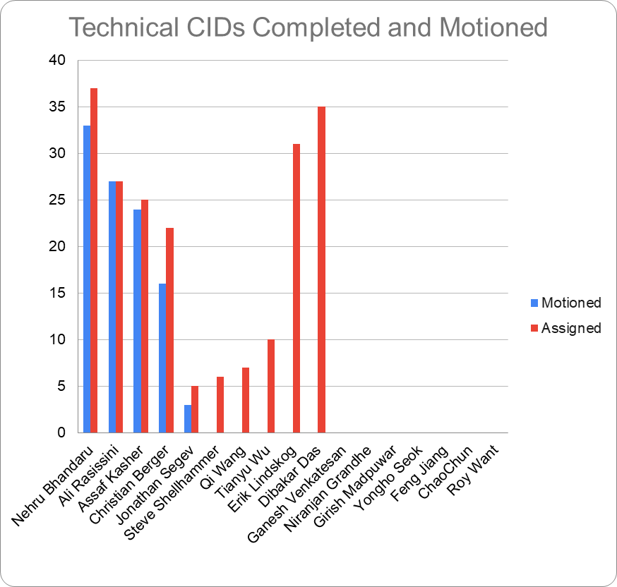
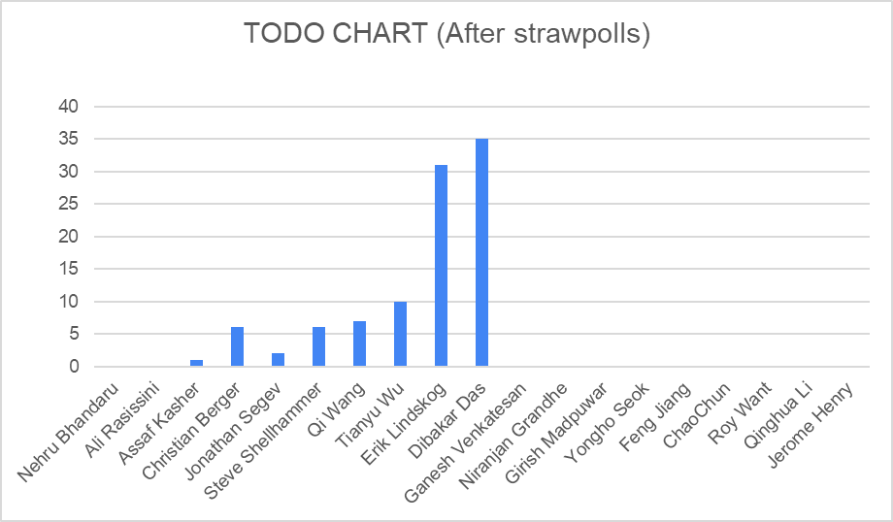
LB253 – Completion Status

Slide 49
May Progress and Targets Towards the July Meeting
Work completed:
Reviewed/approved resolution to 36 CIDs.
Targets toward July:
Complete LB253 comment resolution.
Generate P802.11az D3.1 adopting resolutions from March and May meetings.
Respond to MDR findings (Editors).

Slide 50
Scheduled telecons
May 26* Wed. 13:00 – 15:00 ET
June 2, 9, 16, 23, 30 Wed. 13:00 – 15:00 ET
June 24 ⁺ Thur. 10:00 – 12:00 ET
July 7 Wed. 13:00 – 15:00 ET
*Previously announced.
**WG May meeting is running July 11th – 16th , refer to WG agenda doc.
+ TGaz Plenary (motion) meeting.

Slide 51
AOB

Slide 52
Adjourn

Slide 53
TGaz May 26th Telecon - Agenda
Call the meeting to order (3min)
Review IEEE-SA patent policy, duty to inform, call for potential essential patents, guidelines for anti-trust and competition laws and participation on individual basis in IEEE 802 meeting, IEEE-SA copyrights policy (10 min).
Attendance reminder – we’re now using IMAT.
Review LB253 status (7 min) (Roy Want)
Discussion topics (review submissions):
11-21-835 TGaz LB253 Comment Resolution (Jonathan Segev) – for completion
11-21-834 Mandatory secure LTF repetitions (Christian Berger)
11-21-864 Comment Resolutions of CID 5090 (Steve Shellhammer)
Special order items:
Review submission pipeline and call for submissions (2min)
Review future telecons (3 min)
AoB
Adjourn

Slide 54
Submission 11-21-0???
Strawpoll :
We agree to the resolution depicted by document 11-21-0???r? for CIDs ??? (? CIDs total).
Results (Y/N/A):

Slide 55
Submission pipeline
Current pipeline:
If you have a submission and would like to allocate agenda time, please indicate the DCN and the submission topic.
DCN | Presenter | Title | Topic
11-21-834 | Christian Berger | Mandatory secure LTF repetitions | CR
11-21-835 | Jonathan Segev | TGaz LB253 Comment Resolution | CR – for completion from after 5353
11-21-864 | Steve Shellhammer | Comment Resolutions of CID 5090 | CR

Slide 56
Scheduled telecons
June 2, 9, 16, 23, 30 Wed. 13:00 – 15:00 ET
June 24 ⁺ Thur. 10:00 – 12:00 ET
July 7 Wed. 13:00 – 15:00 ET
**WG May meeting is running July 11th – 16th , refer to WG agenda doc.
+ TGaz Plenary (motion) meeting.

Slide 57
AOB

Slide 58
Adjourn

Slide 59
Backup

Slide 60
Motion to adopt text
Motion
Move to adopt document 11-18-xxxx r? to the 802.11az draft, instruct the technical editor to incorporate it in the 802.11az draft amendment text and empower the editor to perform editorial changes.
Moved:

Slide 61
Approval of previous meeting minutes
Document 11-20/140 “Meeting Minutes January 2020 session” posted to Mentor January 13th 2020
Motion (#?):
Move to approve document 11-20/14r0 as TGaz meeting minutes for the Jan. 2020 meeting.
Moved by:
Seconded by:
Results (Y/N/A):

Slide 62
Approval of previous meeting minutes
Document 11-20/249 “TGaz telecon minutes January 8th 2020” posted to Mentor January 29th 2020.
Motion (#?):
Move to approve document 11-20/249r0 as TGaz meeting minutes for the Jan. 8th 2020 telecon.
Moved by:
Seconded by:
Results (Y/N/A):

Slide 63
Approval of previous meeting minutes
Document 11-20/251 “TGaz telecon minutes January-February 2020” posted to Mentor Mar. 25th 2020.
Motion (#?):
Move to approve document 11-20/251r0 as TGaz meeting minutes for the Jan. 29th, Feb. 5th , Feb. 12th and Mar. 4 2020 telecons.
Moved by:
Seconded by:
Results (Y/N/A):

Slide 64
Approval of previous meeting minutes
Document 11-20/419 “Ad Hoc Meeting Minutes Mar 2020 Session” posted to Mentor Apr. 10th 2020.
Motion (#?):
Move to approve document 11-20/419r1 as TGaz meeting minutes for the Mar. Ad-hoc meeting.
Moved by:
Seconded by:
Results (Y/N/A):

Slide 65
Comment Resolution from Ad Hoc and Telecon
LB249-Clause-9-4-CIDs
Motion ###:
Move to adopt the resolutions depicted by document 11-20-0388r2 for CIDs 3648, 3026, 3027, 3262, 3573, 3574, 3575, 3028, 3029, 3638, 3916, 3918, 4002, 3042 and 4003, instruct the technical editor to incorporate it in the P802.11az draft and grant the editor editorial license.
Moved:
Second:
Results (Y/N/A):
Results from the Mar. Ad Hoc (Y/N/A): 9/0/1

Slide 66
802.11 Template Instructions 2/4
Step 5. Menu select View, Master, Slide Master, select the top master page (theme slide master). Place the document designator in the right hand side of the header.
Document designator example "doc.: IEEE 802.11-04/9876r0" , or
"doc.: IEEE 802.11-04/9876r2"
Step 6. Menu select Insert, Header and Footer (5 data fields):
Slide tab:
Date & Time, Fixed = venue date (as Month Year, e.g. January 2005)
Footer = first author, company
Notes tab:
Data and time, Fixed = venue date (as Month Year, e.g. January 2005)
Header = document designator (e.g. “doc.: IEEE 802.11-04/9876r0”)
Footer = first author, company
Click "Apply to all".
Step 7. Delete the four template instruction slides.

Slide 67
802.11 Template Instructions 3/4
PowerPoint Submission Preparation Summary:
Things to do: 7
Fields to fill in: 12

Slide 68
802.11 Template Instructions 4/4 Recommendations
a) Always create a new presentation using the template, rather than using someone else's presentation.
b) For quick and easy creation of new 802.11 submissions, place the 802.11 template files in the template folder area on your computer. Typical locations are:
c:\Program Files\Microsoft Office\Templates\802.11, or
c:\Documents and Settings\User Name\Application Data\Microsoft\Templates\802.11
To create a new submission from within PowerPoint, menu select File, New, then select the appropriate 802.11 template file.
c) When you update or revise your presentation, remember to check all 6 fields in steps 5 and 6 for the correct values.
rev: 2010-03-01

