Slide 1
EHT TF Clarifications
Date: 03/17/21
Authors | Email
Xiaogang Chen | Xiaogang.c.chen@intel.com
Po-Kai Huang
Alexander Danny
Cheng Chen
Laurent Cariou

Slide 2
Background
TGbe agreed to define a special user field (with AID = 2007) to carry the extra EHT common info for general TF.
This contribution focuses on
  Presence of the special user info field (AID 2007) in different TF types;
  MU-RTS RU allocation indication.

Slide 3
Presence of the special user info field
Proposal: All types of EHT TF shall always include the special user info field (with AID=2007) right after the common field.
  Guarantee a unified processing on the EHT common information (including the HE common info field and special user info field);
  Rx only adjusts common info parser based on B55 instead of based on both B55 and TF types.
    B55 (presence of the special user field) -> Parse EHT common info if B55 = 0; otherwise Parse HE common info.

Slide 4
SP1
Do you agree:
The special user info field (user info field with AID=2007) shall be present in all the EHT TF variants defined in 11be R1.
  For the EHT variant of MU-RTS, all the bits in the special user info field are reserved except the “BW Extension” subfield and “AID 12” subfield.

Slide 5
Background of the RU allocation in HE MU-RTS
RU allocation in HE MU-RTS
  Indicates on which 20MHz subchannels the CTS will be transmitted;
  Use the entries (61-68) corresponding to the RU 242/484/996/996*2 in the HE RU allocation table;
  Only allow CTS transmits on P20/P40/P80/160MHz;
  No puncturing information included in the RU allocation.

Slide 6
Design goal of the RU allocation in EHT MU-RTS
Using HE MU-RTS as baseline and extending with EHT features:
  320MHz CTS response support;
    Straight forward.
  CTS response on non-contiguous 20MHz subchannels;
    Straight forward.
  EHT MU-RTS trigger CTS from both HE and EHT STA.
    Transparent to HE and EHT STA;
    Fully controlled by AP, no need to standardize.

Slide 7
RU allocation in EHT MU-RTS
Proposal:
  RU allocation in EHT MU-RTS reuse the RU allocation defined for general EHT TF;
  For a non-AP STA, the CTS responses to EHT MU-RTS shall be transmitted on the 20MHz subchannel(s) that are overlapped with the large size RU/MRU indicated by its own RU allocation subfield.

Slide 8
SP2
Do you agree that
  The CTS response to MU-RTS supports all the modes defined in 11ax and 320MHz Non-HT duplicate transmission;
  The CTS response to MU-RTS supports transmitting on non-contiguous 20MHz subchannels;
  The CTS response to MU-RTS shall be transmitted on the 20MHz subchannel(s) that are overlapped with the large size RU/MRU indicated by its own RU allocation subfield;
    The 20MHz subchannel(s) that CTS is transmitted shall include the primary 20MHz channel.

Slide 9
Backup

Slide 10
Valid Large RU indication in MU-RTS
PS160 subfield | B0 of RU Allocation subfield | B7-B1 of RU Allocation subfield | Bandwidth | RU size | RU index | PHY RU index
 |  | 61 | 20, 40, 80, 160, or 320 MHz | 242 | RU1 | 4×N + RU index
 |  | 62 | 40, 80, 160, or 320 MHz |  | RU2
 |  | 63, 64 | 80, 160, or 320 MHz |  | RU3 and RU4, respectively
 |  | 65 | 40, 80, 160, or 320 MHz | 484 | RU1 | 2×N + RU index
 |  | 66 | 80, 160, or 320 MHz |  | RU2
 |  | 67 | 80, 160, or 320 MHz | 996 | RU1 | N + RU index
0-1: 160 MHz segment where RU is located | 0 | 68 | Reserved |  |  | Reserved
 | 1 |  | 160, or 320 MHz | 2×996 | RU1 | LU160 + RU index
0 | 0 | 69 | Reserved |  |  | Reserved
0 | 1
1 | 0
1 | 1 |  | 320 MHz | 4×996 | RU1 | RU1

Slide 11
Valid Large MRU indication in MU-RTS
PS160 subfield | B0 of RU Allocation subfield | B7-B1 of RU Allocation subfield | Bandwidth | RU size | RU index | PHY RU index
 |  | 90–93 | 80, 160, or 320 MHz | 484+242 | MRU1 to MRU4, respectively | 4×N + RU index
0-1: 160 MHz segment where RU is located | 0 | 94–95 | 160, or 320 MHz | 996+484 | MRU1 to MRU2, respectively | 4×LU160 + RU index
 | 1 |  |  |  | MRU3 to MRU4, respectively
0-1: 160 MHz segment where RU is located | 0 | 96-99 | 160, or 320 MHz | 996+484+242 | MRU1 to MRU4, respectively | 8×LU160 + RU index
 | 1 |  |  |  | MRU5 to MRU8, respectively
0 | 0 | 100-103 | 320 MHz | 2x996+484 | MRU1 to MRU4, respectively | RU index
0 | 1 |  |  |  | MRU5 to MRU6, respectively
1 | 0 |  |  |  | MRU7 to MRU8, respectively
1 | 1 |  |  |  | MRU9 to MRU12, respectively
0 | 0 | 104 | 320 MHz | 3x996 | MRU1 | RU index
0 | 1 |  |  |  | MRU2
1 | 0 |  |  |  | MRU3
1 | 1 |  |  |  | MRU4
0 | 0 | 105-106 | 320 MHz | 3x996+484 | MRU1 to MRU2, respectively | RU index
0 | 1 |  |  |  | MRU3 to MRU4, respectively
1 | 0 |  |  |  | MRU5 to MRU6, respectively
1 | 1 |  |  |  | MRU7 to MRU8, respectively

Slide 12
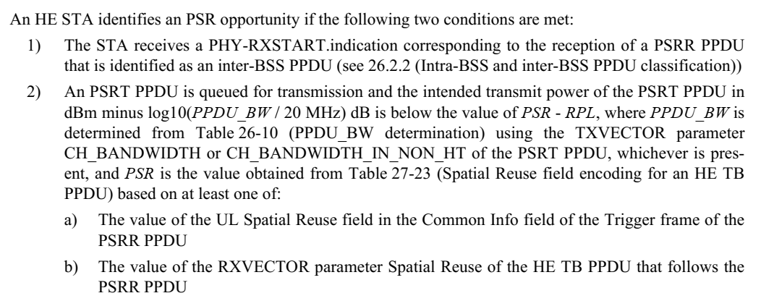
Special user info field

